Slide 1
What is Flat Lay Photography?

Slide 2
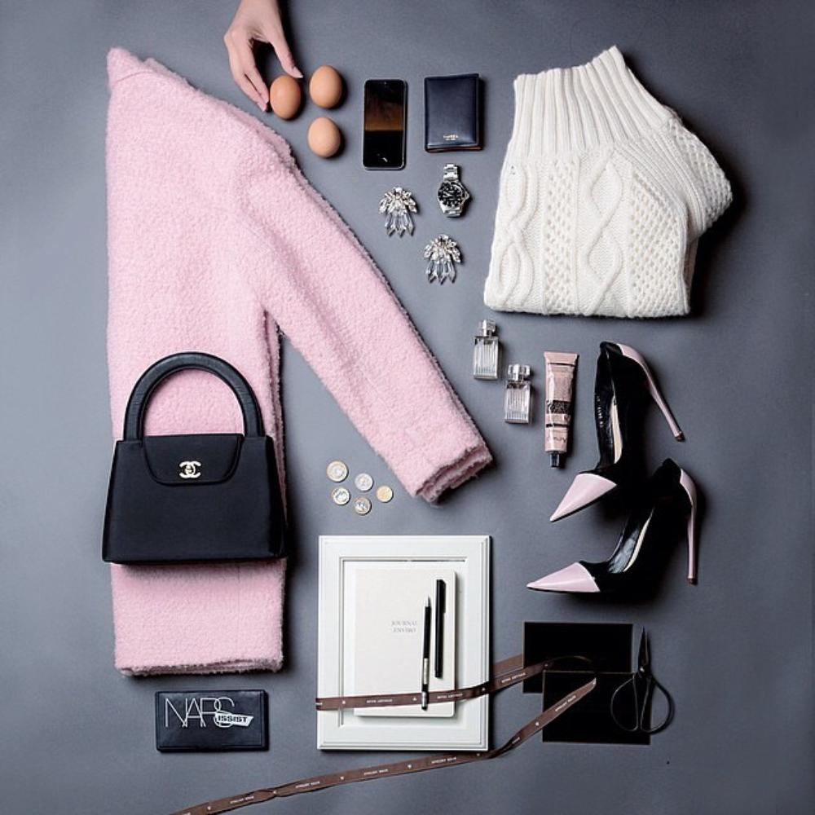
Here is an example!

Slide 3
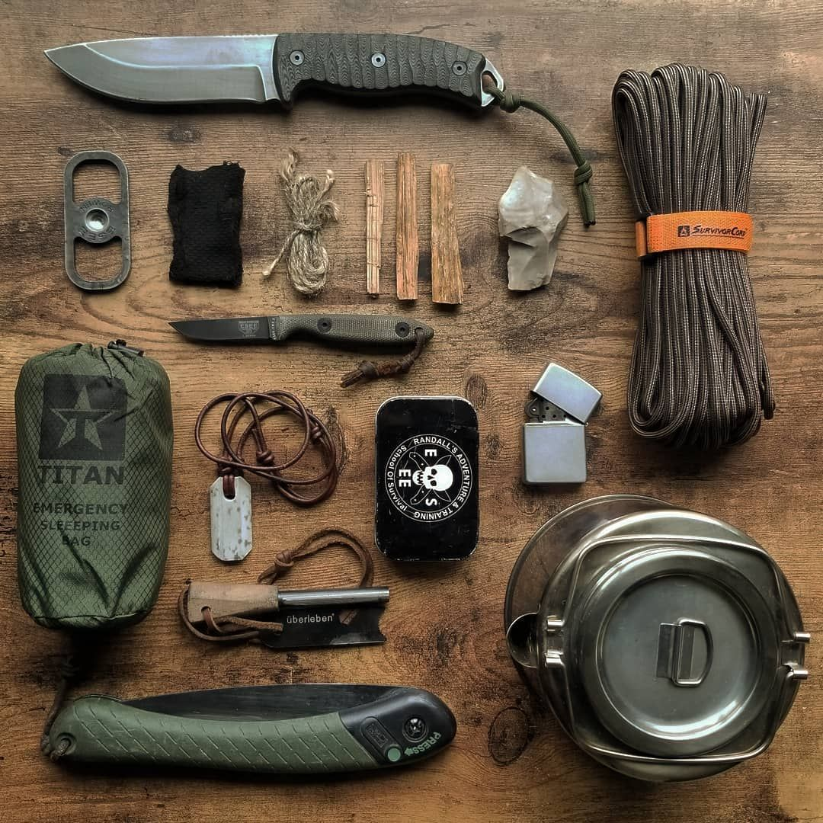
A flat lay is a type of still life photo shot top down (Birds Eye View).
Objects are arranged or organized in such a way that the viewer's eye moves around the composition rather than settling on one focal point

Slide 4
A lot of flat lays center around a theme

Slide 5
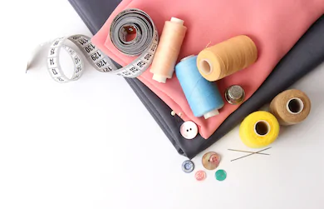

Slide 6
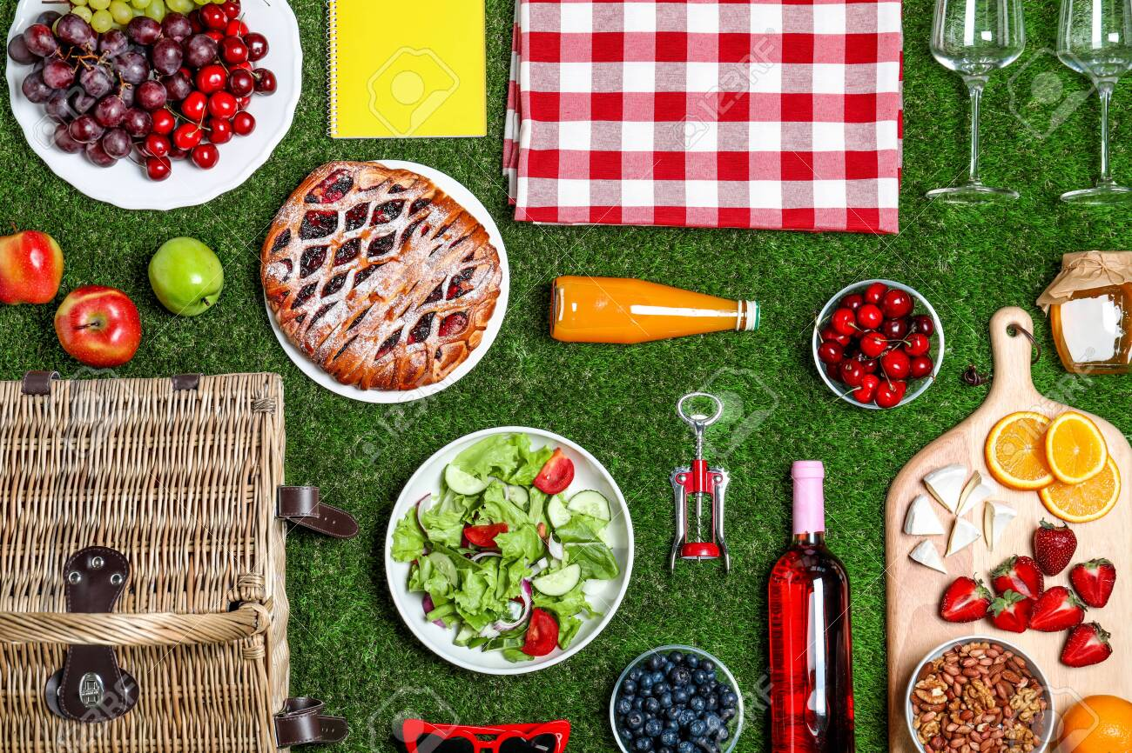
We are
Going
on a
picnic

Slide 7
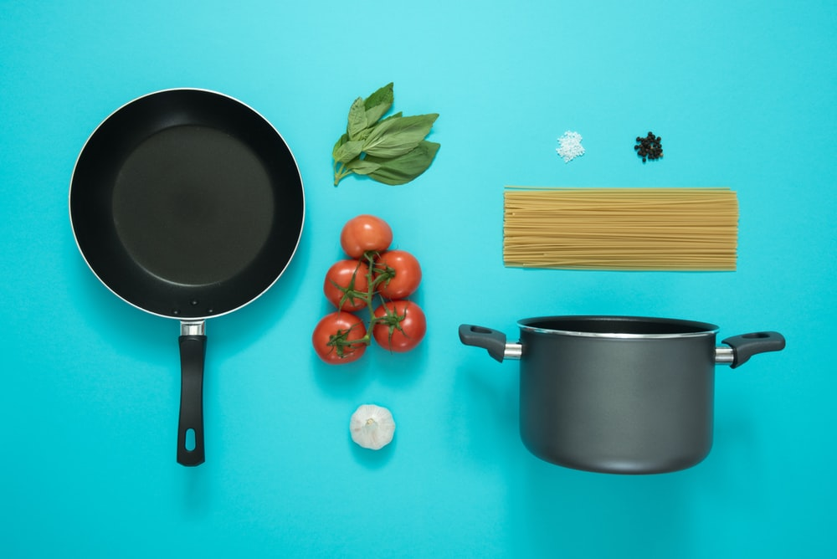

Slide 8
Other flat lays tell a story or describe a person

Slide 9
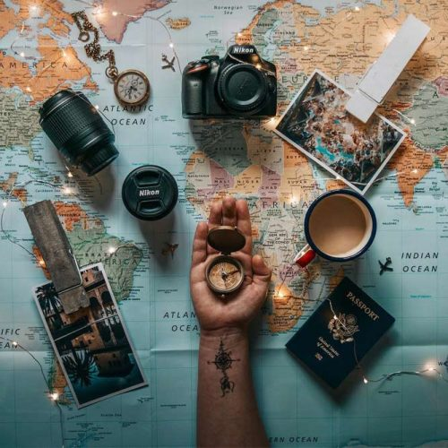
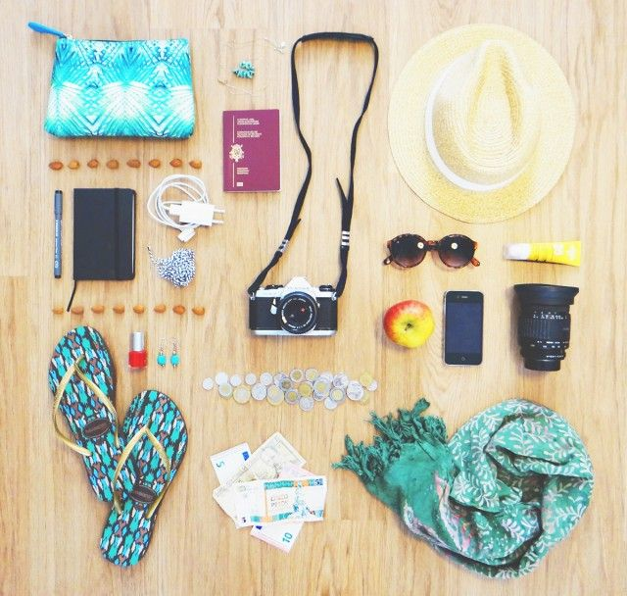
Planning Vacation

Slide 10
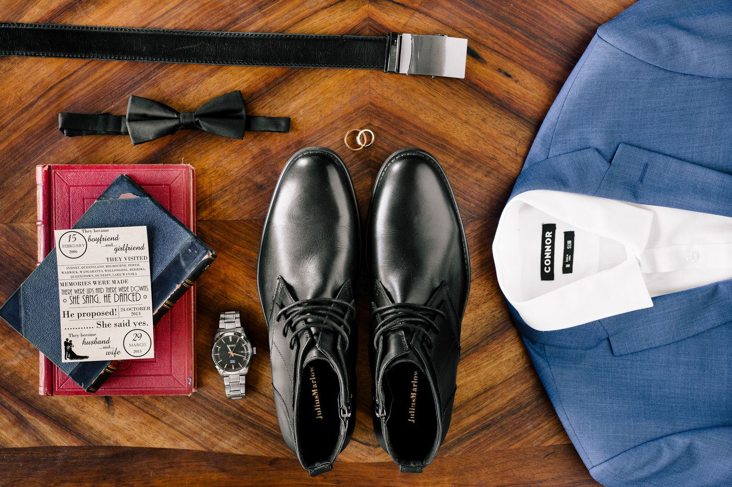
Groom to be

Slide 11
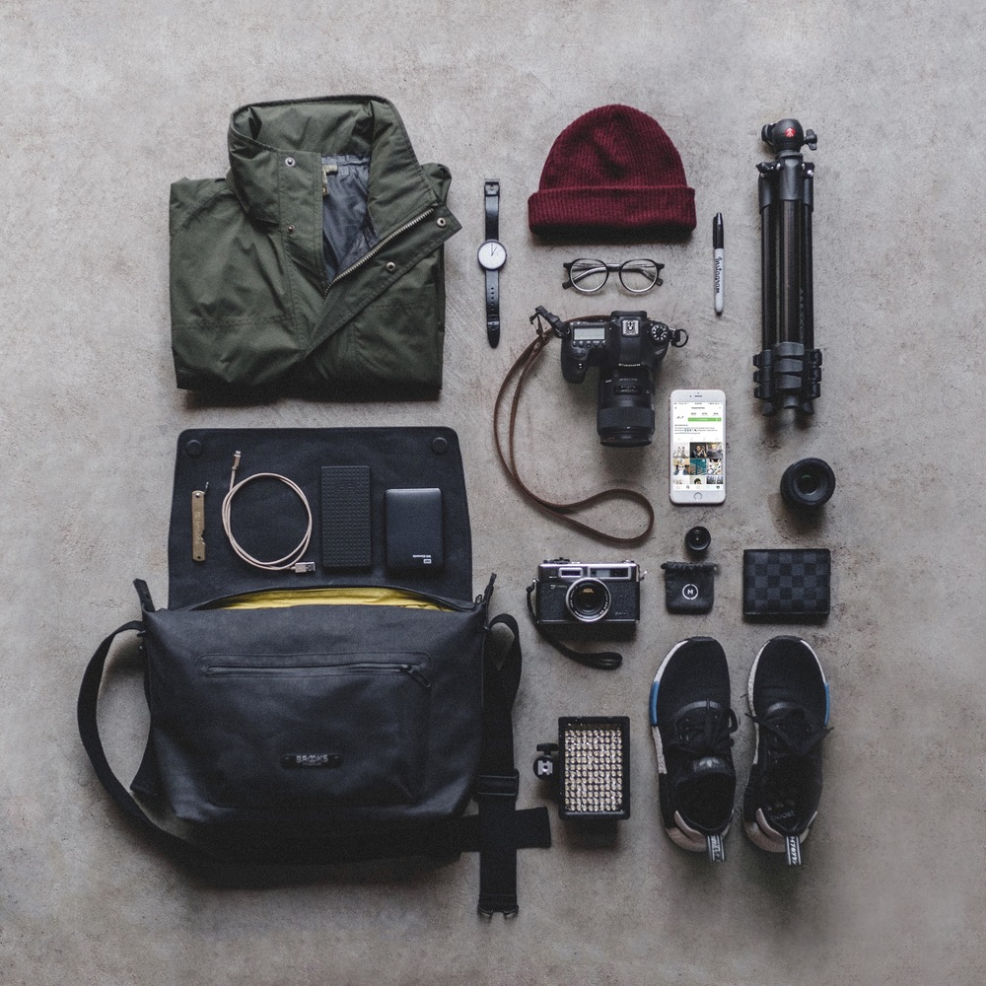
Hipster
Starter
Kit?

Slide 12
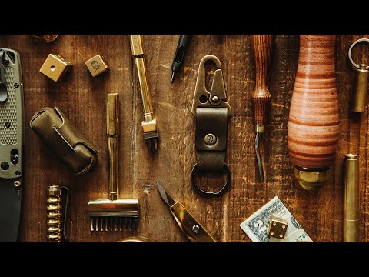
Video

Slide 13
Your task is you design a flat lay to photograph.

Slide 14
It should have a theme or tell a story.

Slide 15
4 Easy Steps
Come up with a theme
Choose a surface that adds to you photo
(or at least doesn't distract from it)
Identify your light source
Arrange your objects thoughtfully/ aesthetically

Slide 16
Come up with a theme
Brainstorm
Come up with more themes than you need
Make lists of what you have available

Slide 17
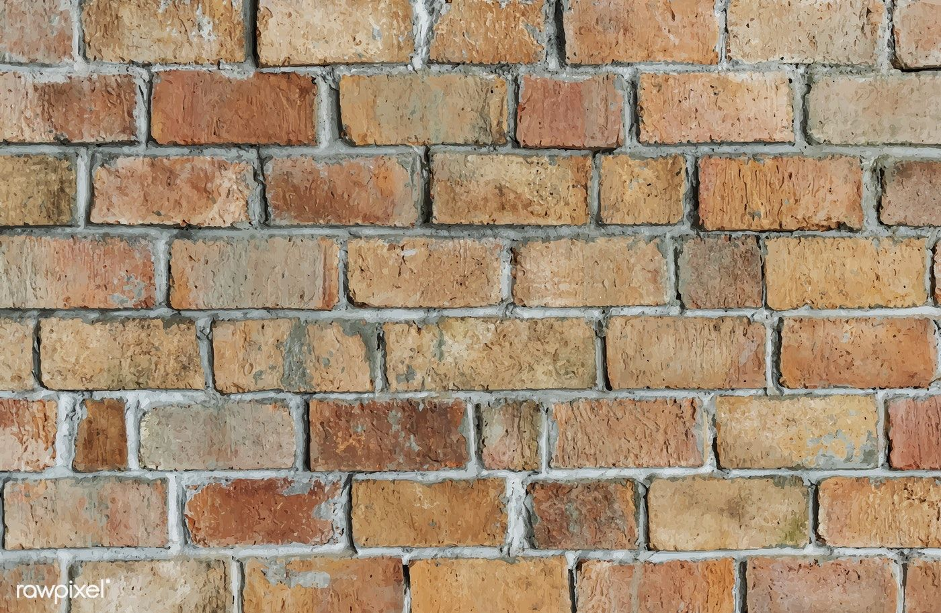
2. Choose a surface that adds to you photo
(or at least doesn't distract from it)

Slide 18
Here are
just a few
possibilities:
Towl
Table
Carpet
Floor
Sheets
Grass
Asphalt
Sidewalk
Decking
Tiled floor
Paper
Cardboard

Slide 19
For added value you can have the background relate to the theme!
Cooking theme > Cutting Board
Beach theme > Towel
Carpentry theme > Plywood or Cement floor

Slide 20
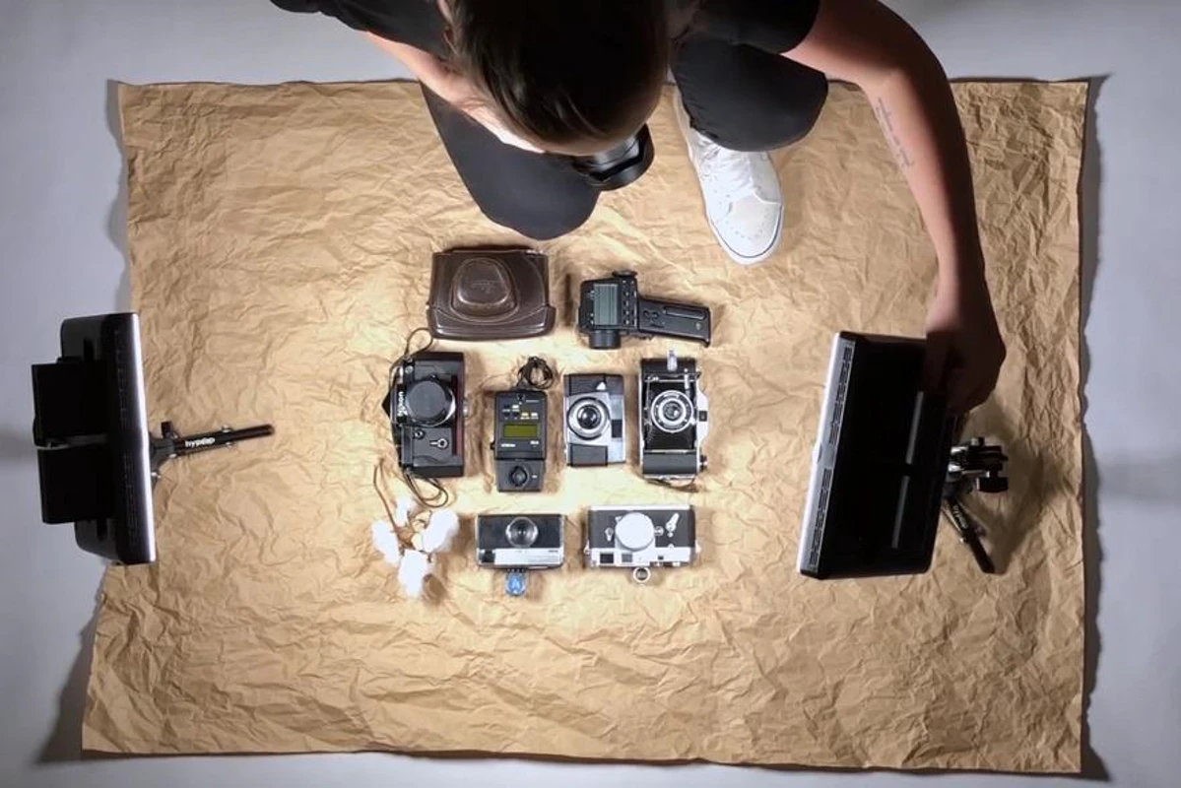
3. Plan your
light source

Slide 21
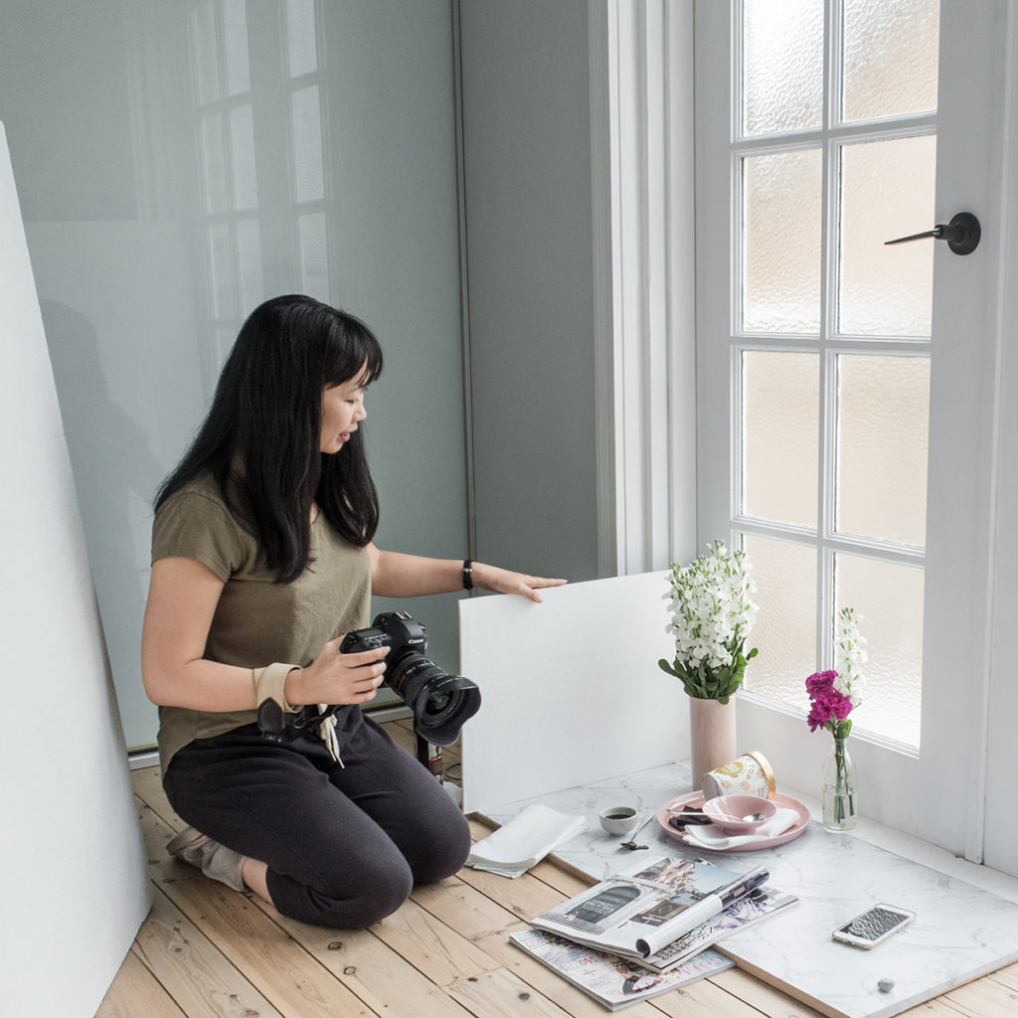
A big window or glass door will work as well if not better than a lamp.
You can also shoot outside!

Slide 22
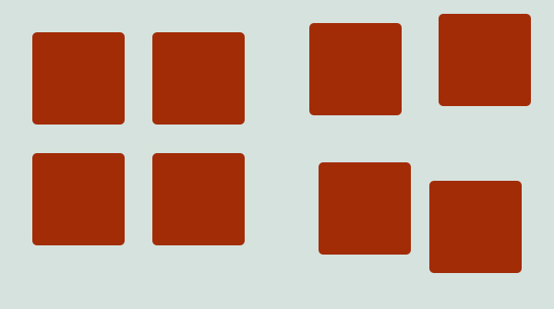
4. Arrange your objects thoughtfully
and aesthetically
Static & Calming Energetic & Fun

Slide 23
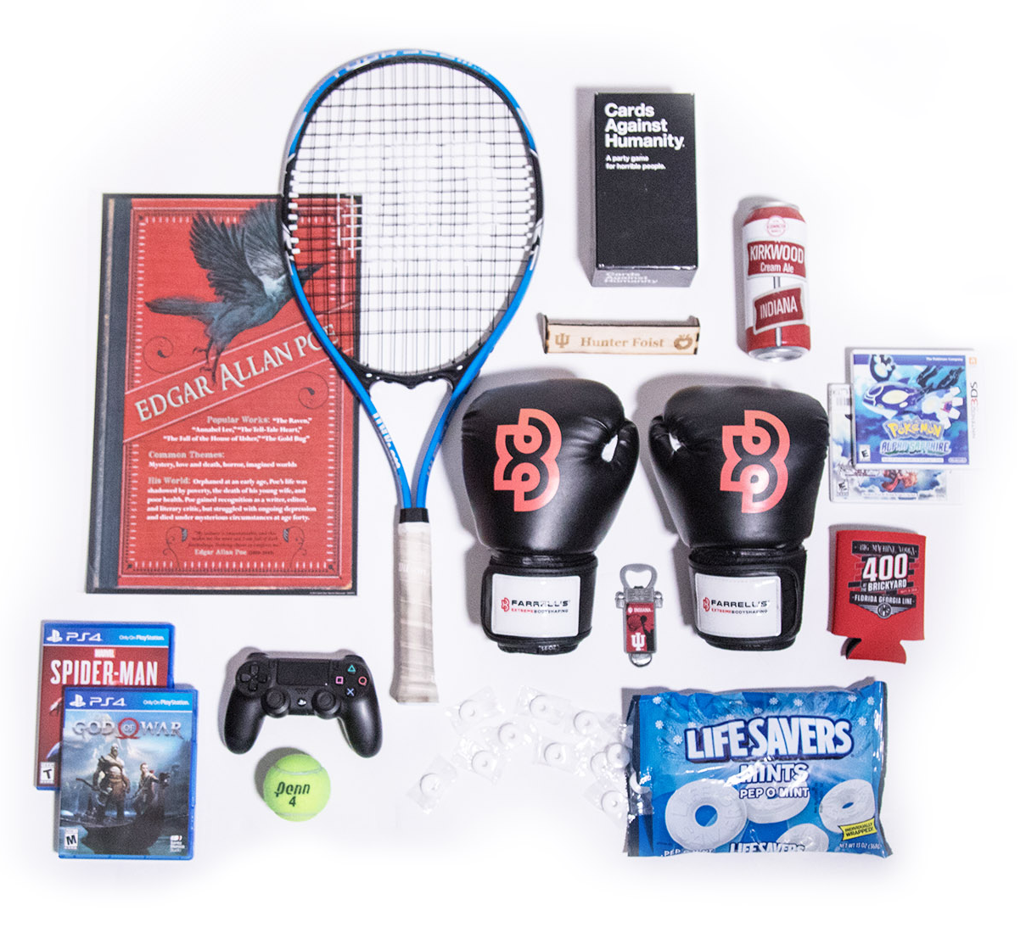
Even if the objects are random organizing them in a pleasing way makes for a good image

Slide 24
5. Take many photos from bird’s eye view. Re-arrange as you go along. Keep tapping phone to focus.
6.Edit using Snapseed. Don’t rush this part! Take your time to make your photo look its best.

Slide 25
7. In Teams you will turn in:
your best edited photo of your flat lay
the original shot before you edited it
screenshot (or collage) of ALL your shots

Slide 26
Student Work

Slide 27
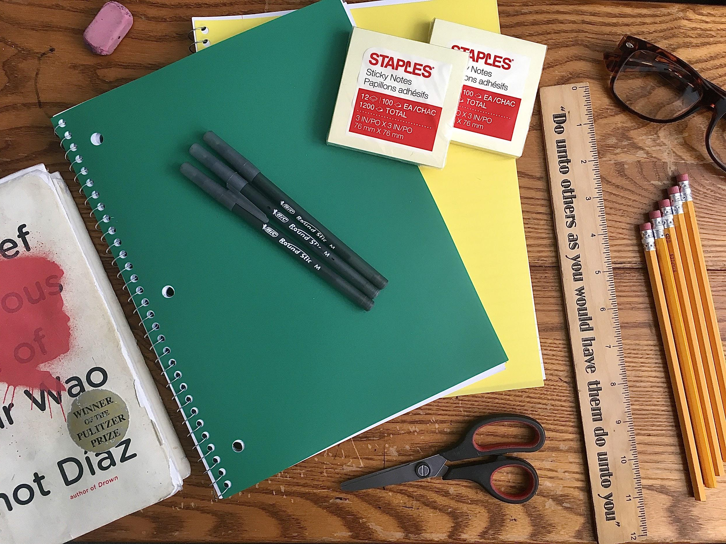
Ariel
School Day

Slide 28
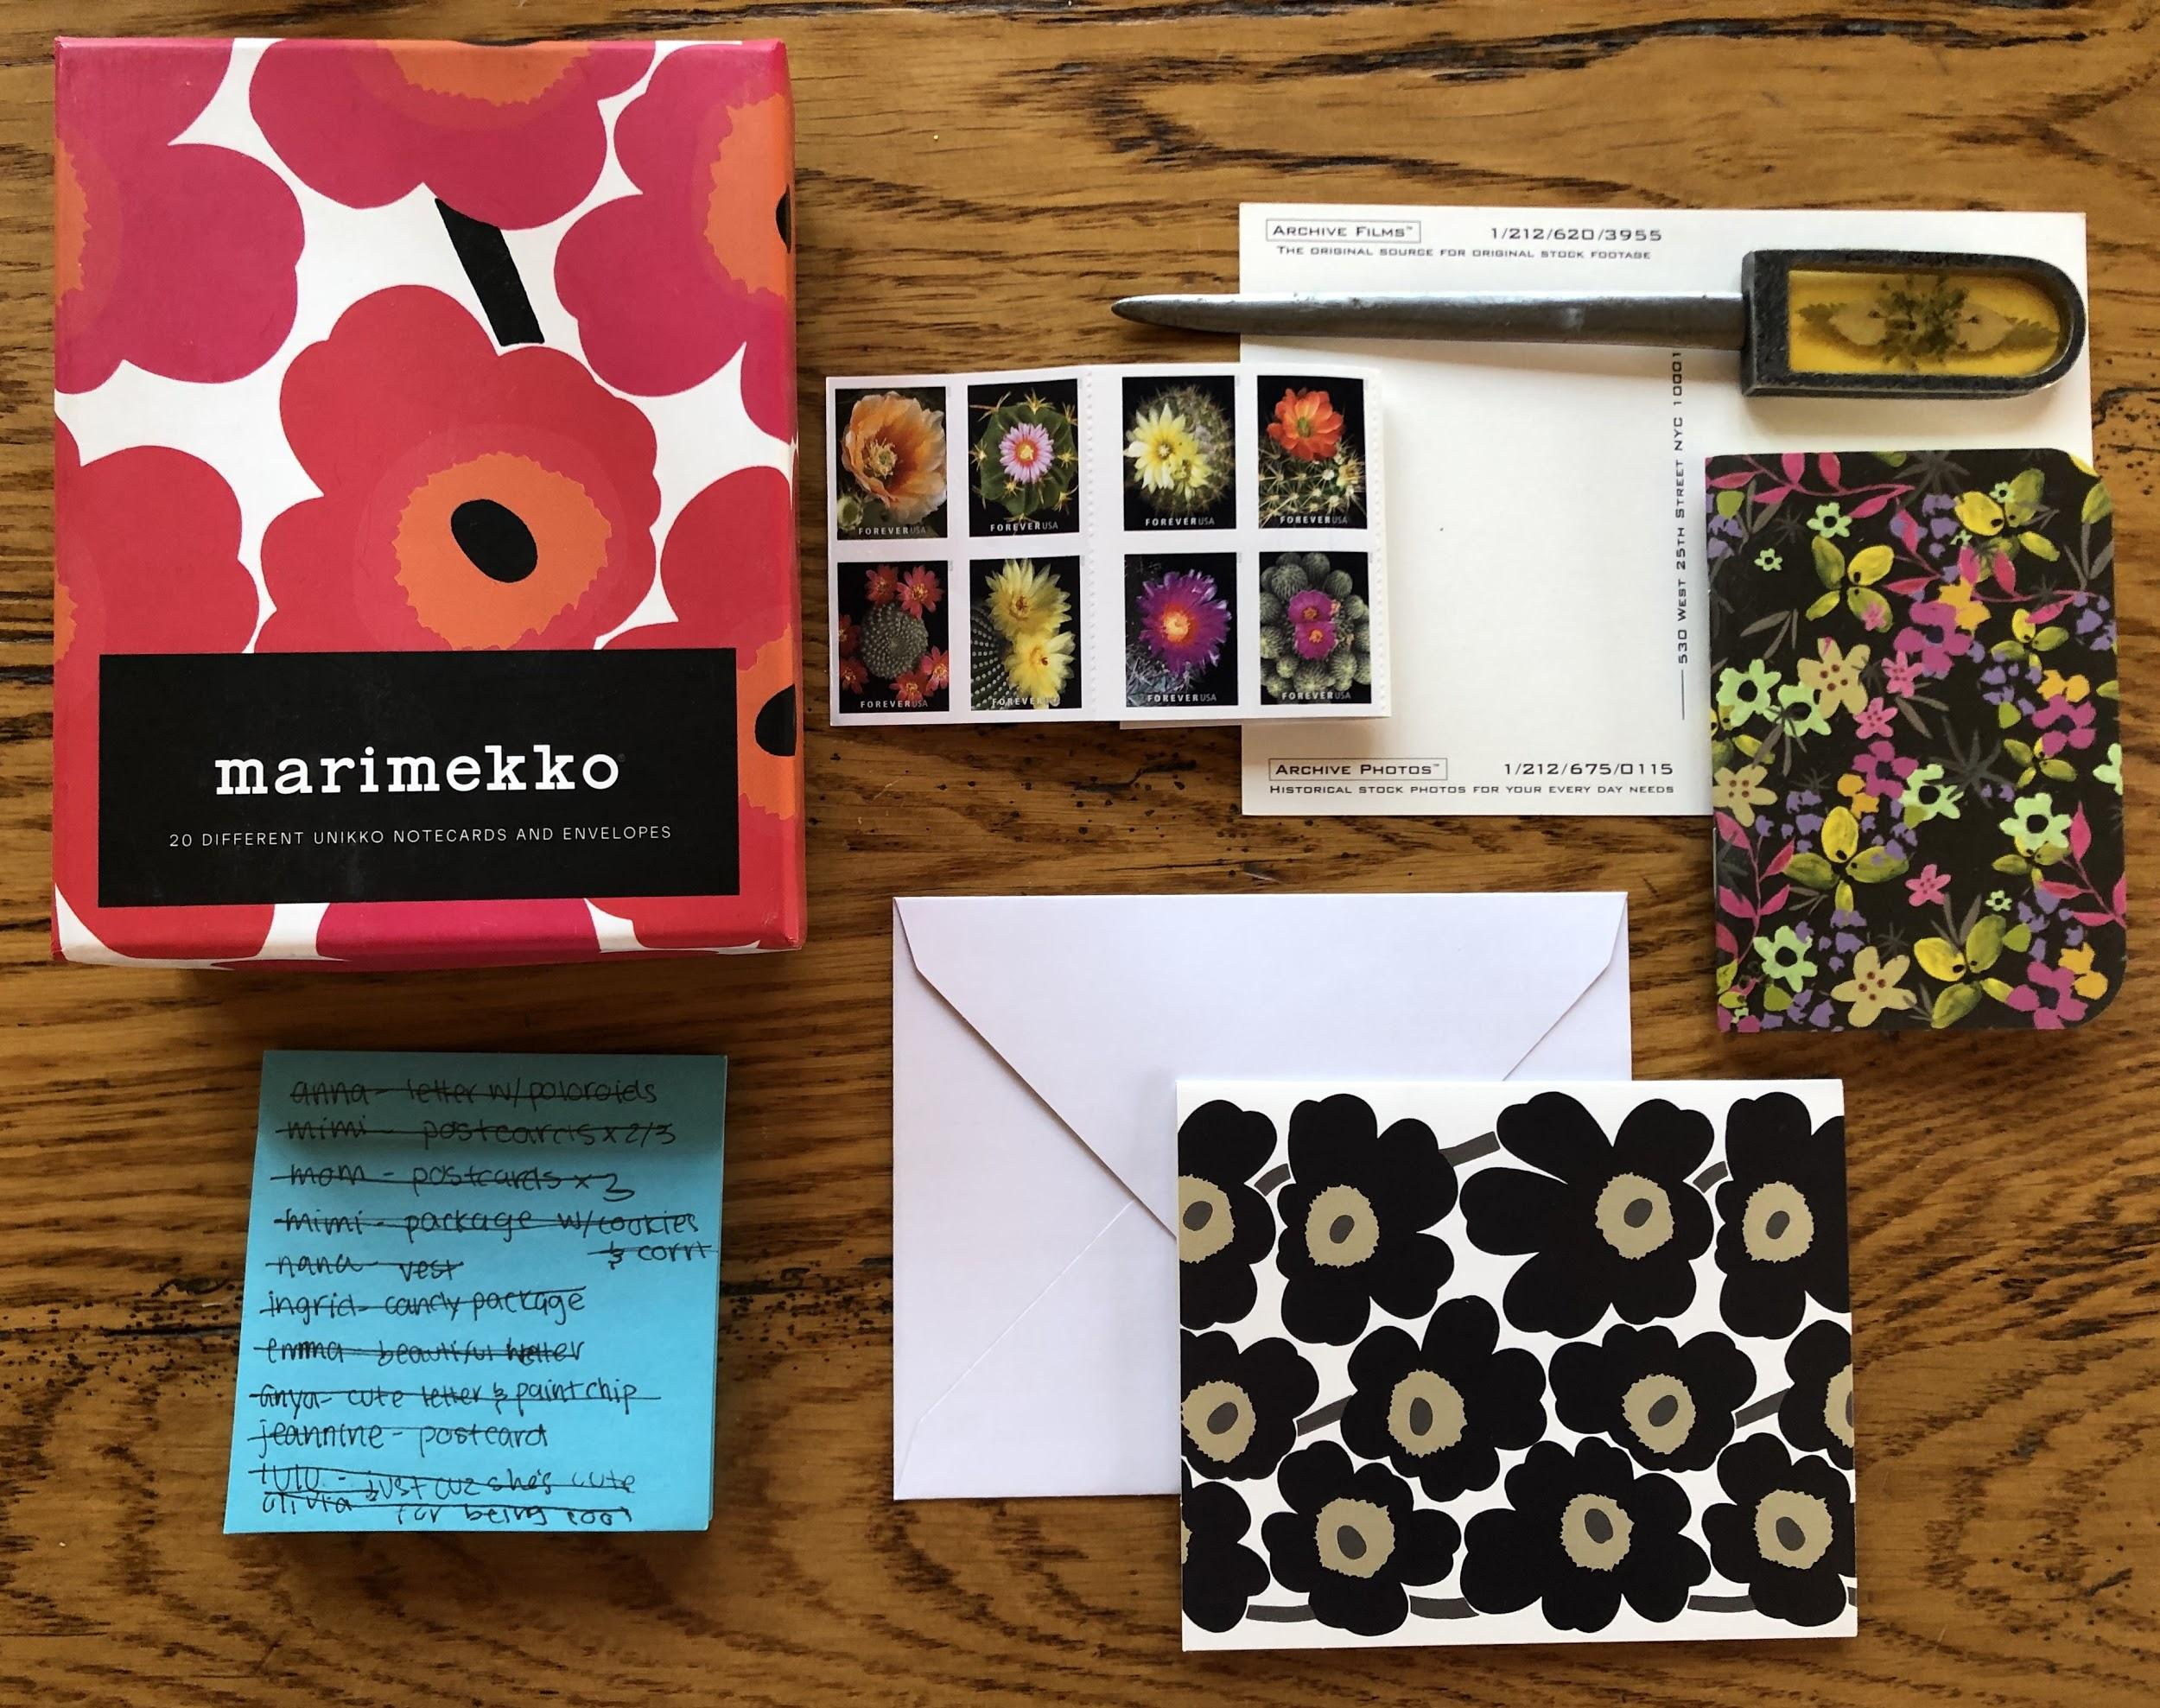
Edie
Keeping correspondence in a dark time

Slide 29
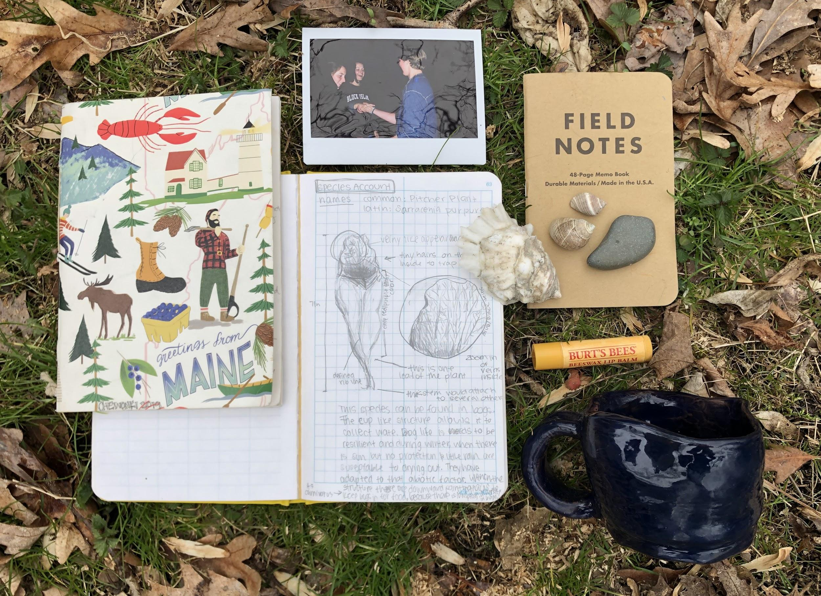
Edie
Semester in Maine

Slide 30
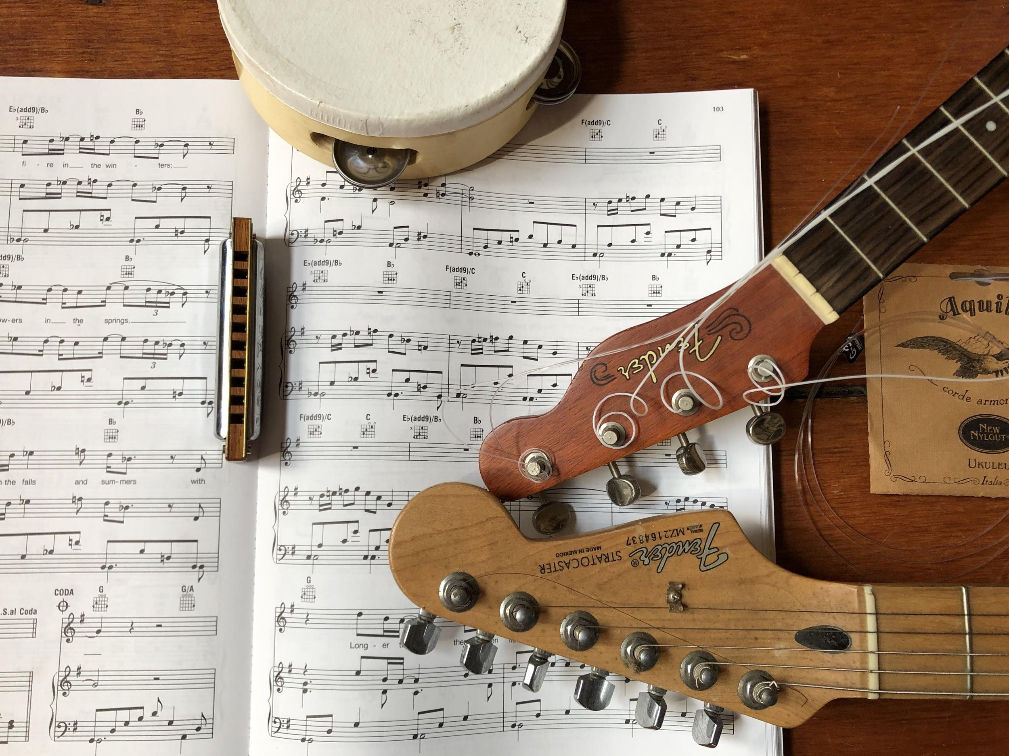
Edie
Idyllically Musical

Slide 31
Ari
上海 / 北京
China 2019

Slide 32
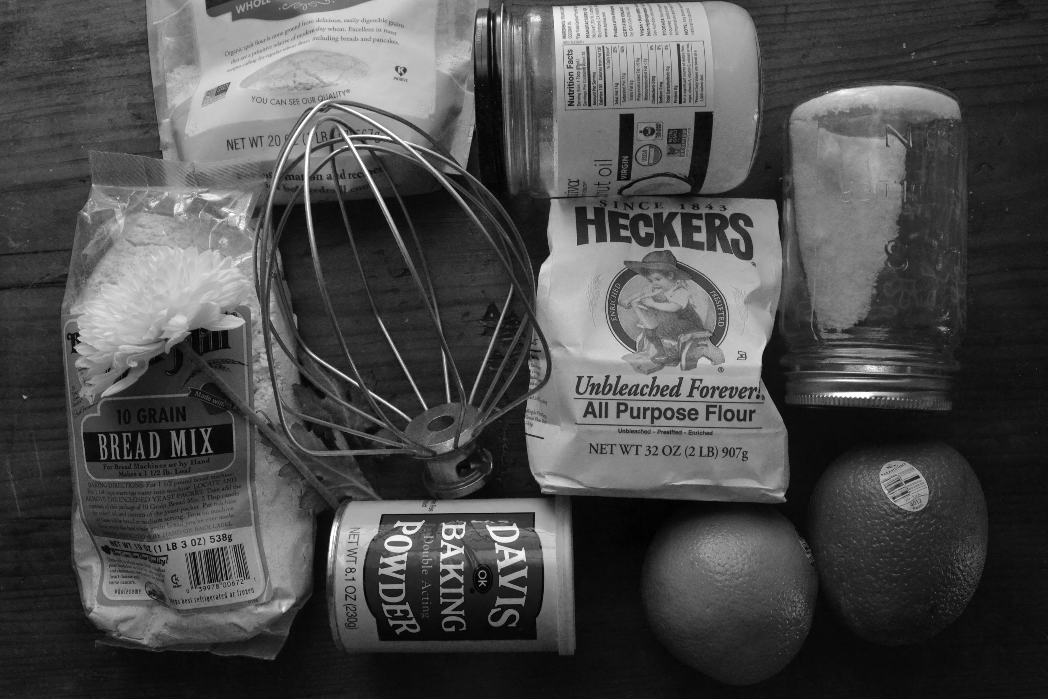
Ari
Baking

