Slide 1
Camera Angles
Digital Photography
http://www.mediacollege.com/video/camera/angles/

Slide 2
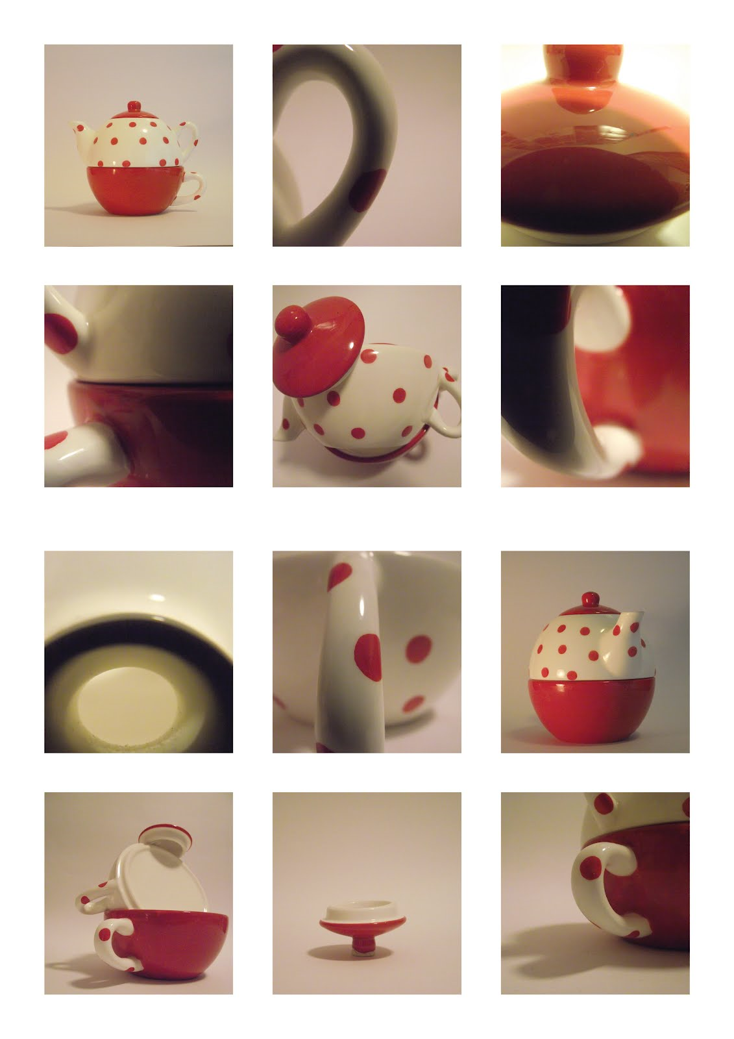
Camera Angle definitions
Camera angles refers to the angle of the camera in relation to the subject.
In photography, subject refers to the person or thing/s you are photographing.

Slide 3
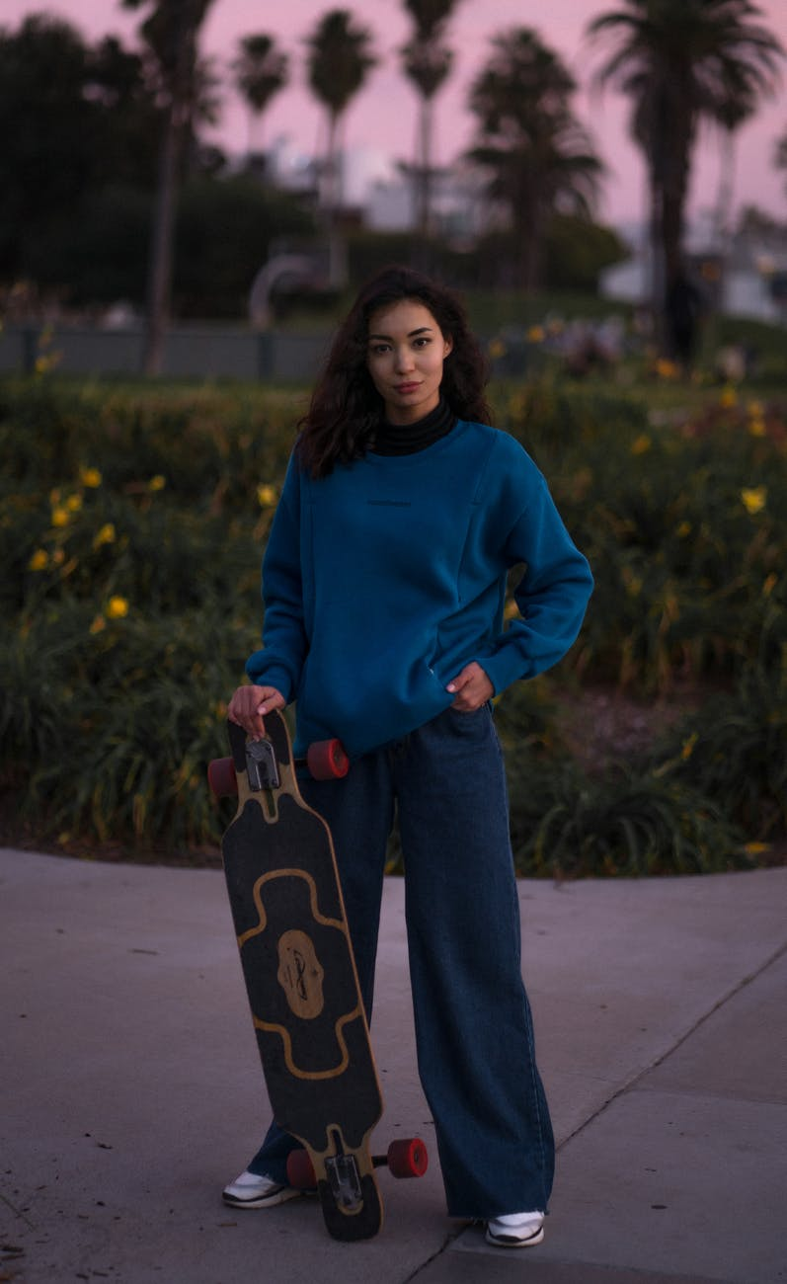
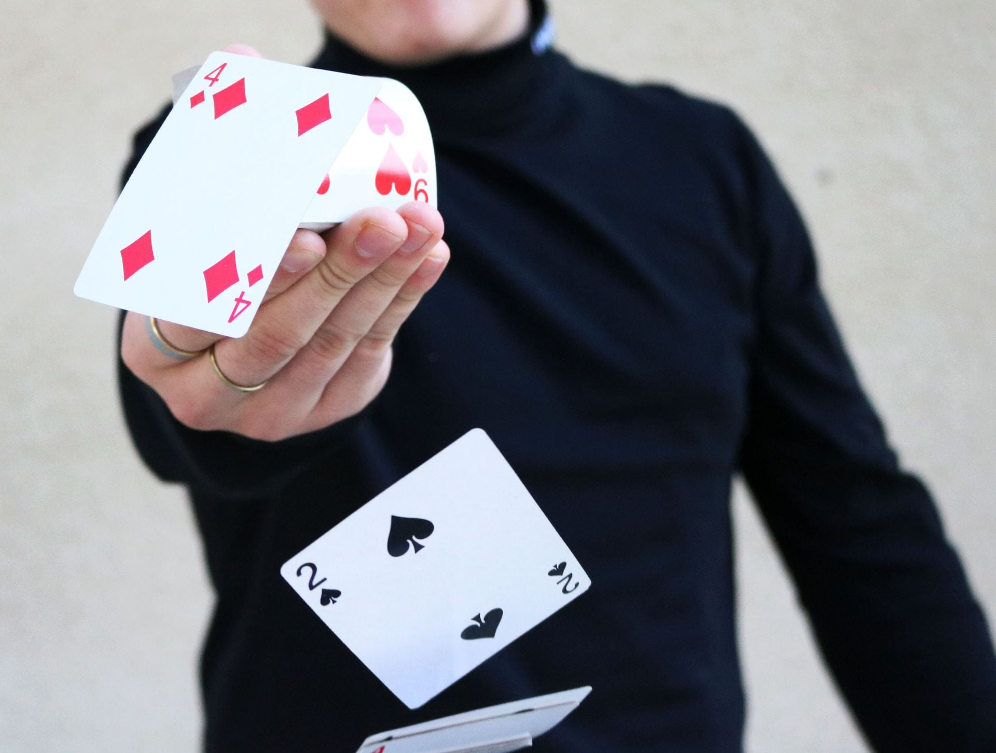
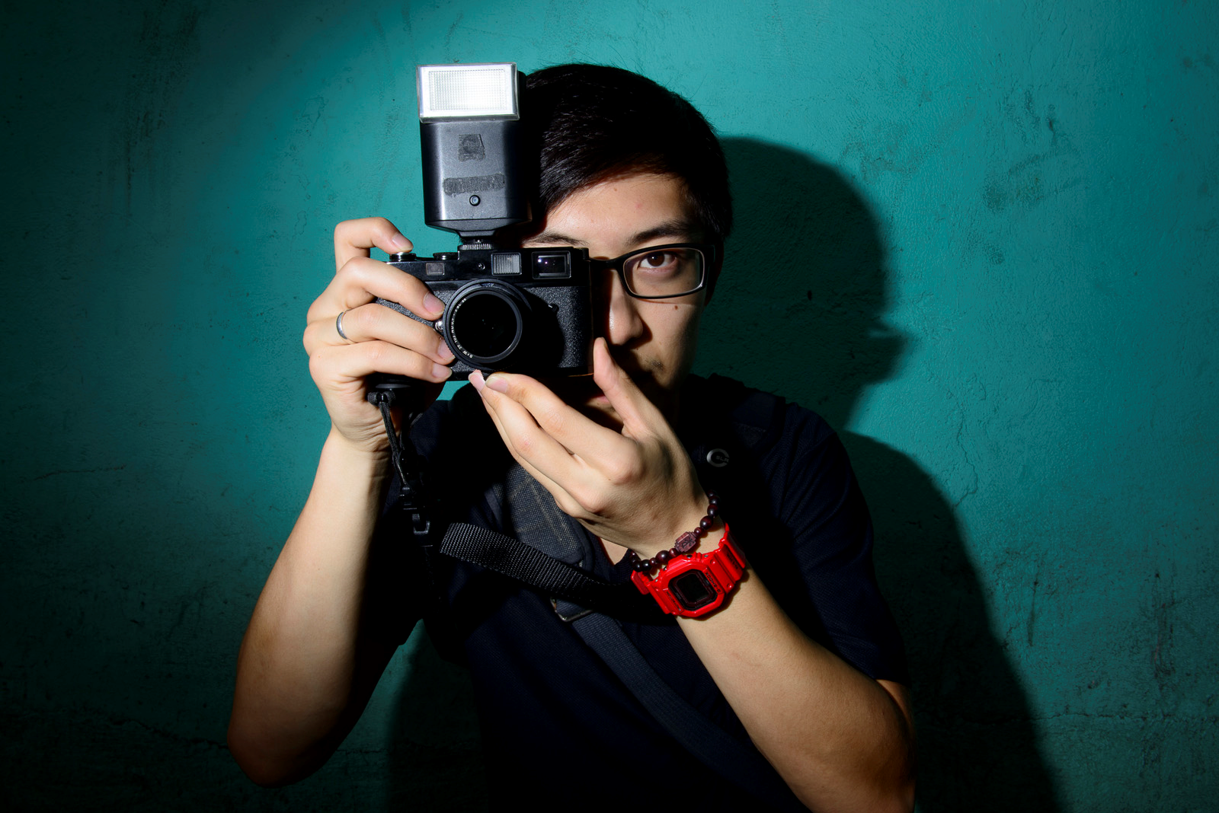
Eye Level Shot
This is the most common, everyday view. Camera is near our eye level and not tilted up or down. It is a neutral shot which shows subjects as we would expect to see them in real life.

Slide 4
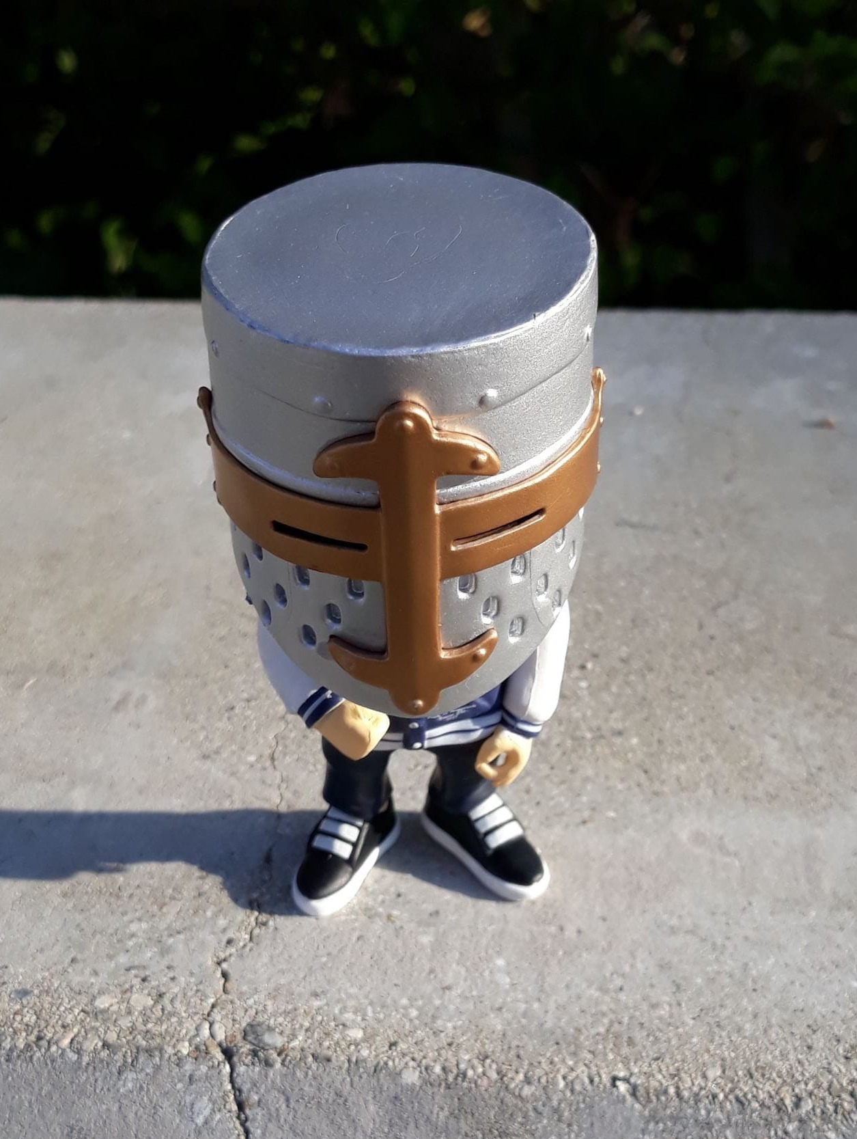
High Angle
A high angle shows the subject slightly from above, so the camera is angled down a bit towards the subject. This can make subject look smaller, appear less significant, or vulnerable. A handy camera angle to show some of the top of a subject.

Slide 5
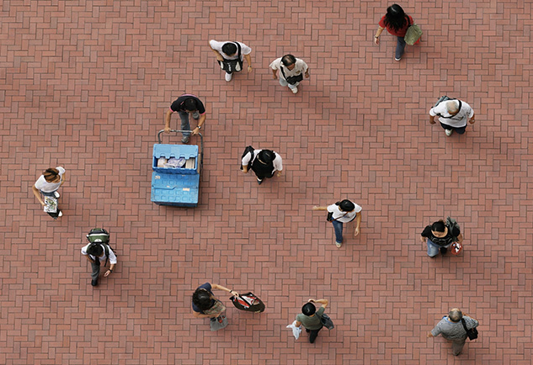
Bird’s Eye View
This type of high angle is taken from directly above looking straight down. This is a completely different and somewhat unnatural point of view which can be used for dramatic effect or to show the positions/placement of different subjects and objects at one time.

Slide 6
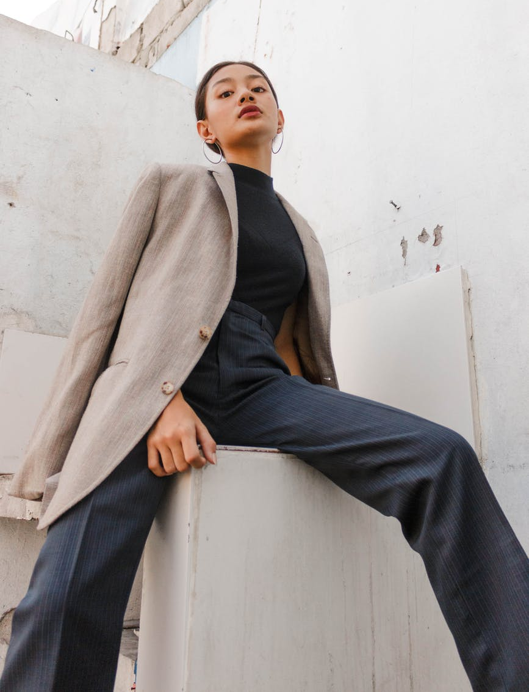
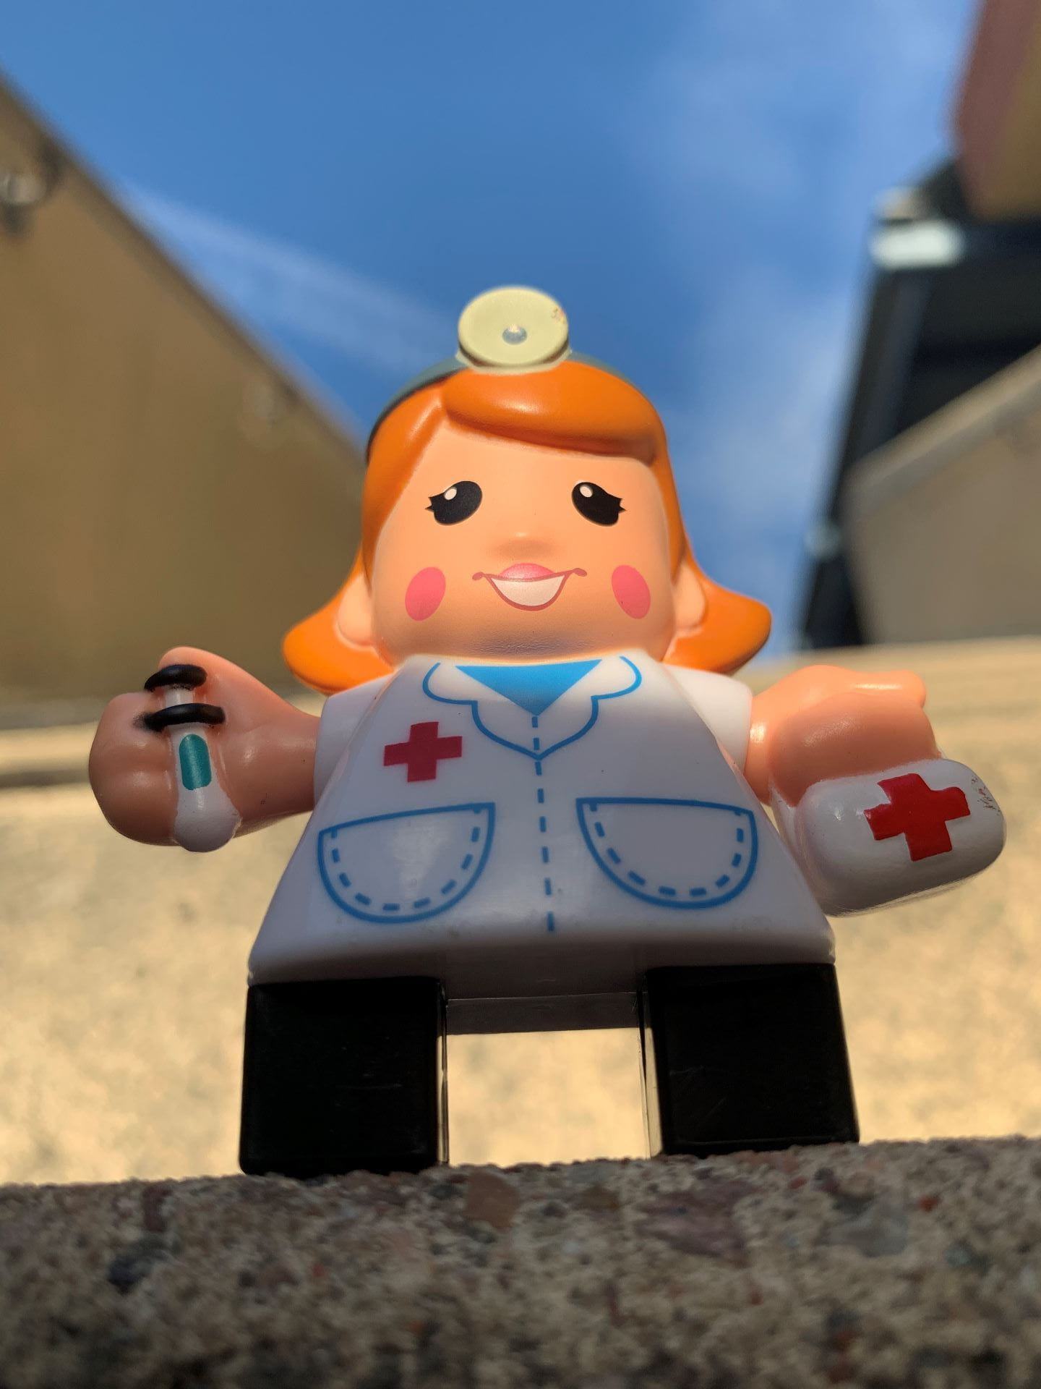
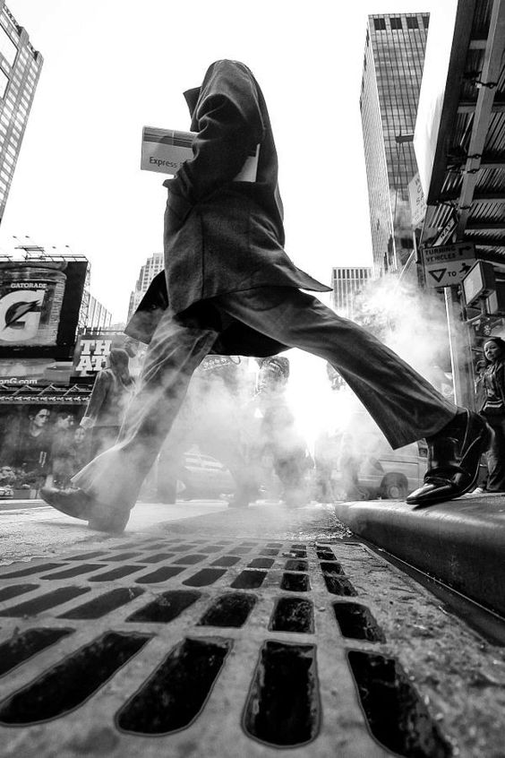
Low Angle
For this camera angle, your camera is positioned below the subject and looks up at it. This shows the subject slightly from below, giving them the impression of being bigger/taller, more powerful, or dominant.

Slide 7
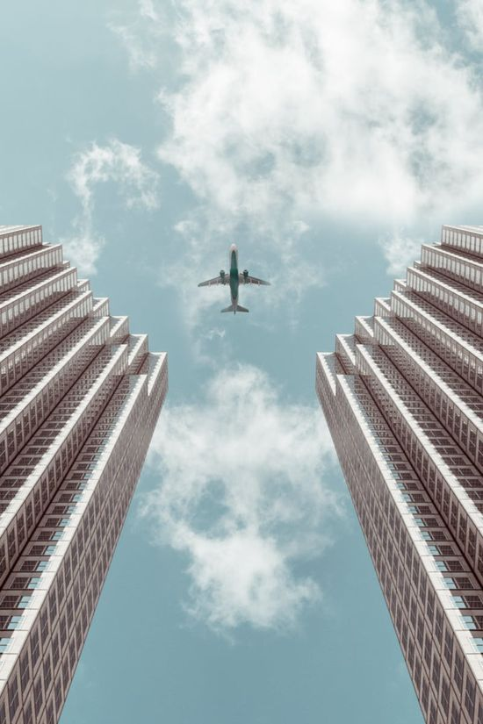
Worm’s Eye
This type of low angle points the camera directly up towards the sky to create a unique perspective.

Slide 8
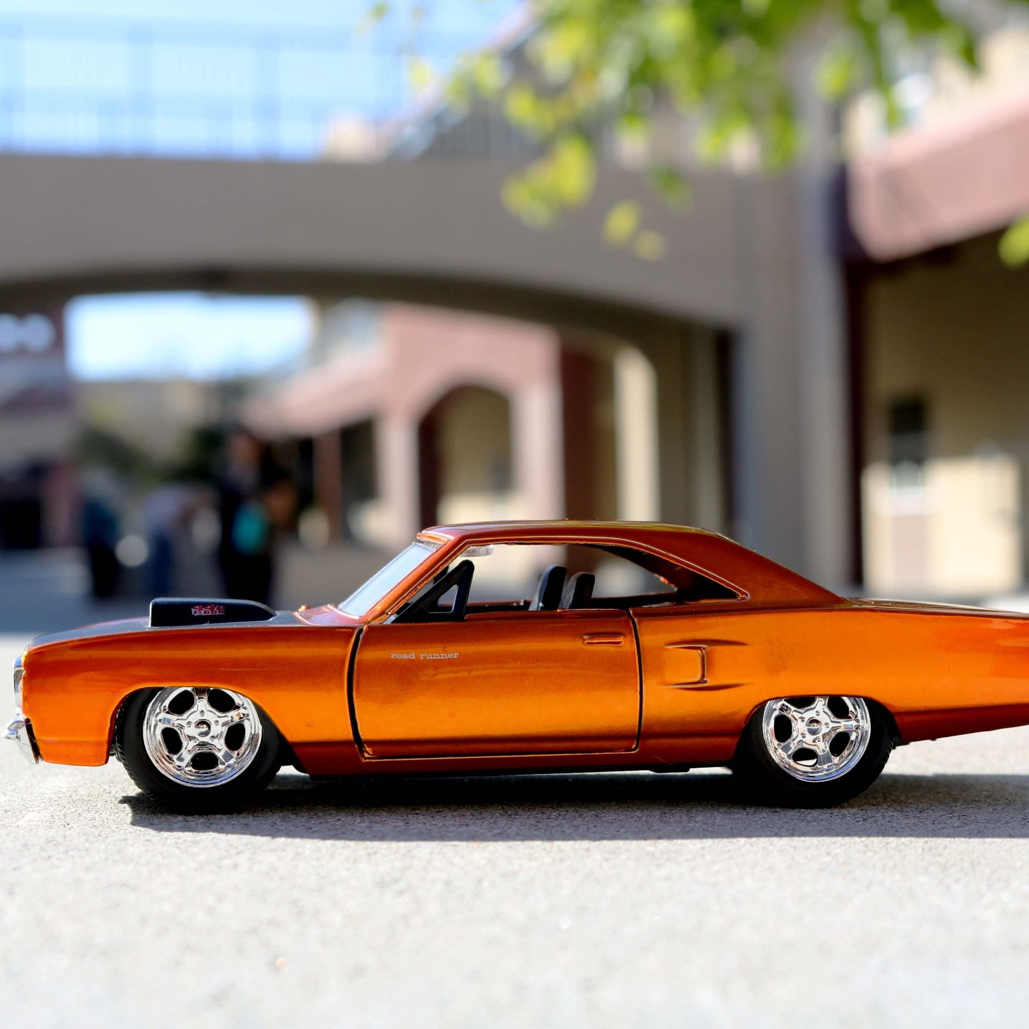
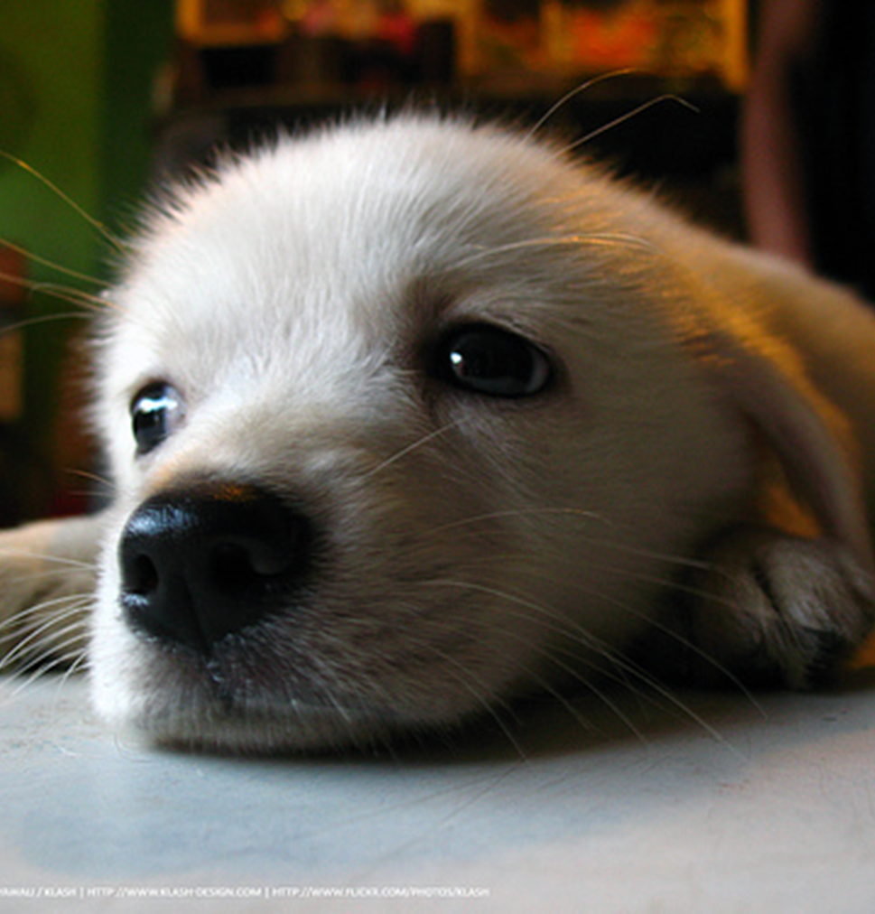
Ground Level
This angle simply means the camera is sitting on the same surface as the subject, which is sometimes the ground. This is another way to present everyday subjects in an uncommon way for dramatic effect because we don't often view the world this way. Helps to make smaller objects look life-size.

Slide 9
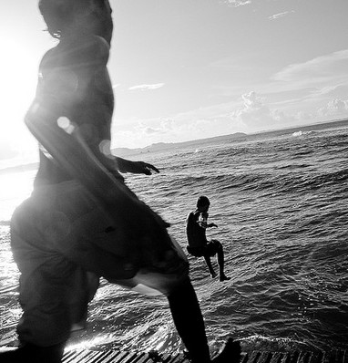
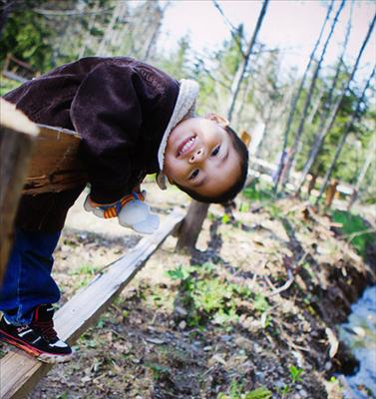
Tilted Angle
This is where the camera is purposely tilted towards one side so the horizon is diagonal. This creates an interesting and dramatic effect. Tilted angles can be used to add a sense of movement, excitement, or instability.

