Slide 1
Rules of Composition
Digital Photography
Ms. De La Rosa

Slide 2
What is composition?
Composition in photography is the way that the visual elements are arranged in the frame.
Composition includes ALL the elements in a photo, not just the primary subject.
Composition includes what you leave OUT OF the frame.

Slide 3
1. The Rule of Thirds
The rule of thirds involves mentally dividing up your image evenly using 2 horizontal lines and 2 vertical lines, as shown in this photo.
You use the rule of thirds grid to position the focal point of your scene along the lines OR at the intersections of those lines.
Basically, it’s the idea of putting the most important thing a little off-center.

Slide 4
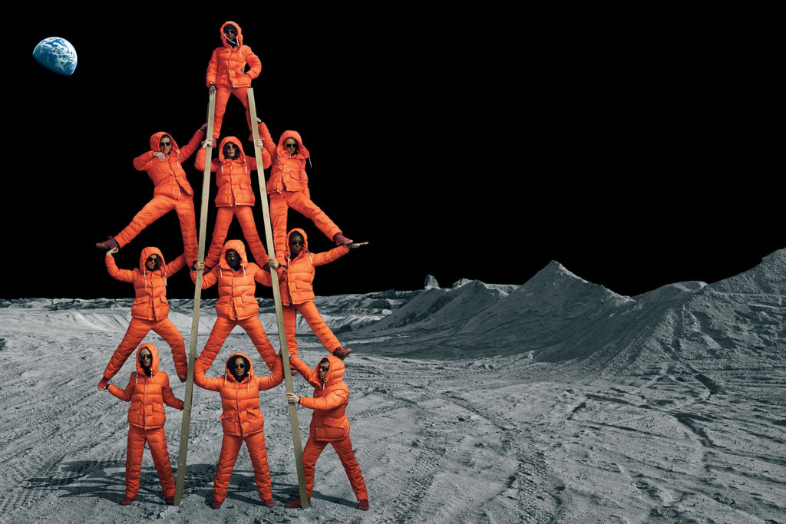
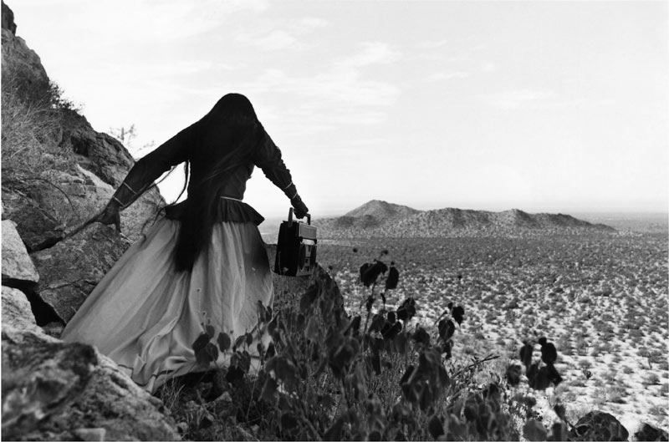
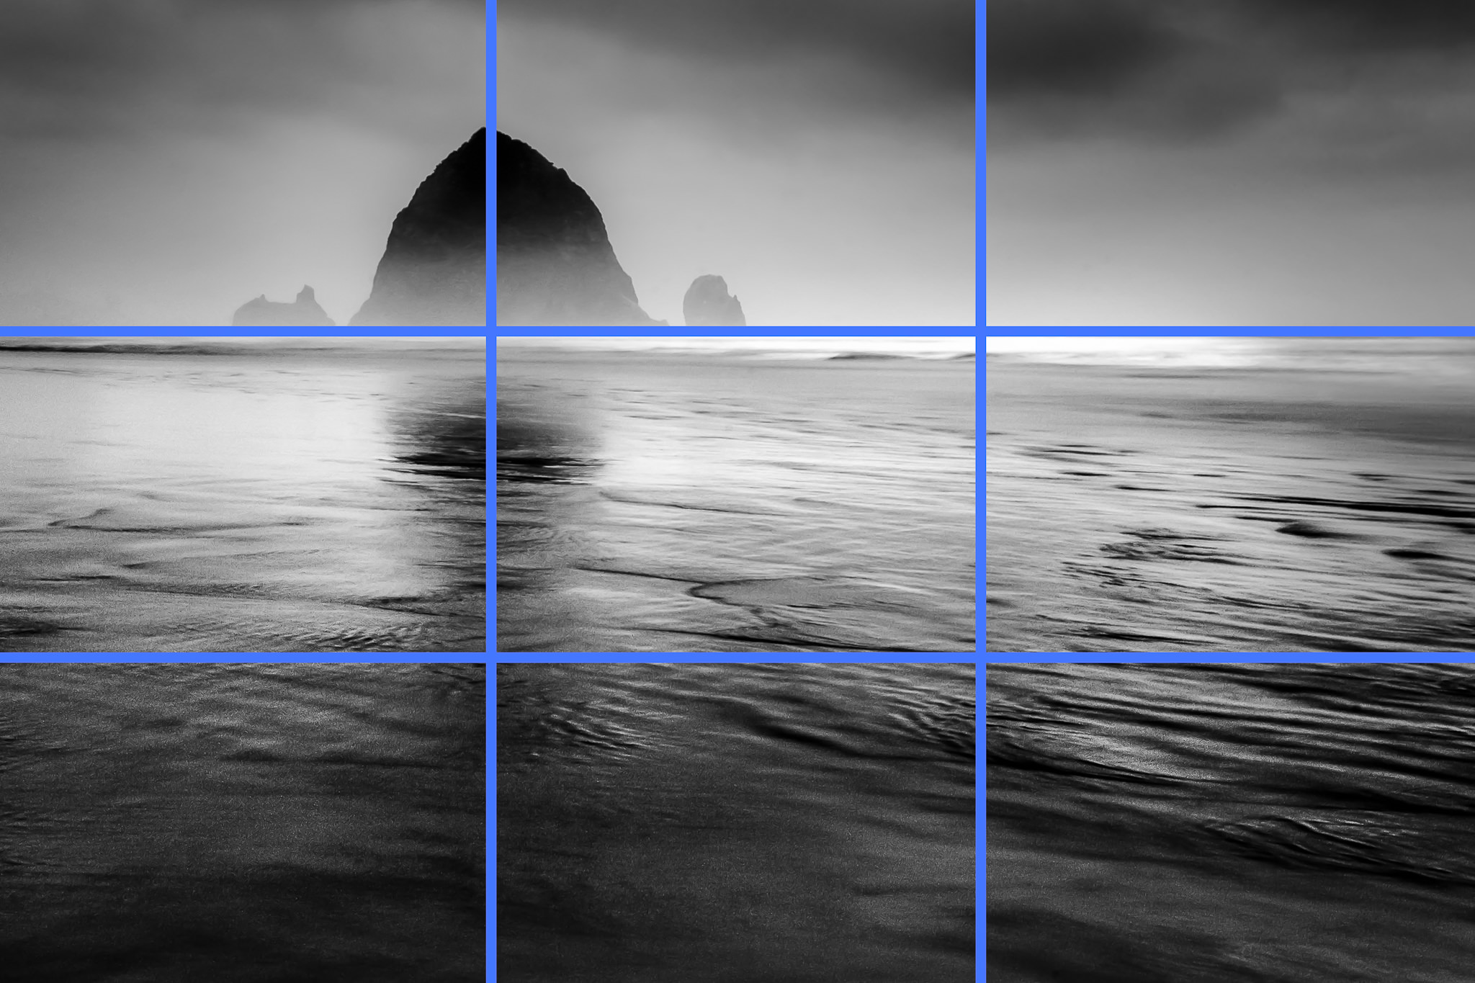
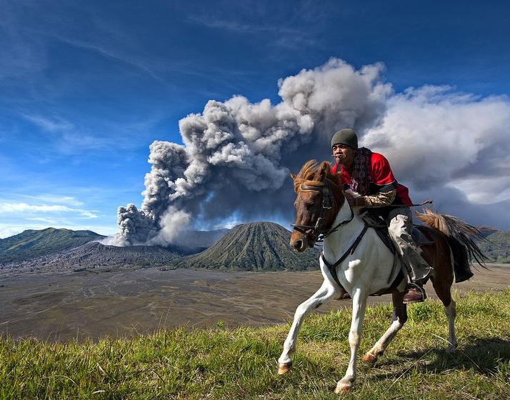
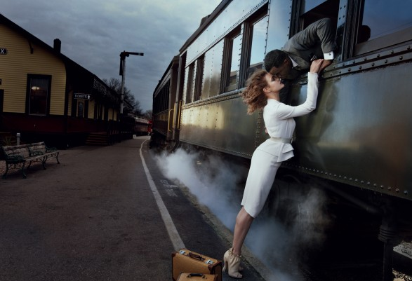

Slide 5
Wished you used
Rule of Thirds after you've already
taken a photo?
Crop it to fit the rule of thirds and give it a new composition!
This rule is helpful when you want to feature some of the scene along with your focal point.
Also, helpful when you want to leave some “lead room” or “nose room”.

Slide 6
2. Informal Balance
Informal balance is the balancing of unlike things.
Although the rule of thirds creates a more pleasing and interesting composition, it runs the risk of creating an unbalanced image.
Adding other smaller or less dominant elements on the emptier side can help create more balance in the frame.

Slide 7
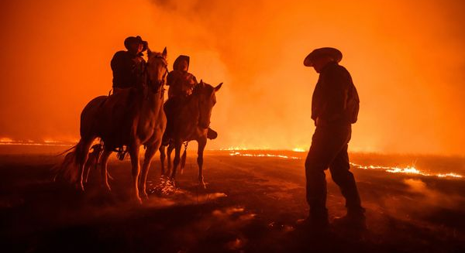
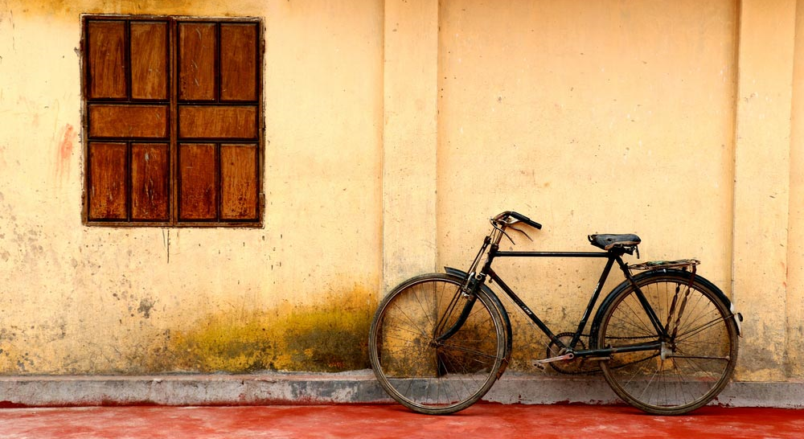
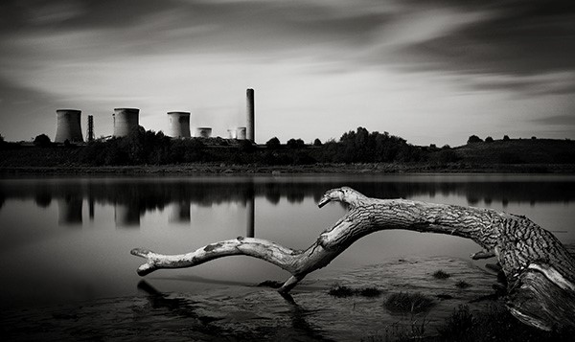
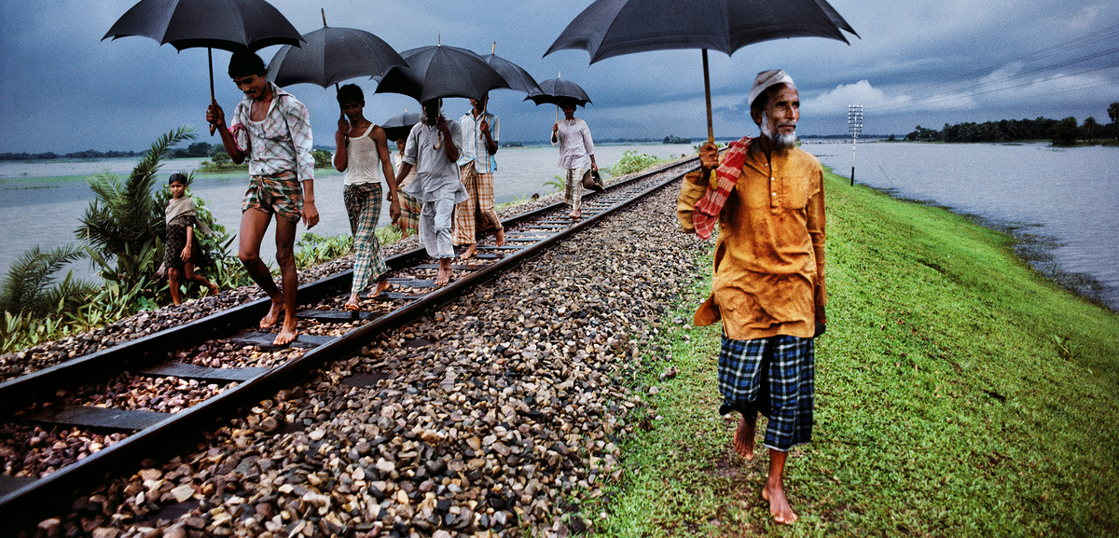

Slide 8
3. Formal Balance/Symmetry
Symmetry is when both halves of an image are practically identical.
Symmetry can make for very eye-catching compositions.
It’s okay if you break the symmetry with small details. What matters is that the overall composition is symmetrical.

Slide 9
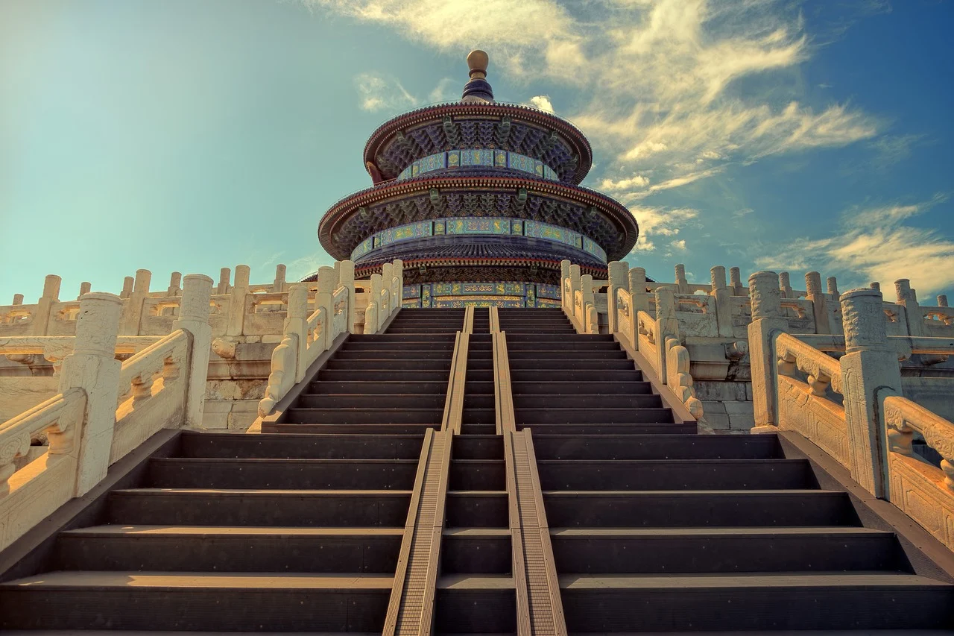
https://time.com/2848303/heres-what-faces-would-look-like-if-they-were-perfectly-symmetrical/

Slide 10
4. Simplicity
Simplicity uses mainly empty space to draw attention to your subject.
Empty space in visual art is referred to as “negative space”, and the actual subject matter is the “positive space”.
Simple images can be very calming and pleasing to look at.
Simplicity is also used to create certain moods such as tranquility, cleanliness, freedom, or loneliness, depending on the subject matter.

Slide 11
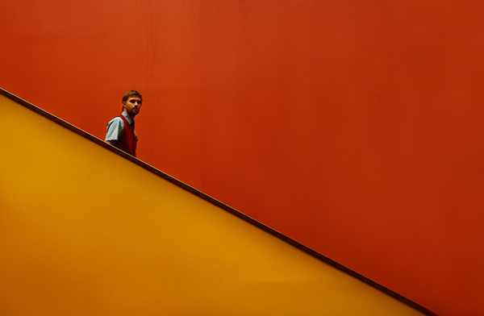
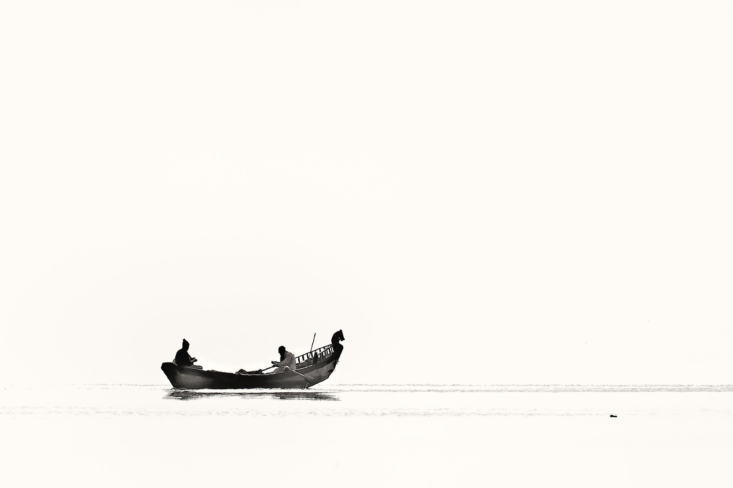
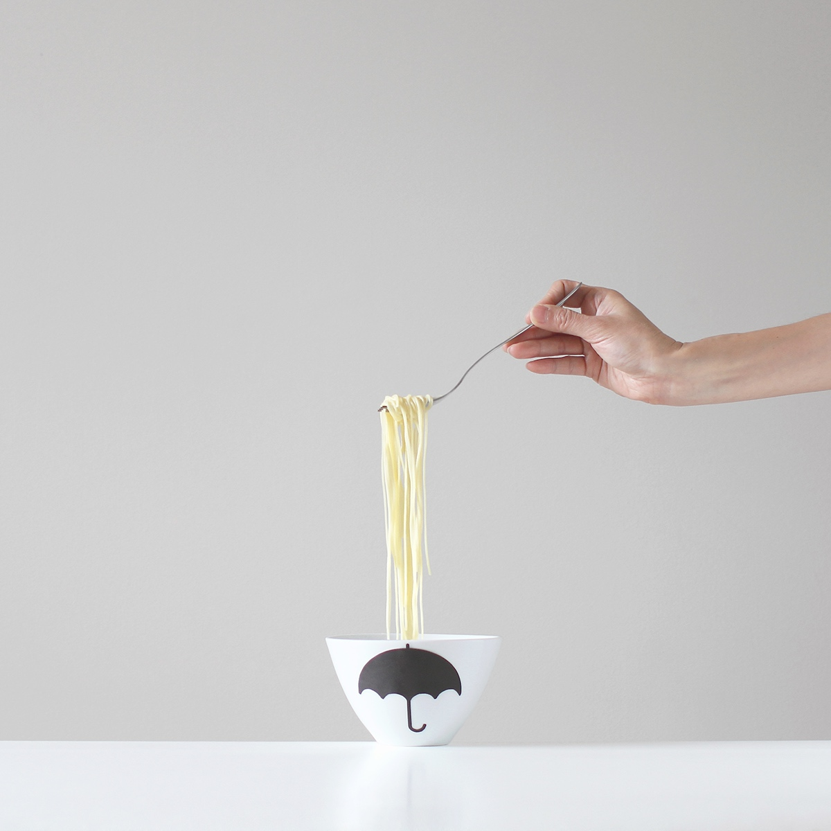
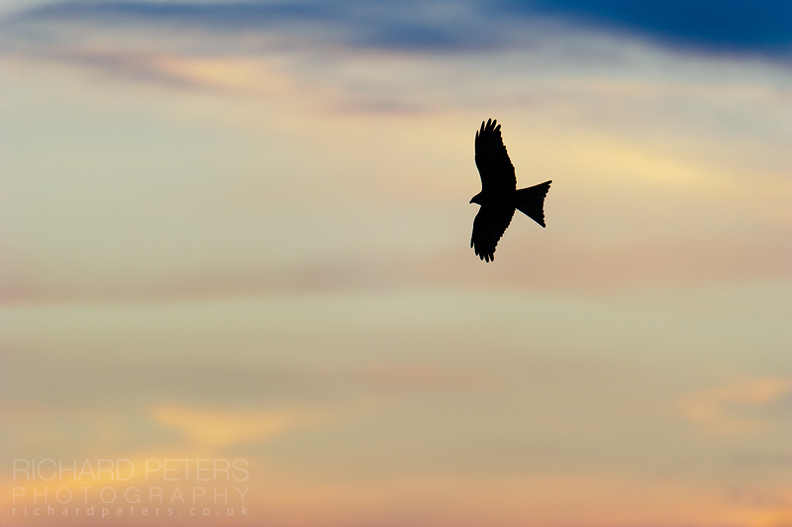
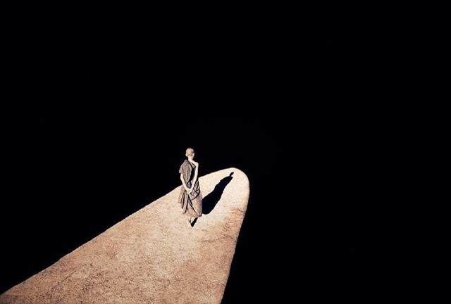

Slide 12
5. Fill The Frame
This rule is very self-explanatory: fill the picture frame with your subject matter!
This often means getting super close to your subject to eliminate any empty space or other distractions.
Unlike simplicity, filling the frame consists of mostly positive space with no negative space, or VERY little of it.

Slide 13
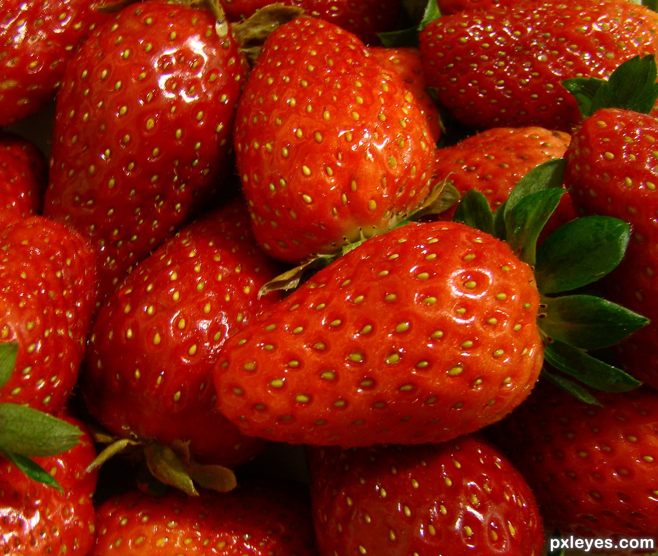
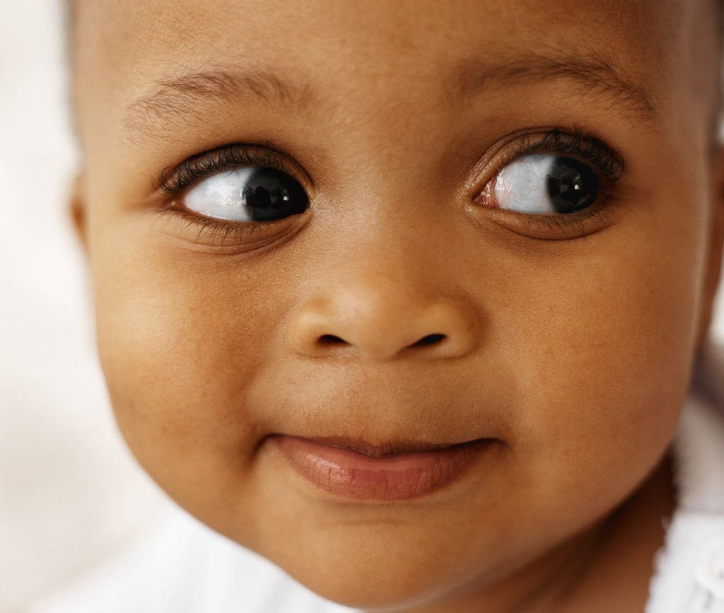
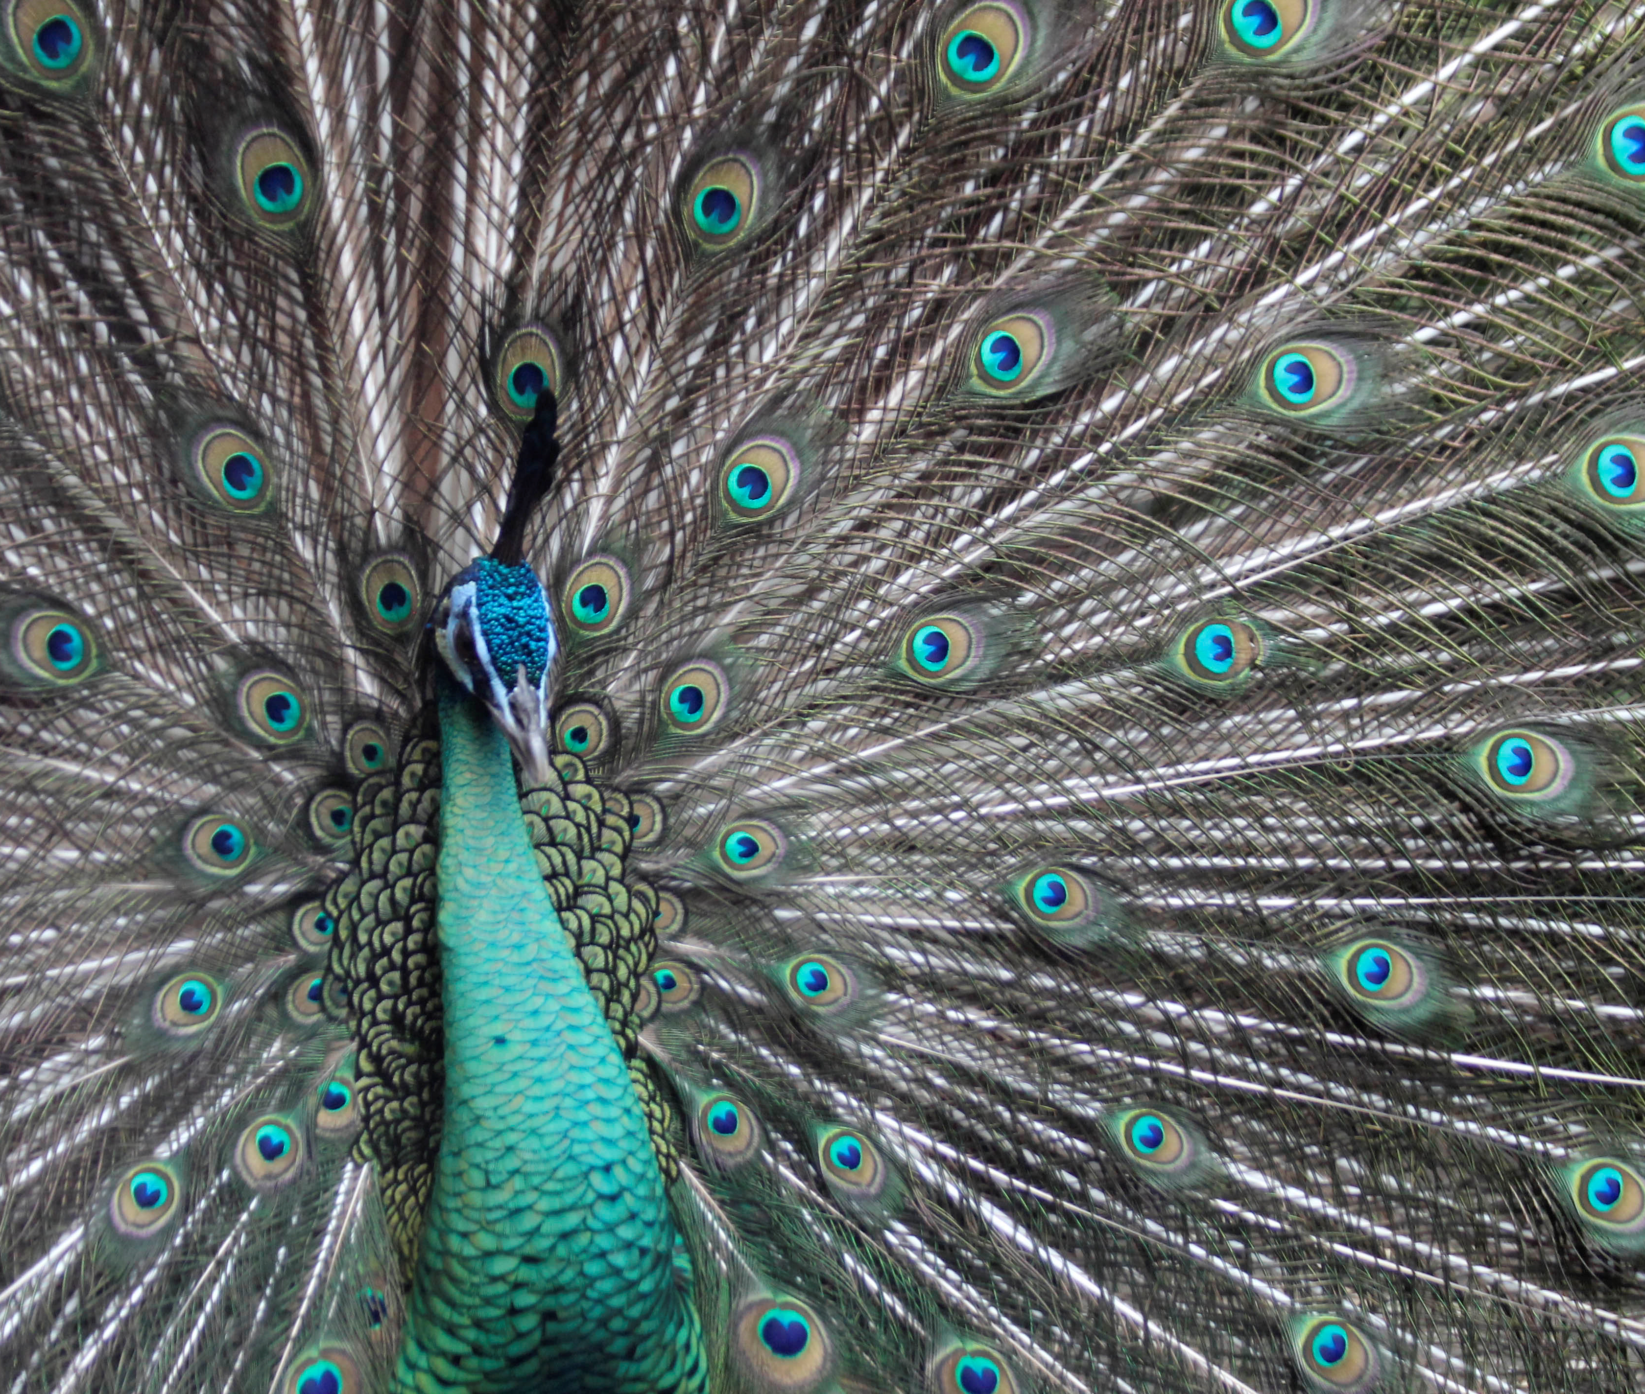

Slide 14
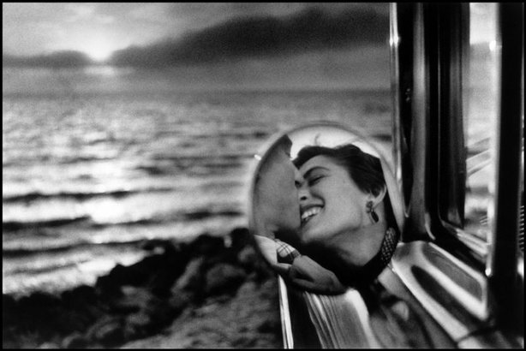
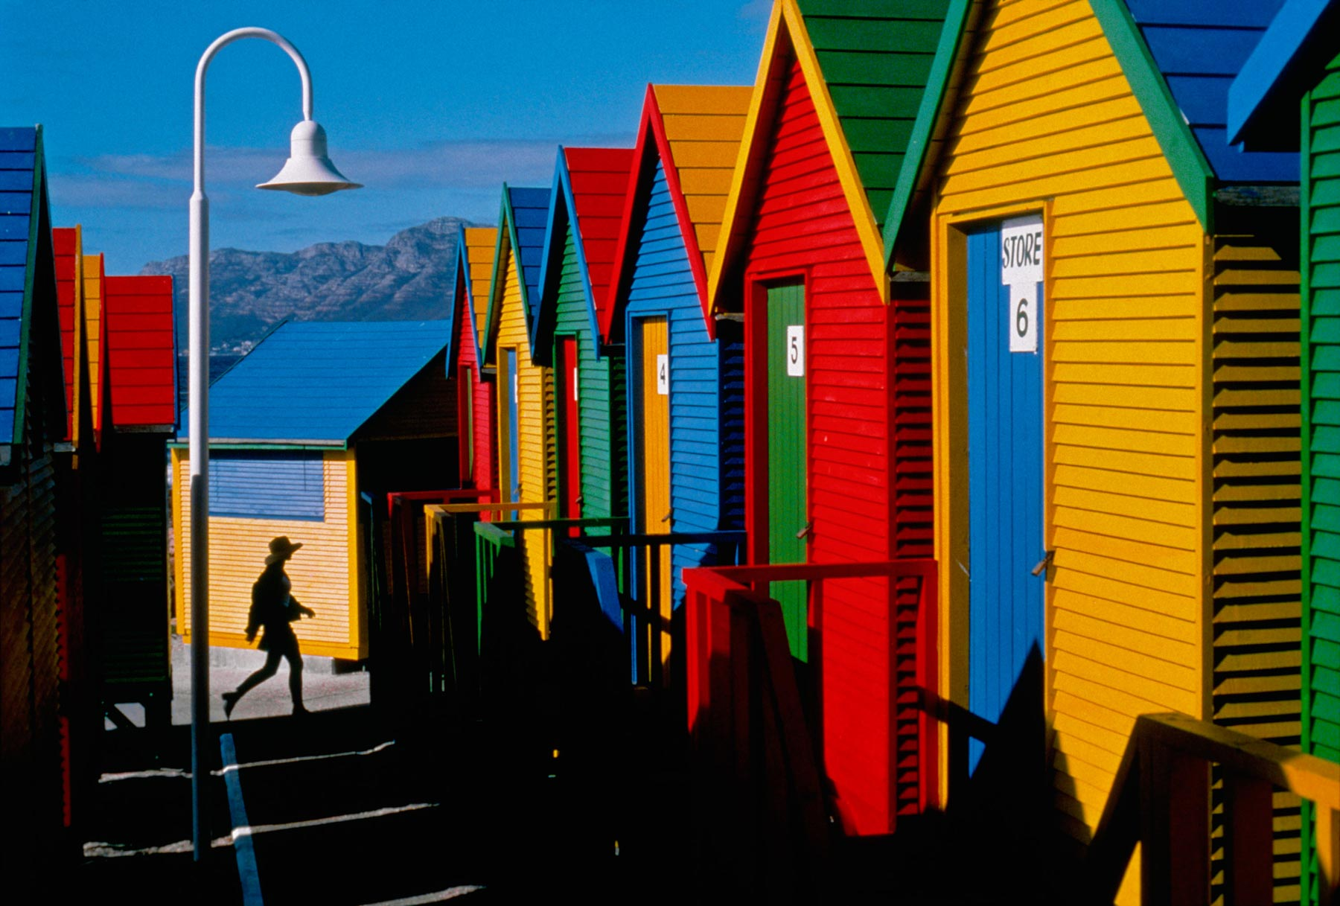
6. Framing Device
(Natural Framing)
Framing devices are elements that surround or enclose your main subject in a photo, creating a sense of depth, context, and interest.
The world is full of objects, which make perfect natural frames, such as trees, windows, archways, and doors. The result is a more focused image, which draws your eye naturally to the main point of interest.

Slide 15
