Slide 1
Depth of Field
(For DSLR’s & Phones)
Aperture • Distance • Focal Distance

Slide 2
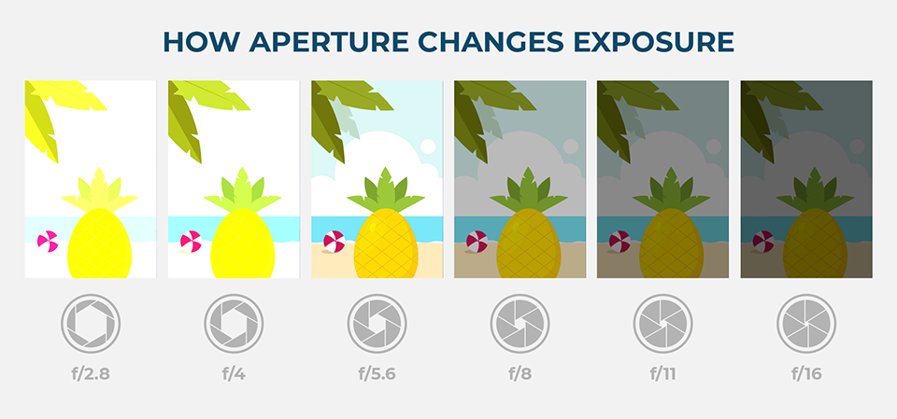
Aperture is the opening in the lens.

Slide 3
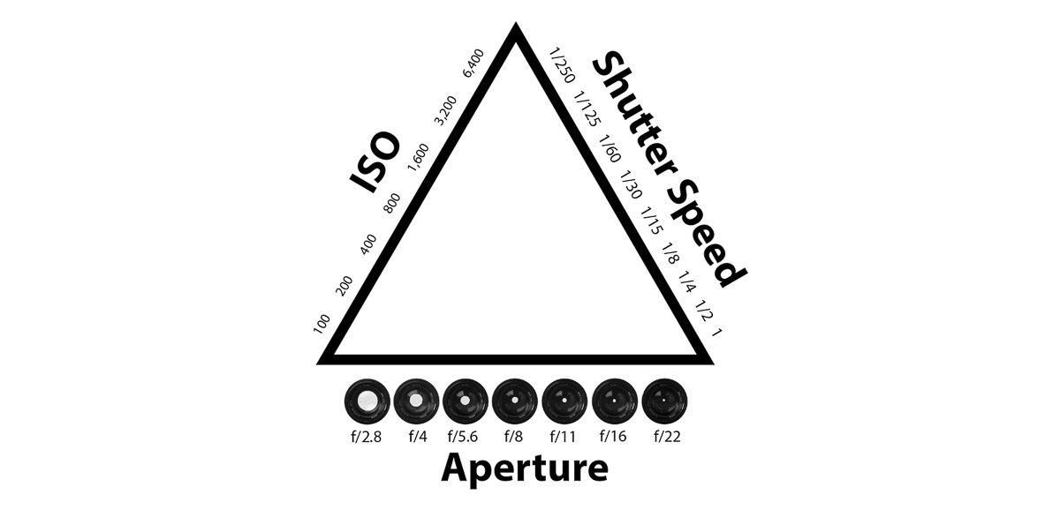
The Exposure Triangle
Aperture is just one part of the Exposure Triangle.
Changing the aperture affects how much light enters the camera. The smaller the hole, the less light enters (and vice versa).
It also has an important creative effect called “Depth of Field”.

Slide 4
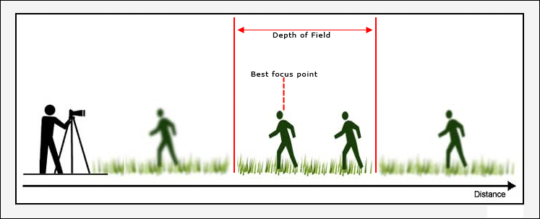
What is Depth of Field?
Also called focus range, Depth of Field is the distance between the nearest and farthest objects in a scene that appear acceptably sharp in an image.
Notes:
https://en.wikipedia.org/wiki/Depth_of_field
http://digital-photography-school.com/wp-content/uploads/2014/04/Depth_of_field_photography_cheat_sheet.jpg

Slide 5
What affects Depth of Field?
Focal Length
Distance between the lens and image sensor inside of the camera Longer lenses will produce more shallow depth of field than shorter lenses.
Distance from subject
The closer your camera is to the subject, the shallower the depth of field.
Aperture/ F-Stop
How large or small the aperture (lens opening) is. A low f-stop number is wider and creates more shallow depth of field. A larger f-stop number makes the lens opening smaller and produces more range of sharp focus.
Notes:
http://photography.tutsplus.com/articles/understanding-the-factors-that-affect-depth-of-field--photo-6844

Slide 6
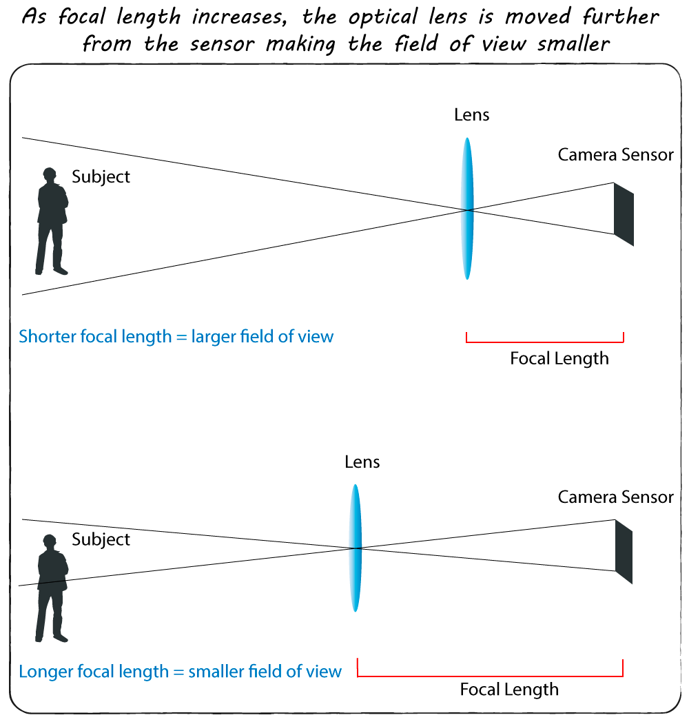
Focal Length
Distance between lens and image sensor
Zooming in on an object increases the focal length
The longer the focal length, the shallower the depth of field

Slide 8
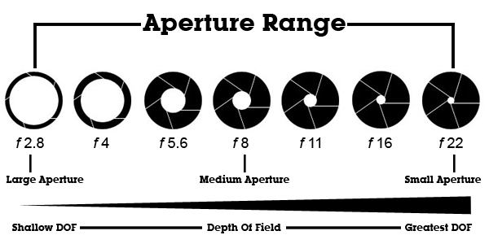
Adjusting Aperture
F-stop numbers are actually fractions, so 1/2.8 is larger than 1/22
Large Aperture (low F-stop number) = Shallow Depth of Field
Small Aperture (high F-stop number) = Great Depth of Field

Slide 9
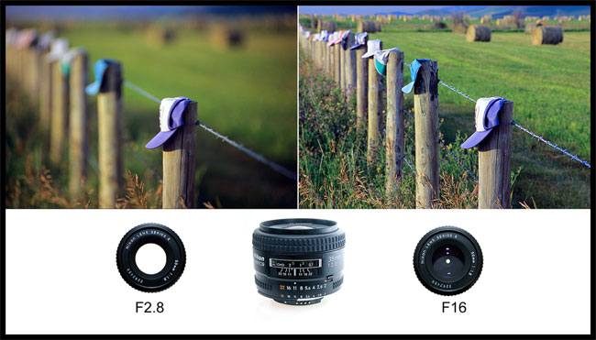
Large Aperture
Shallow Depth of Field
Small Aperture
Large Depth of Field

Slide 10
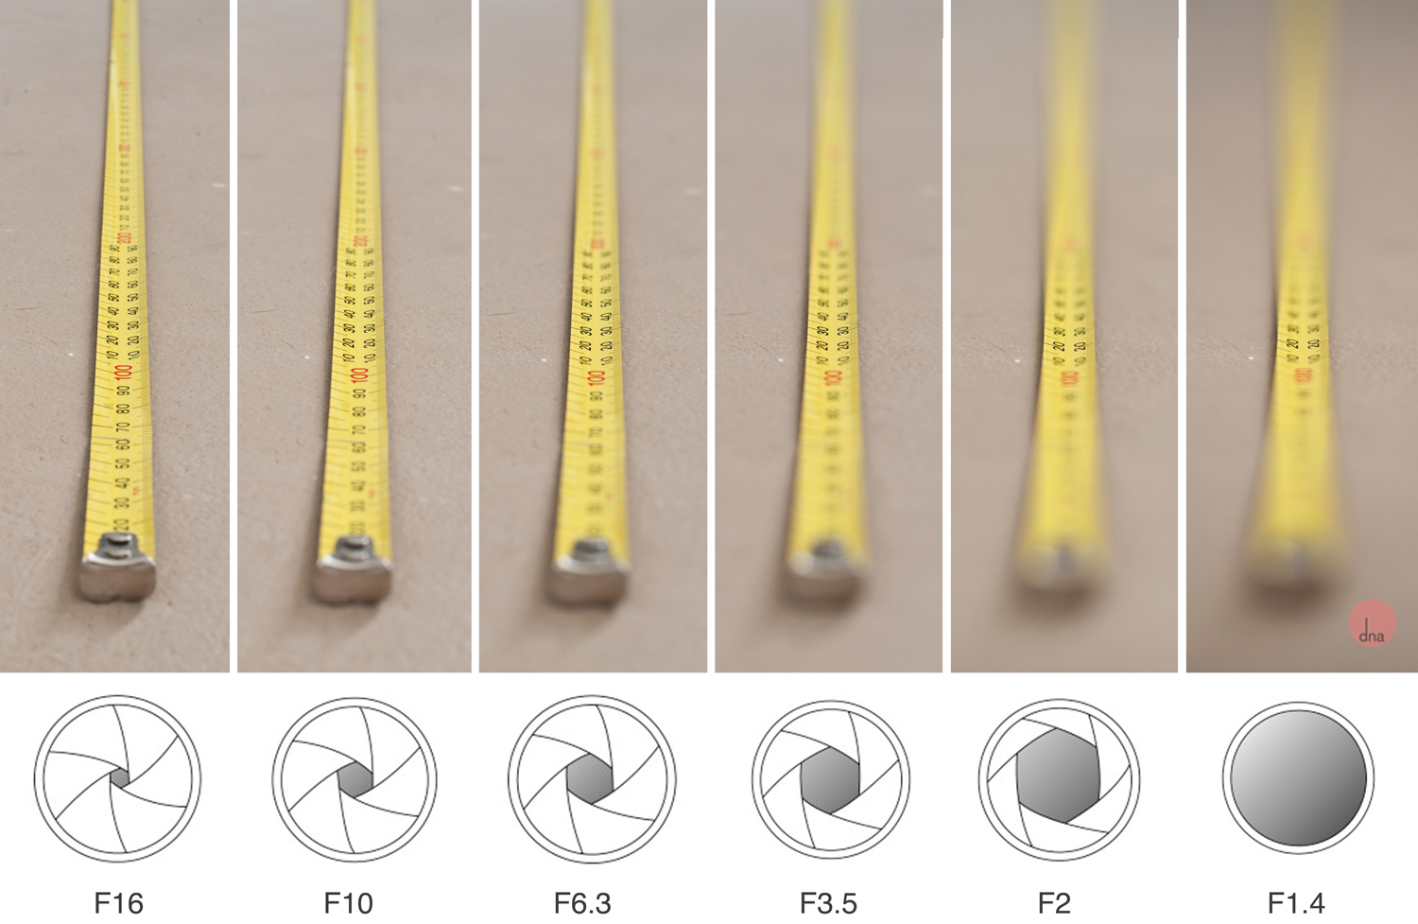

Slide 11
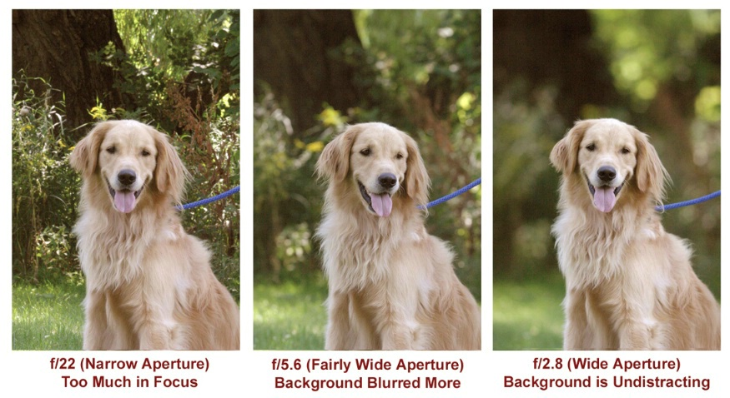
Aperture and Depth of Field

Slide 12
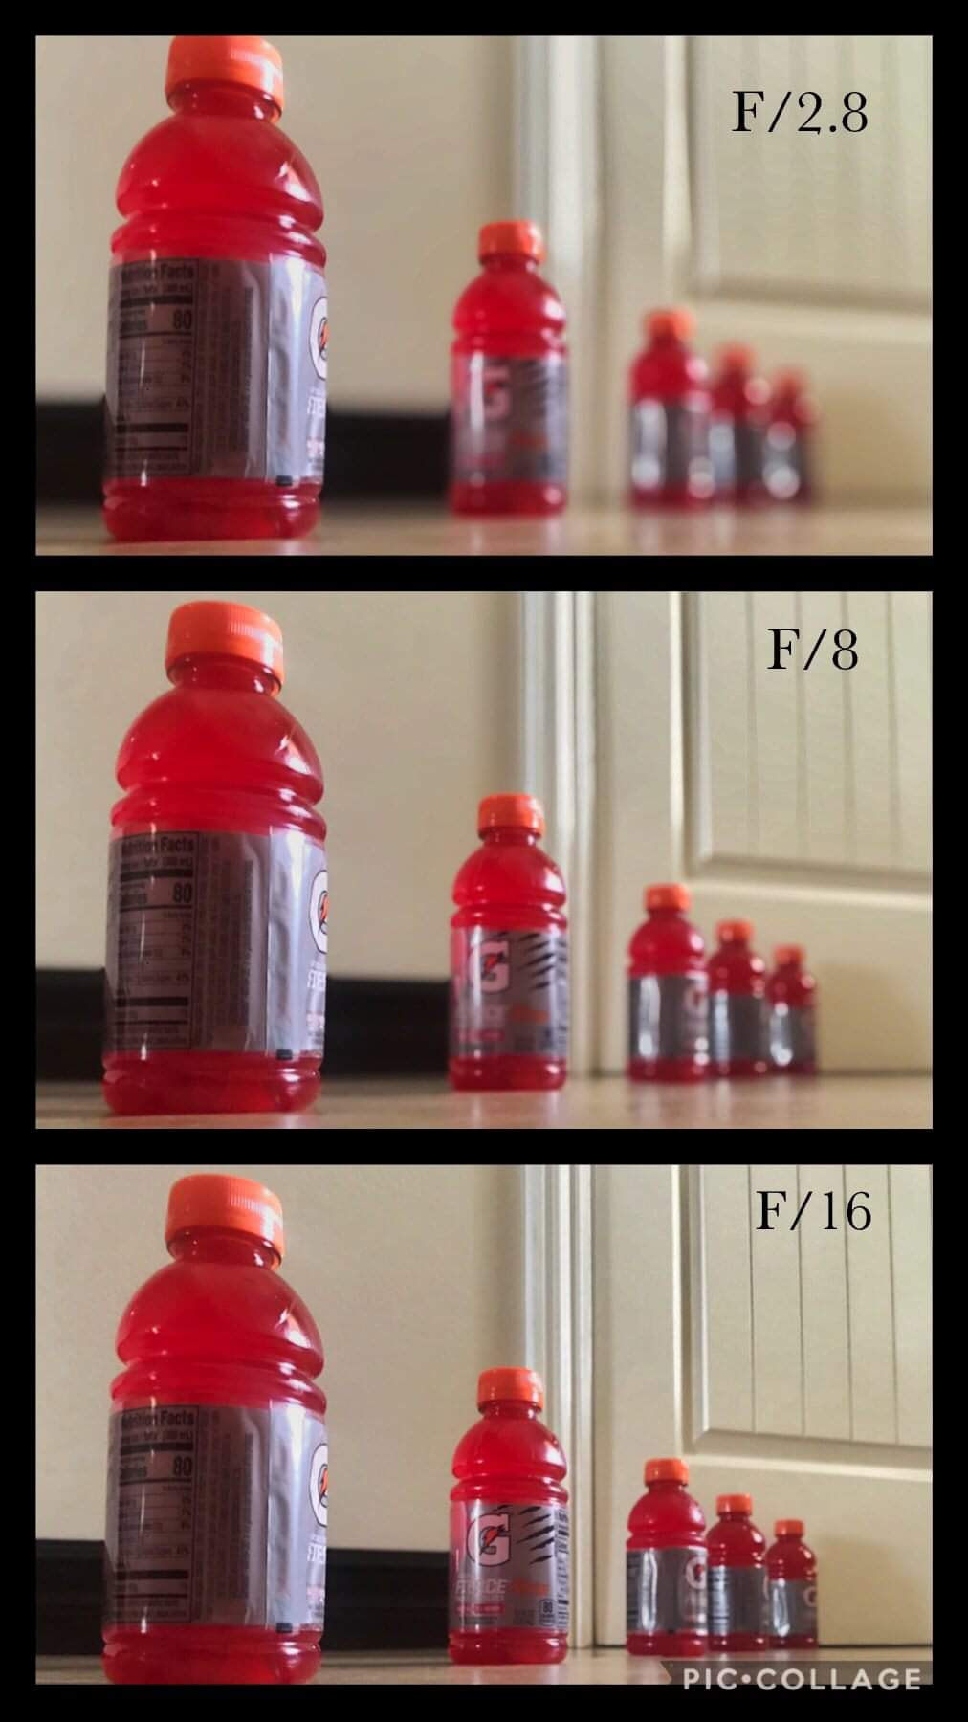
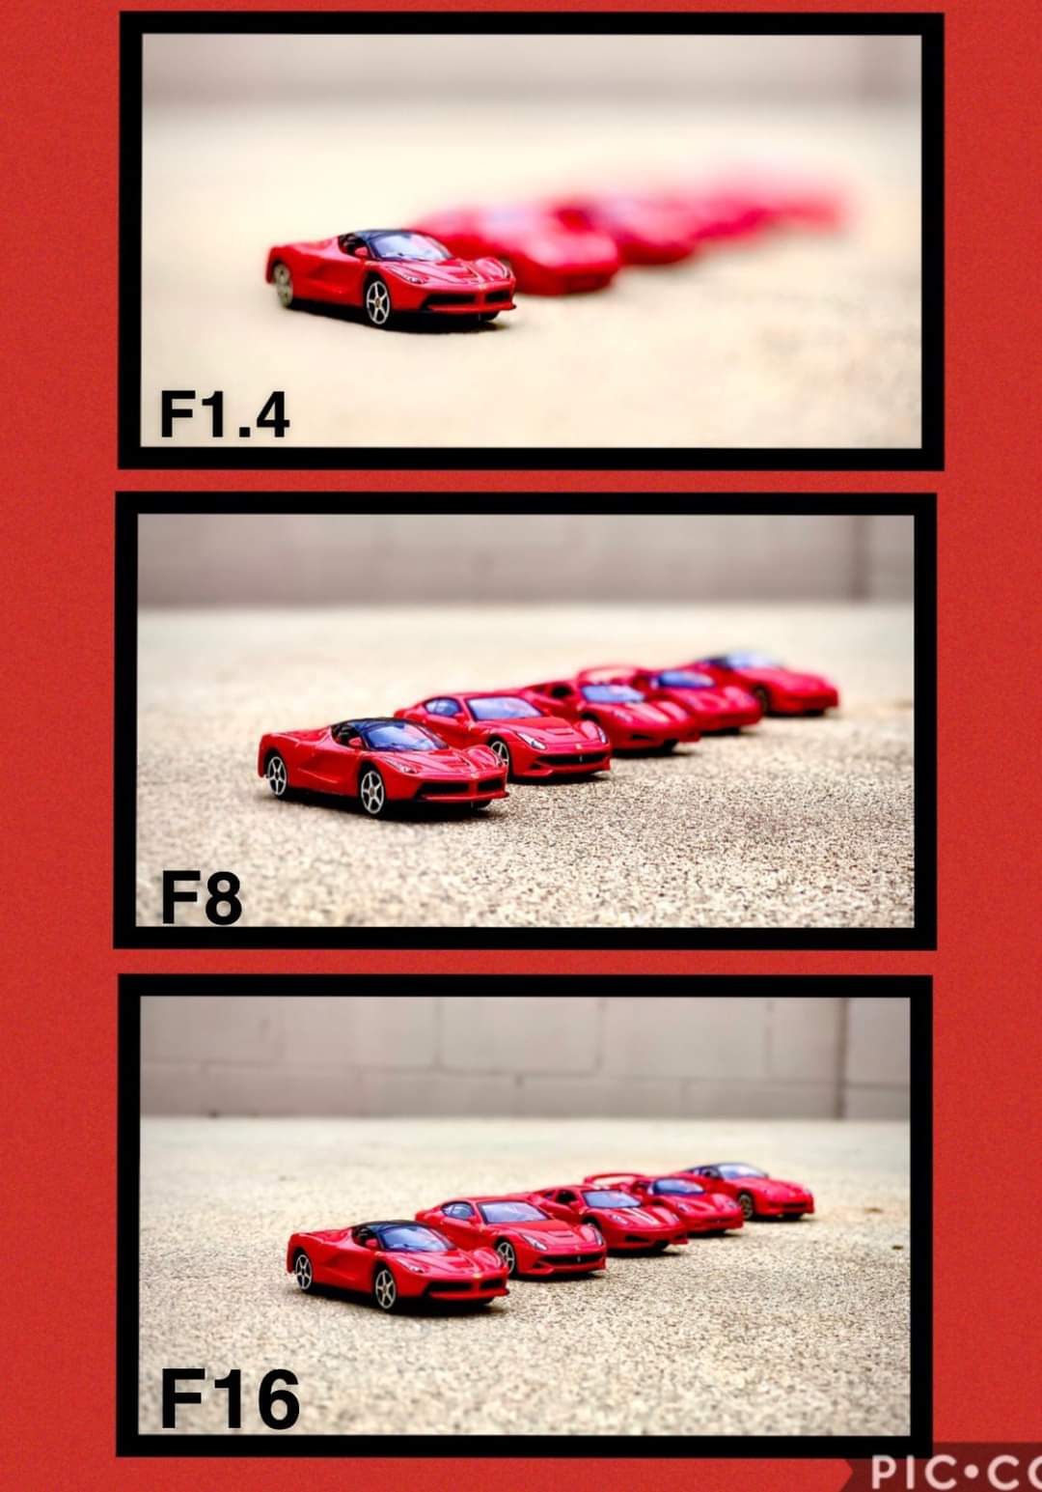

Slide 13
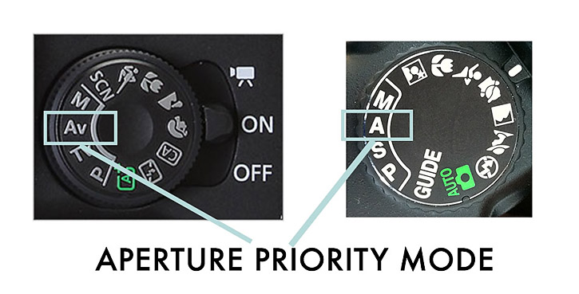
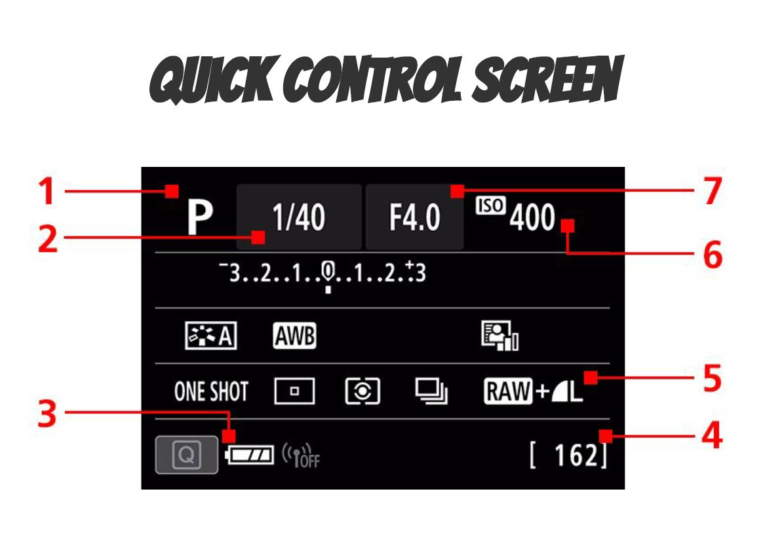
DSLR Cameras
Canon
Nikon
Set your camera to Aperture Priority (Av)
Stabilize your camera (set on table/floor or use tripod)
Use main dial on camera to adjust aperture.

Slide 14
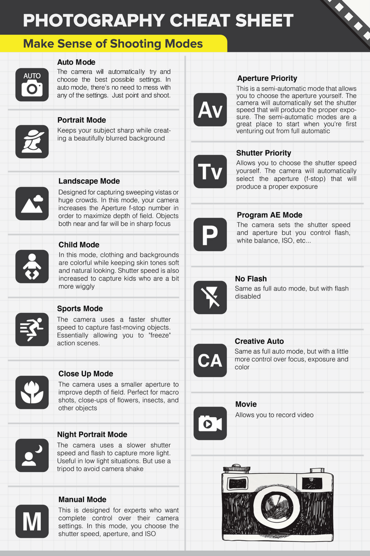
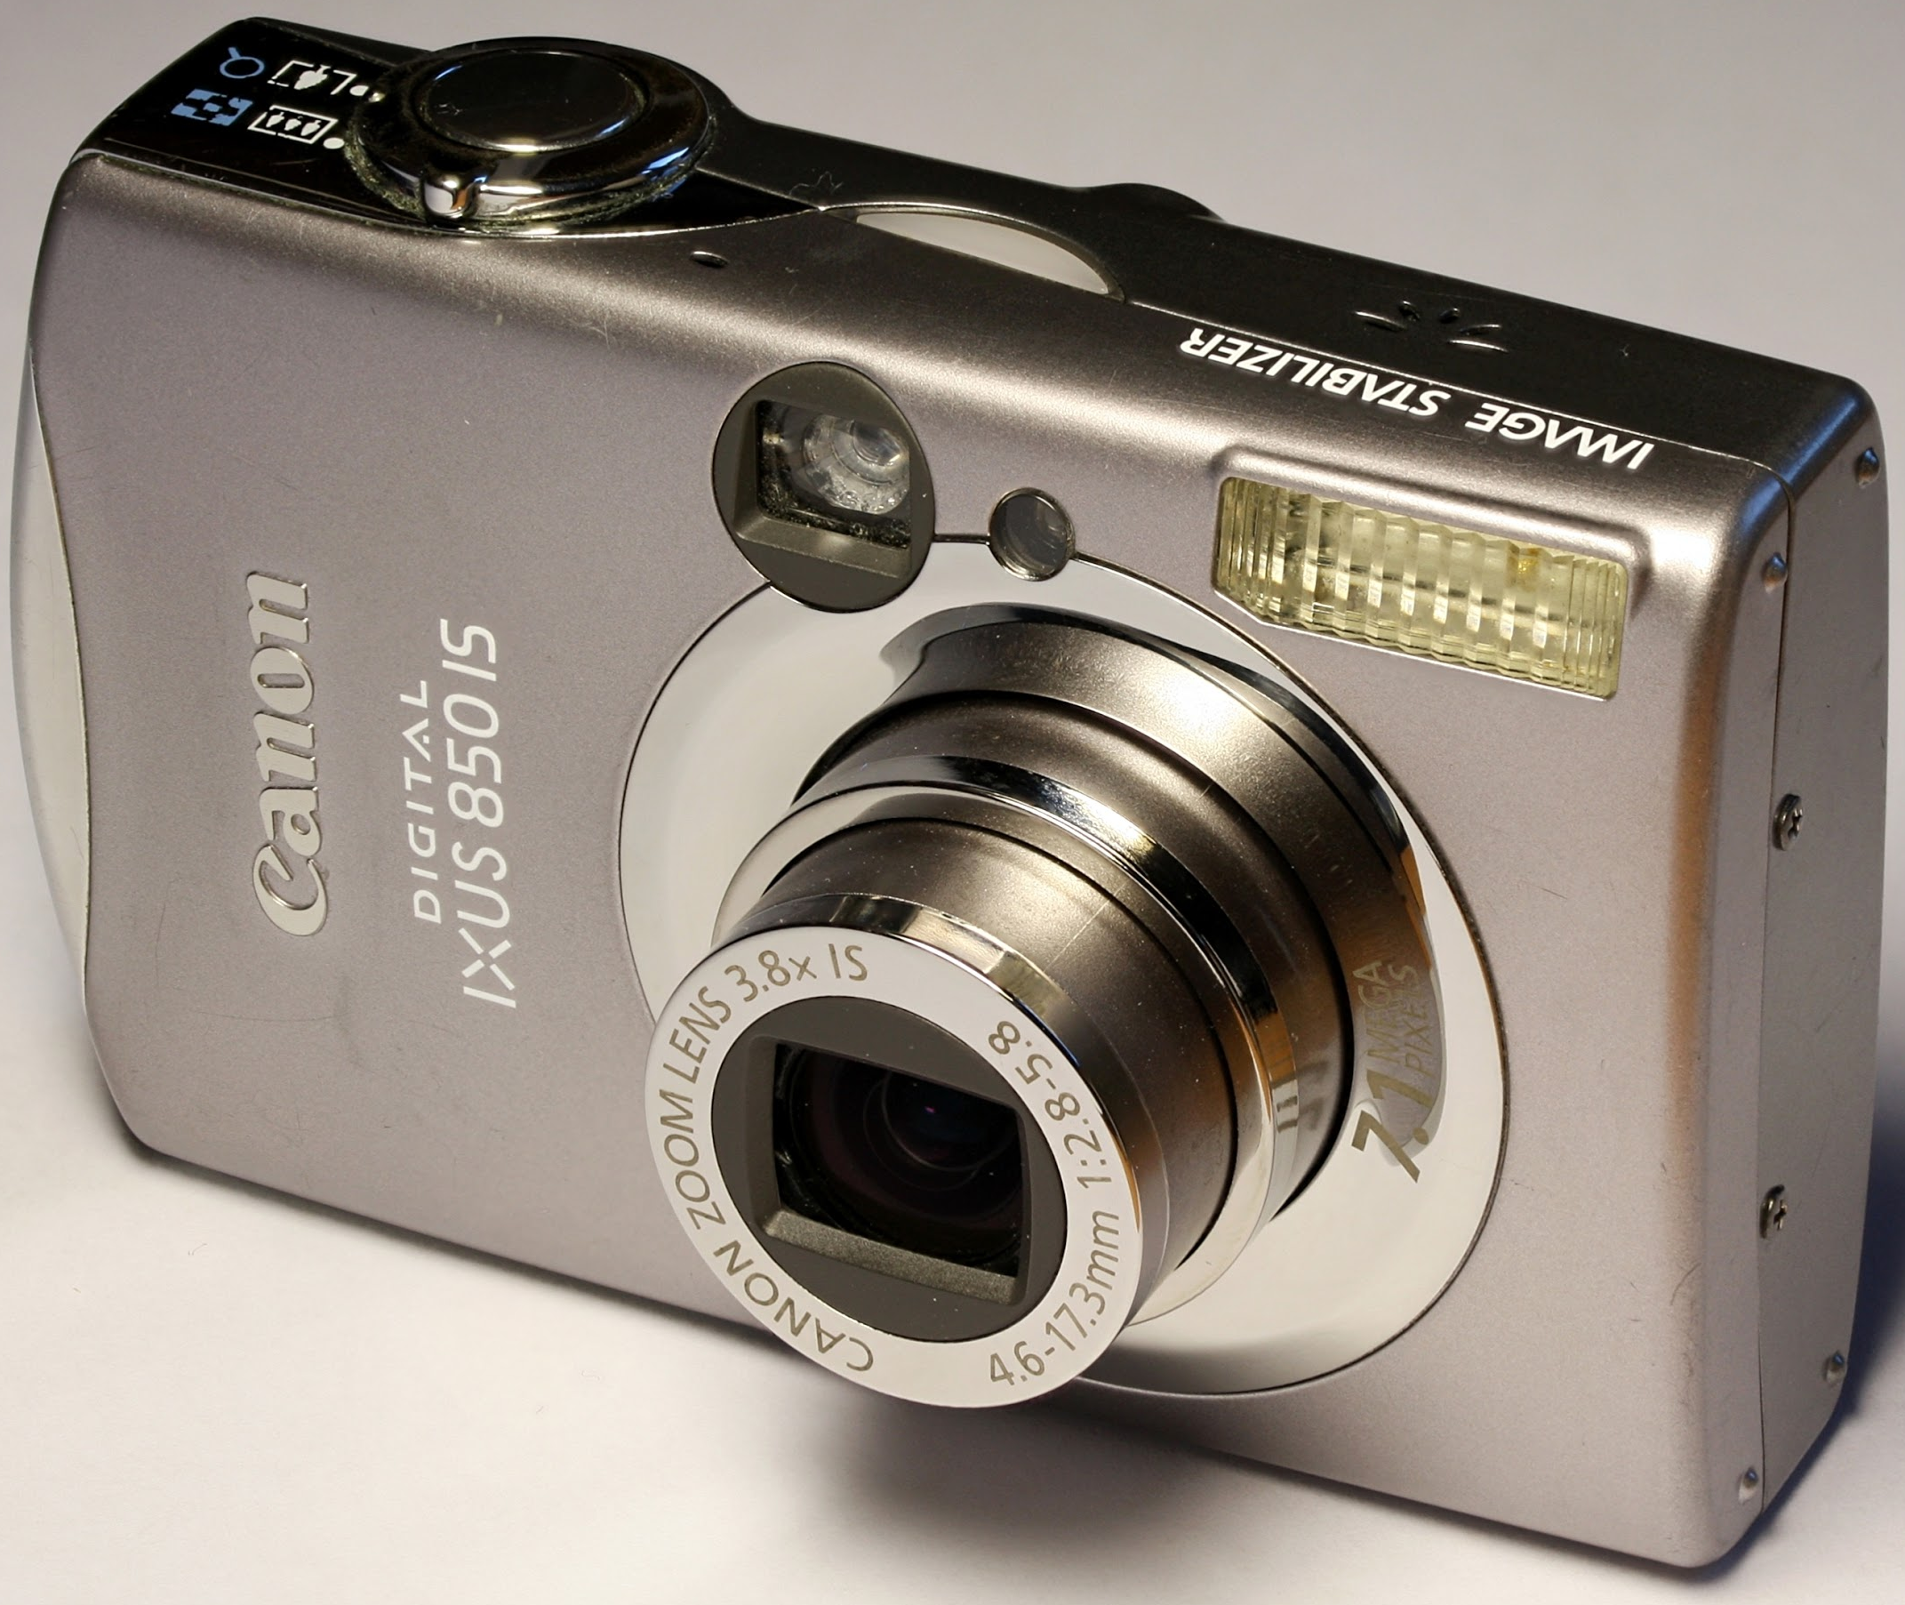
Point & Shoot Cameras
Some cameras have Aperture Priority Mode and you can use them just like the dSLRs on the previous slide.
If there is no Aperture Priority mode, there are several auto modes that use Depth of Field.
Portrait & Macro Modes both work for Shallow Depth of Field
Landscape Mode for Wide Depth of Field
Use Auto Mode for Medium Depth of Field

Slide 15
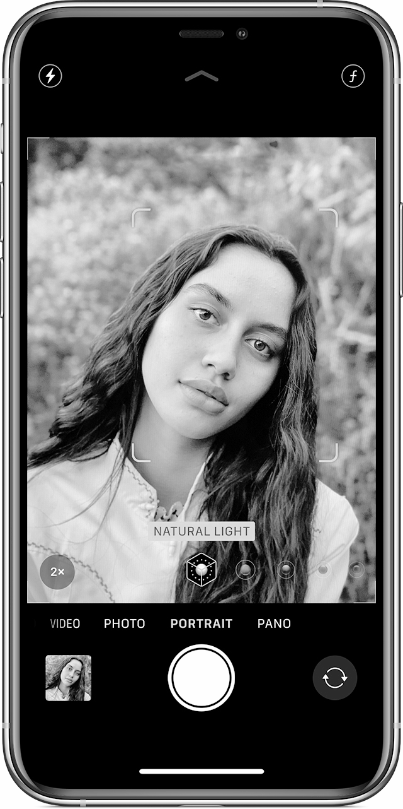
iPhones (X and Newer)
Set your camera to Portrait Mode.
Click on the cricle with the f symbol in upper right corner.
Slide finger across screen to change f stop down near the shutter button.

Slide 16
Special Note
Smart Phones do not actually have adjustable f-stops because their lenses are fixed. Phones with dual cameras estimate the distance objects are from the lens and use an algorithm to simulate Depth Of Field by blurring objects the phone reads as being farther away than the main subject.

