Slide 1
Authentic Portrait of significance
Worksheet Guide Begins on Slide 11
(Click here for shortcut)
adapted from photographer Chris orwiG’S WORKSHOP

Slide 2
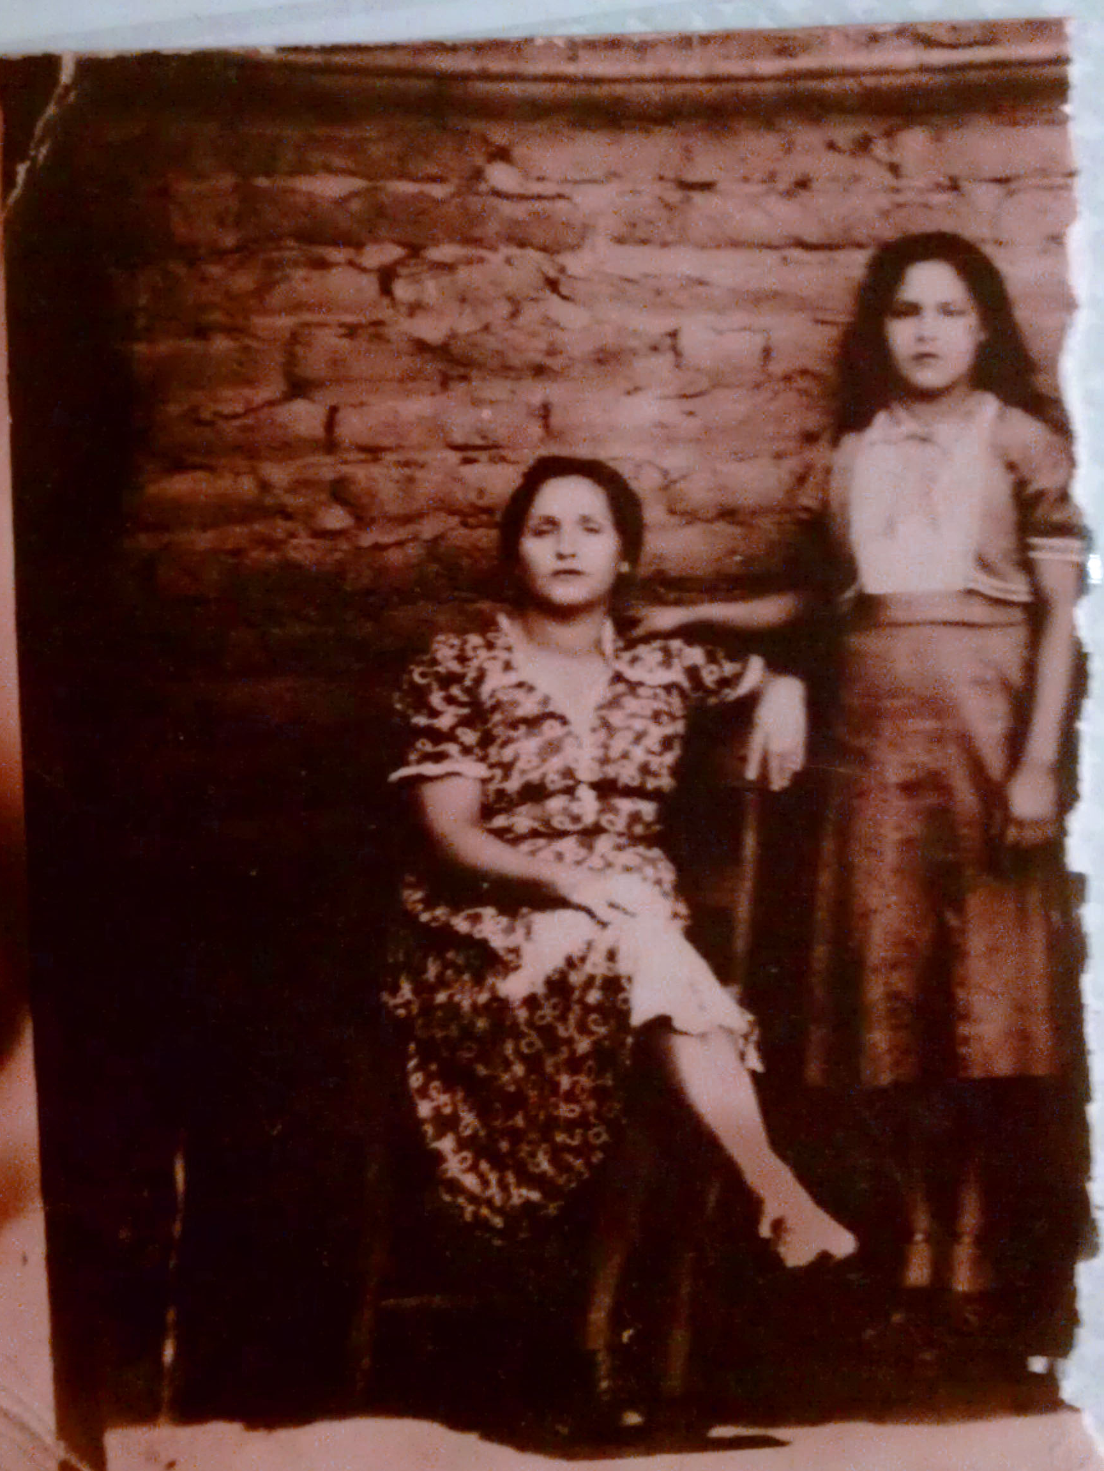
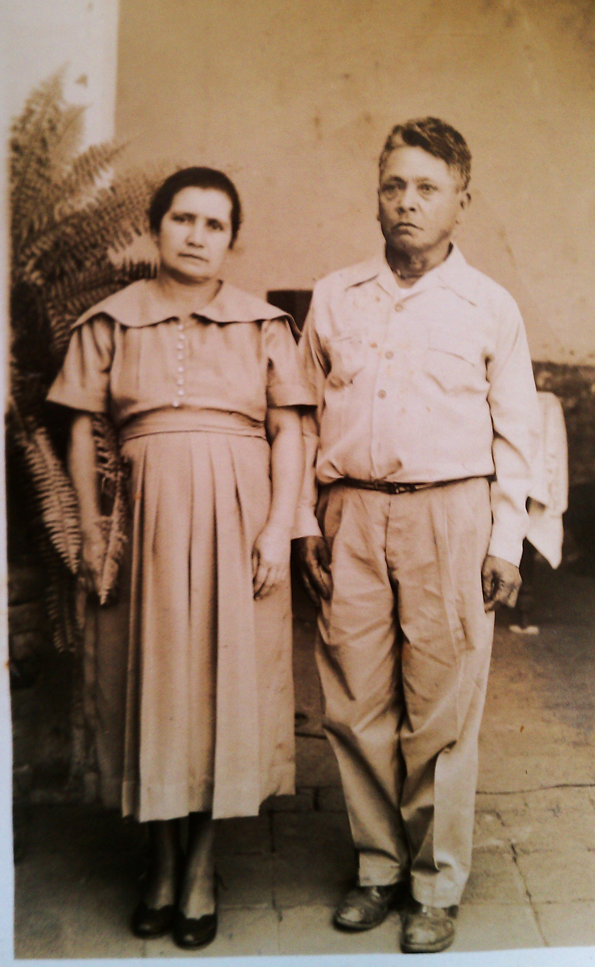
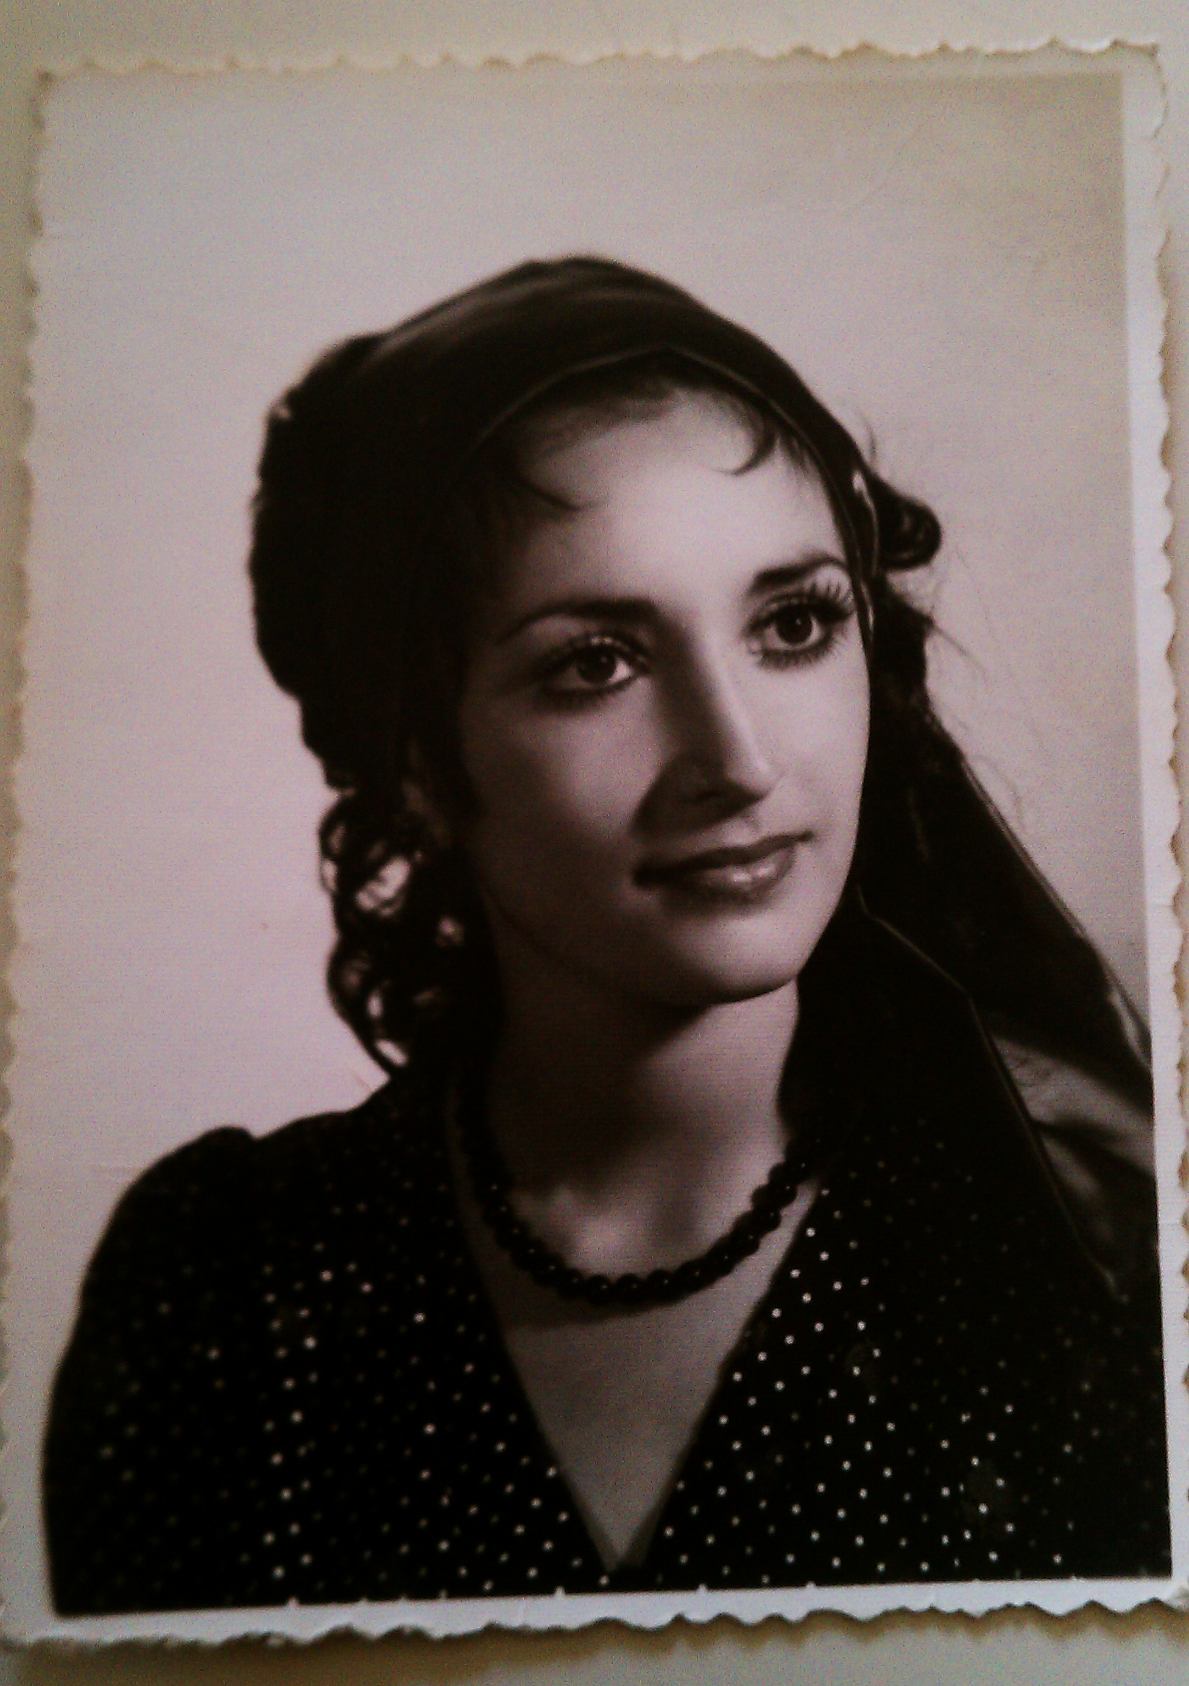
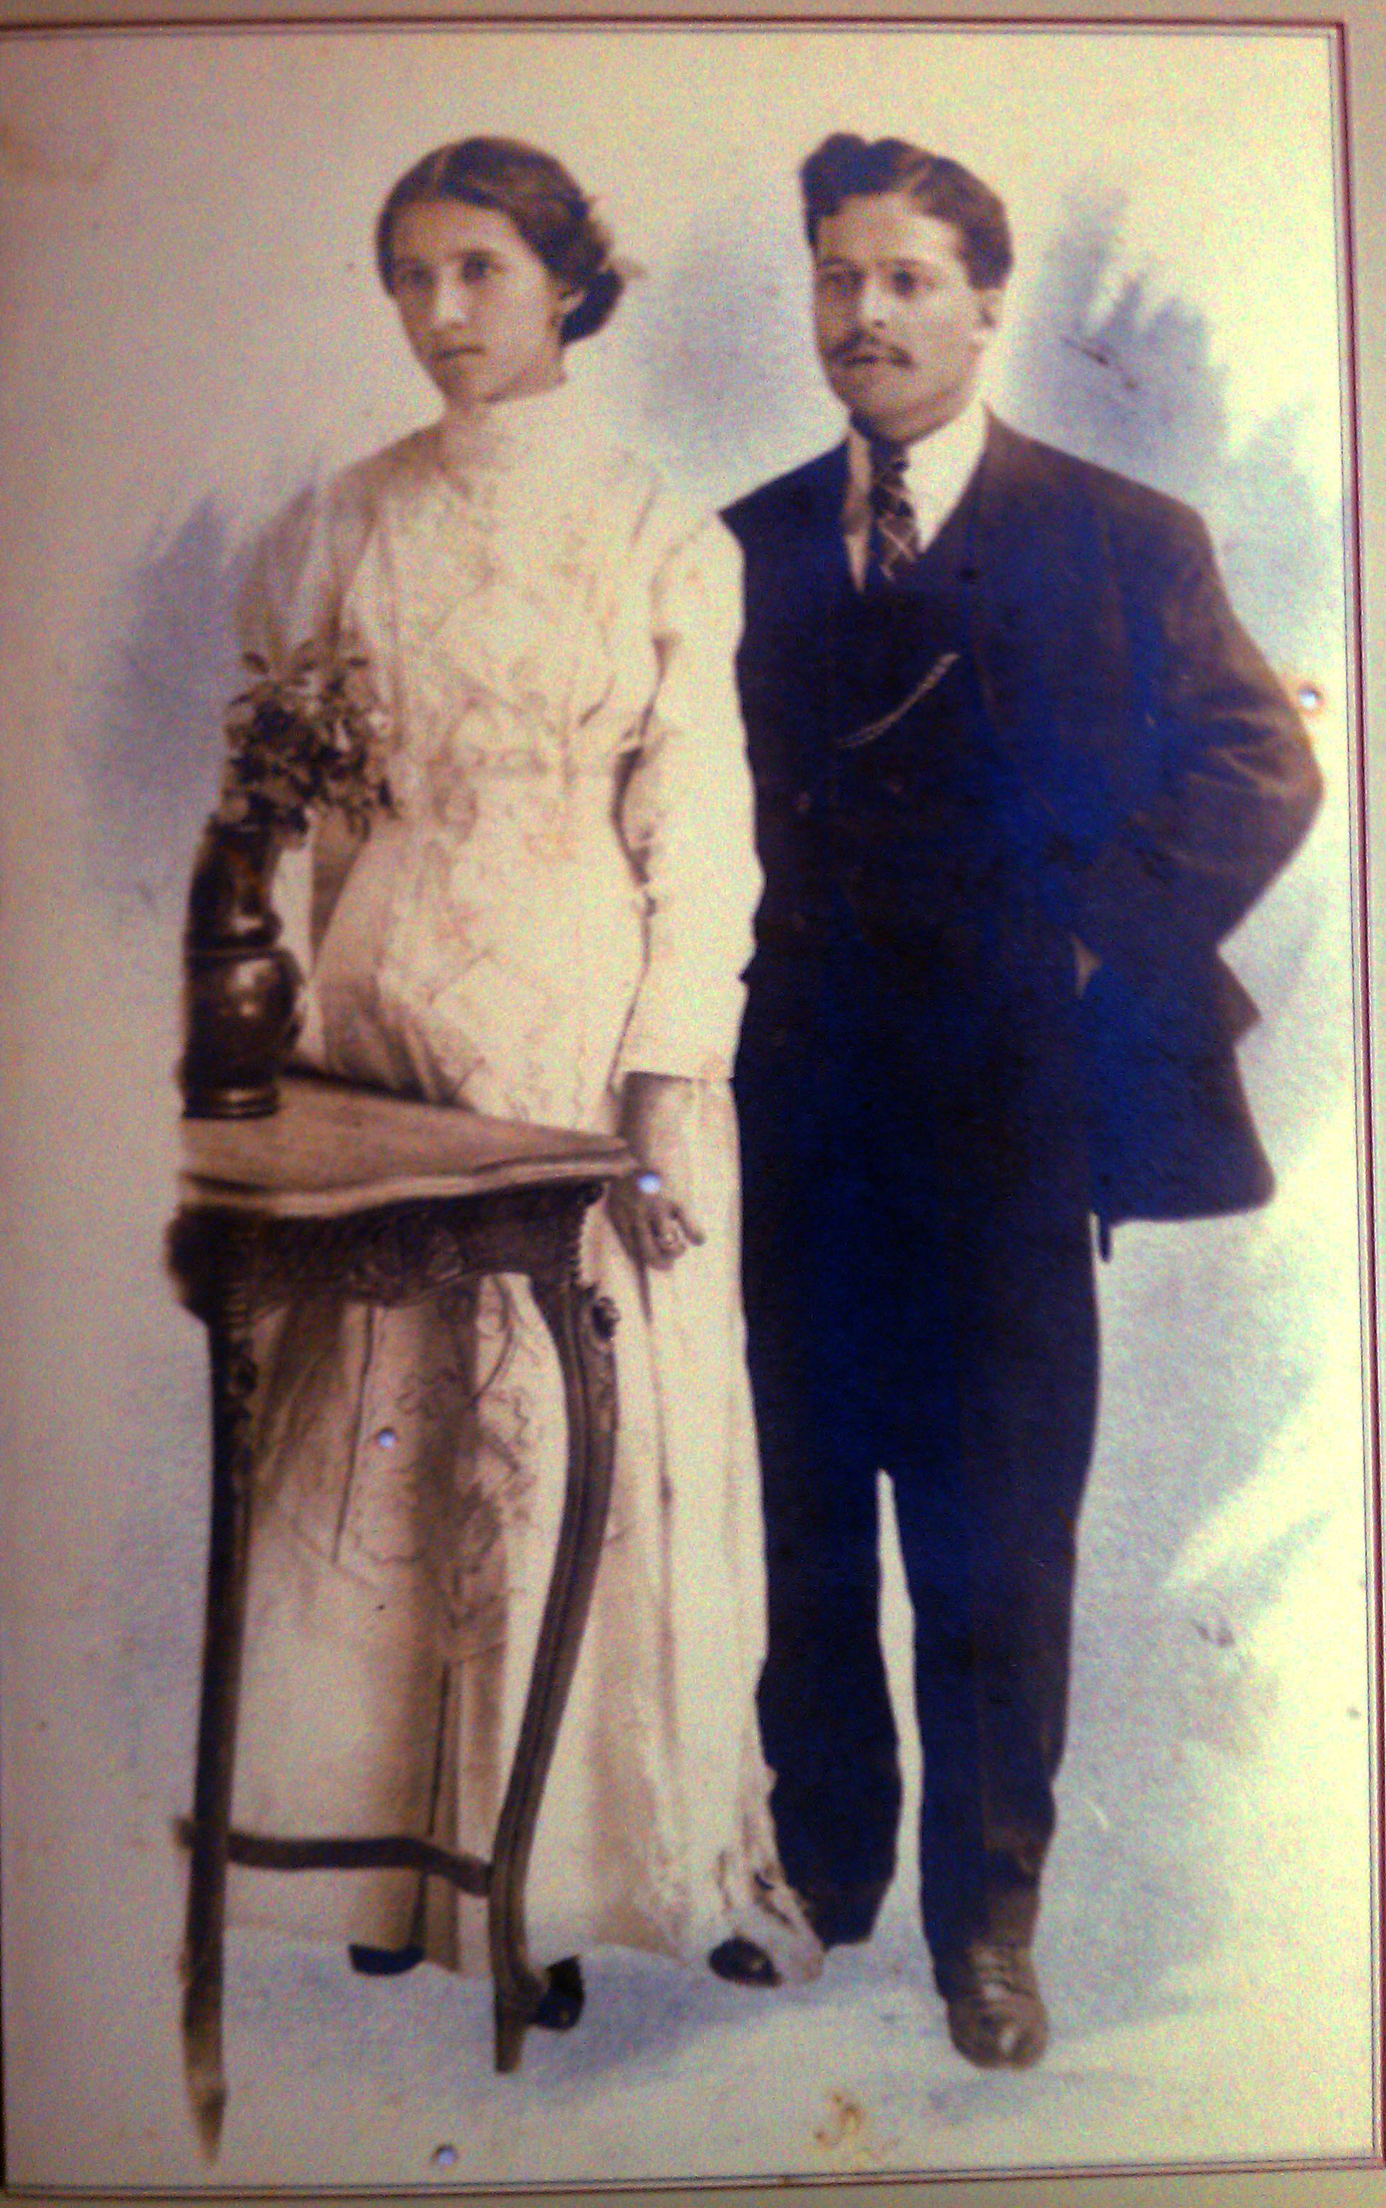
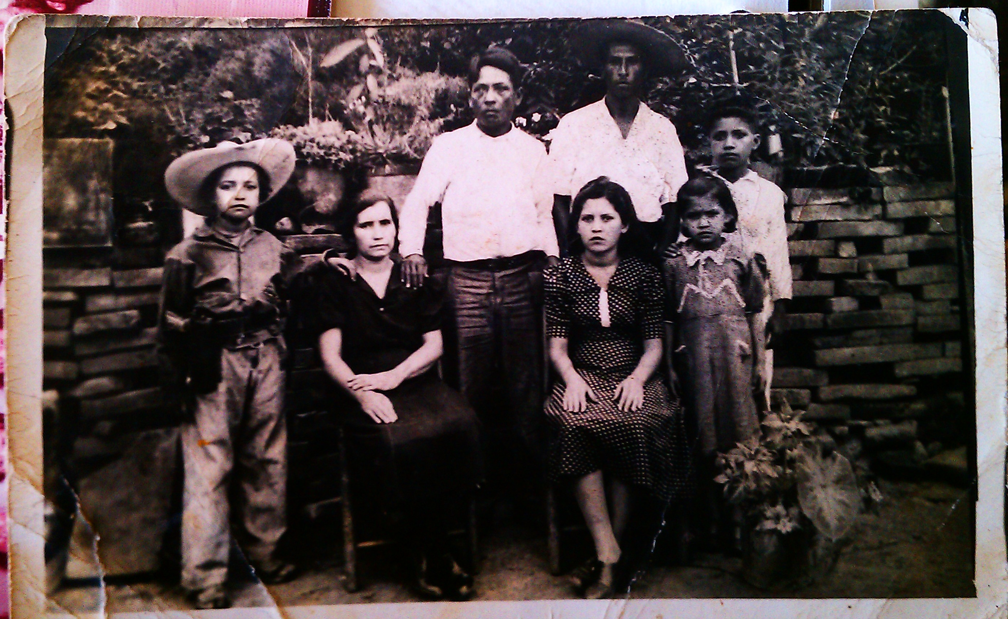
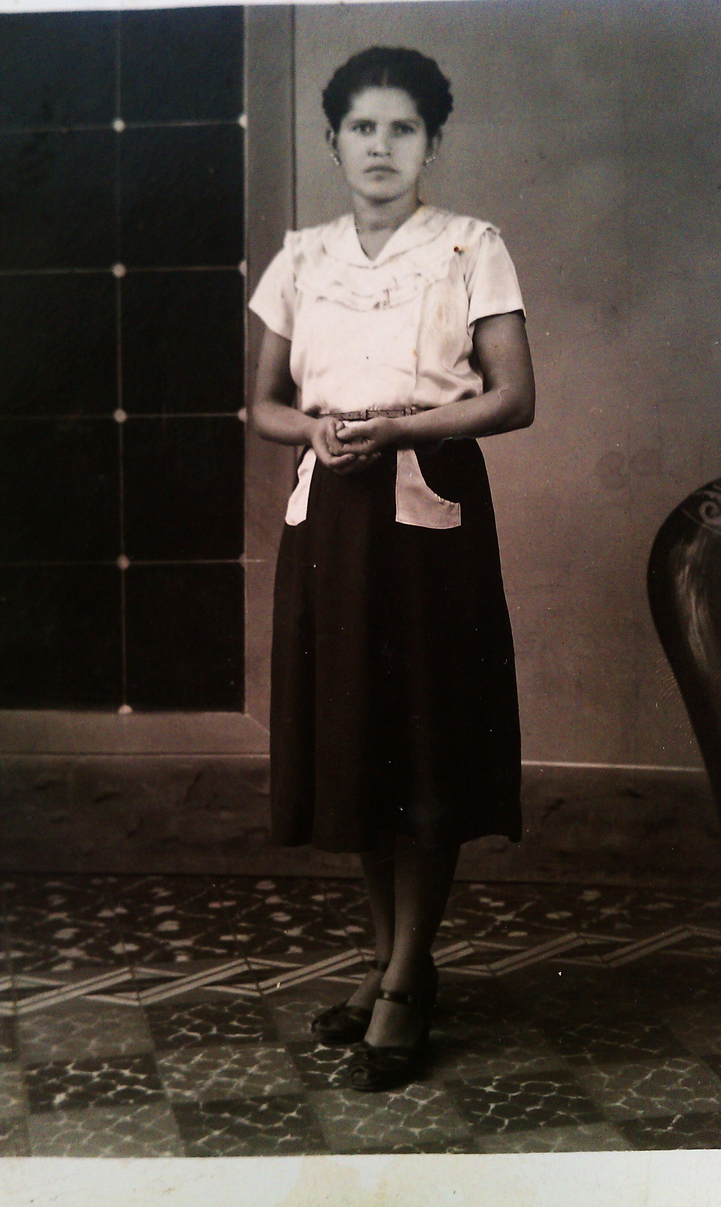
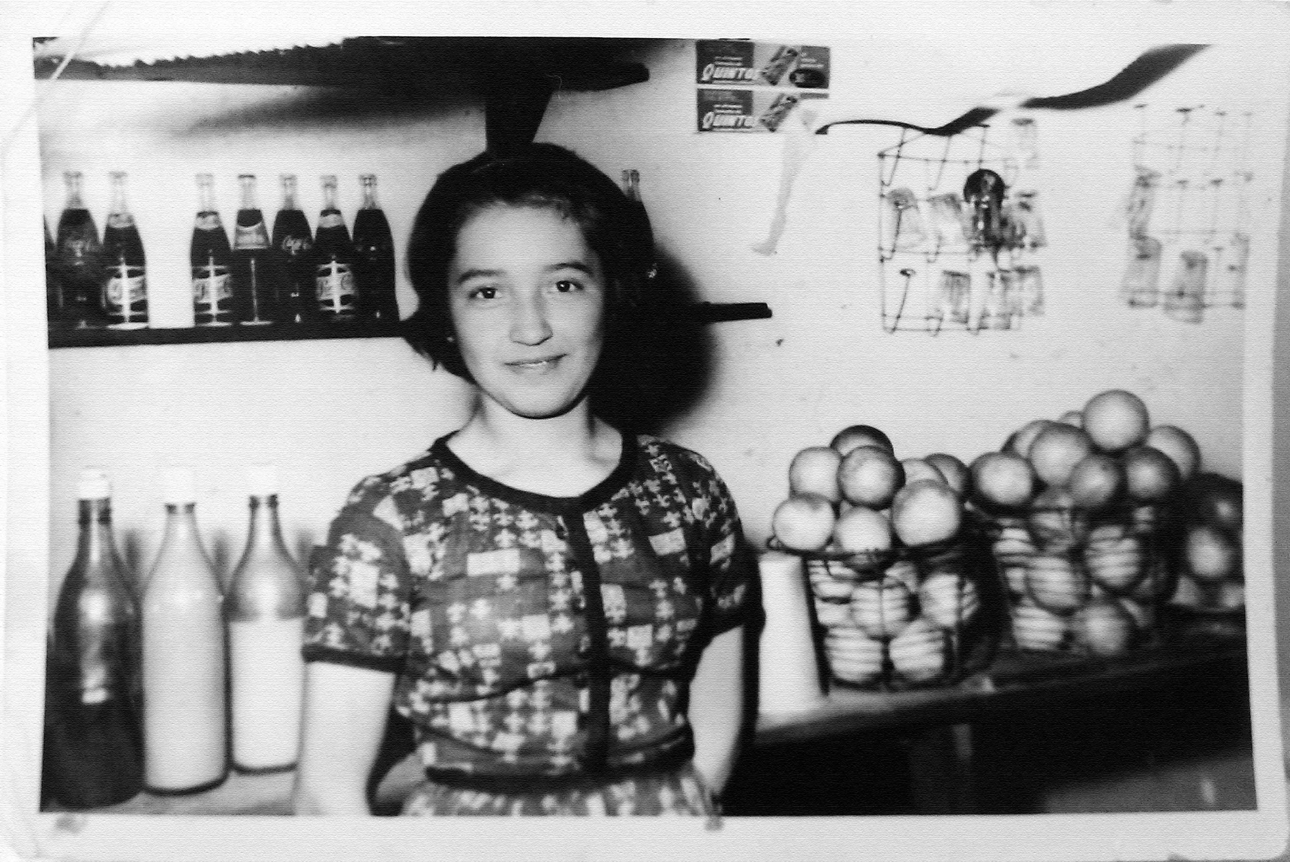
“A portrait! What can be more simple and more complex, more obvious and more profound.”
-Charles Baudelaire, 1859

Slide 3
Rethink Portraiture
Watch:
The Lab: Decoy
“In a portrait, you always leave part of yourself behind.”
– Mary Ellen Mark

Slide 4
Four tips to help capture a subject more authentically
-Ask Questions: create opportunity for them to talk about themselves and their passions. Make a connection.
-Movement: have them shake it off, walk around, swing arms around, try “anchoring”, hold prop, etc.
-Deep Breath: ask them to take a few deep breaths to break up tension.
-Close Eyes: ask them to close their eyes, when you ask them to open again be ready to take a photo at that moment.

Slide 5
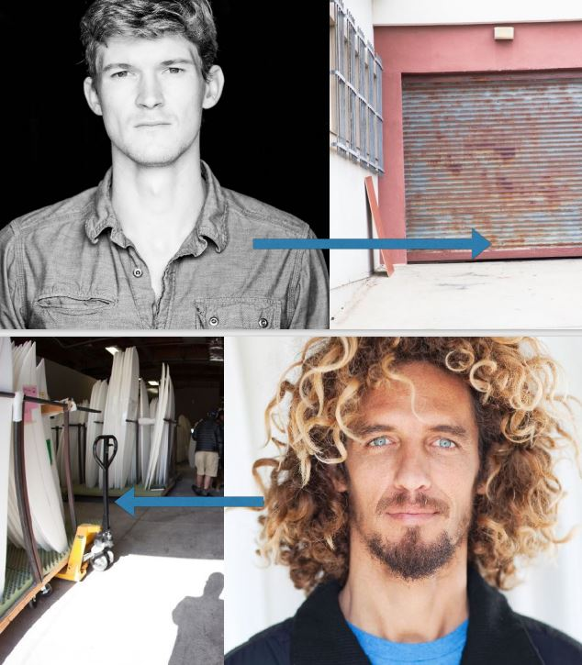
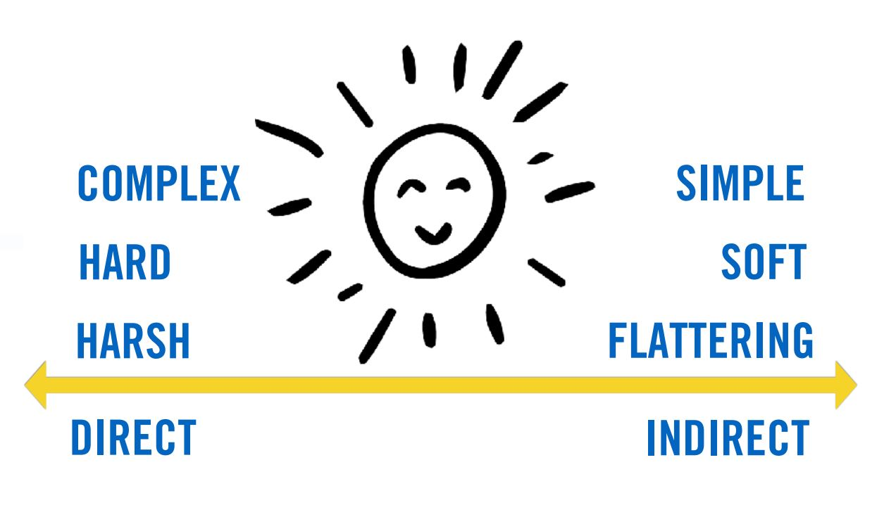
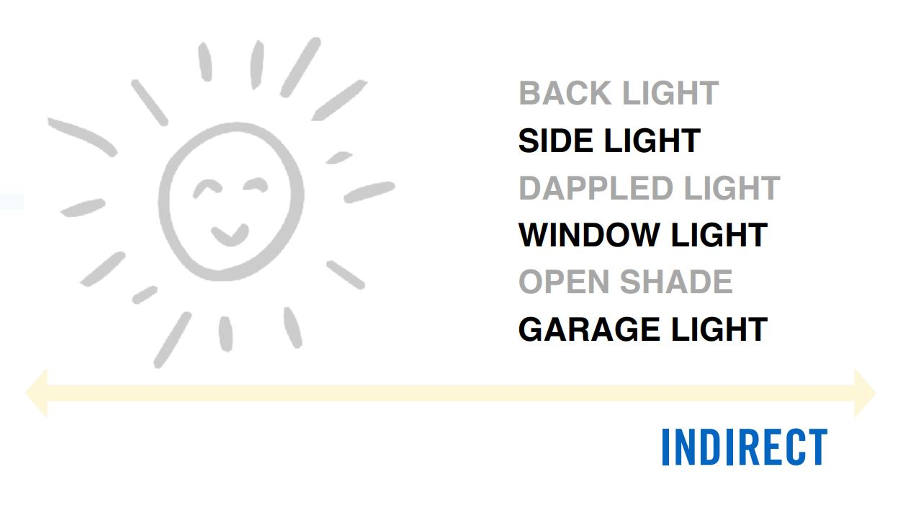
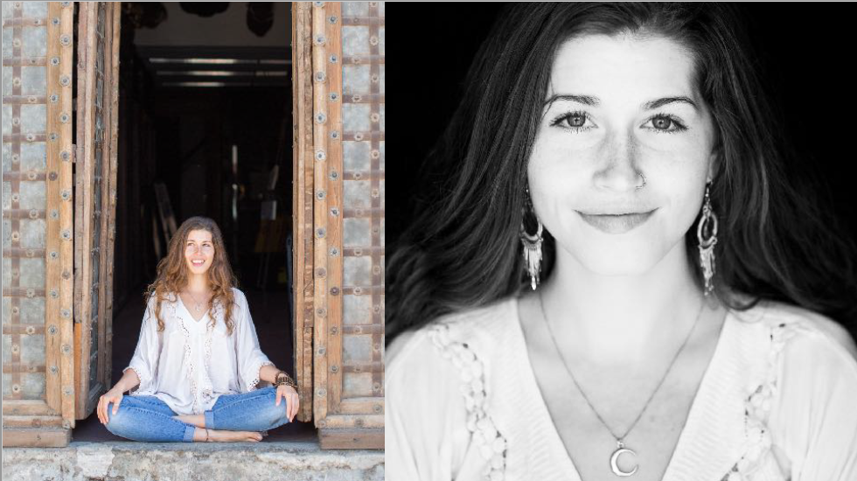
Use Natural Indirect light

Slide 6
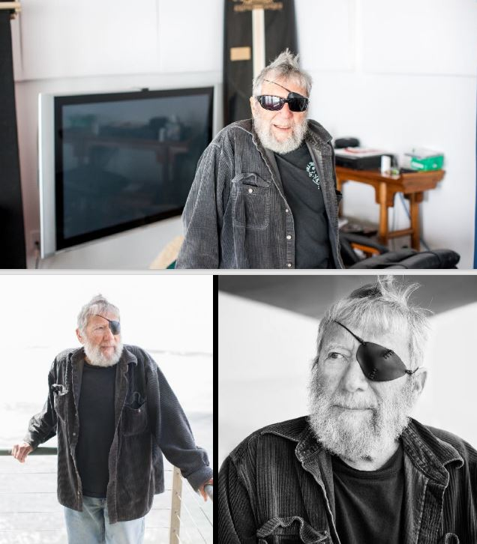
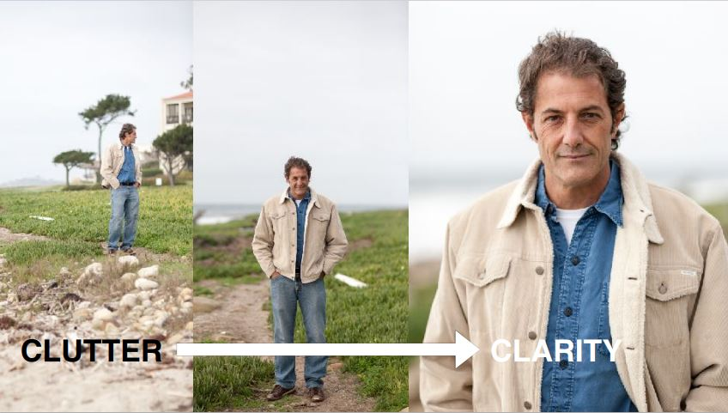
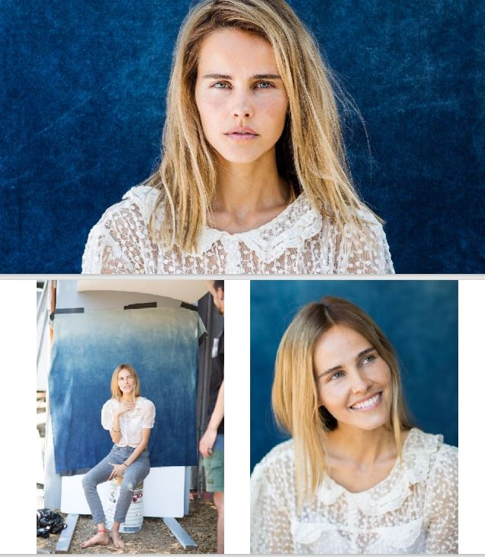
Simplify the frame

Slide 7
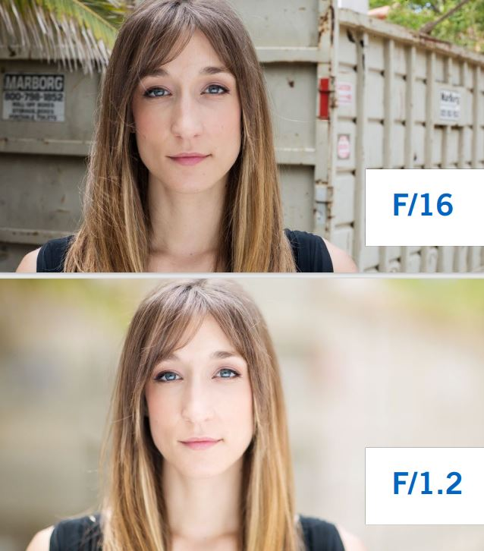

Slide 9
be yourself!
Every photographer has something to contribute, even you! Because at their core, portraits are photographs of individuals created by individuals.
The more “YOU” that you are, the better your portraits will become.
It doesn’t matter how young, how old, how introverted, how extroverted, how experienced, how inexperienced you are…all that is you is what makes you unique. And when you make portraits from a place that taps into and honors your life story, your core, and your essence, you bring to light something that no one else can.
It isn’t about the gear, the light, or technique. It’s about you, your vision, your voice, and your hope for connecting with another human soul.

Slide 11
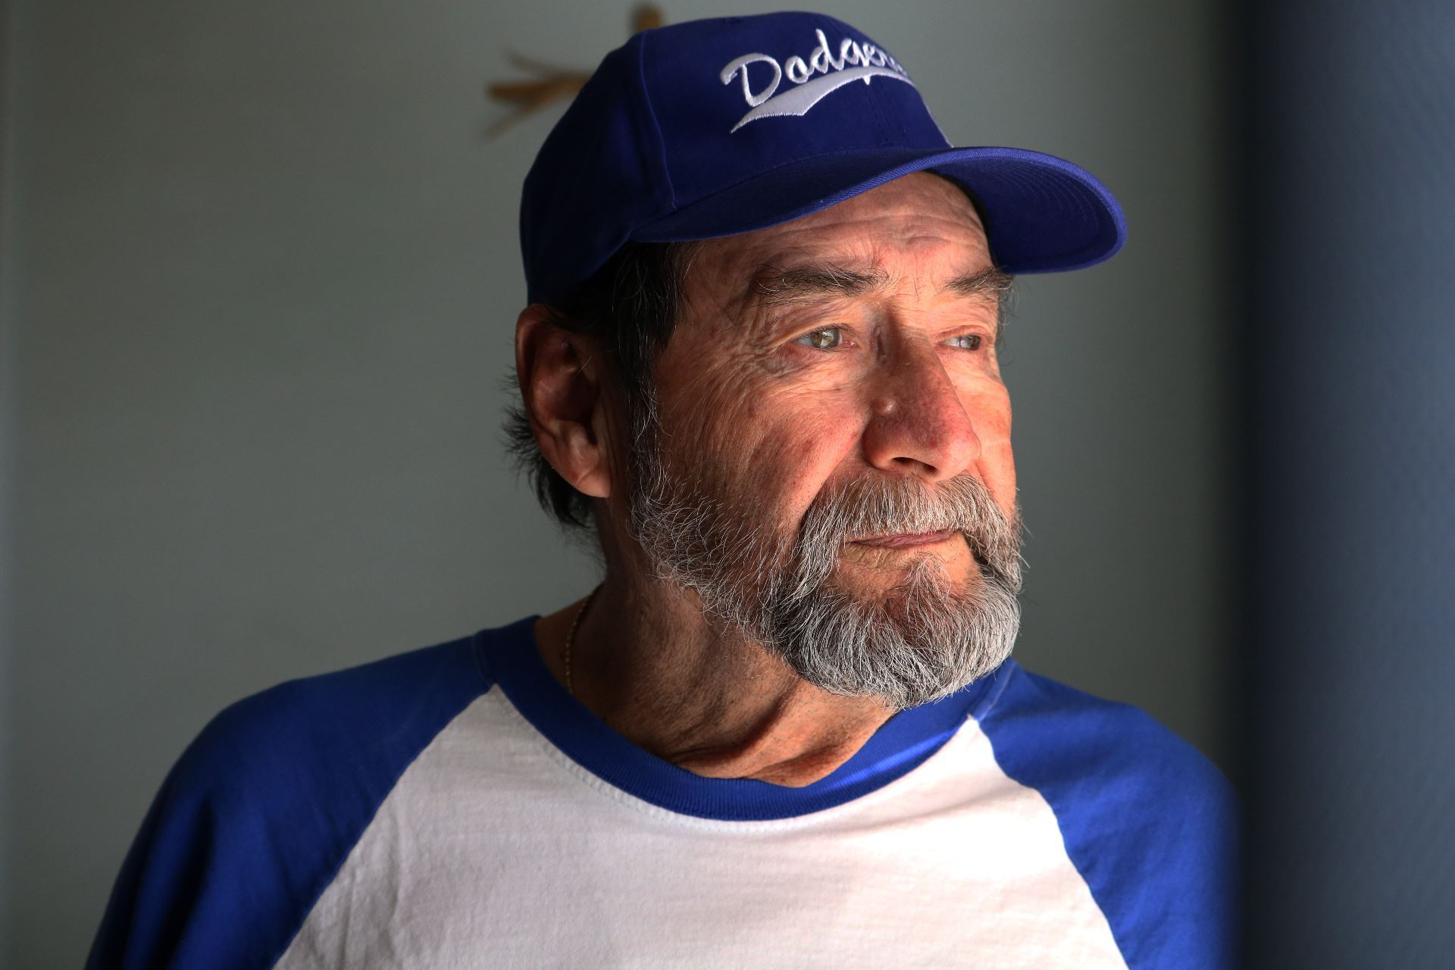
Worksheet Guide:
Make a list of the most important people in your life.
Answer the Who, Why, What, What, Where, and When Questions.
Write your personalized script to ask your subject to be part of your project.
Map out your expected flow and write/copy down your favorite 5 conversation starters from the list.
What camera, lenses, and other equipment would you like to use?
Copy down at least 3 directional tips you might use.

Slide 12
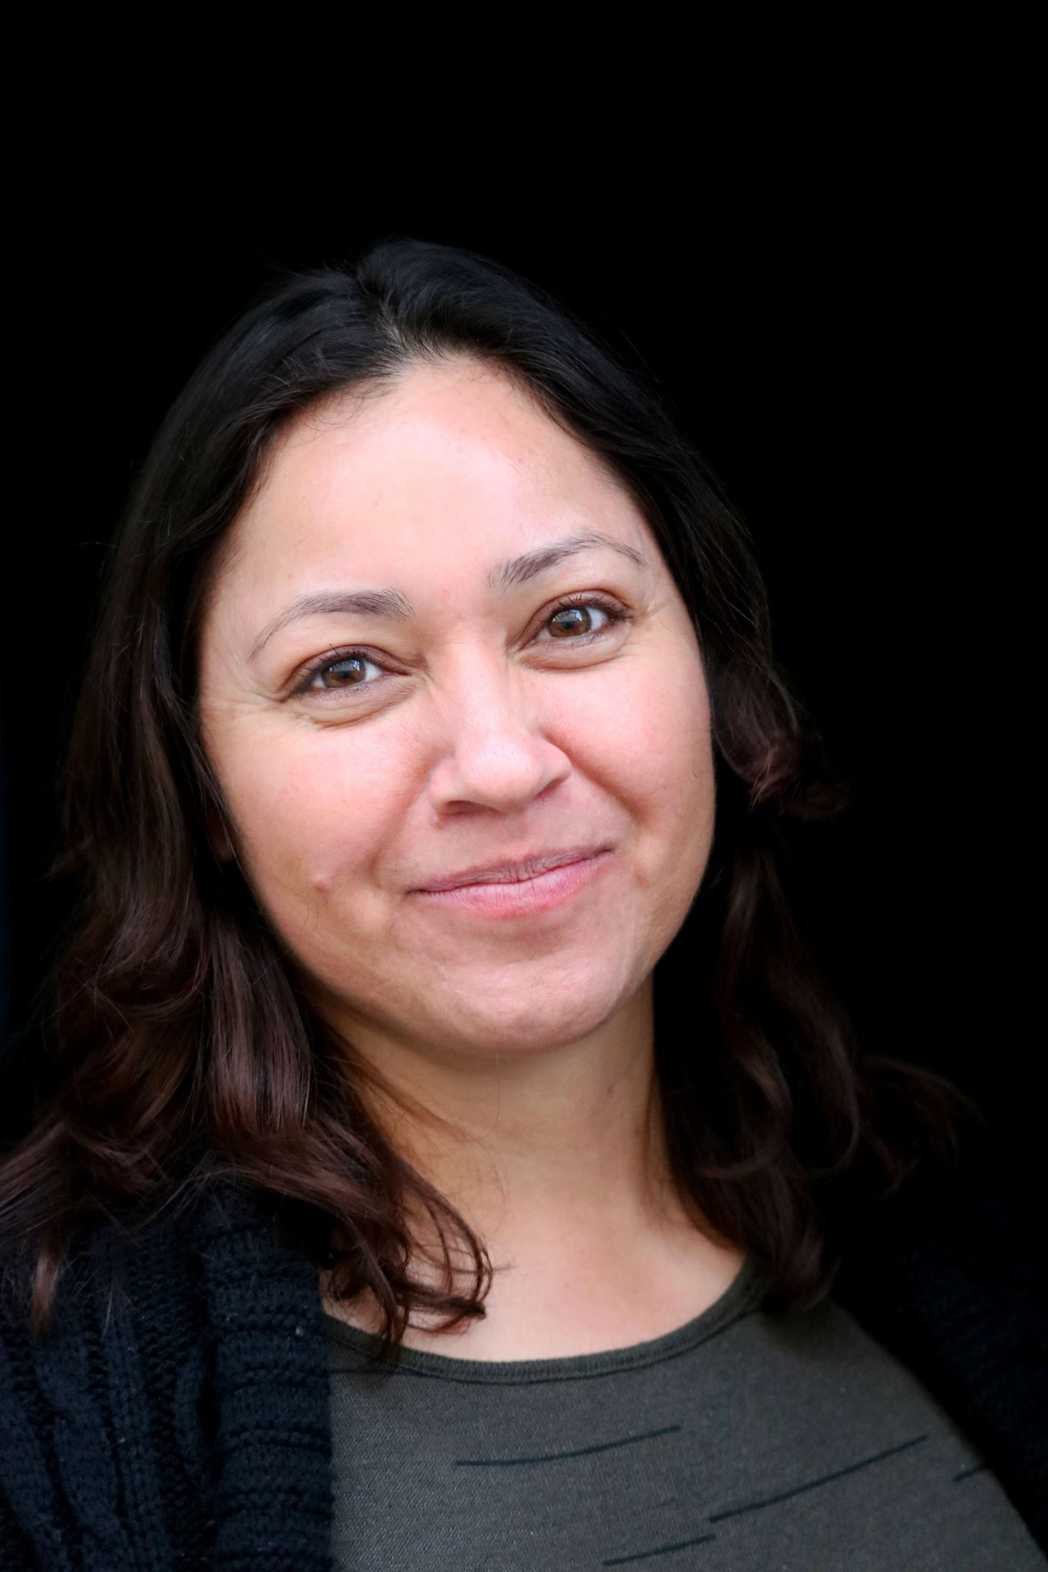
Example ideas for the “what” questions in your worksheet

Slide 13
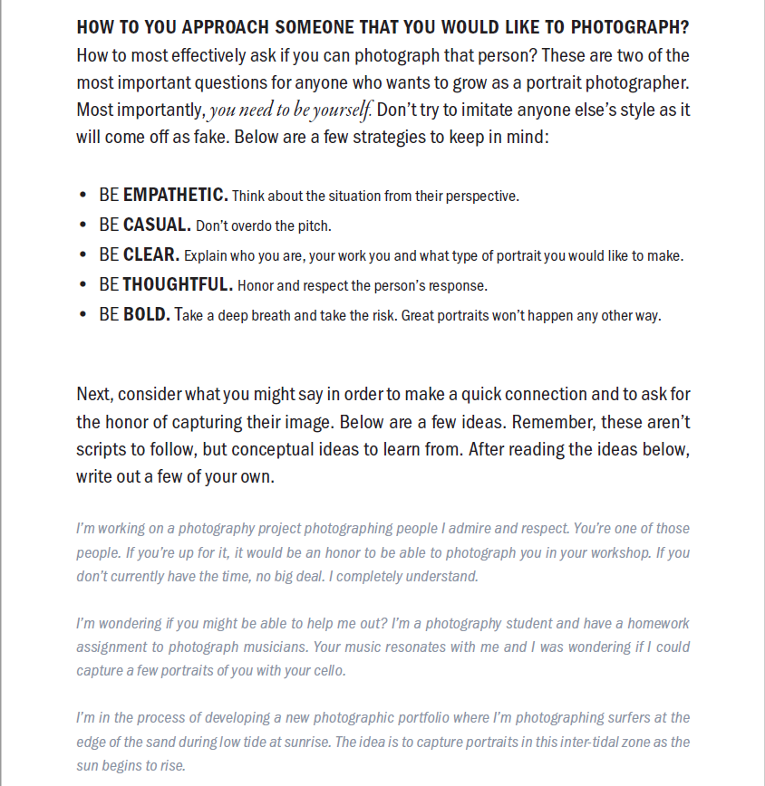
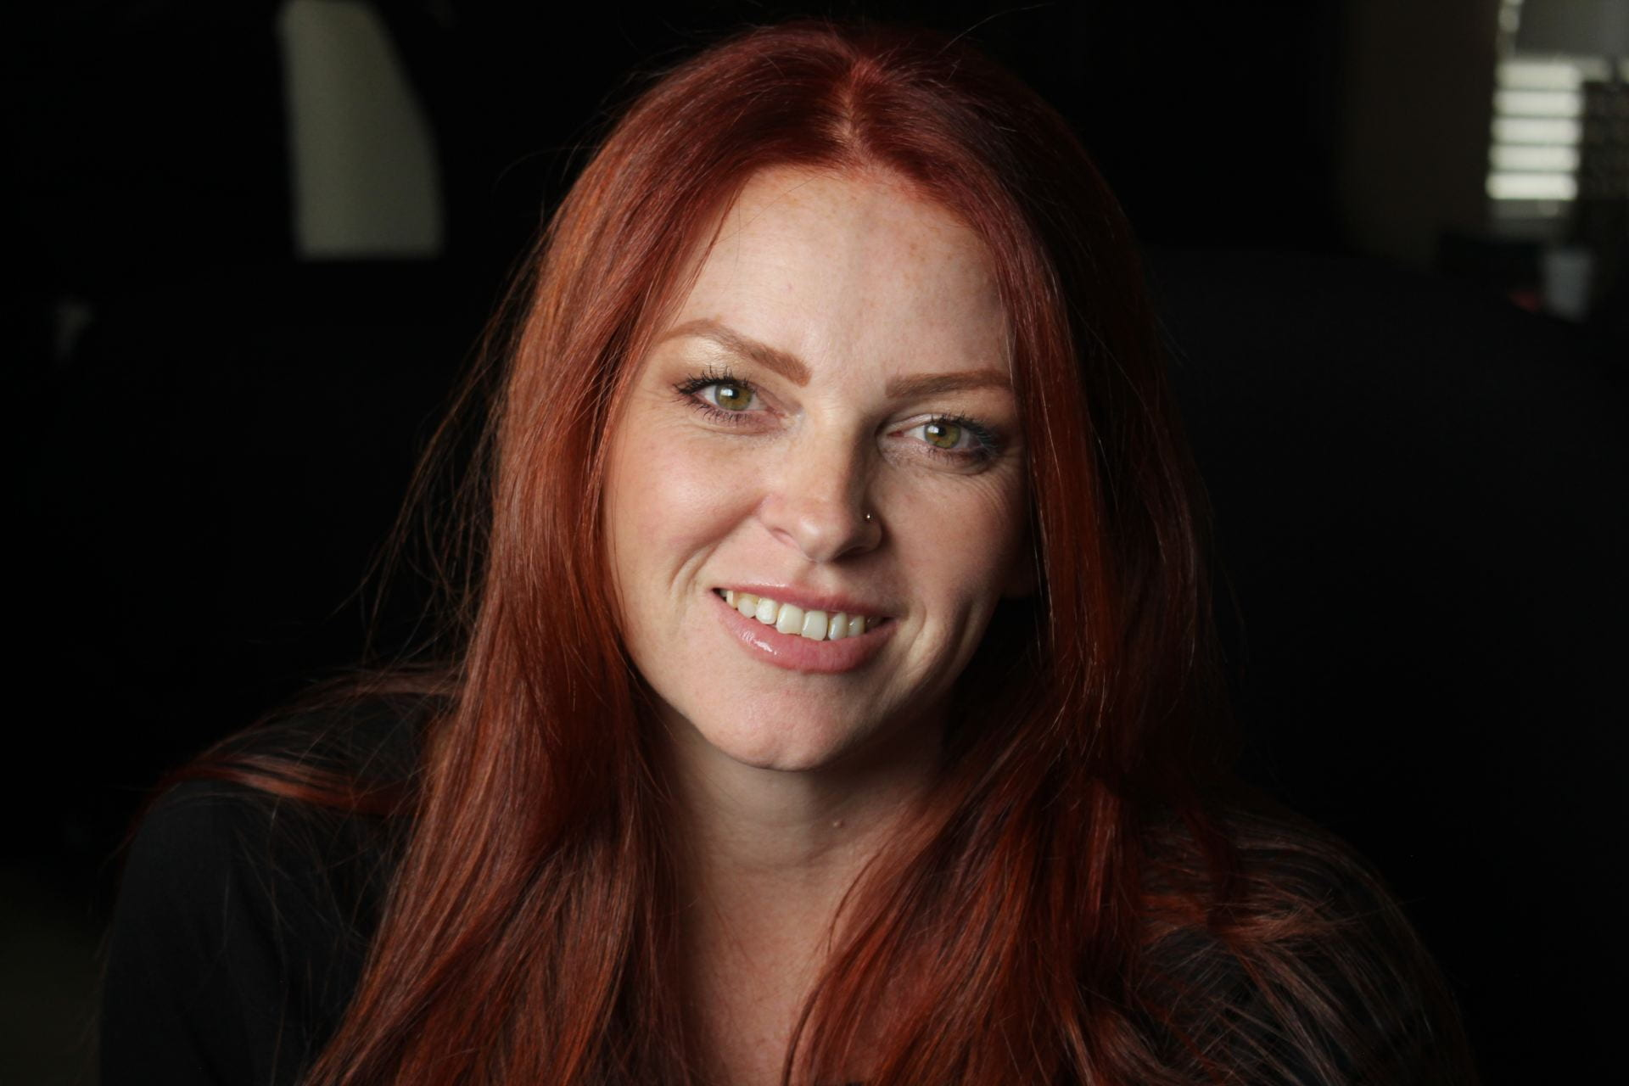
Approaching Subjects

Slide 14
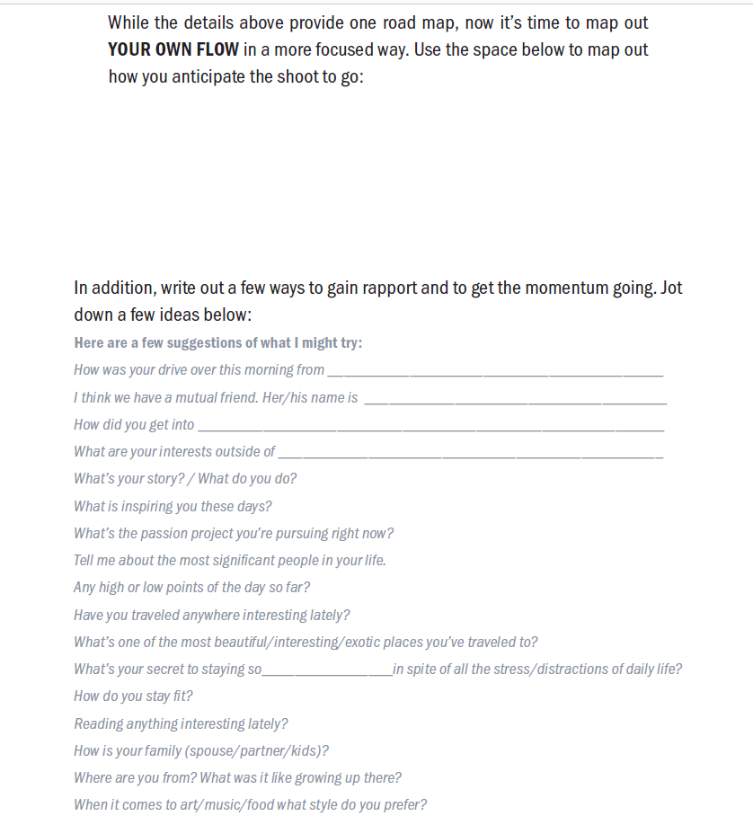
Map out your flow

Slide 15
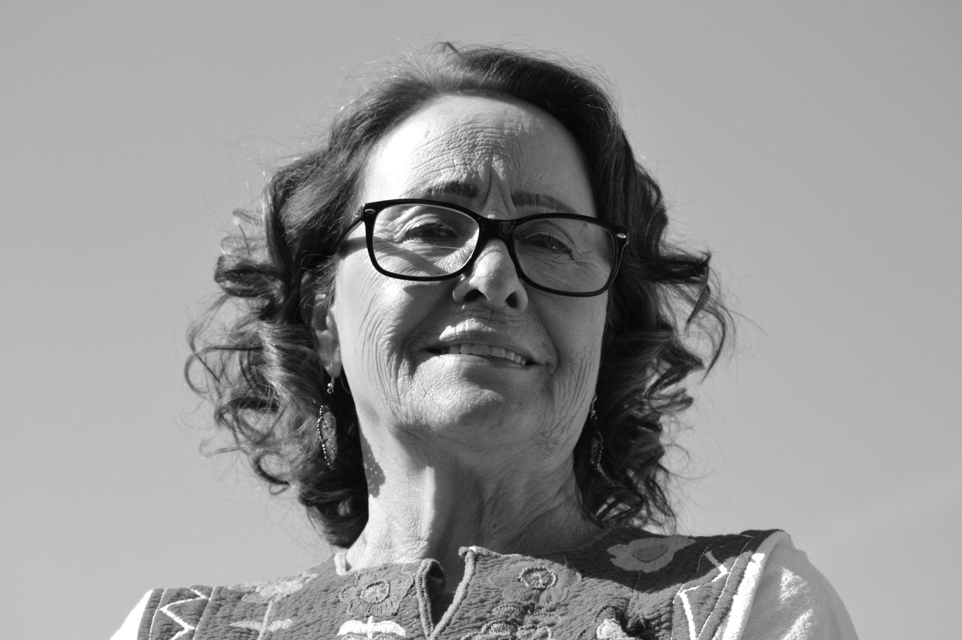
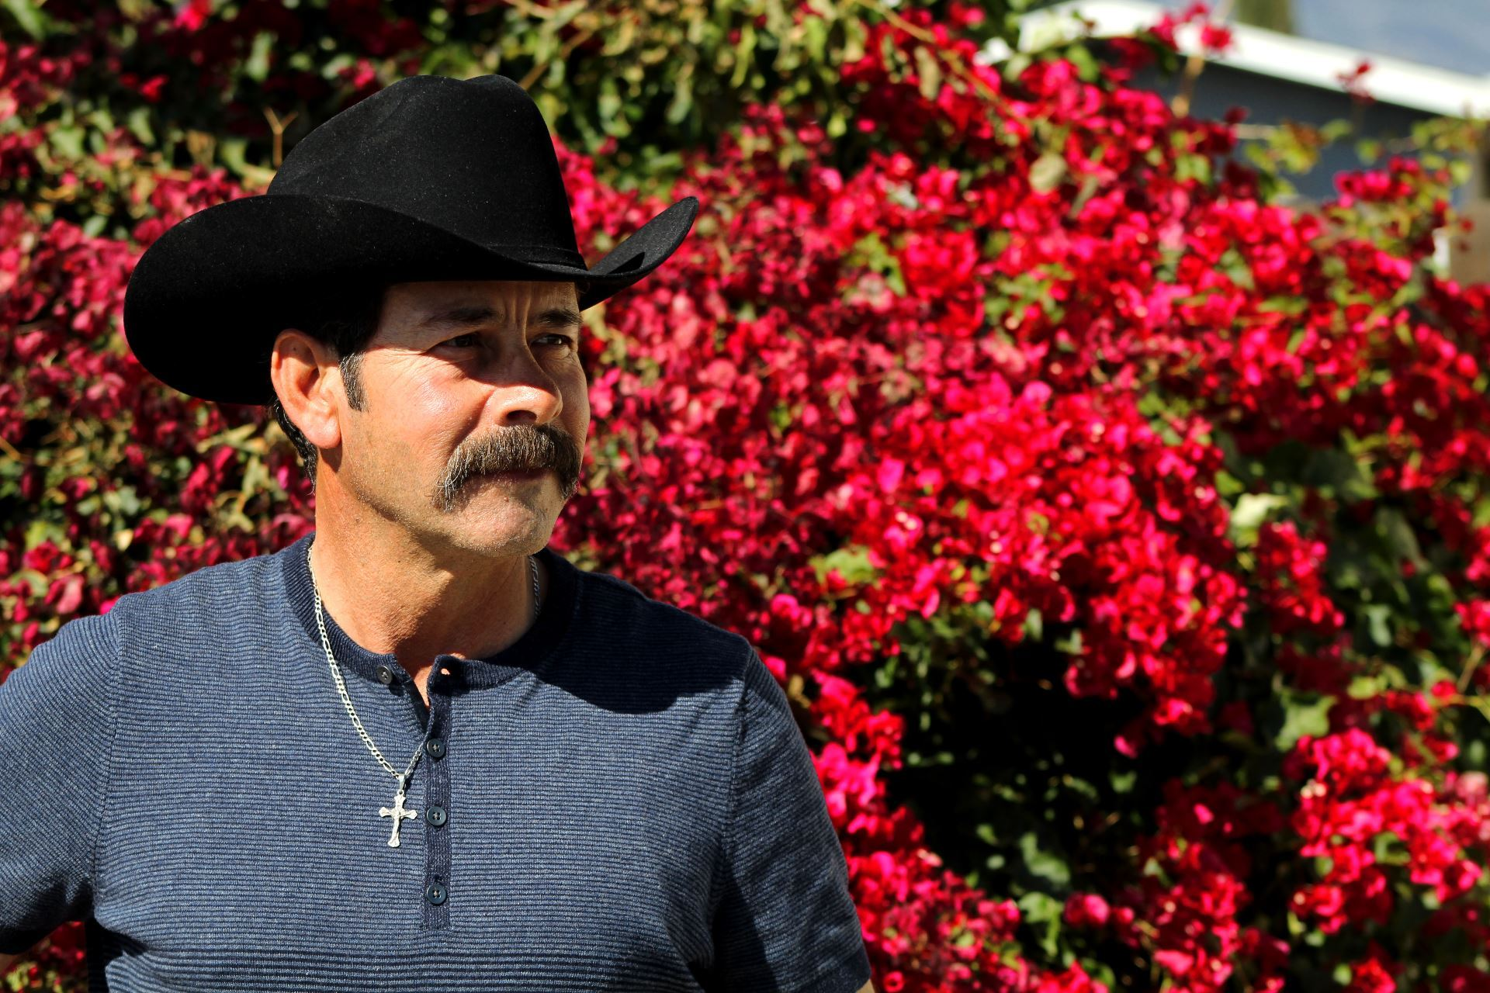
Gear/lenses

Slide 16
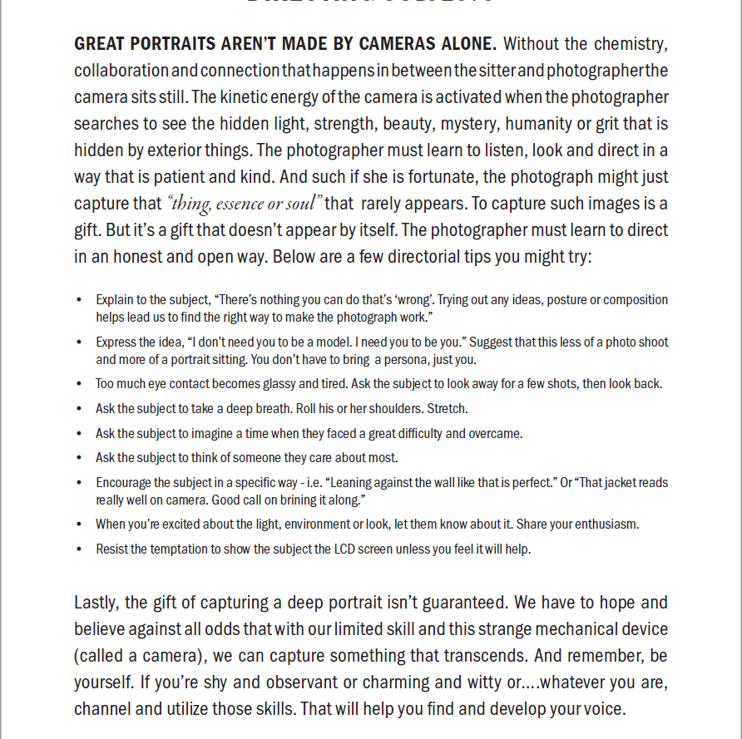
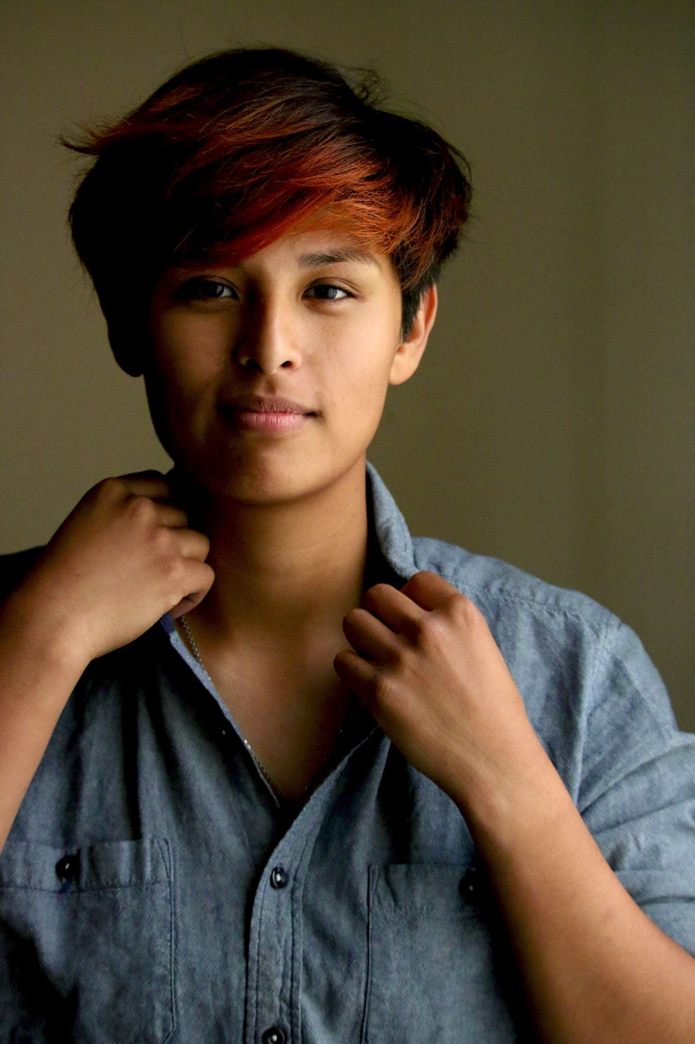
Directing subjects
Portrait Posing Made Simple w/ Chris Orwig

Slide 17
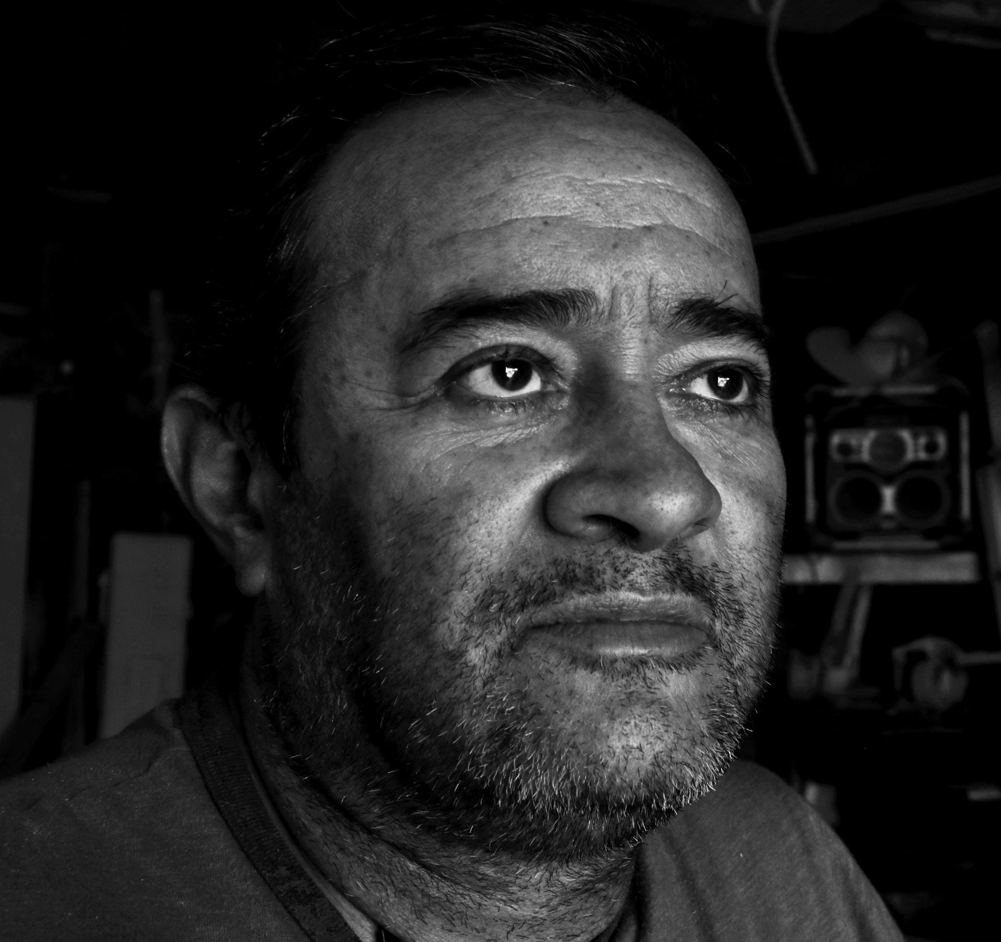
A little Inspiration…
“The best thing about a picture is that it never changes, even when the person in it does.” – Andy Warhol
“When I say I want to photograph someone, what it really means is that I’d like to know them. Anyone I know I photograph. It’s my way of understanding people.” – Annie Leibovitz
“Think about the photo before and after, never during. The secret is to take your time. You mustn’t go too fast. The subject must forget about you. That’s when you capture them at their most natural.” – Henri Cartier-Bresson

Slide 18
Project Criteria
3 Edited Portraits of Your Chosen Subject:
Headshot (shallow DOF)
Waist shot
Your choice:
”environmental portrait” (shows surroundings that can give us more insight into your subject)
in action (interacting with prop or surroundings)
or another head or waist shot.

Slide 19
Posting Instructions:
Create a new post titled, “Authentic Portrait of Significance: [first name of your subject]”.
Add the 3 edited portraits in one gallery w/ the following gallery settings: one column, medium size, link to media file. Include the camera settings in the captions of the 3 edited portraits!
Two paragraphs telling us about this person and why you chose them.
One paragraph sharing what the portrait sitting experience was like.
Add a second gallery with ALL the unedited photos you took during the portrait sitting. Settings: 4 columns, thumbnail size, link to media file. No captions.
Please take the time to check your writing for clarity, grammar, and spelling. ☺

