Slide 1
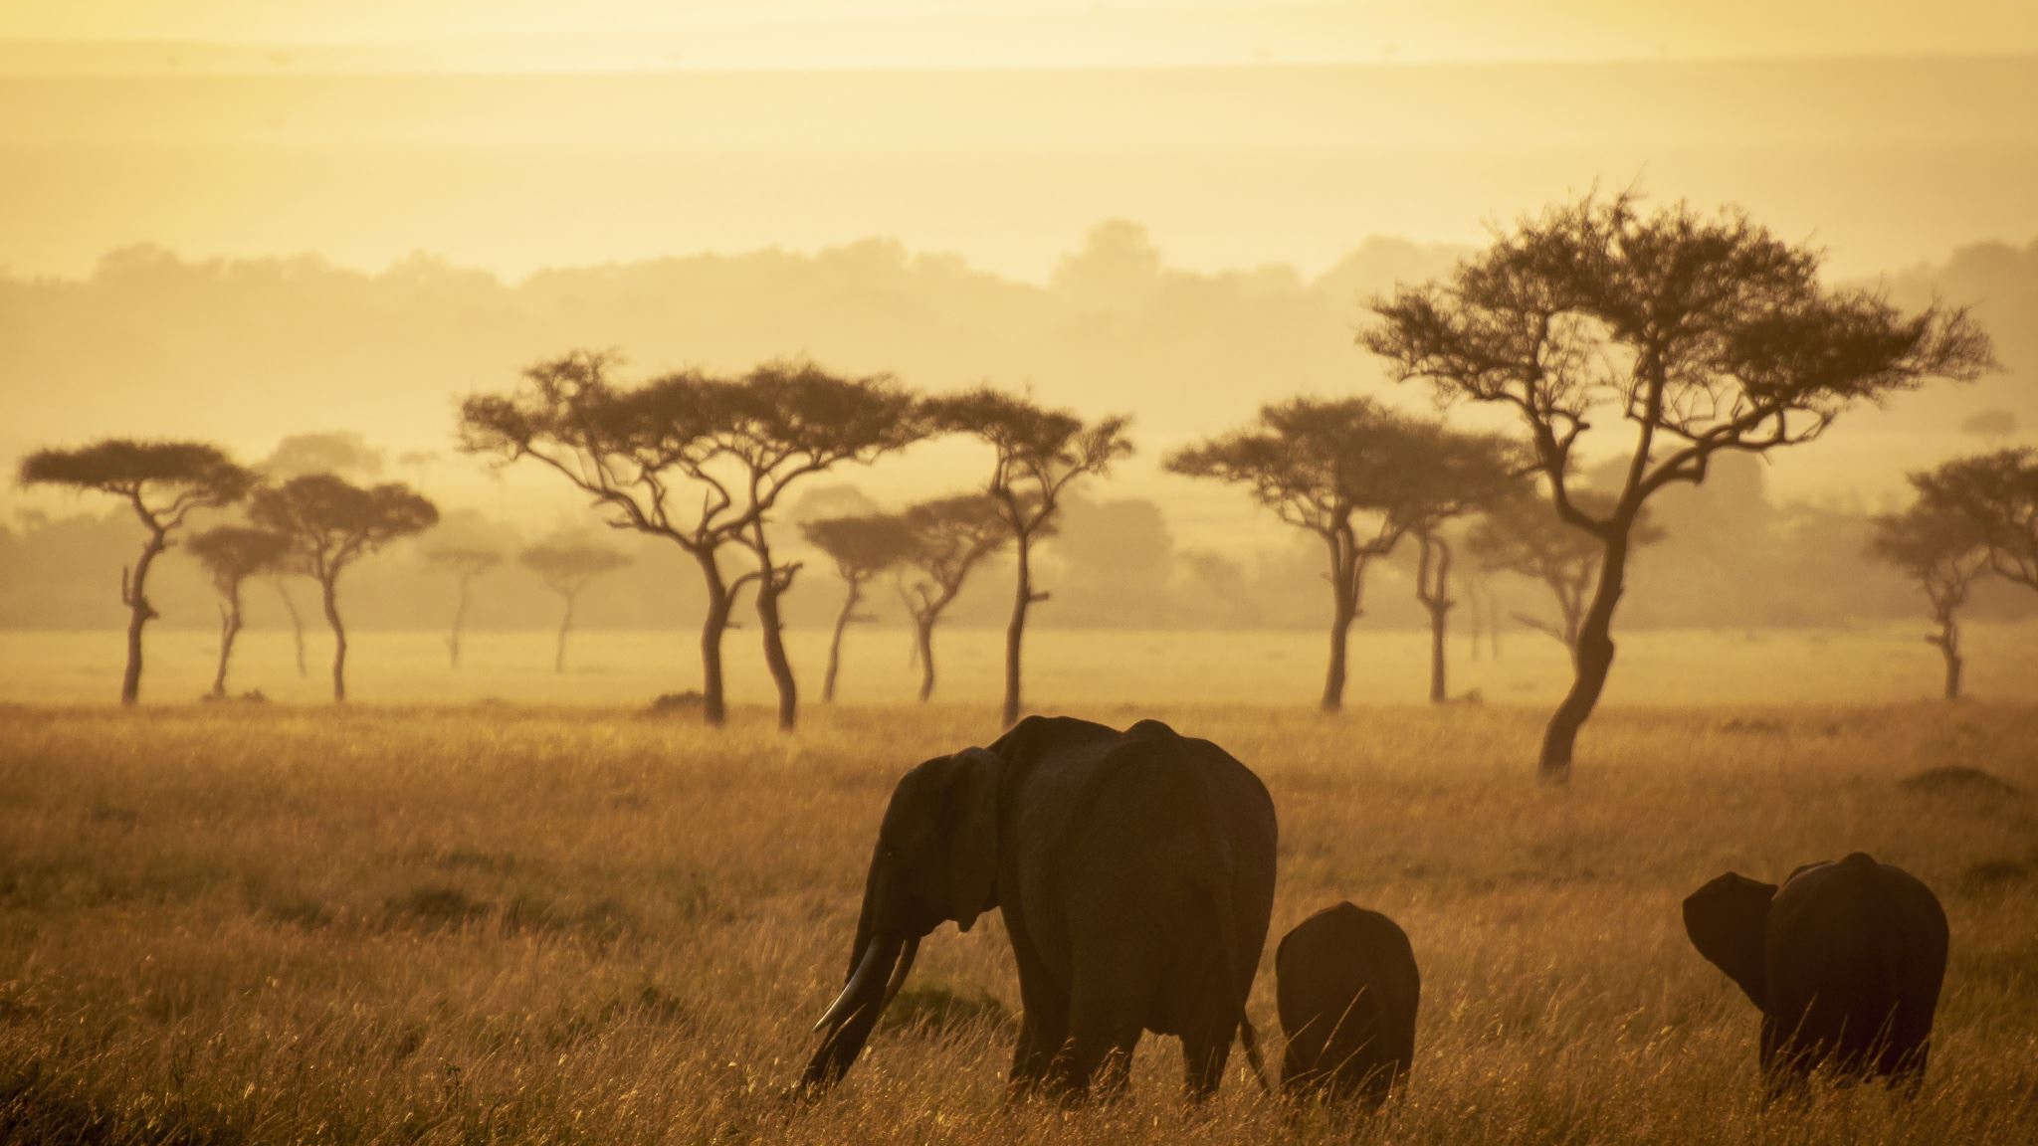
PHOTO SAFARI
Verbal and Visual

Slide 2
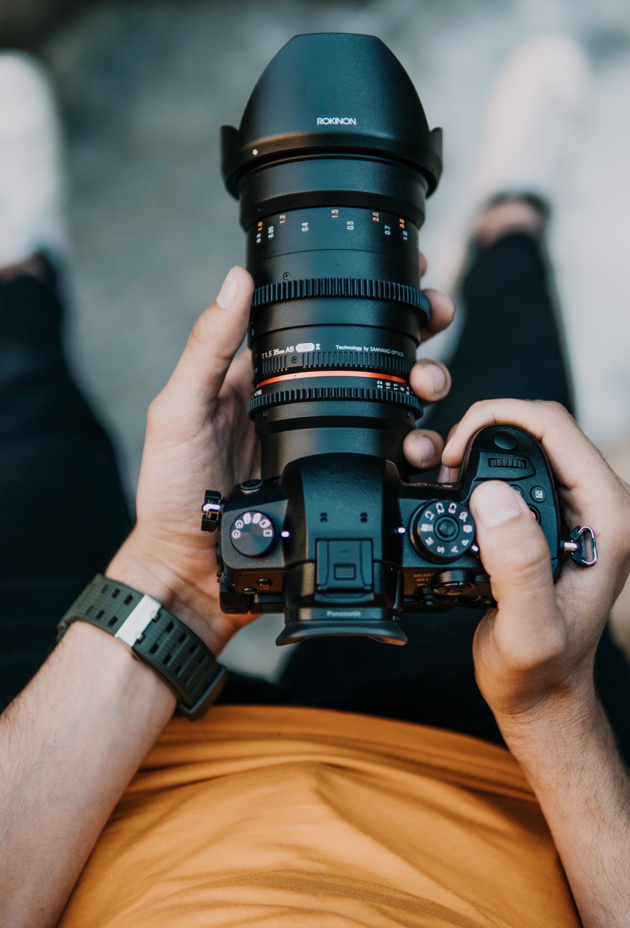
A Photo Safari…
Going on the “hunt” for specific imagery.
  No words should be hurt in the process of photographing.
You will be hunting an adjective of your choice.
Thing of an adjective that inspires “poetic imagery.” For example:
  Adamant: unyielding; a very hard substance
  Pervasive: widespread, expanding throughout something
  Turbulent: restless, conflict, disorder, or confusion
  Zealous: eager, devoted

Slide 3
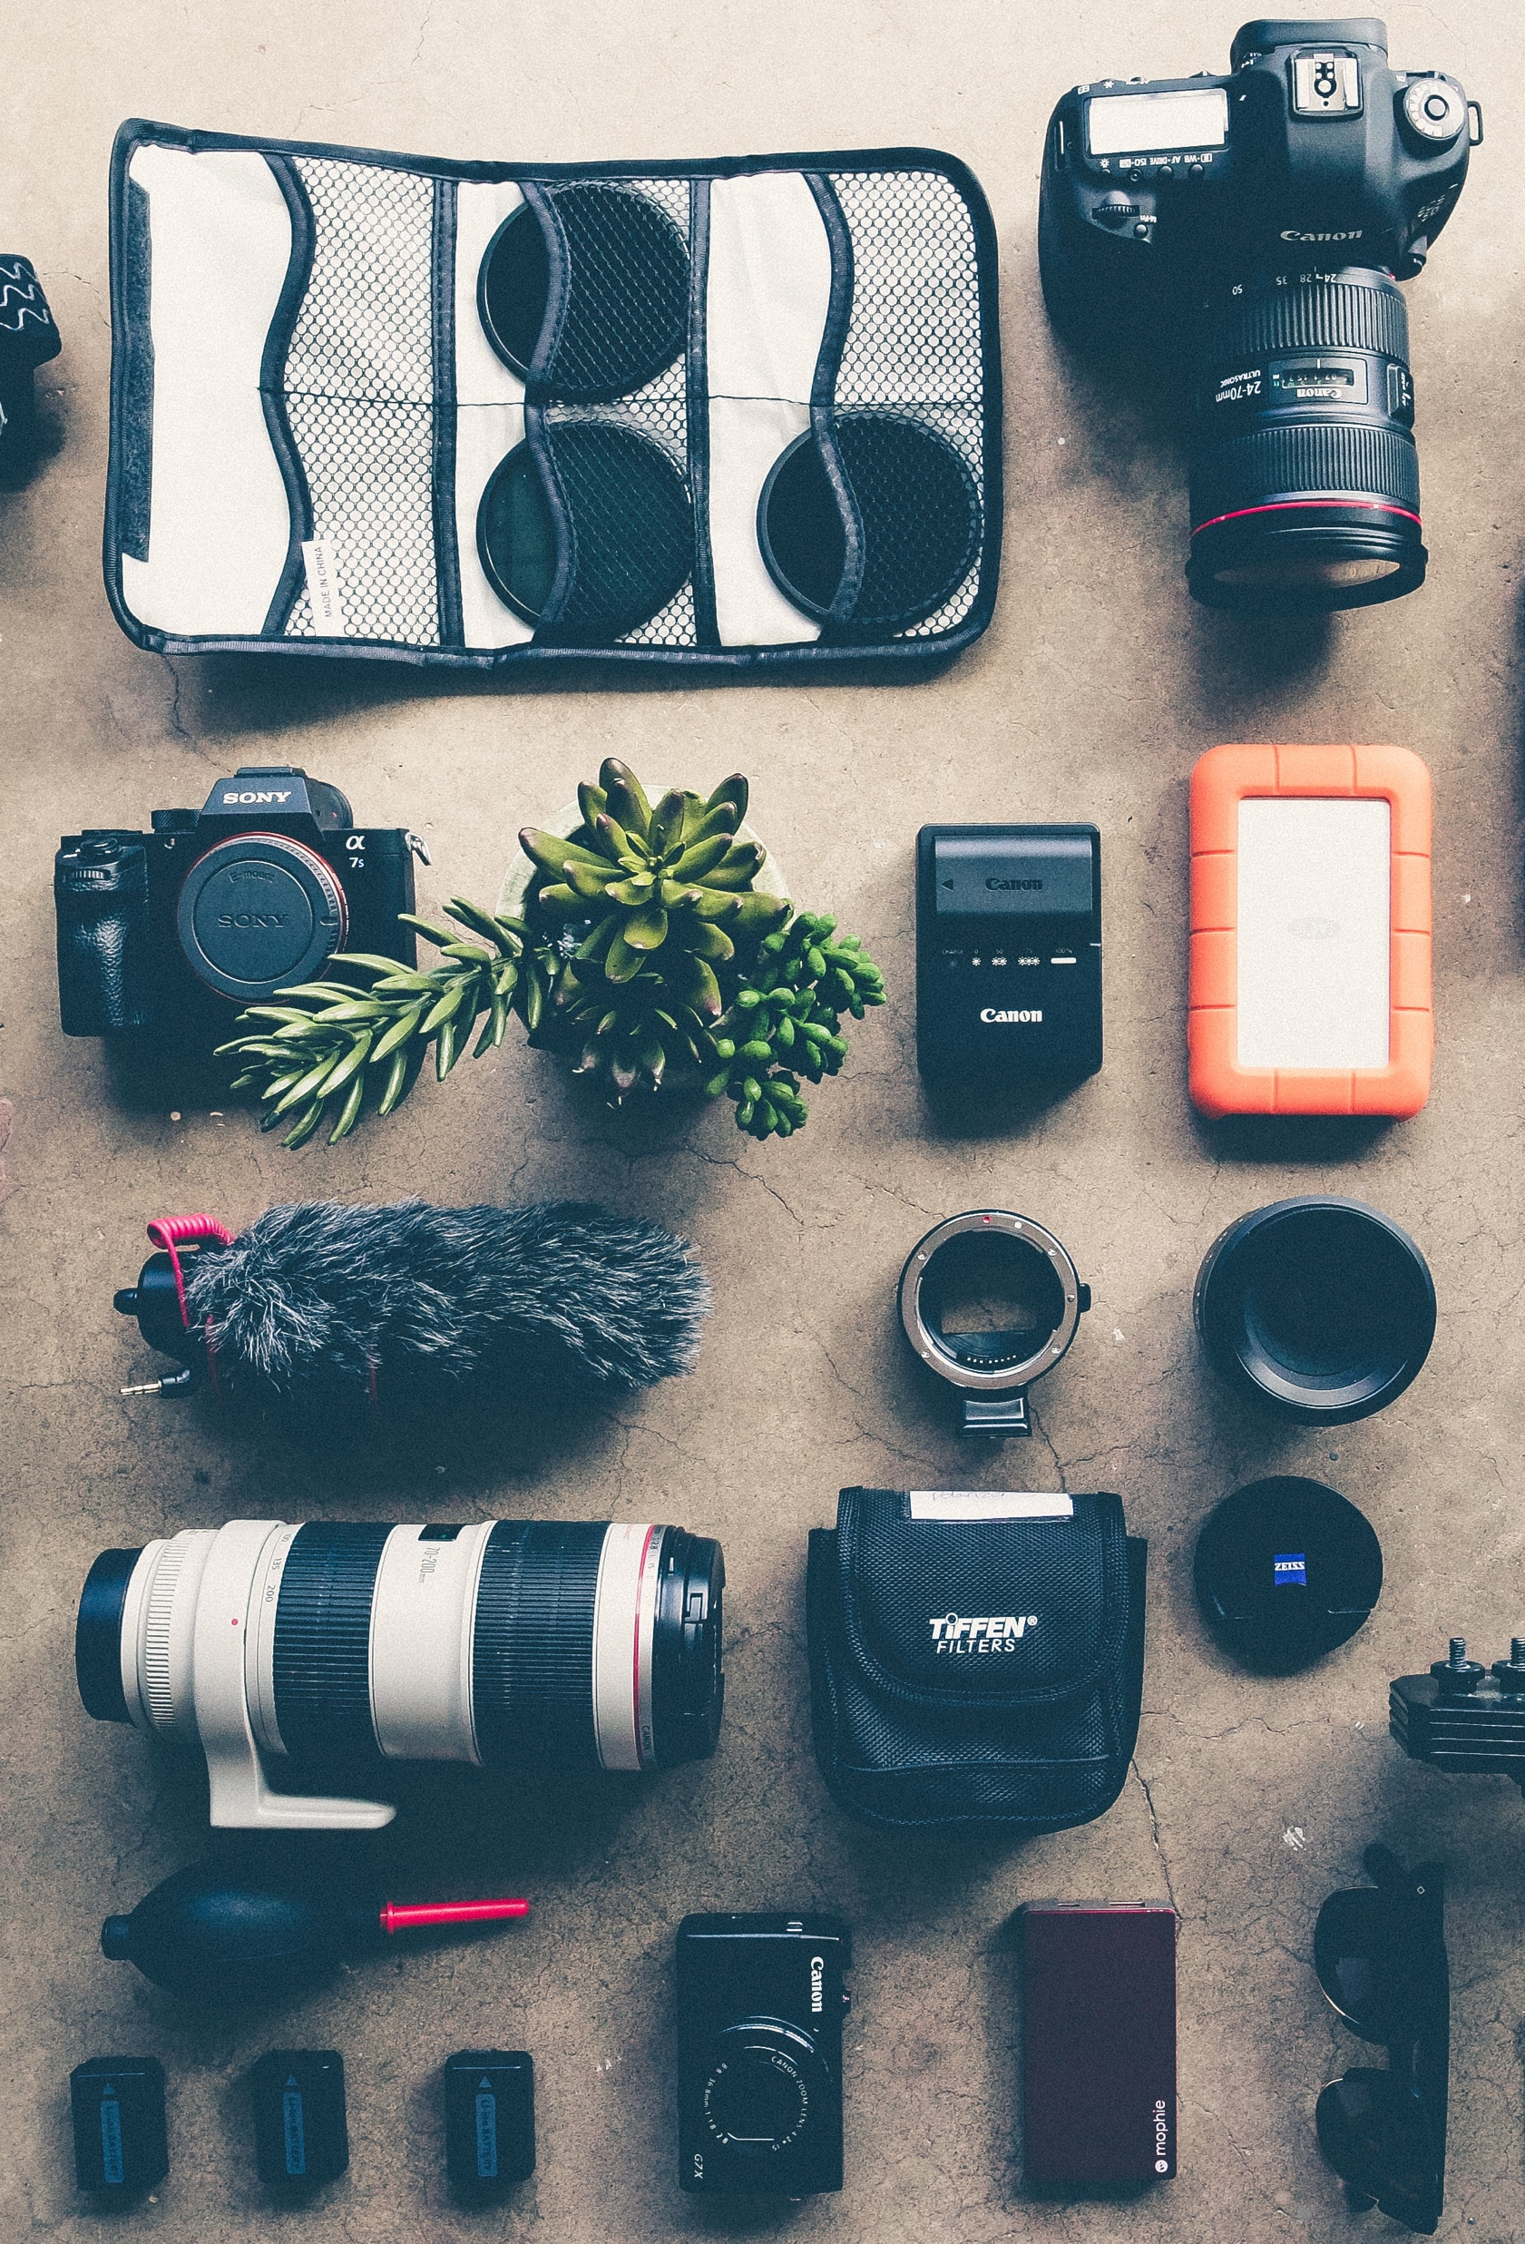
Look at the following photographs…
Try to guess which of the following adjectives reflect the photographs:
  Adamant: unyielding; a very hard substance
  Pervasive: widespread, expanding throughout something
  Turbulent: restless, conflict, disorder, or confusion
  Zealous: eager, devoted

Slide 4
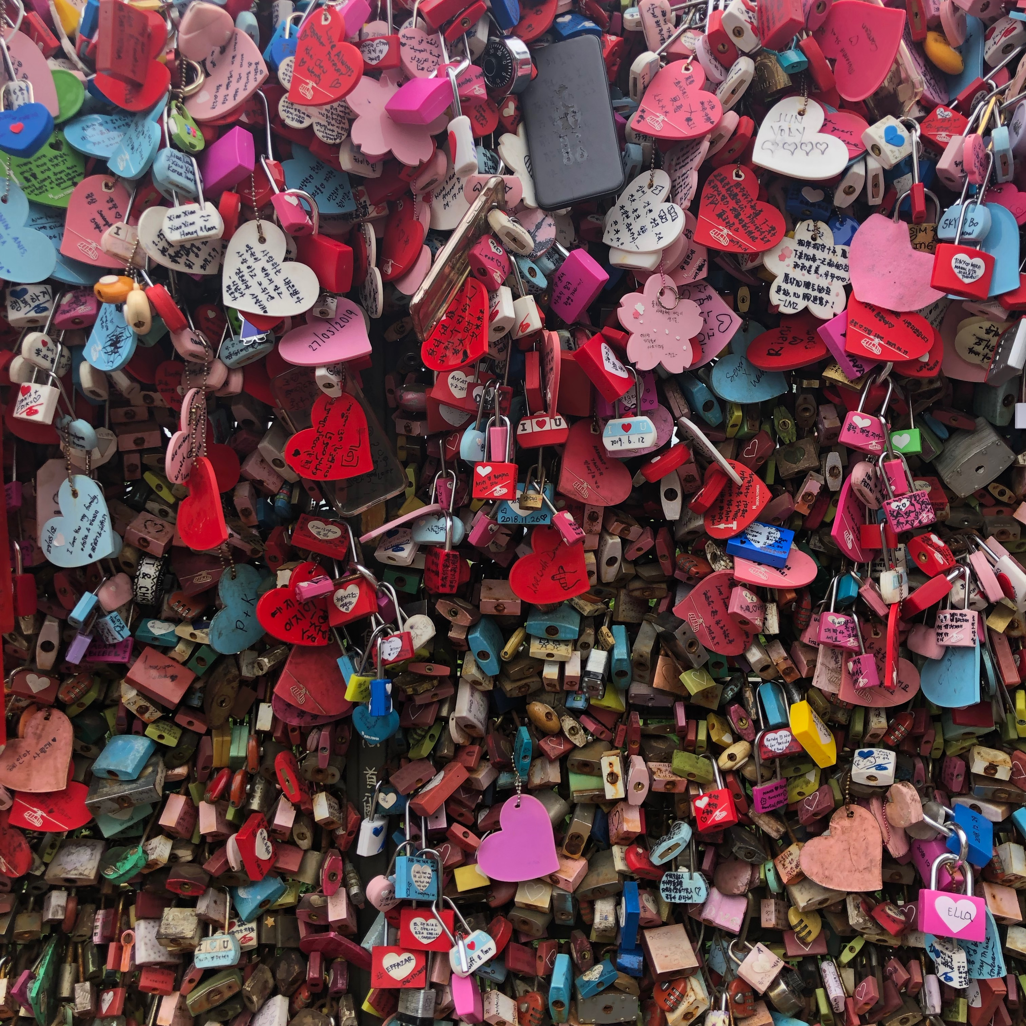

Slide 5
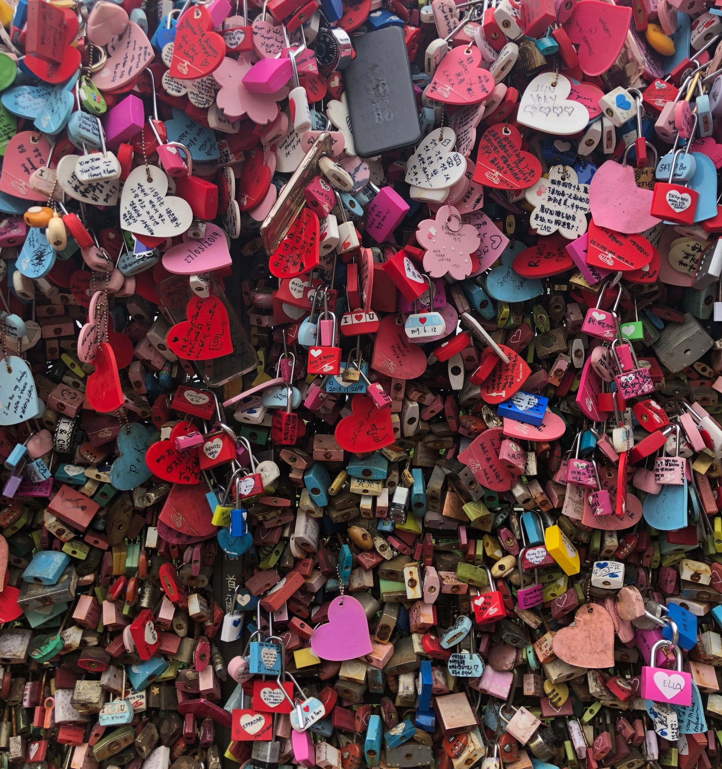
Pervasive

Slide 6
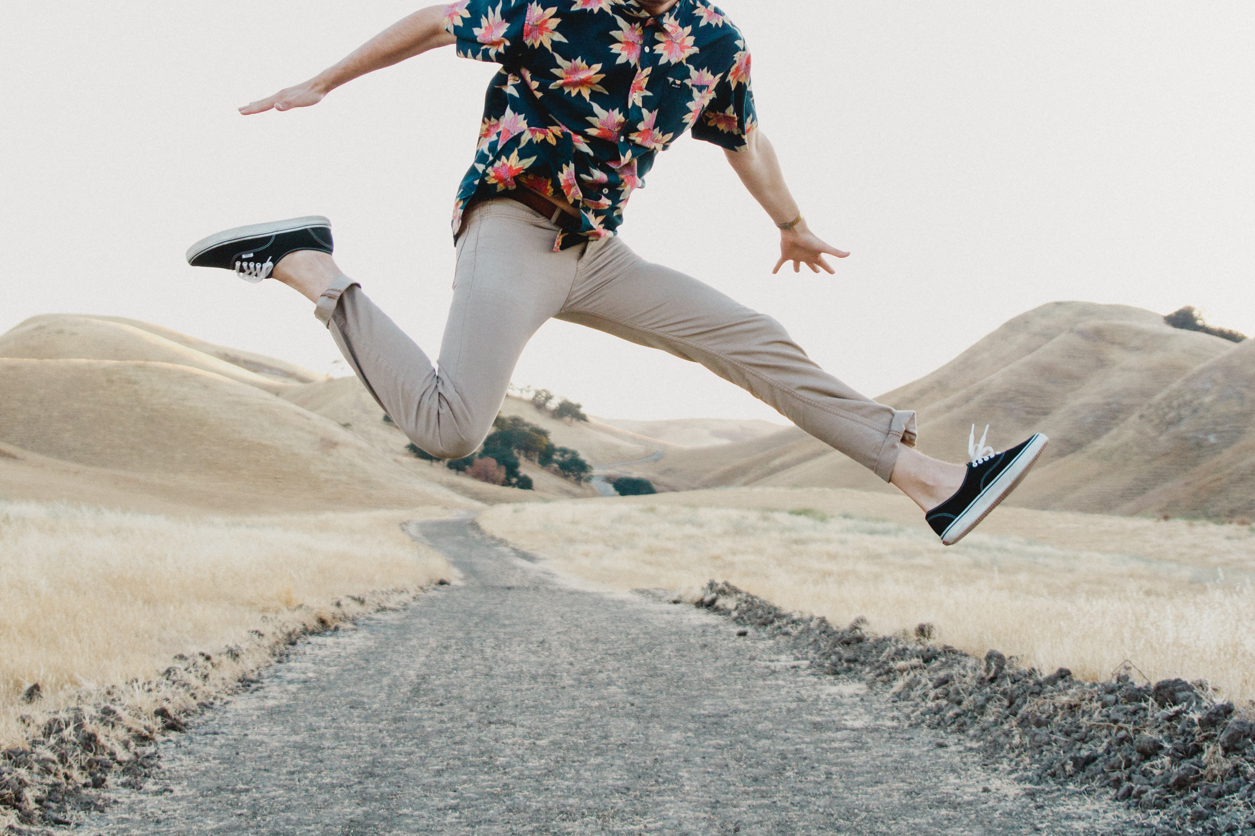

Slide 7
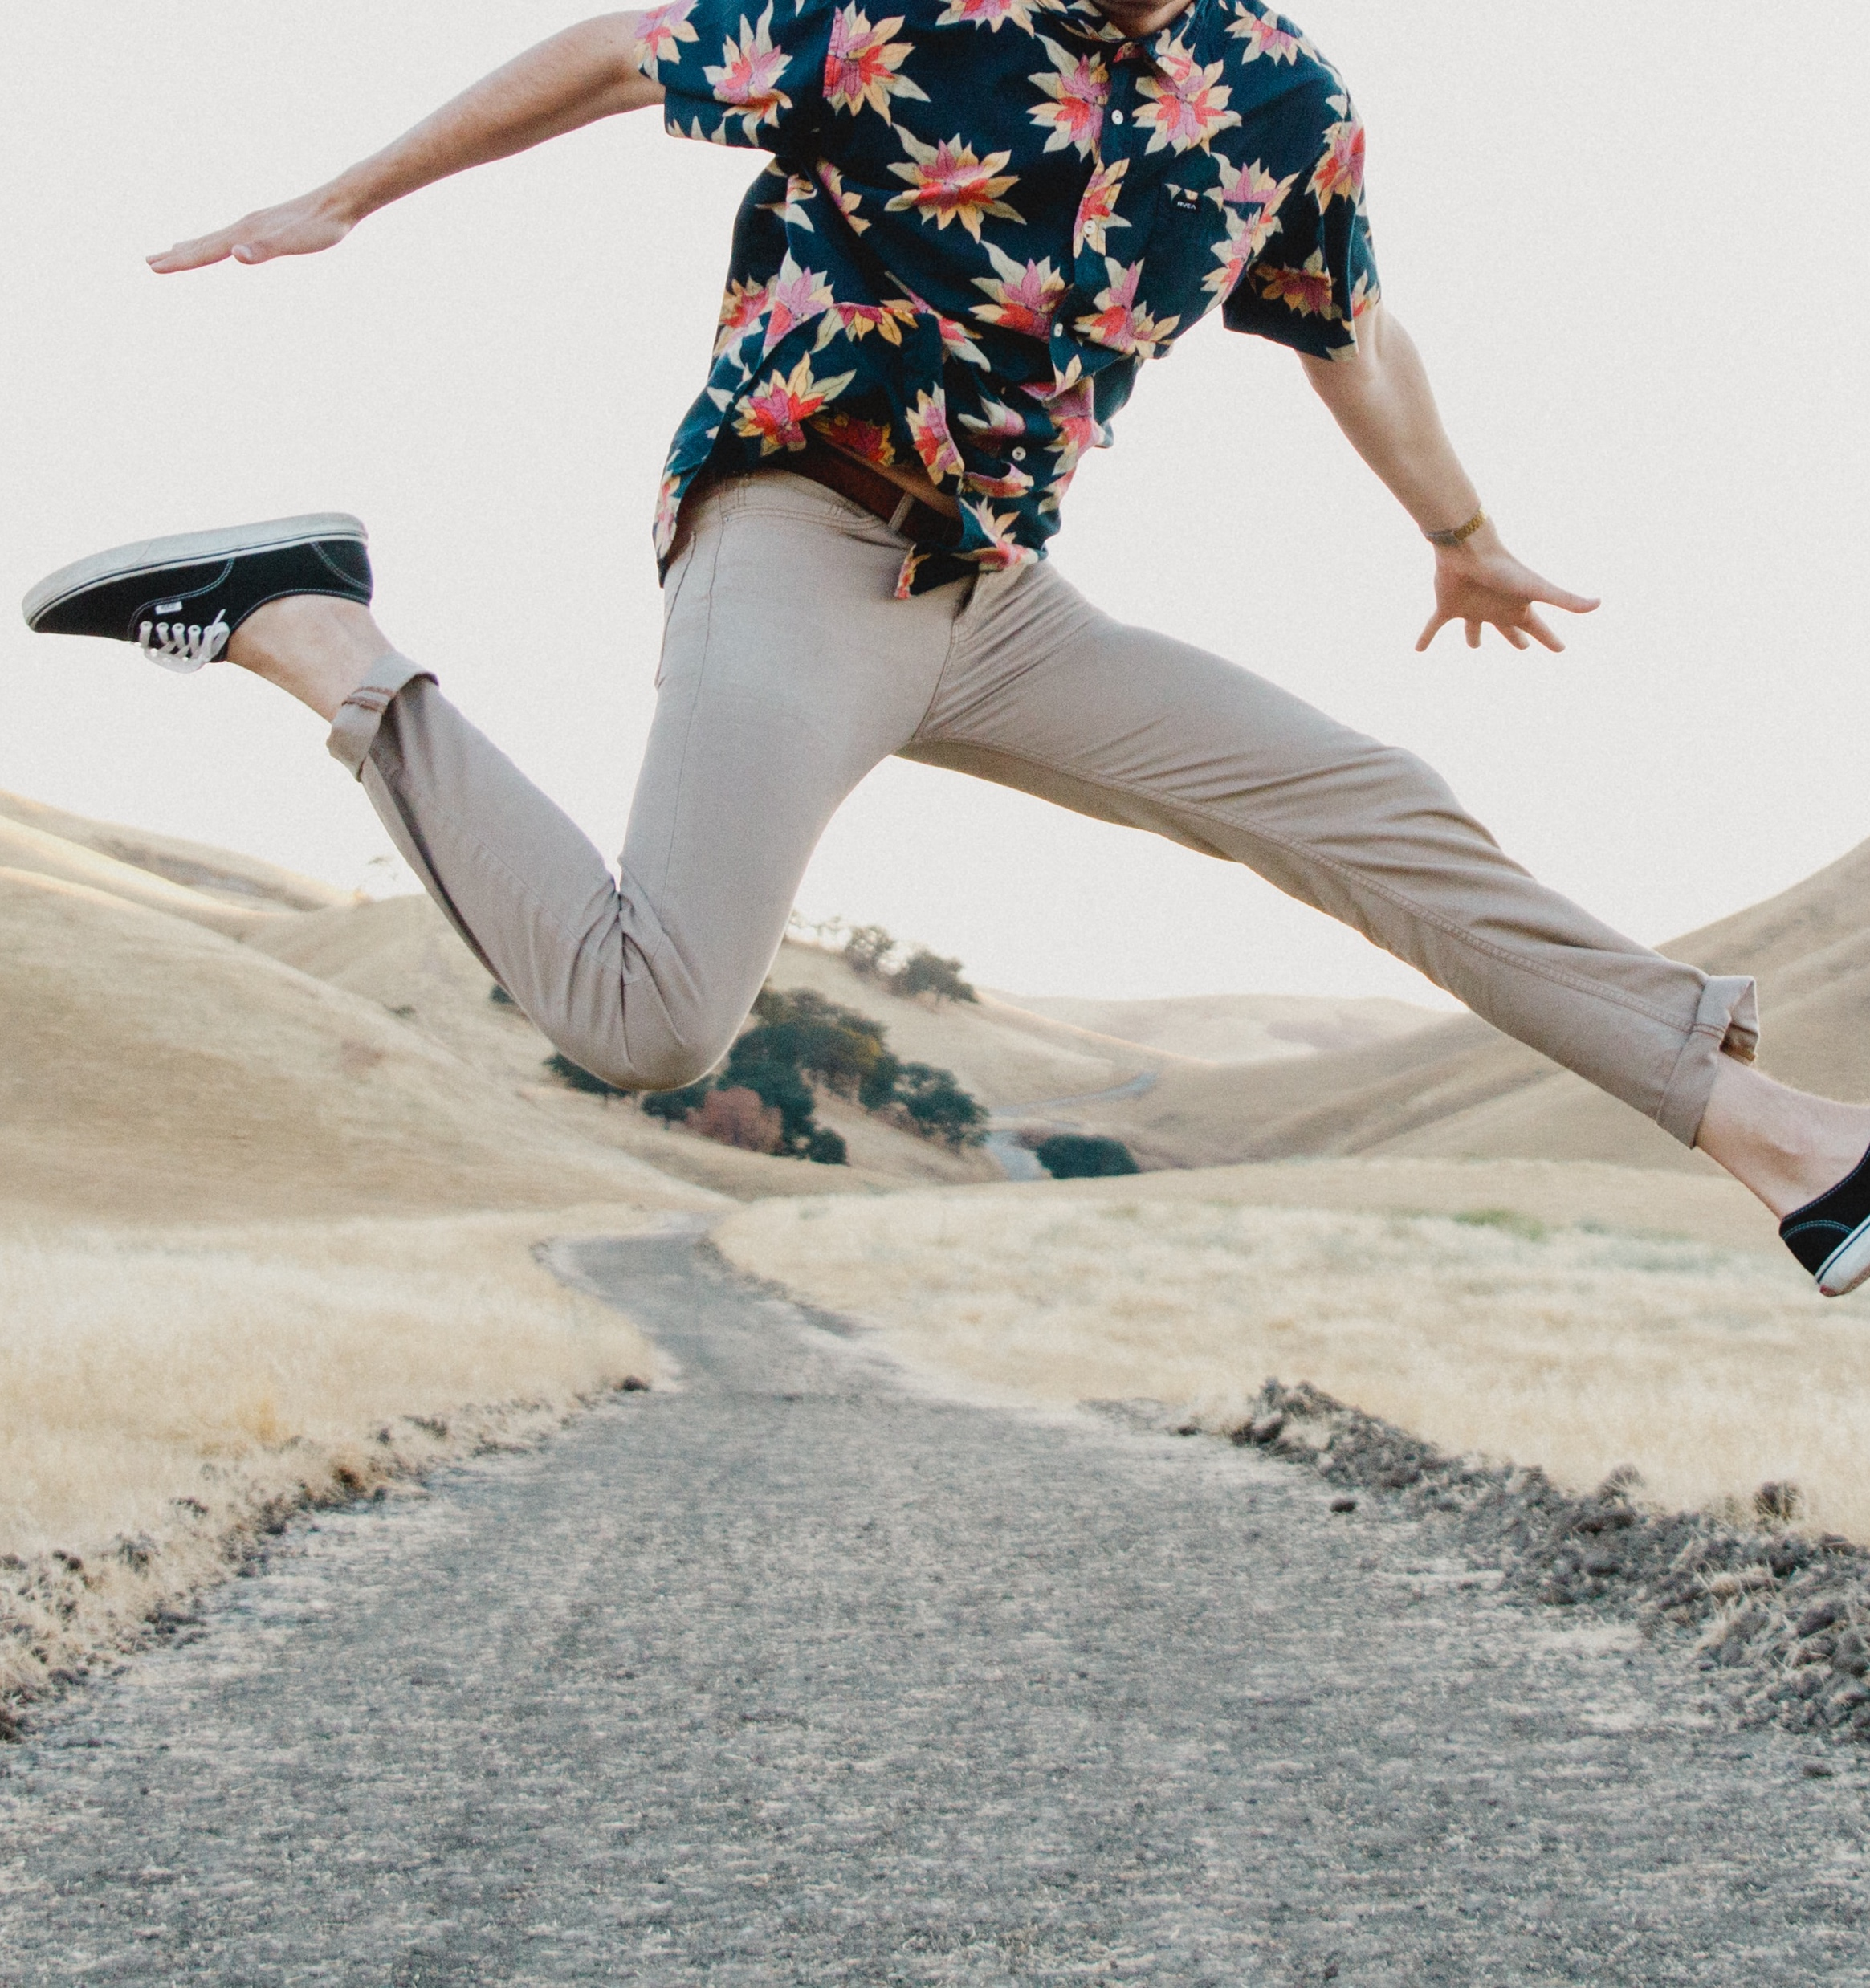
Zealous

Slide 8
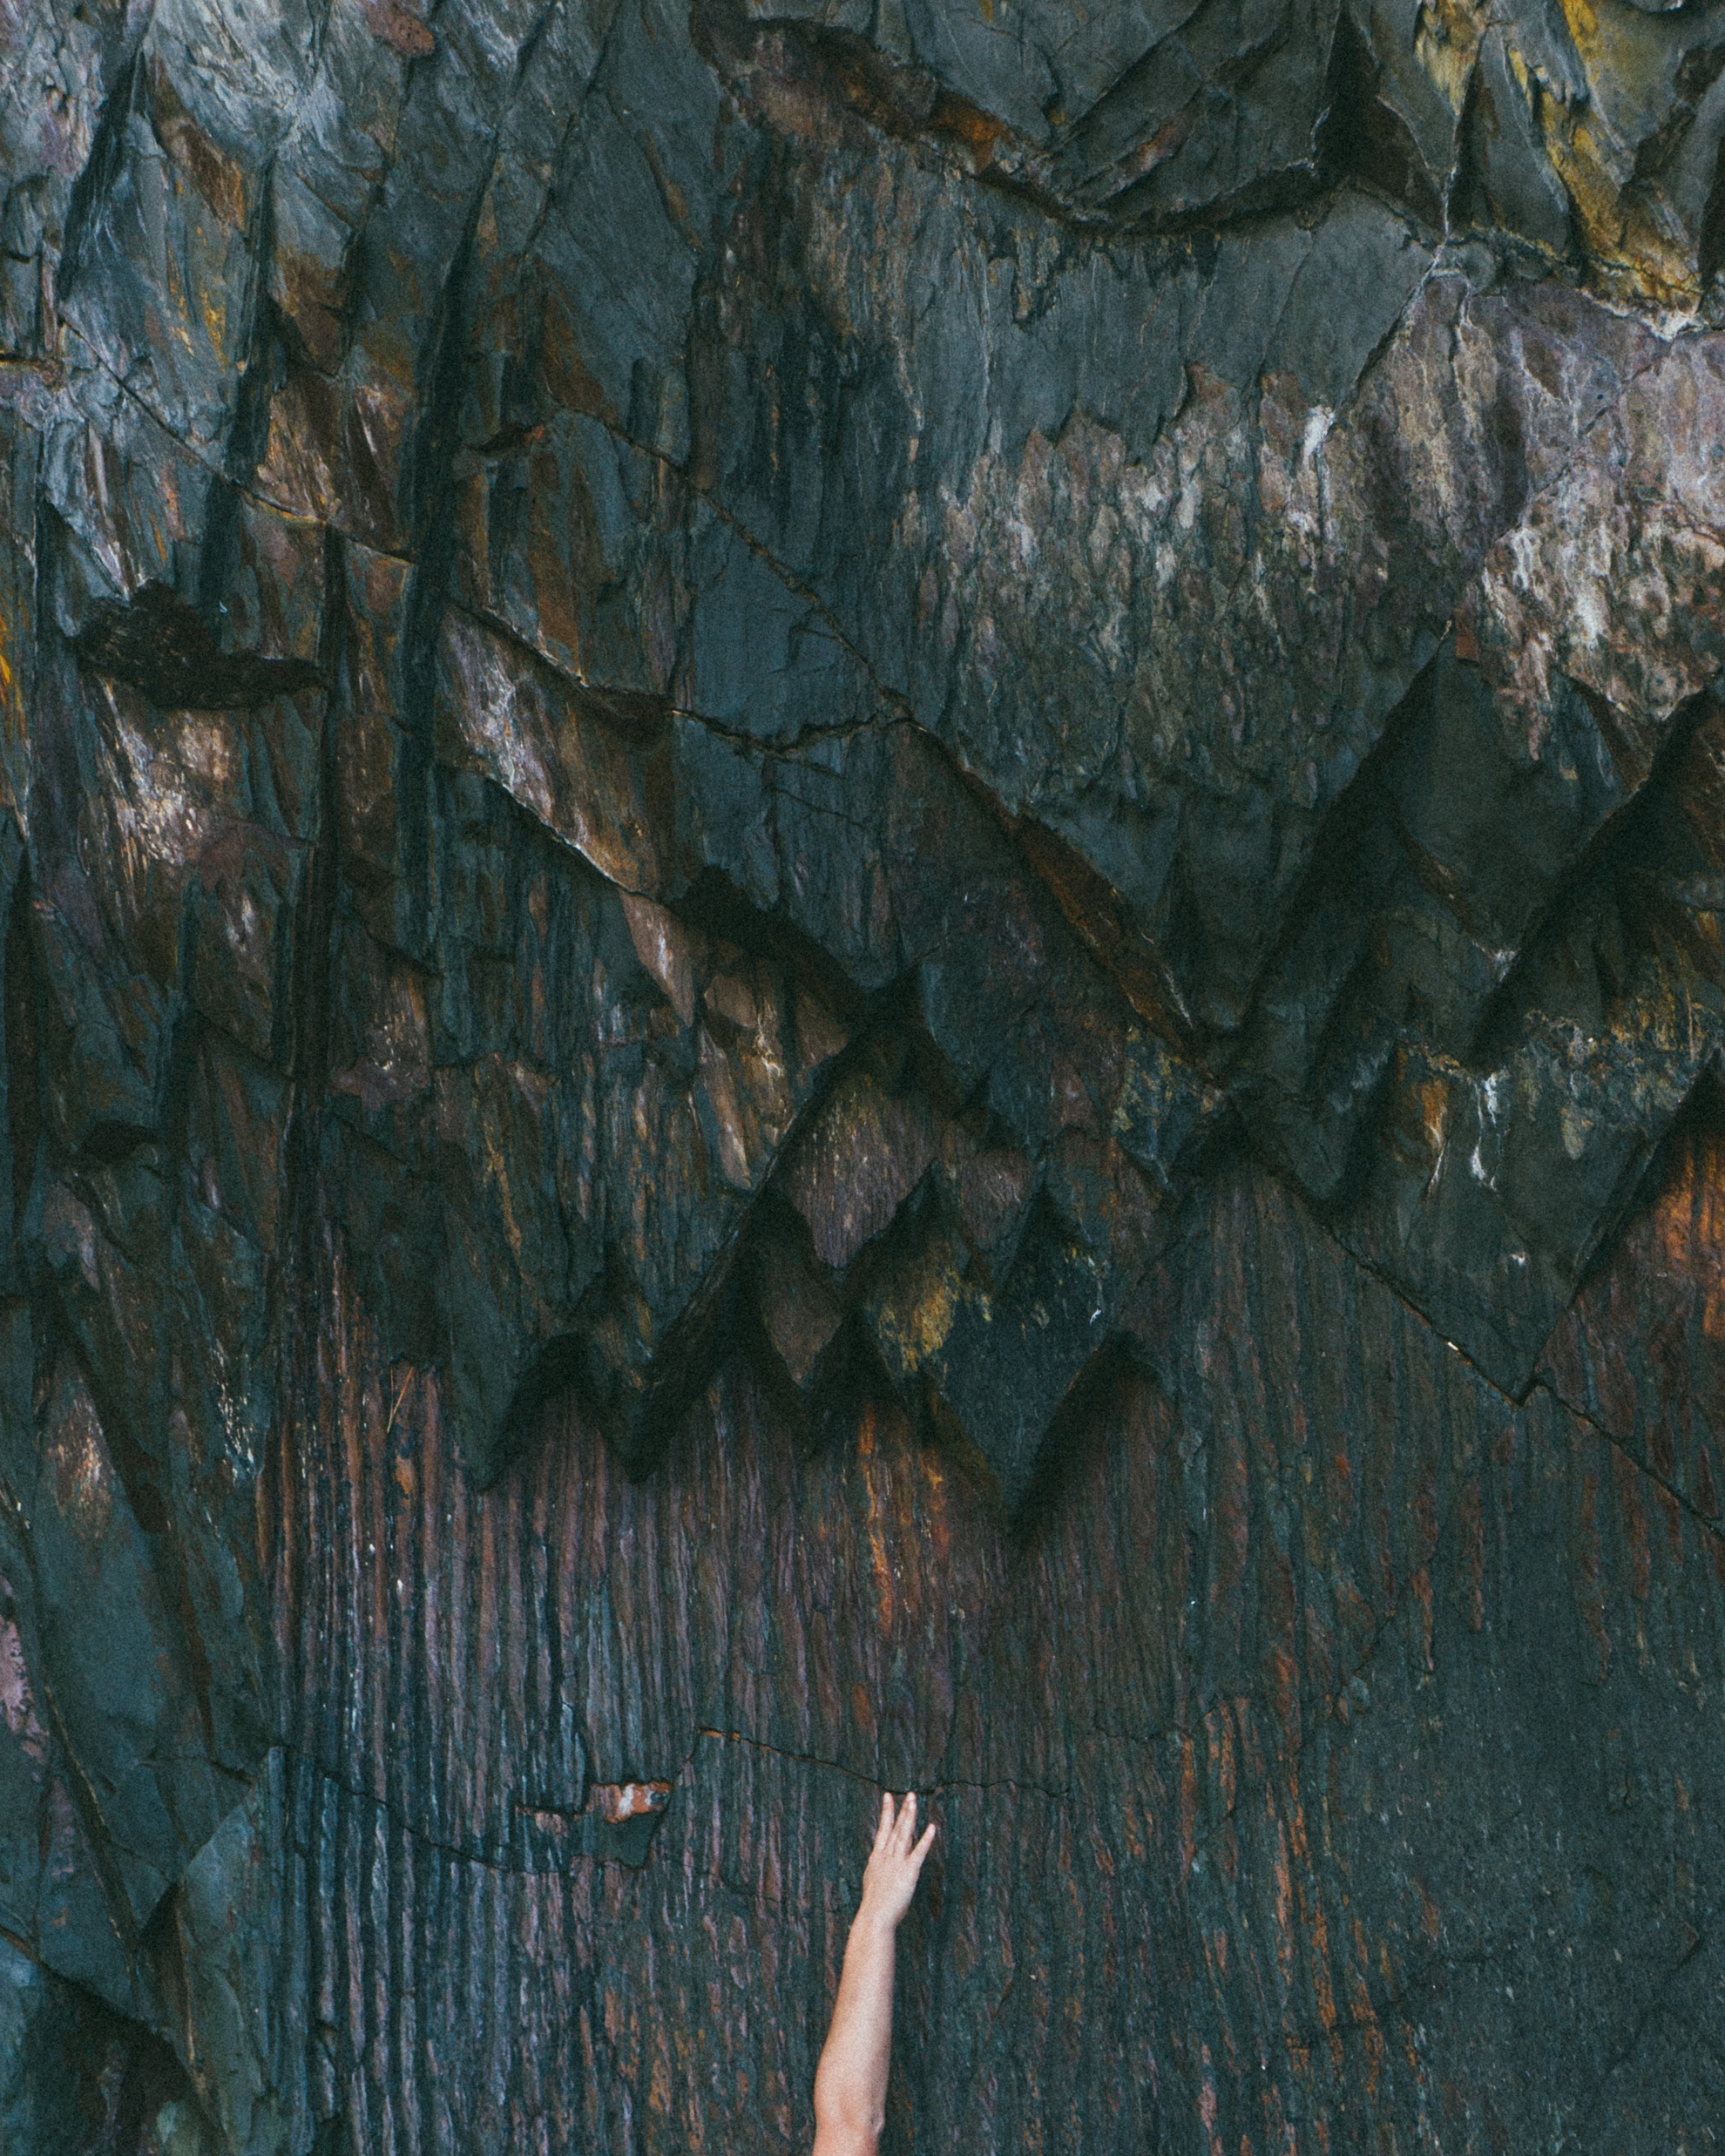

Slide 9
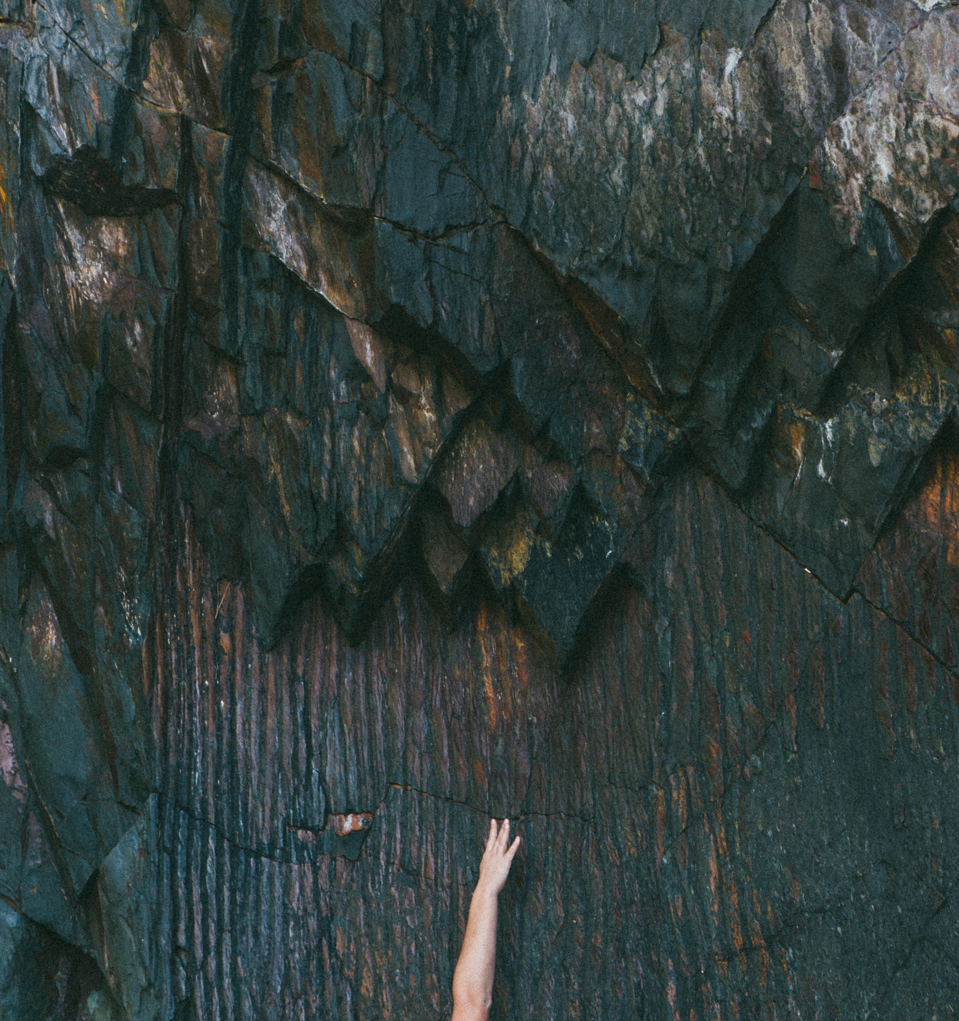
Adamant

Slide 10


Slide 11

Turbulent

Slide 12
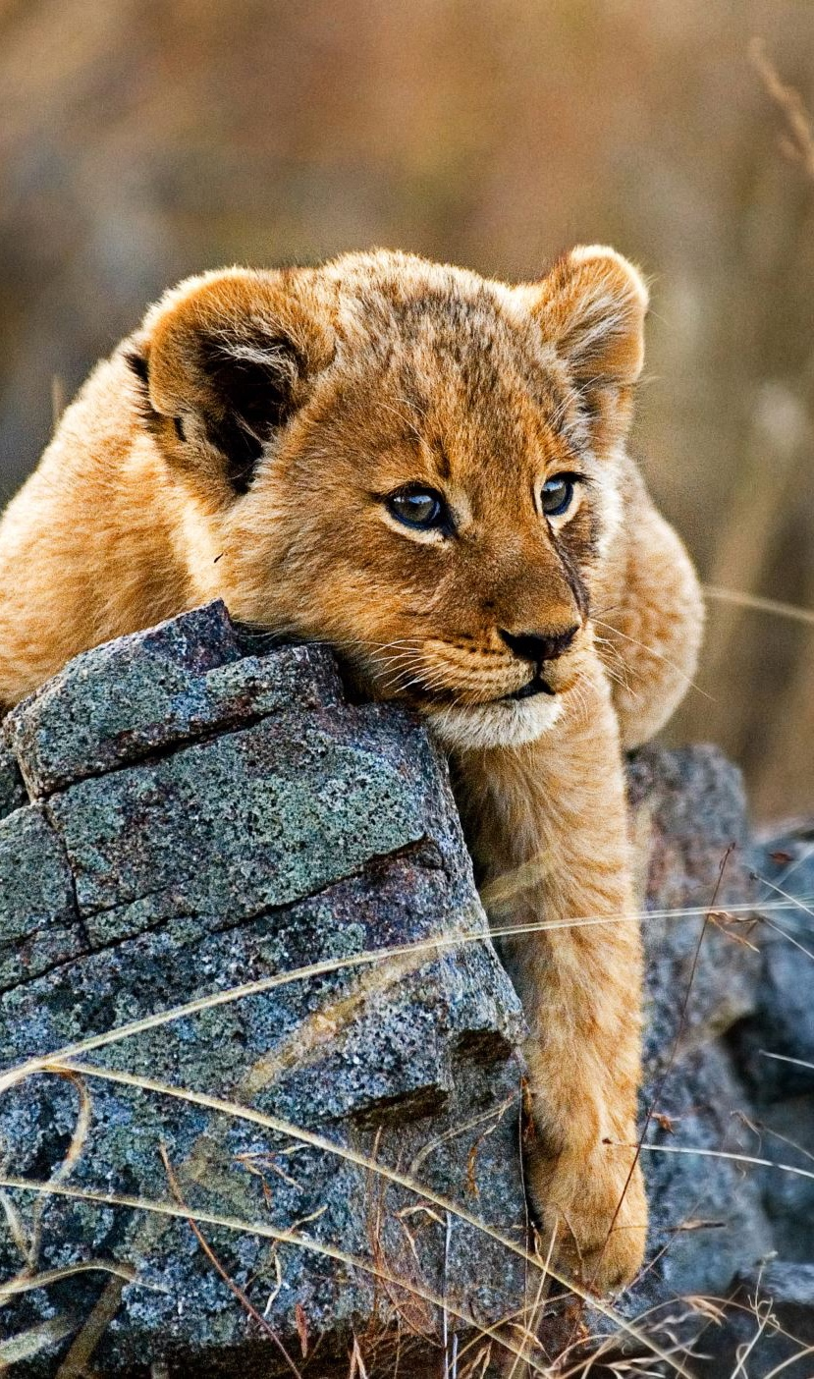
Your assignment…
Choose an adjective that offers poetic imagery.
Explore your adjective as if you were going on a Safari, on the hunt for it.
Find different ways to photograph your adjective.
  You must explore at least three different subjects to reflect your adjective.
You must submit at least 5 edited photographs as blog post in your Assignments page.
Go above and beyond, be creative, think outside of the box!

Slide 13
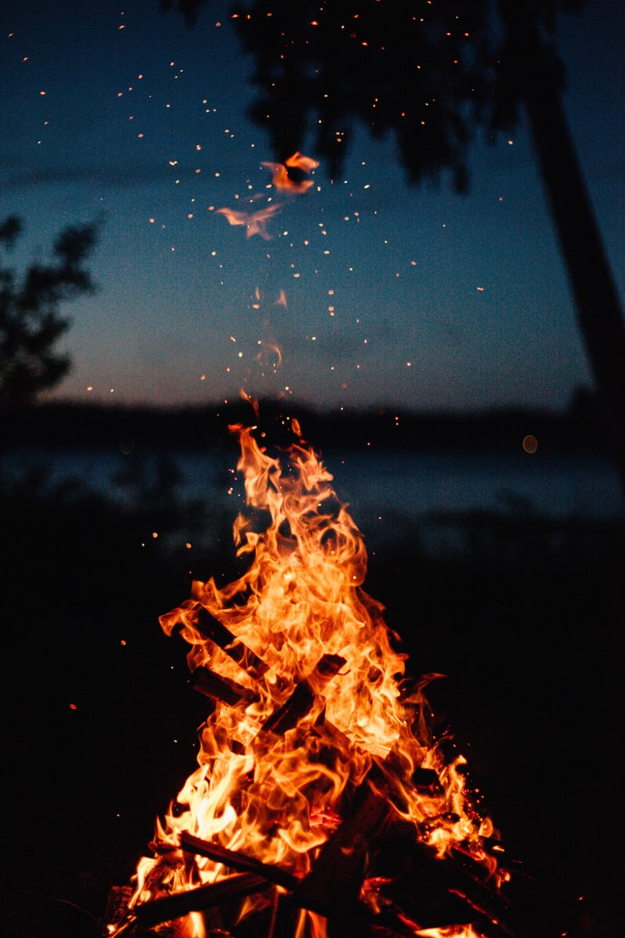

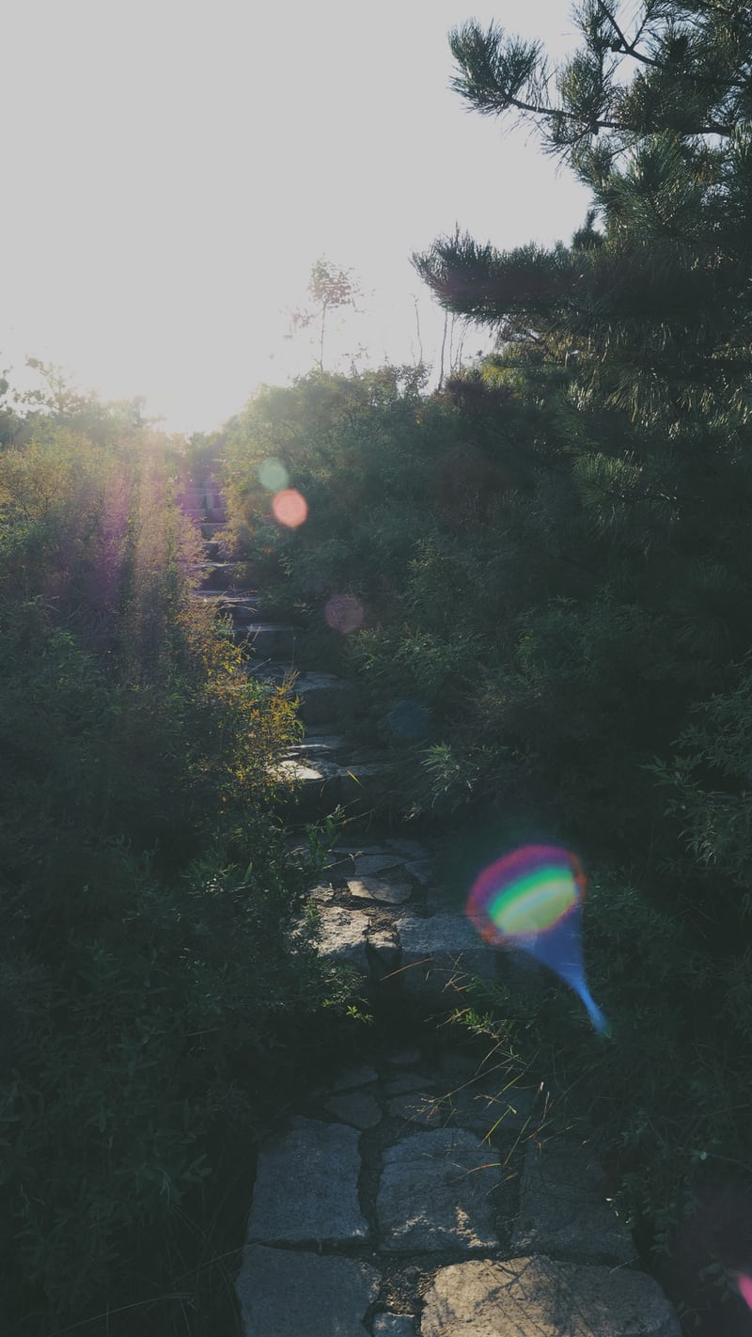
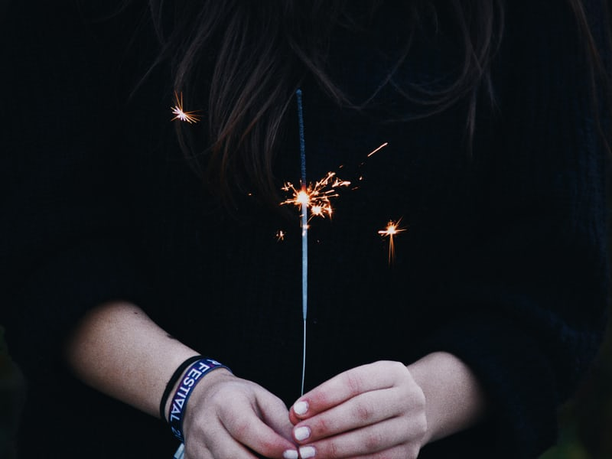

Brilliance

Slide 14
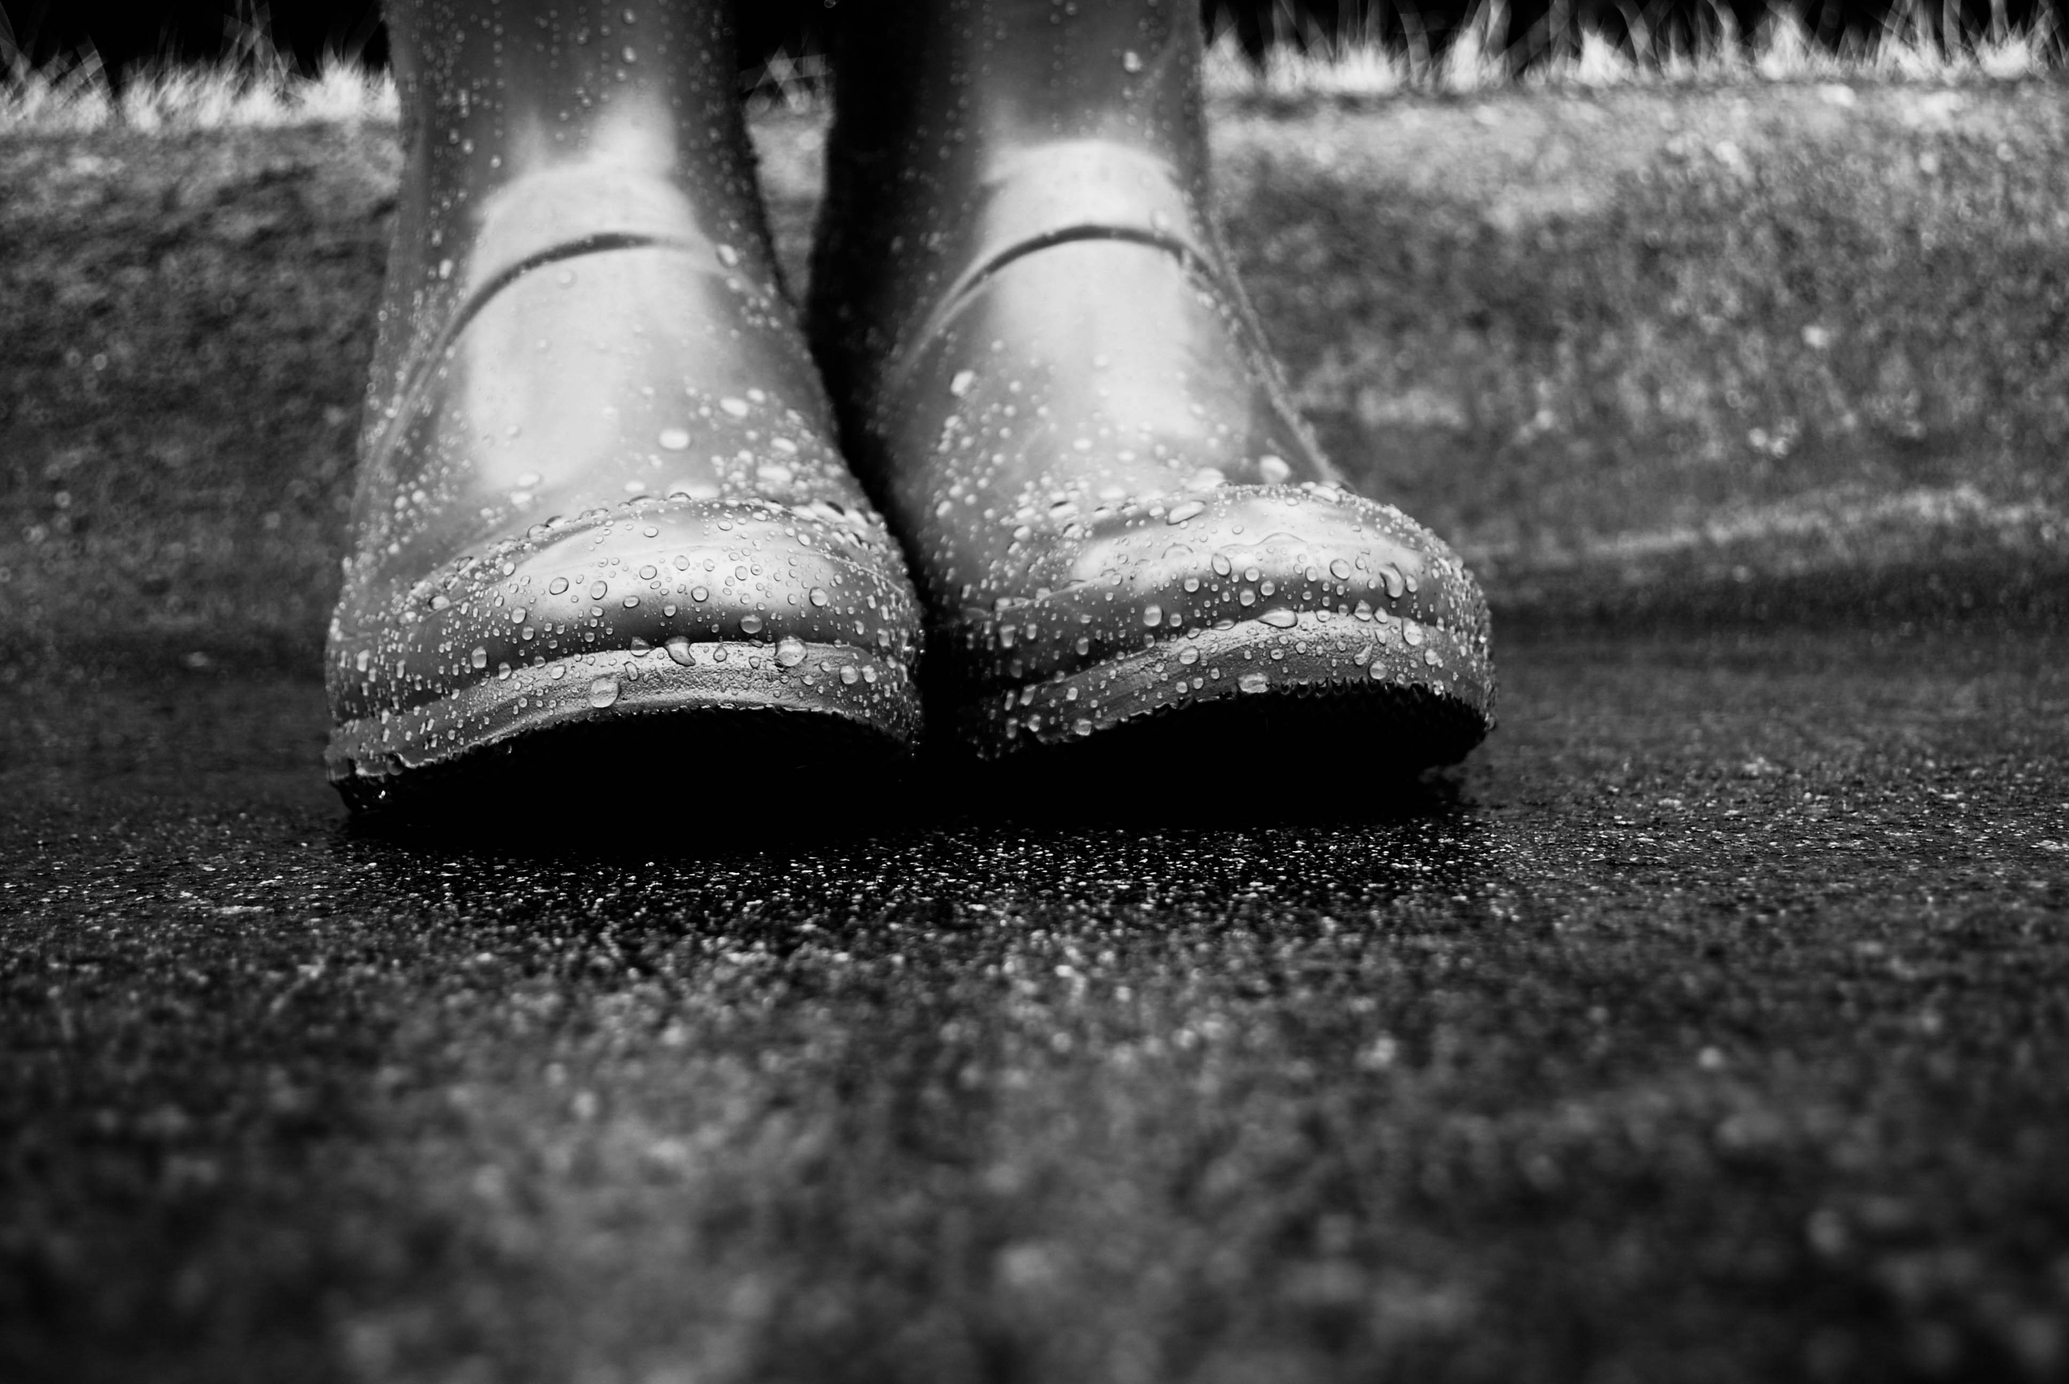
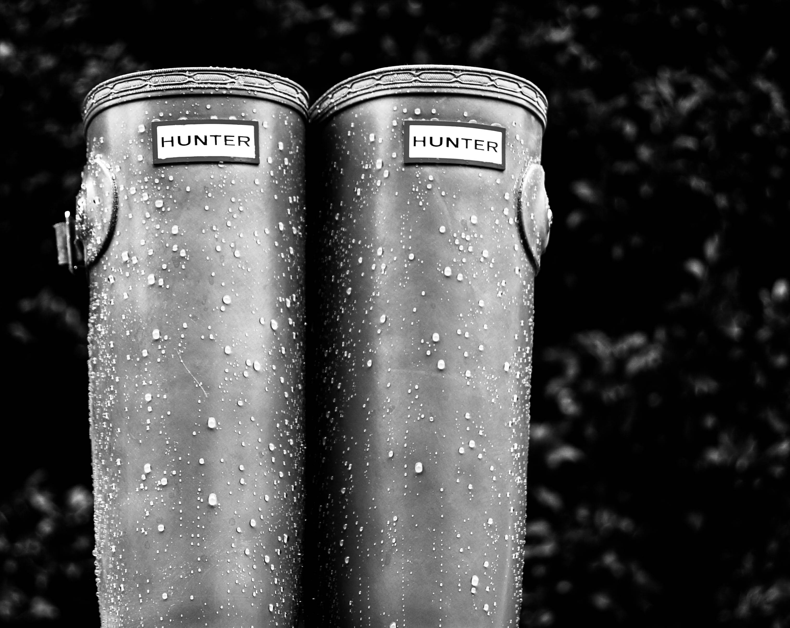
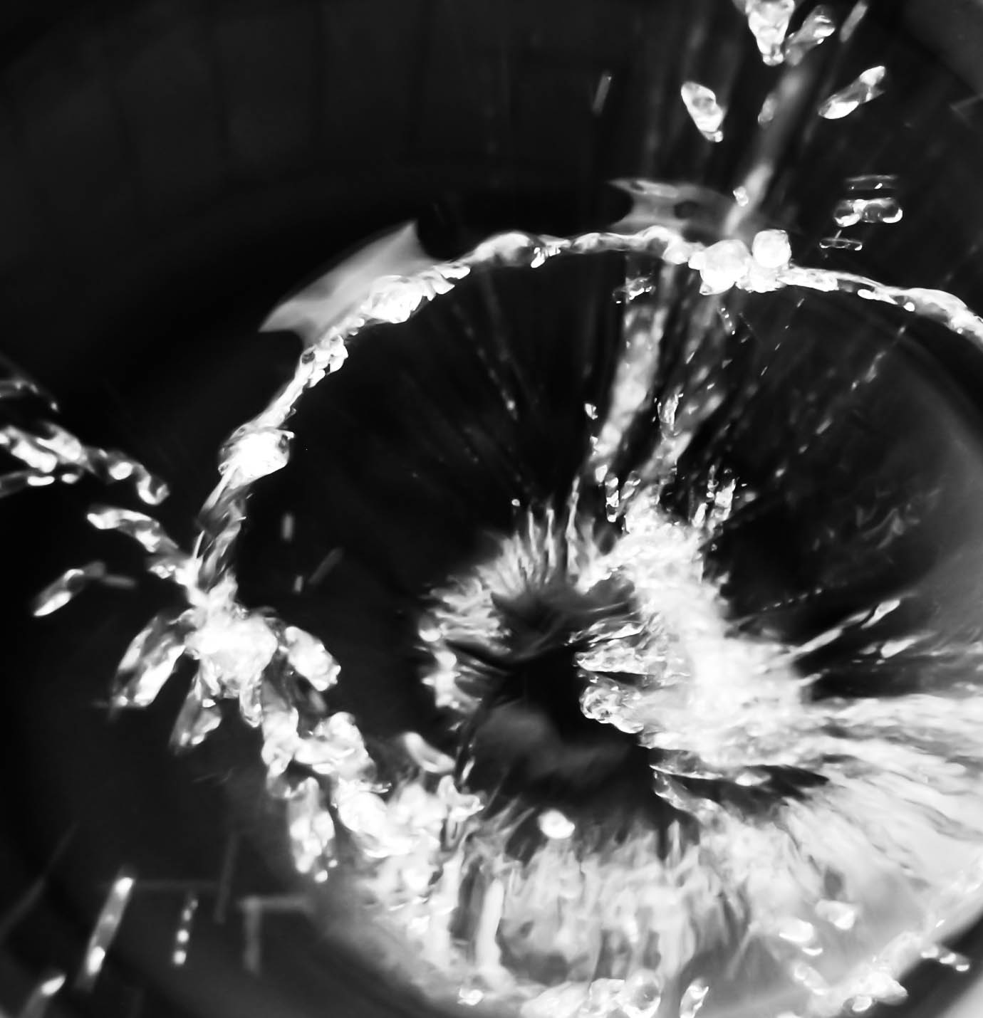
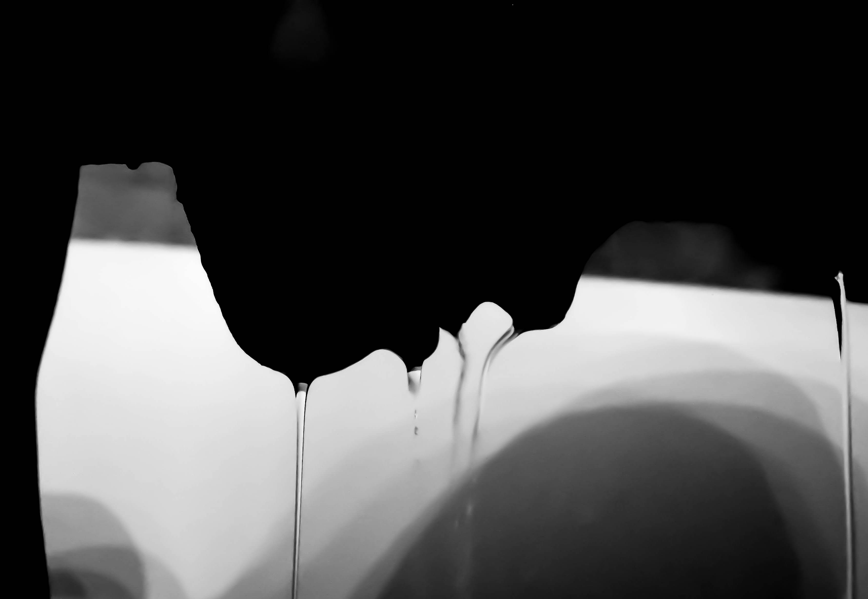
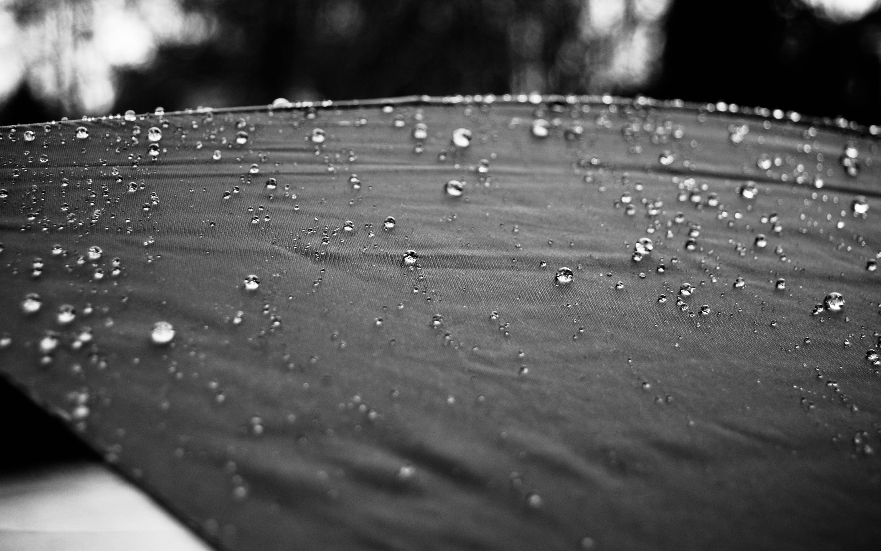
Liquid

Slide 15
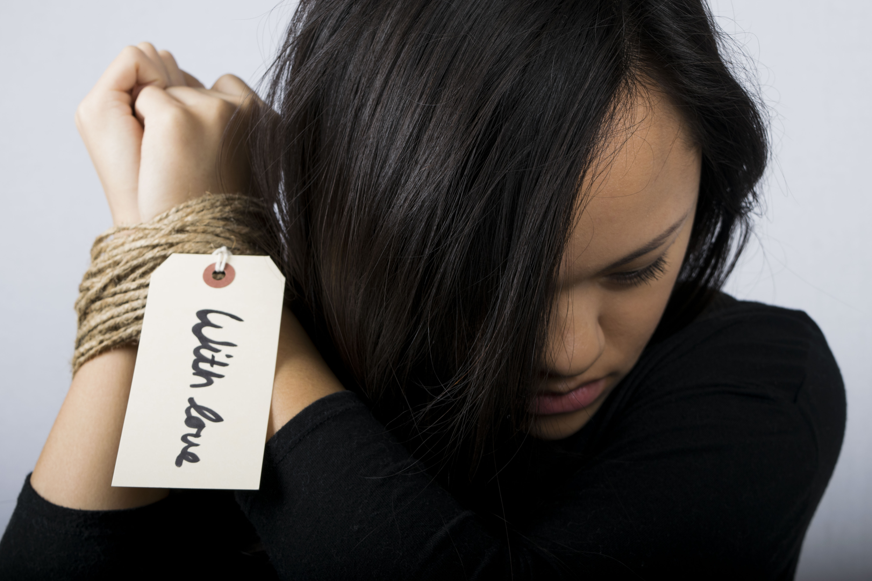
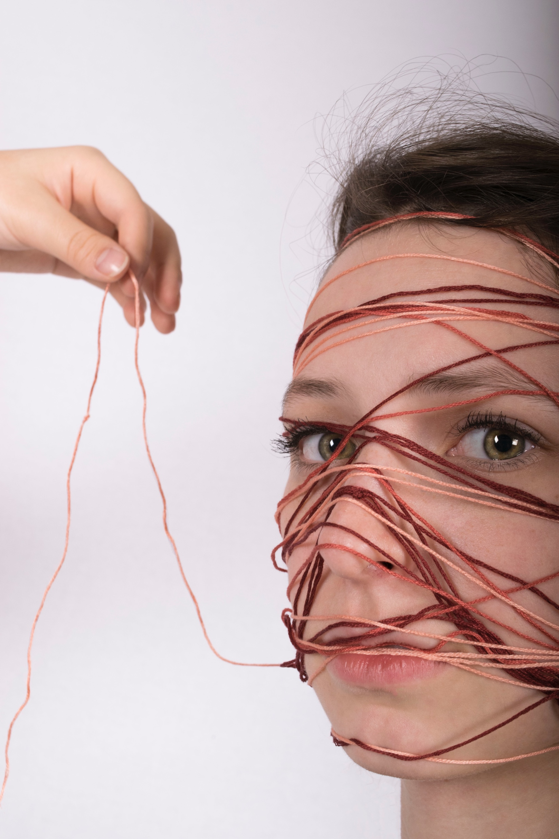
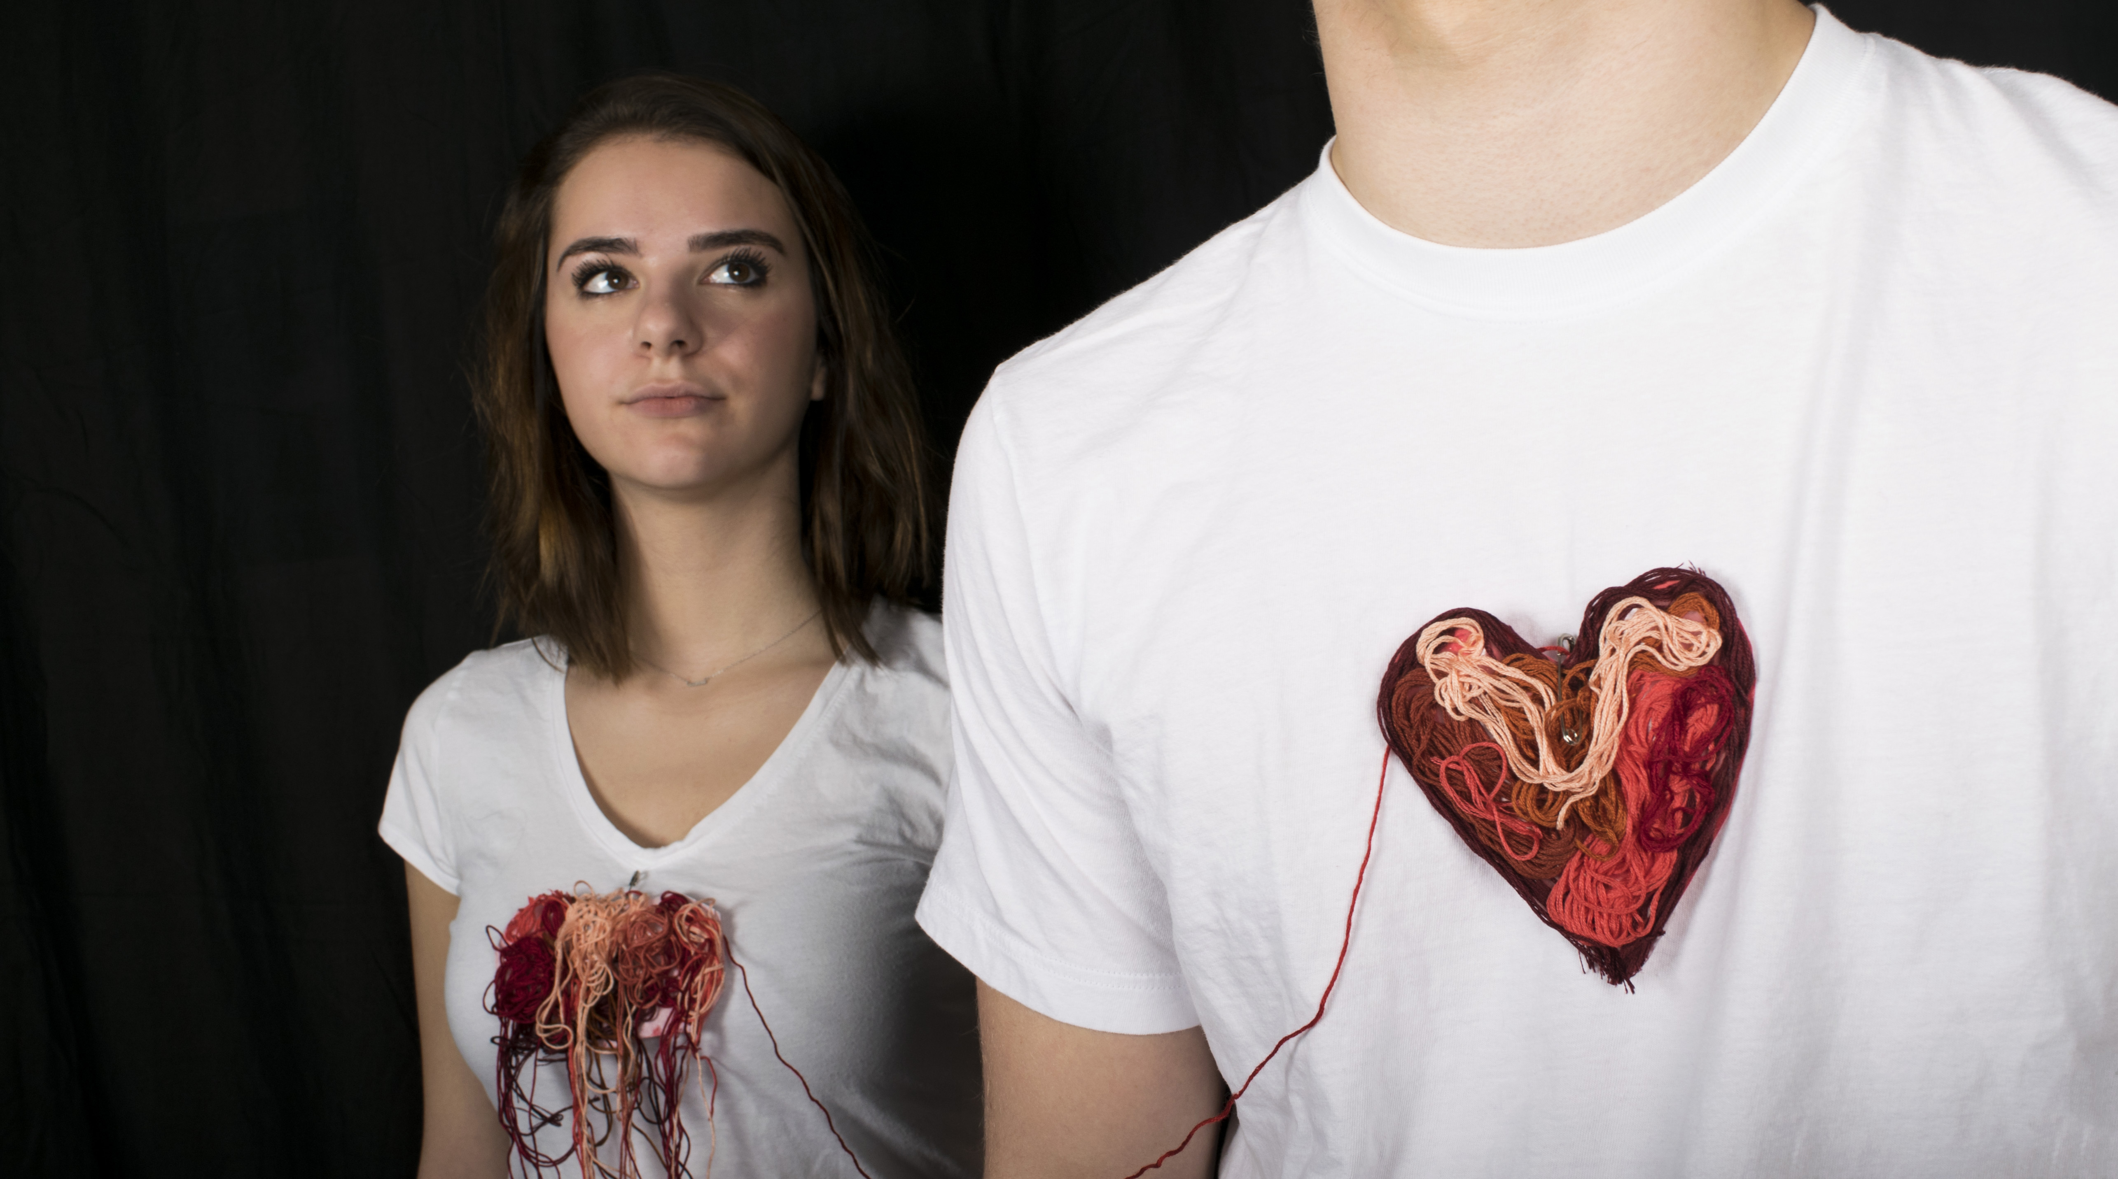
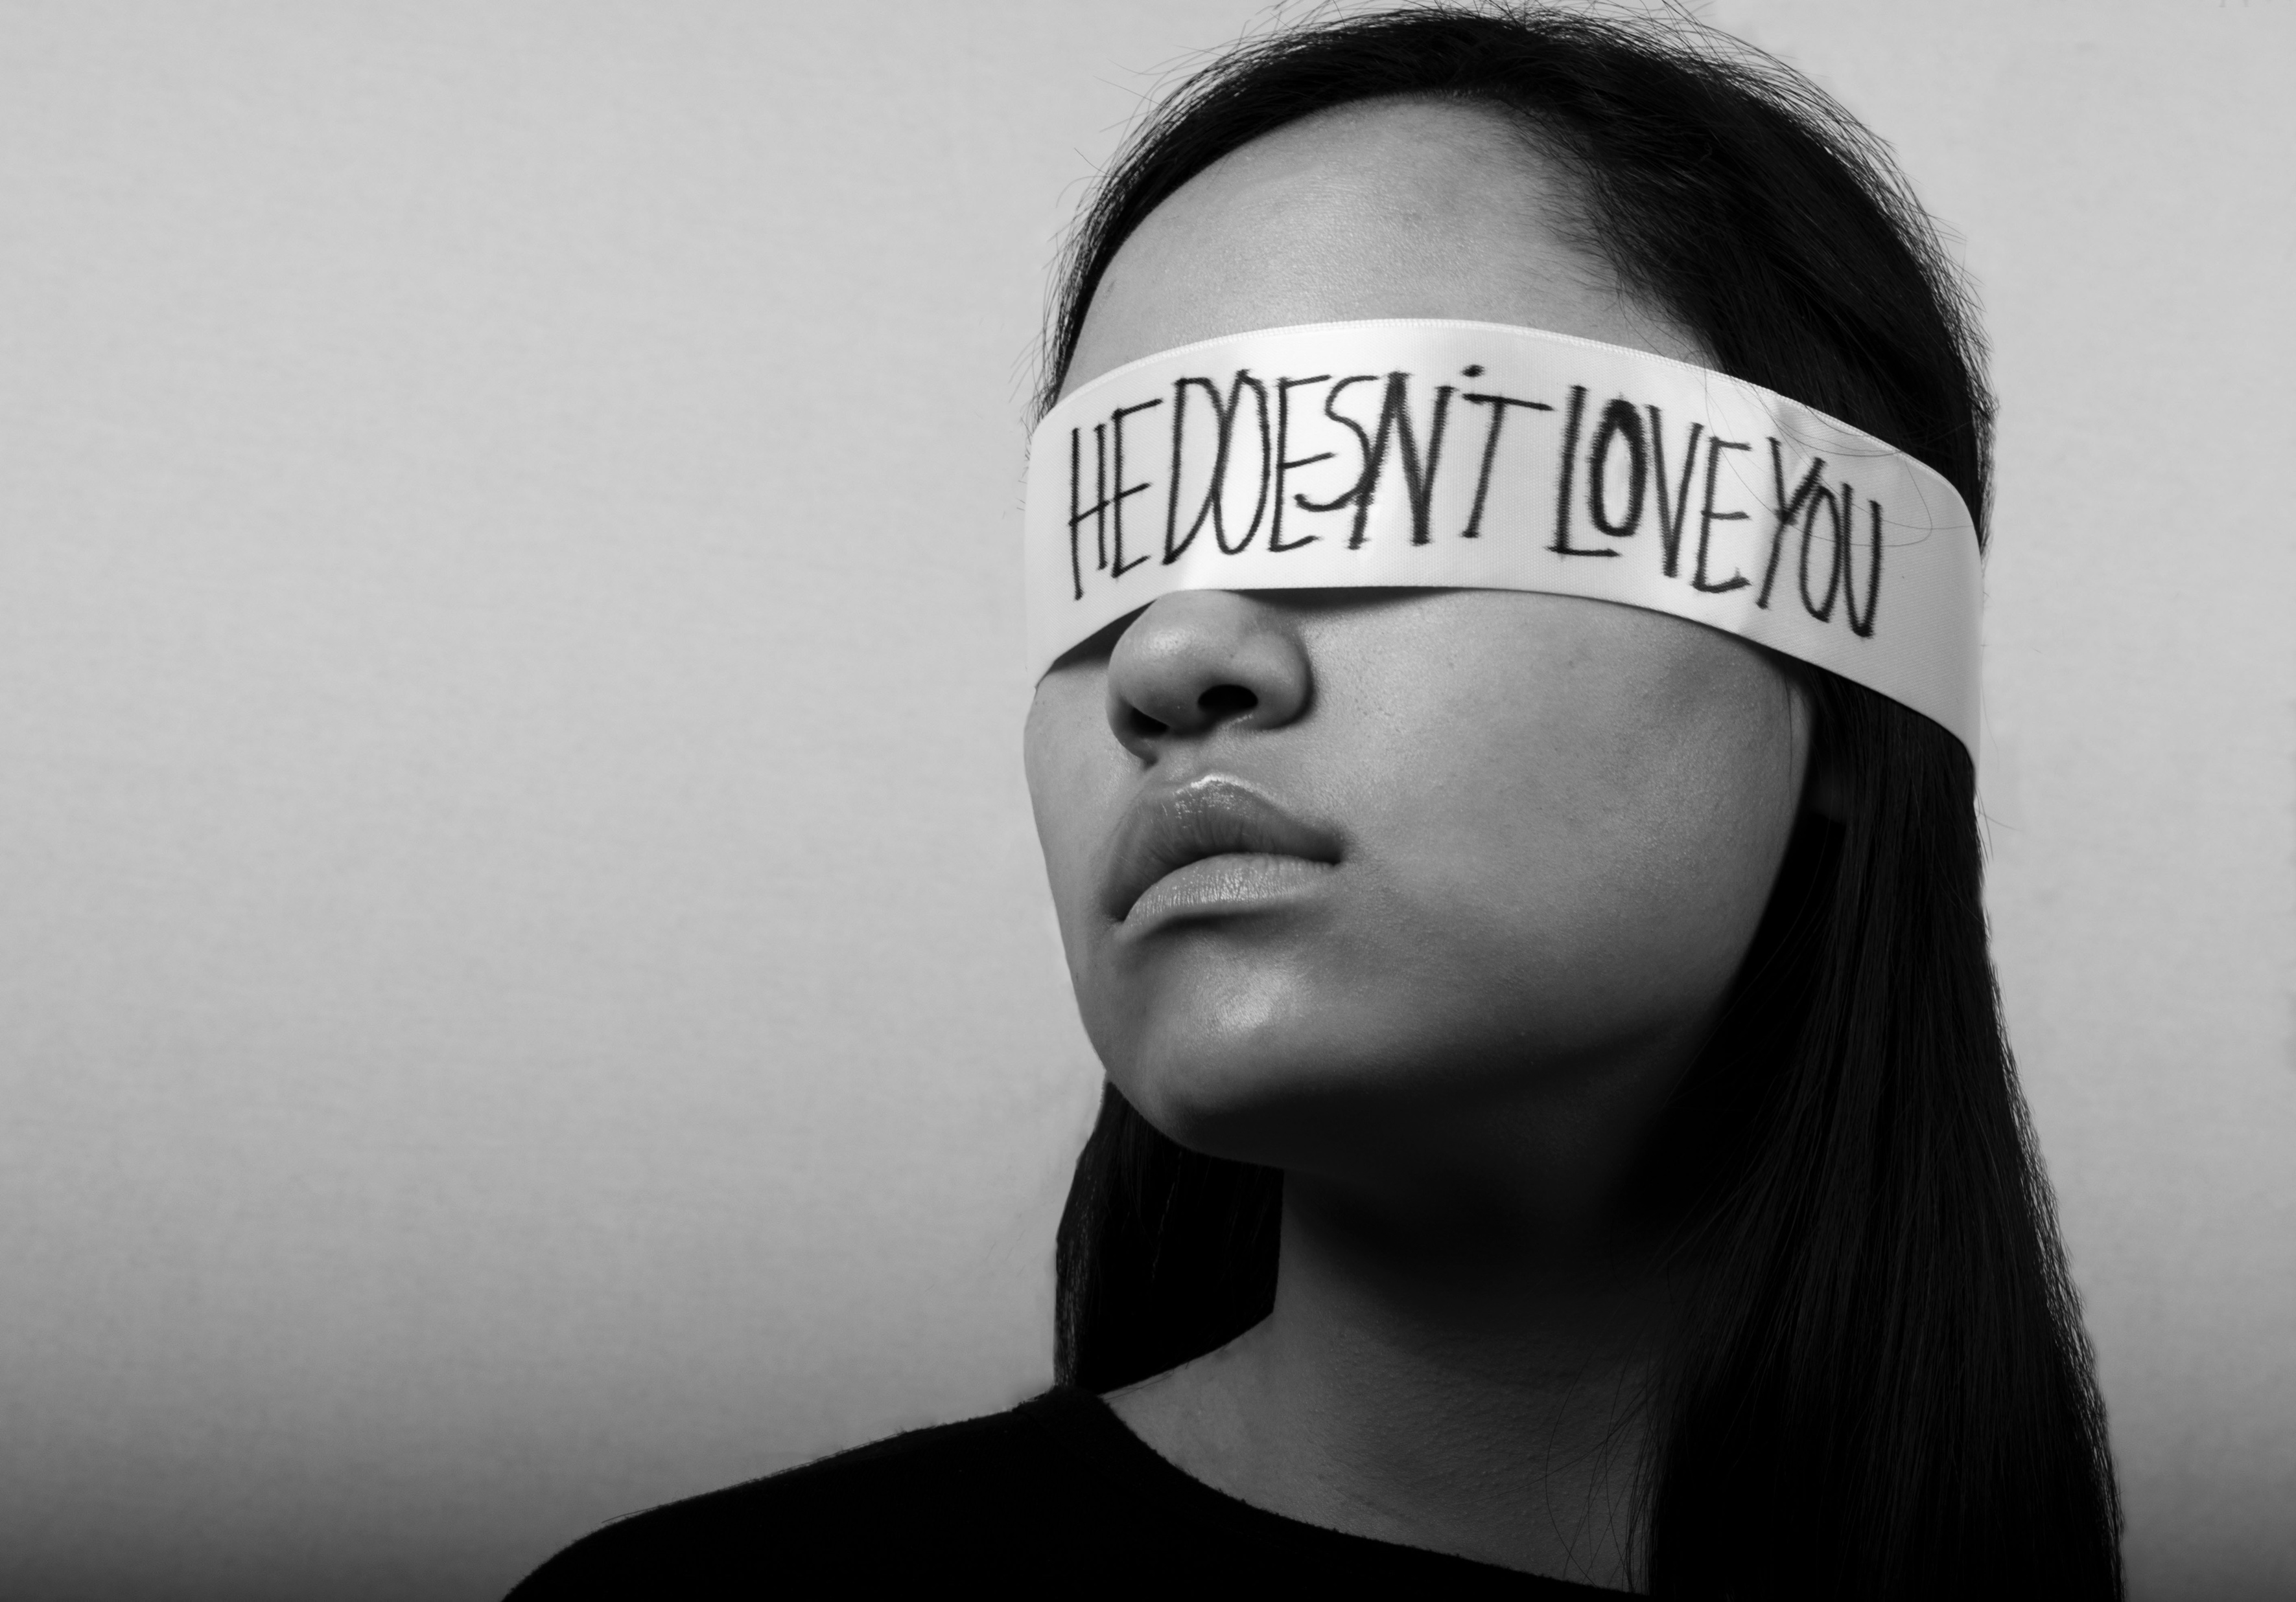
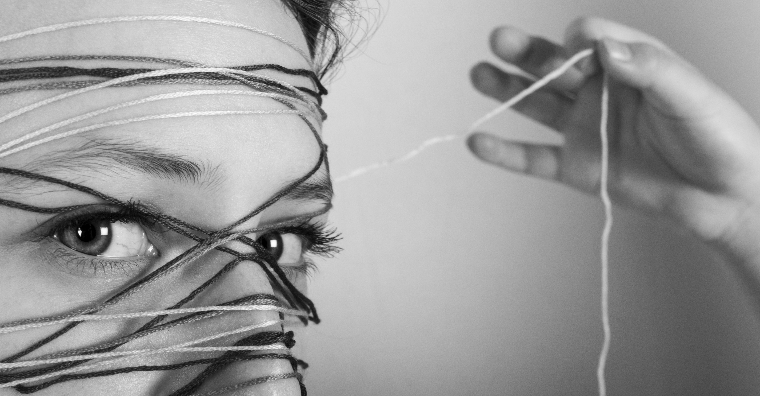
Limerence

Slide 16
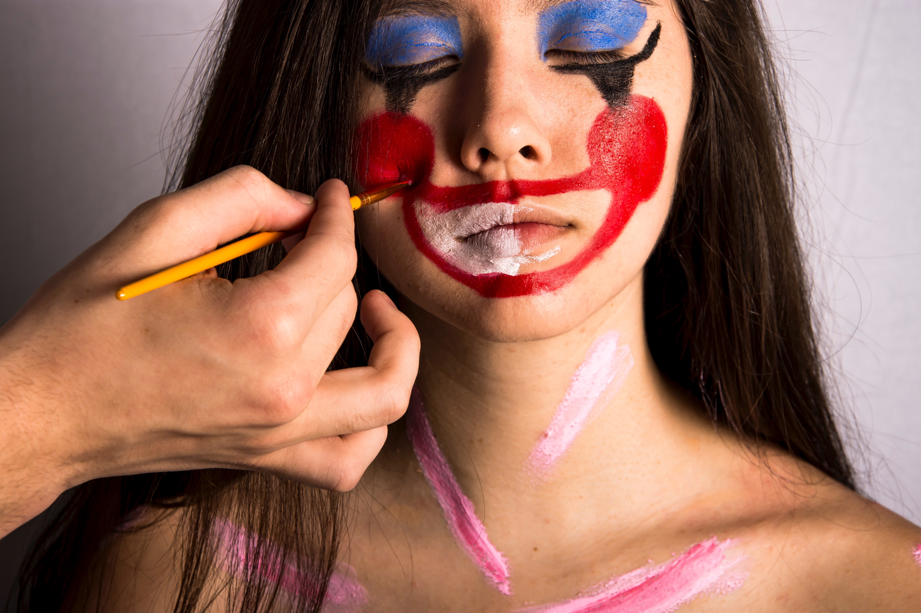
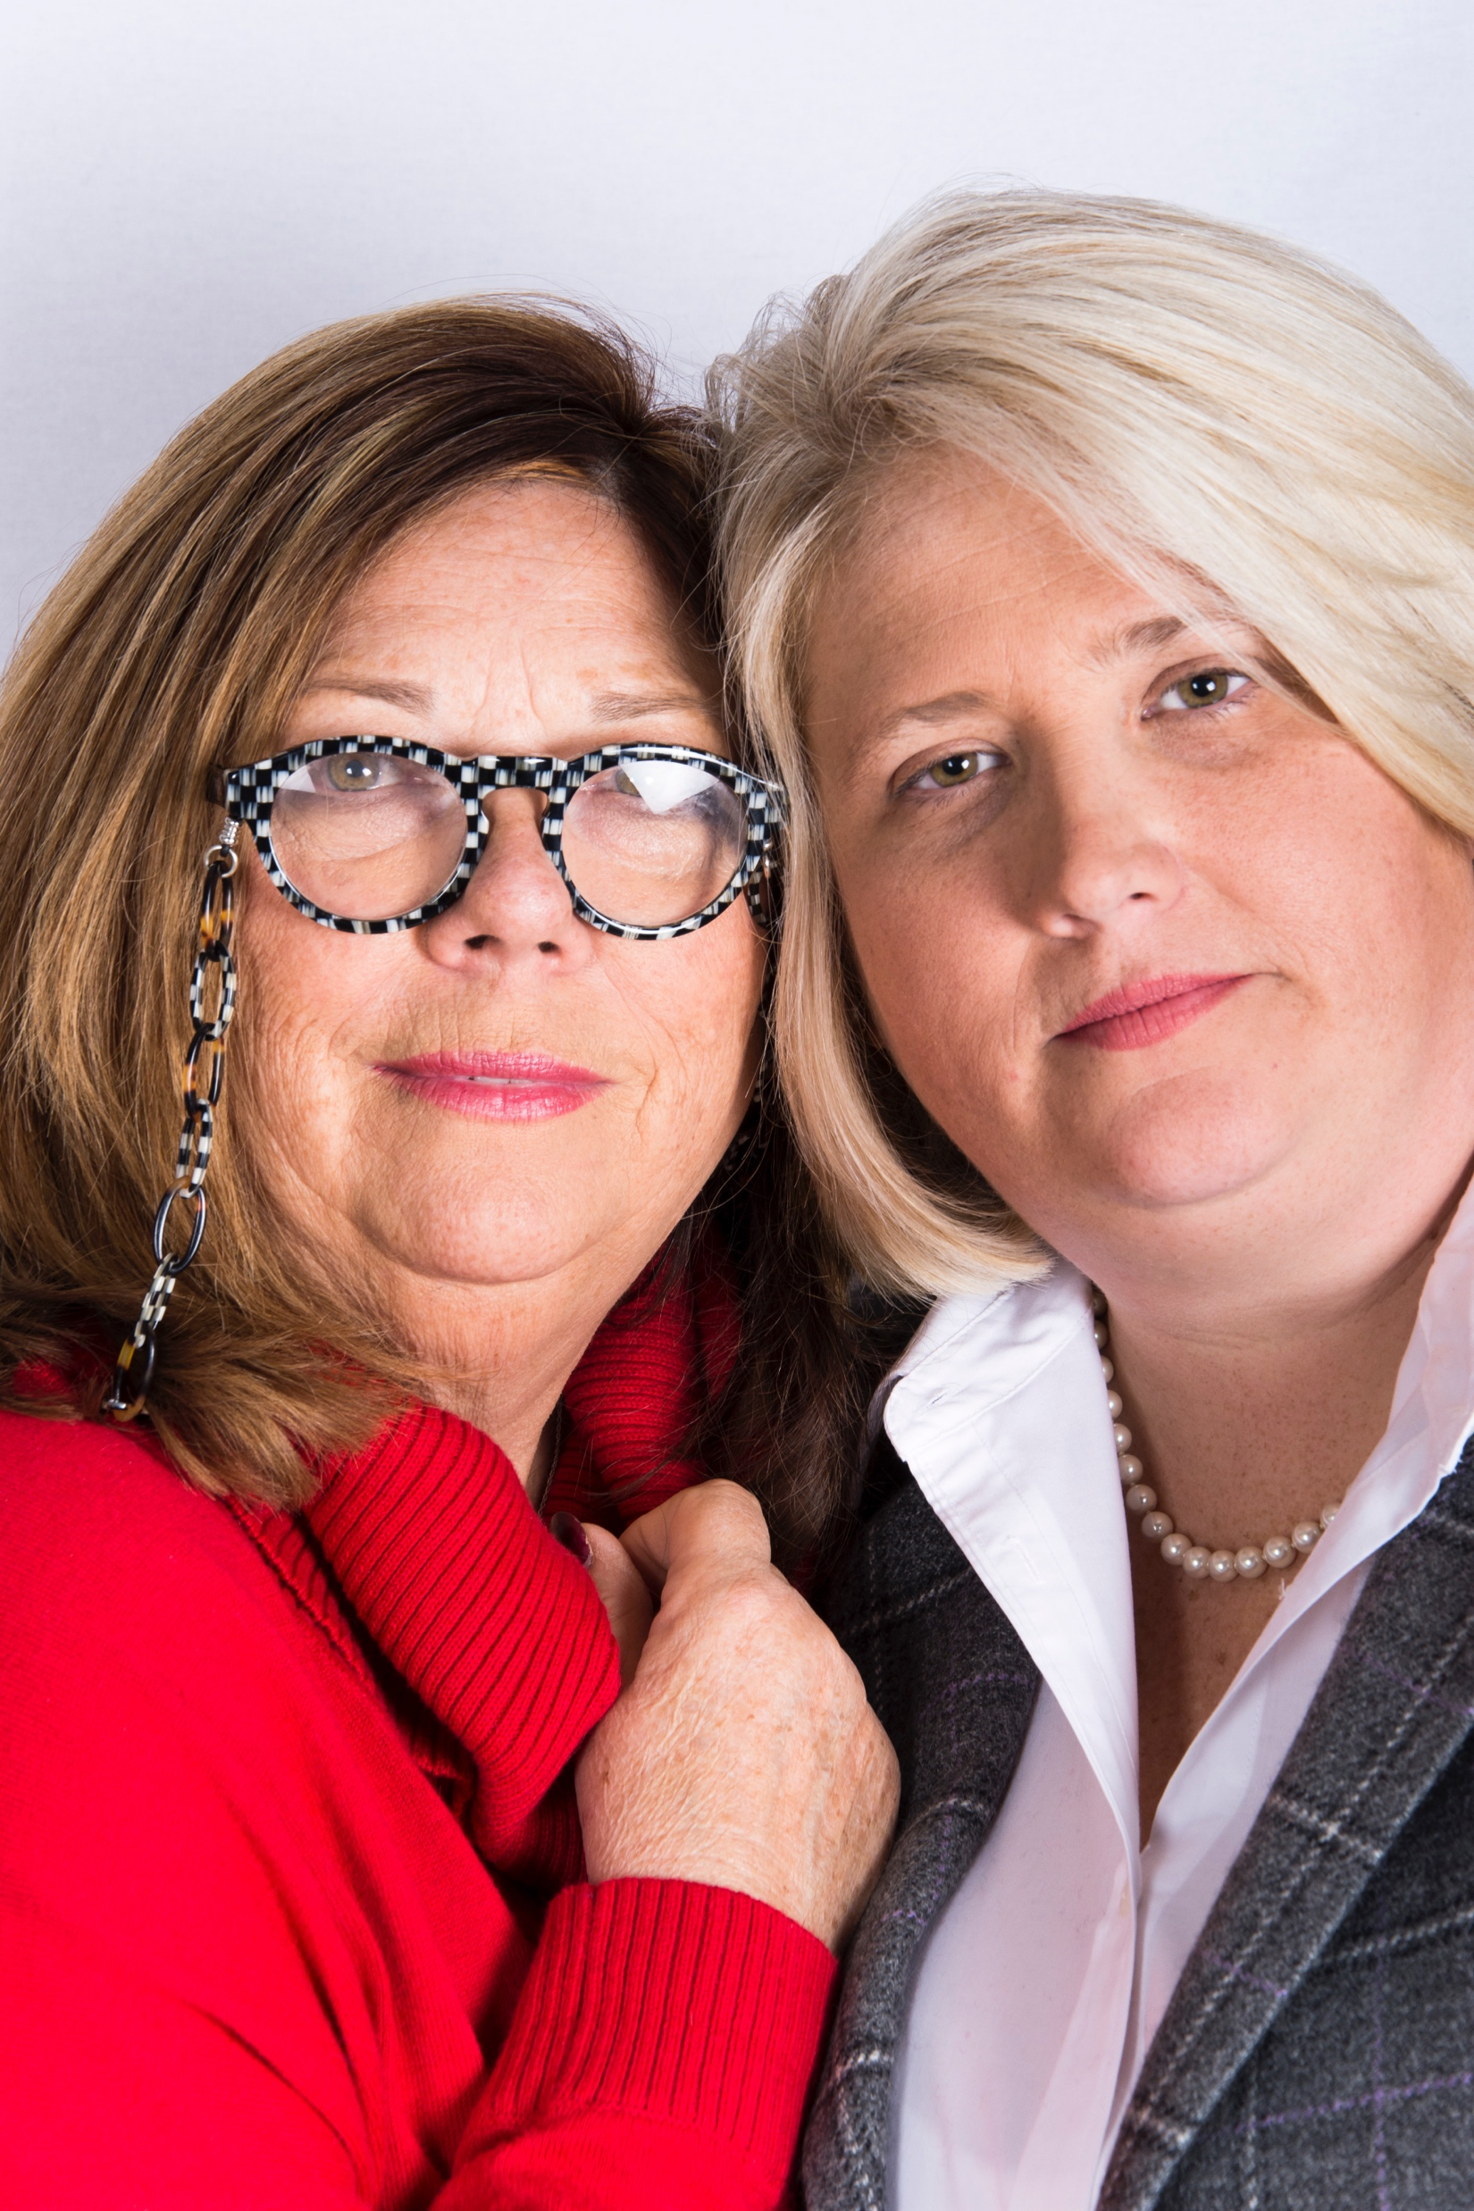
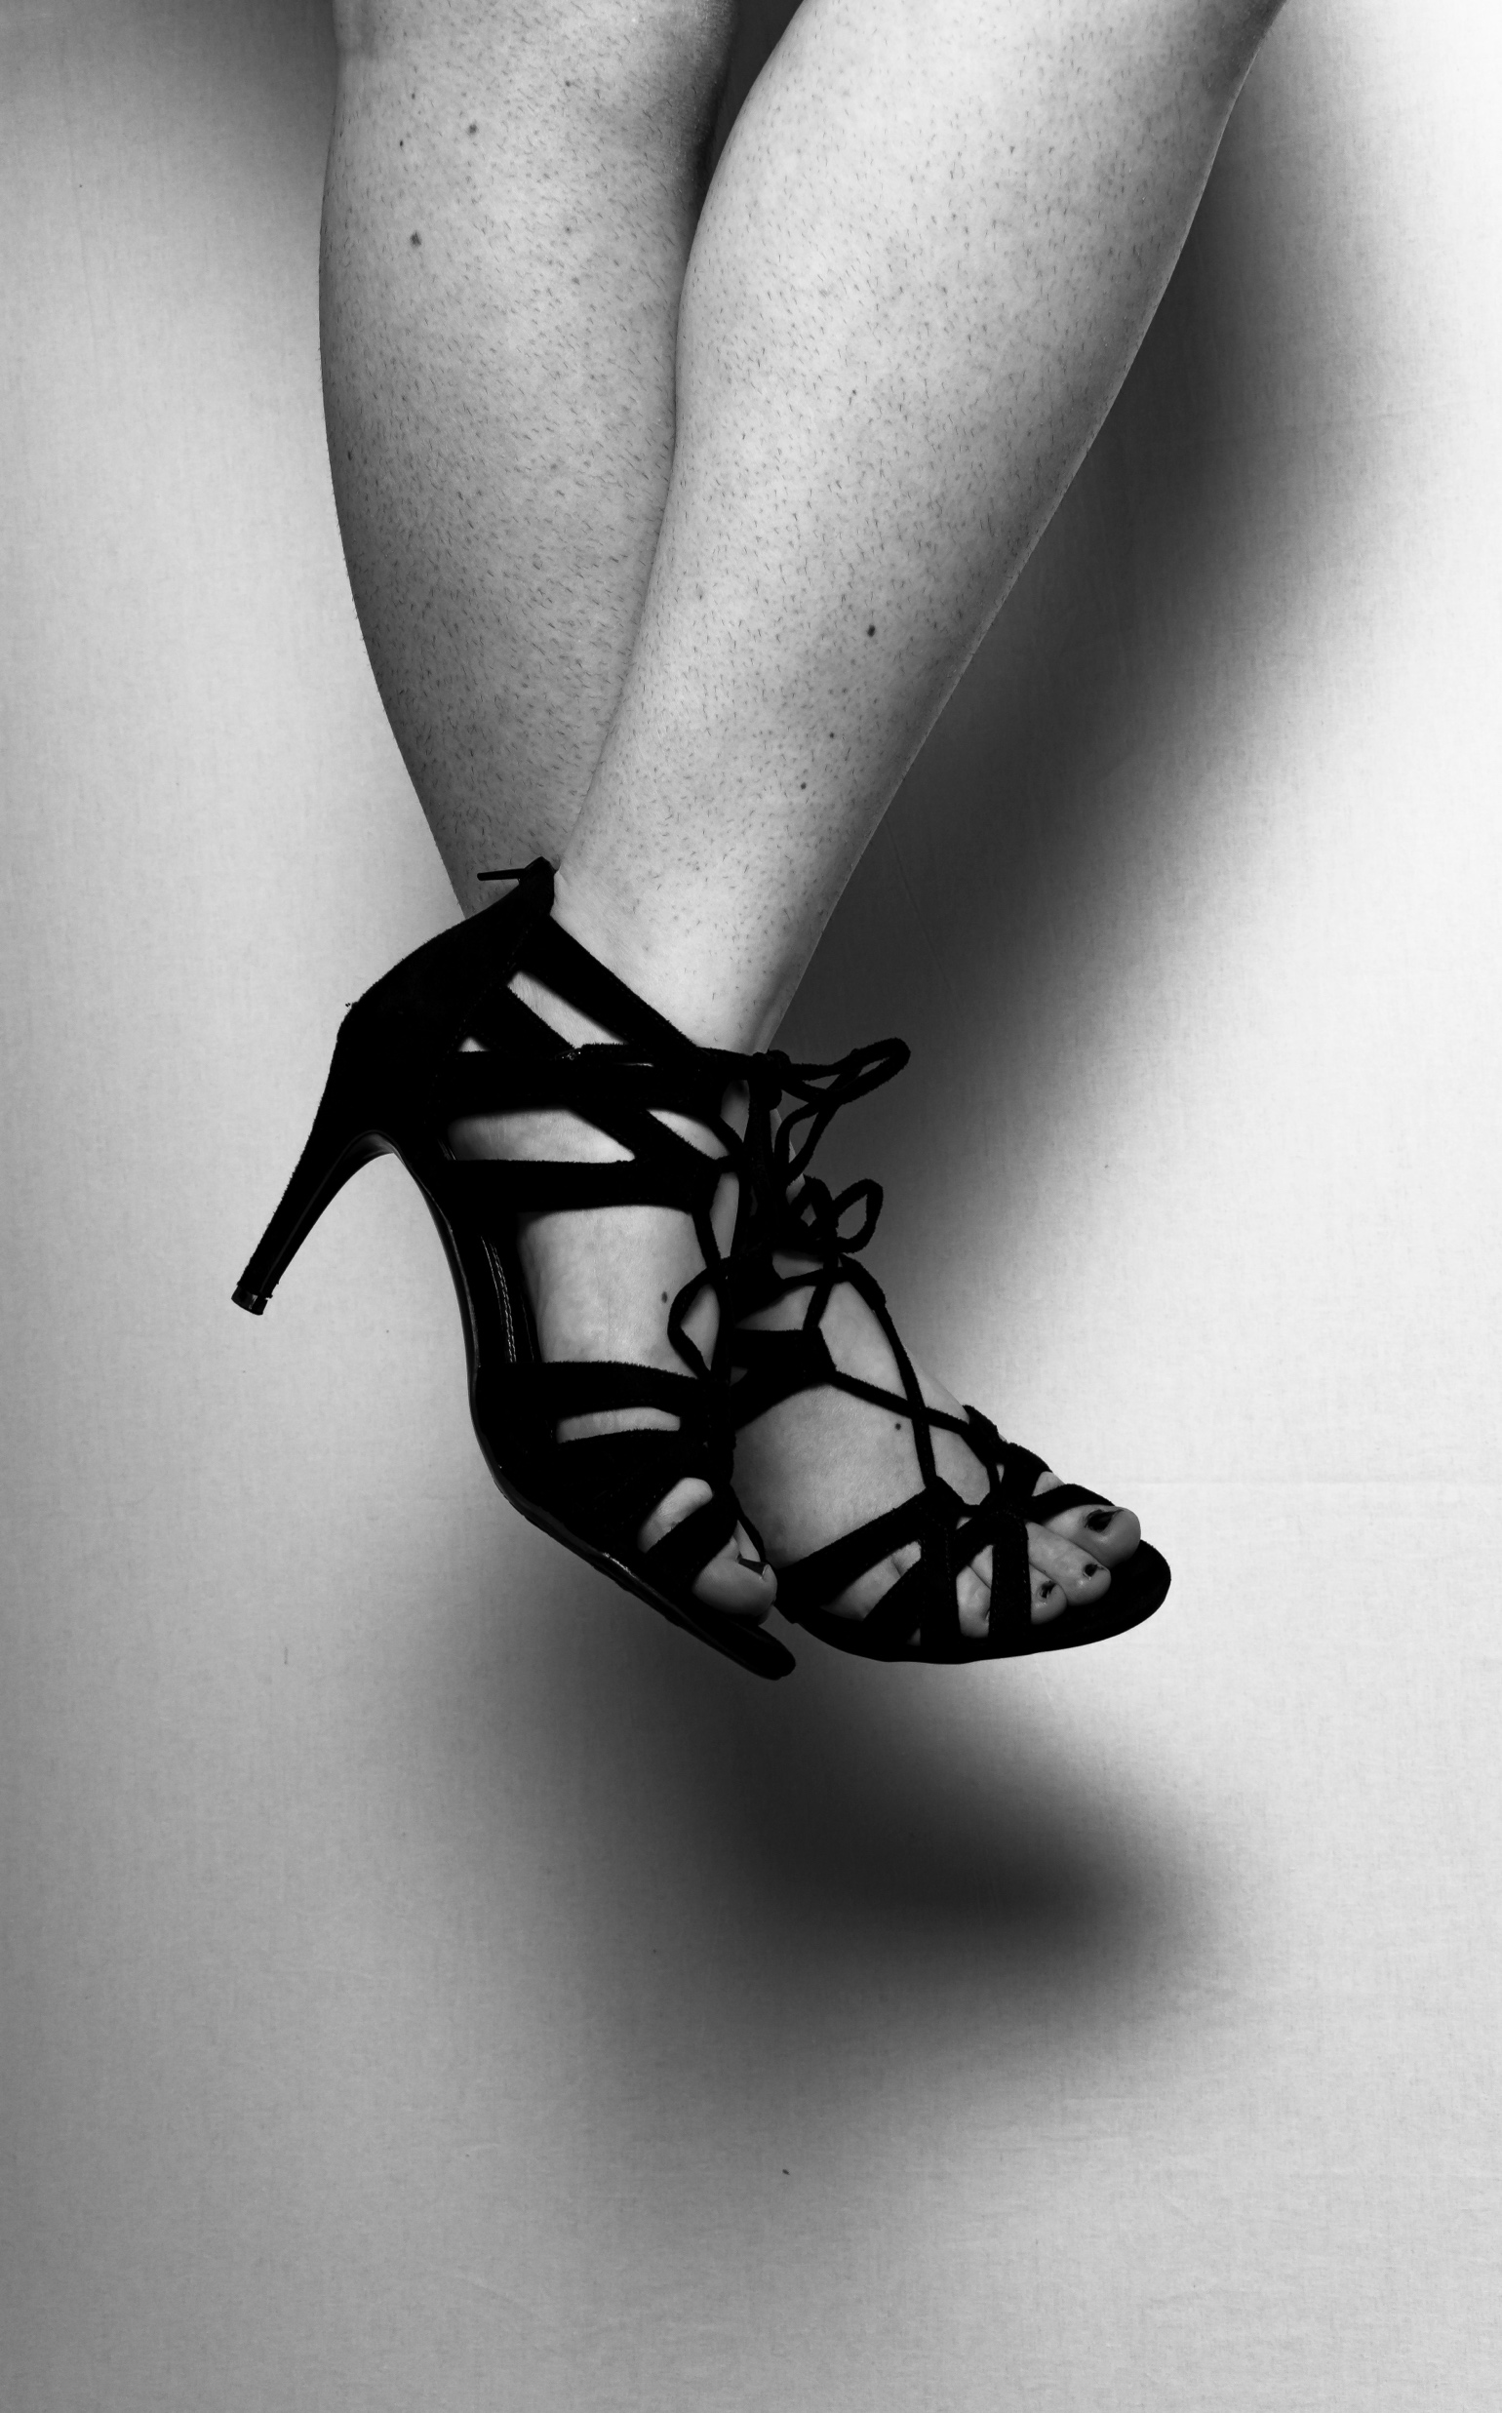
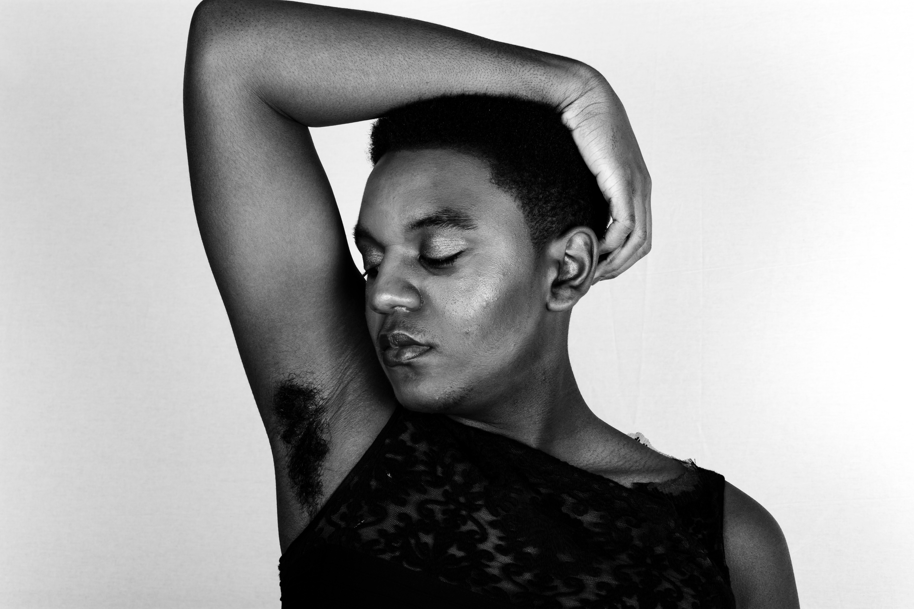
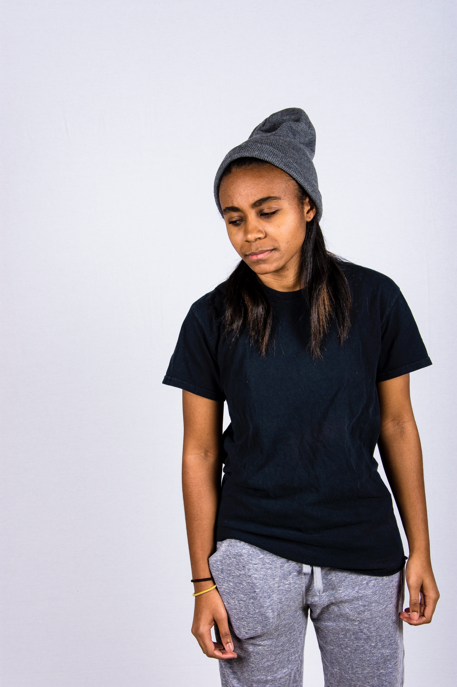
Feminine

Slide 17
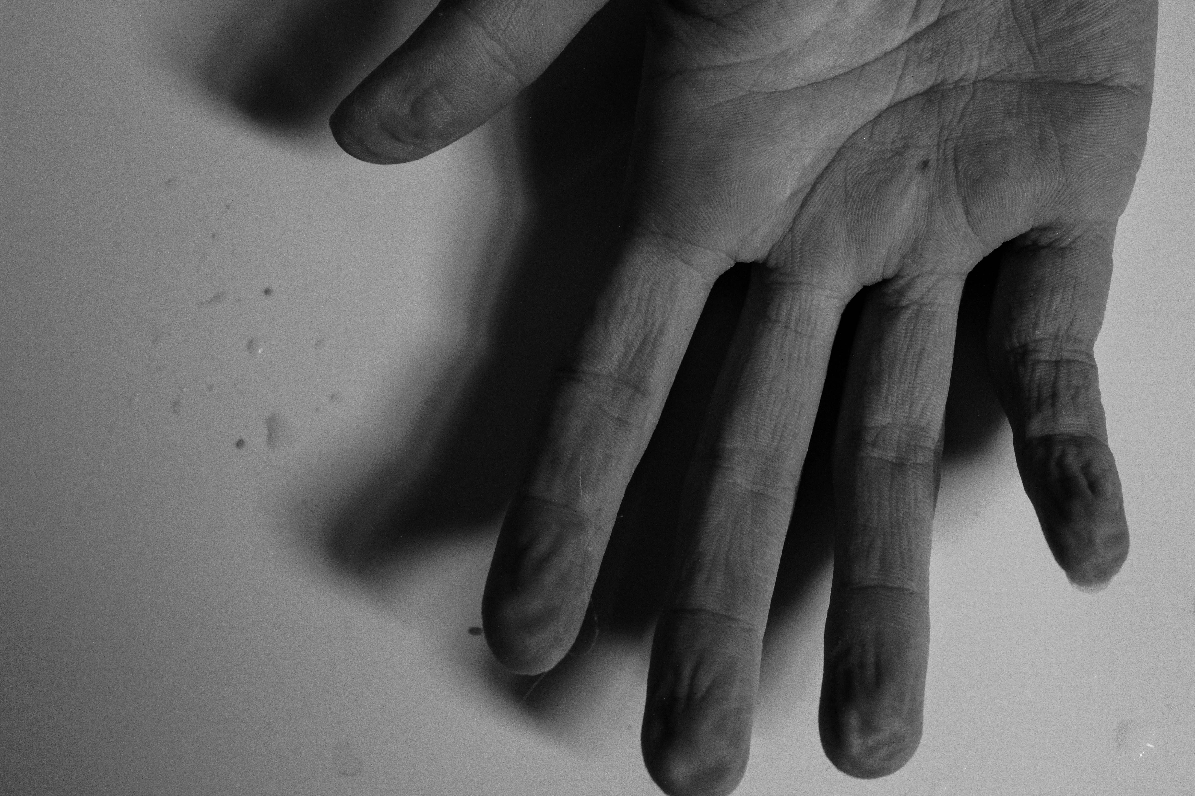
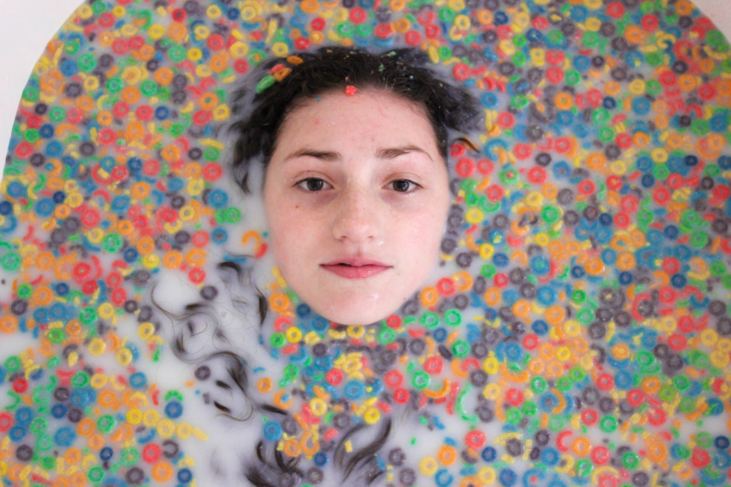
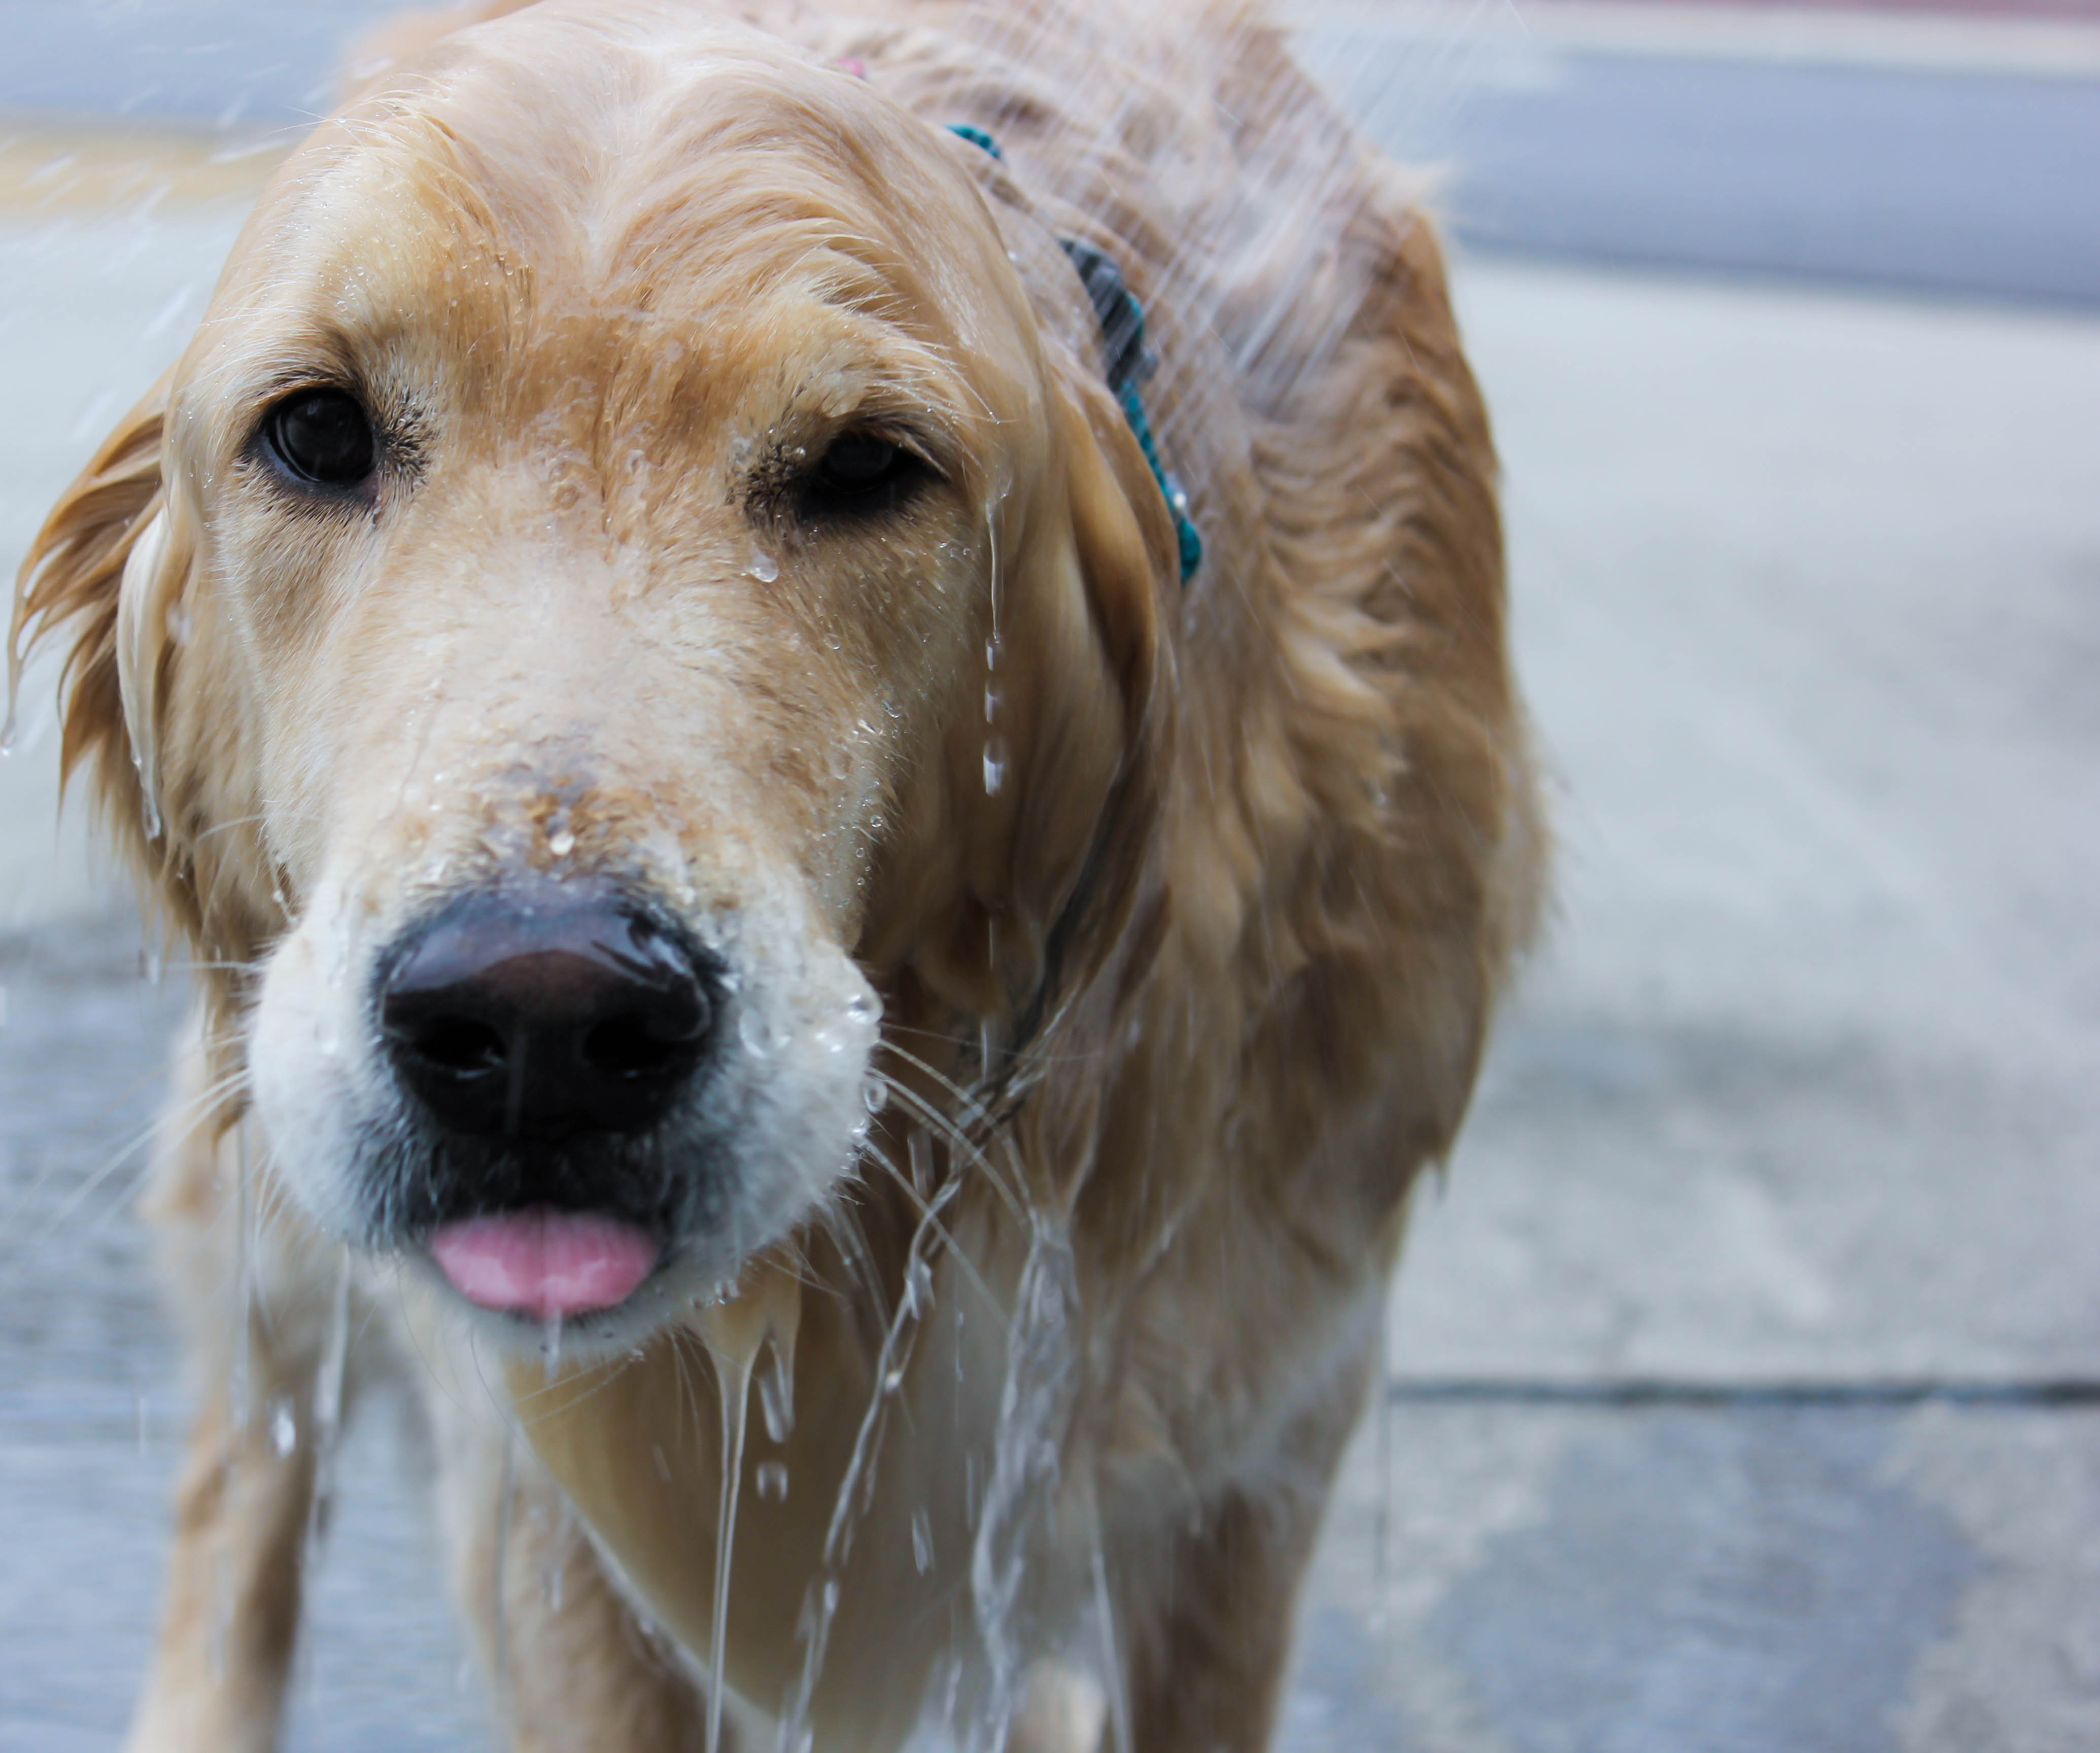
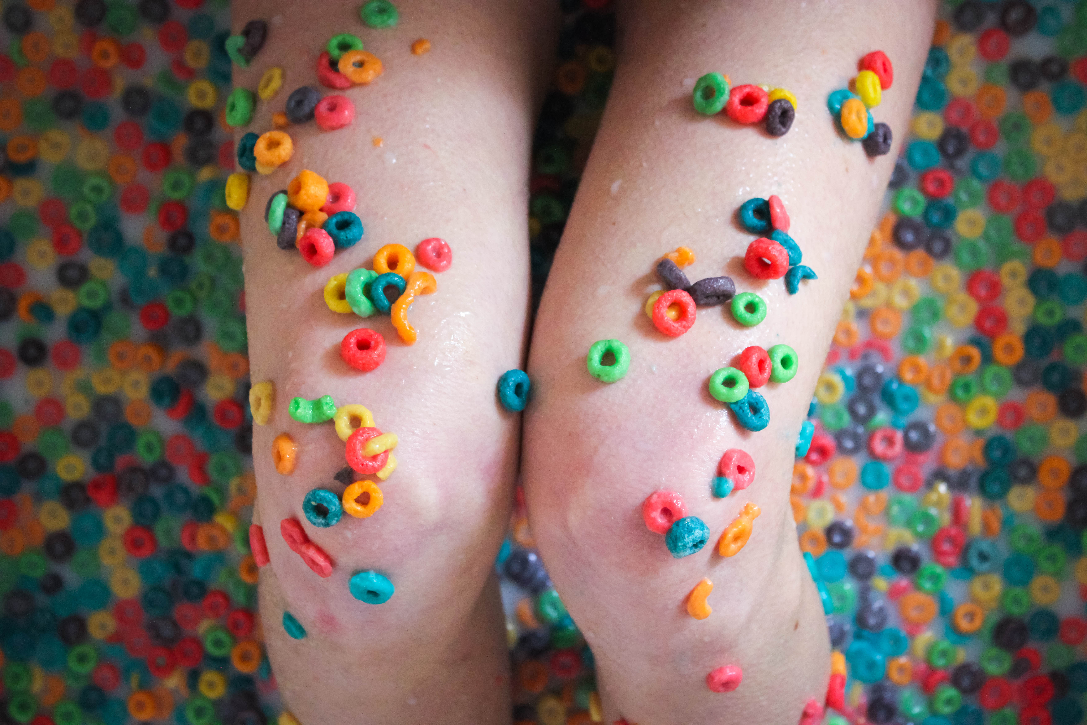
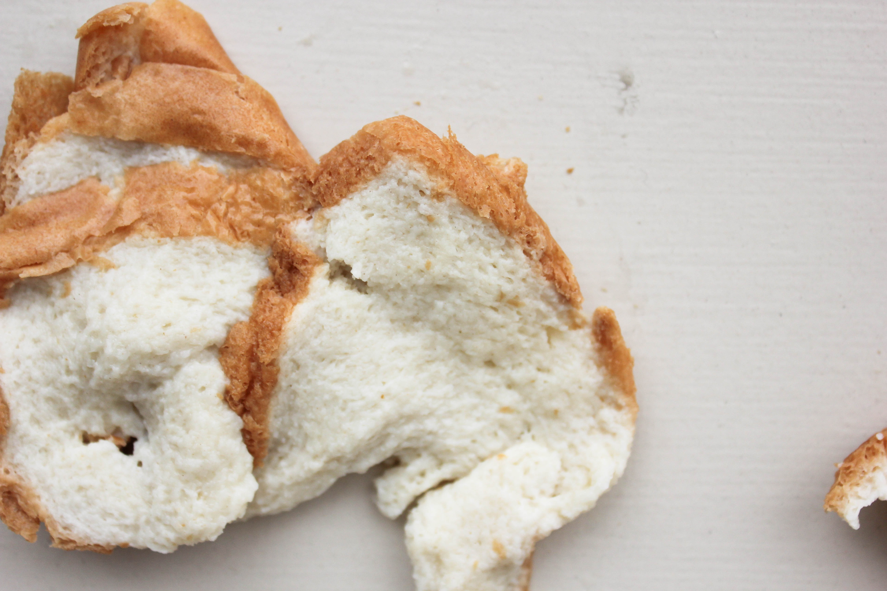
Soggy

Slide 18
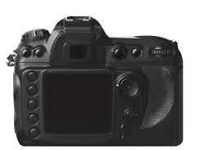
Don’t Forget:
Manual Mode
SHUTTER SPEED
ISO
Check the screen on the back of your camera to see what you have your settings set to.
Reference your cheat sheet as needed to see how these will impact your image.
M 1/80 F3.2 250
APERTURE

Slide 19
Your to do list…
Research adjectives and brainstorm ideas for your photo safari.
Capture your 5 images of at least 3 different subjects.
Edit your 5 pictures and post them on your assignment page.
Include camera settings in the captions (MASIF=mode, aperture f-stop, shutter speed, ISO, and focal length).
Submit link in Teams.
Participate in a class critique of your final photographs.

Slide 20
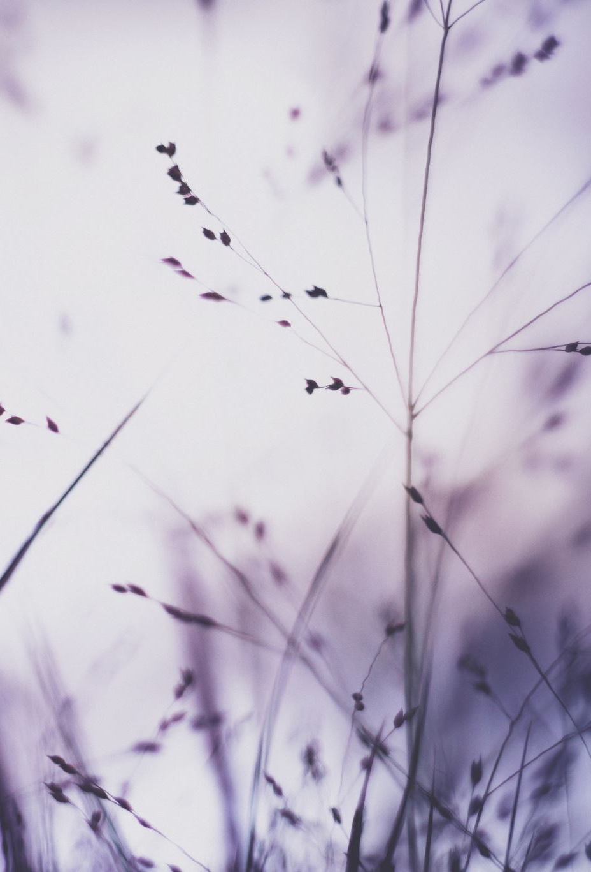
Your grade…
Creativity: expand the boundaries of your word.
  Don’t go for the obvious.
Composition: focus on getting a good variety, use space well.
Originality: don’t lean on photos you have seen before, make it new.
Quality: sharpness, good exposure and editing.
5 photographs that represent your adjective.
At least three different subjects to interpret your idea.

Slide 21
THE END

