Slide 1

Photographic Rules of Composition
Digital Photography
Ms. De La Rosa

Slide 2

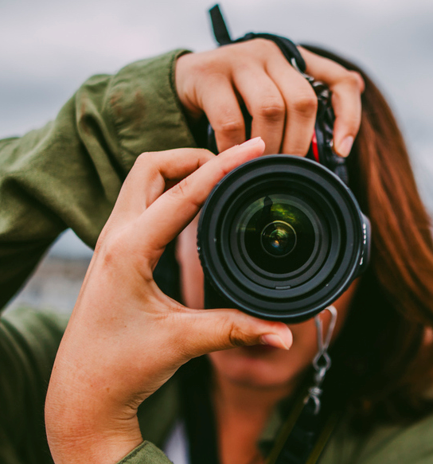
What is Composition?
You hear photographers talk about composition all the time, but what exactly is composition and how is it different from subject?
Composition is the way that elements are arranged in an image. Composition includes ALL the elements in a photo, not just the primary subject.
The human eye tends to prefer images that have a certain sense of order, while it tends to reject images that are chaotic.
In order to develop a good understanding of what works and what doesn't work in photographic composition, it helps to learn the "rules" and practice following them. But keep in mind that these are more like guidelines than actual “rules”.

Slide 3

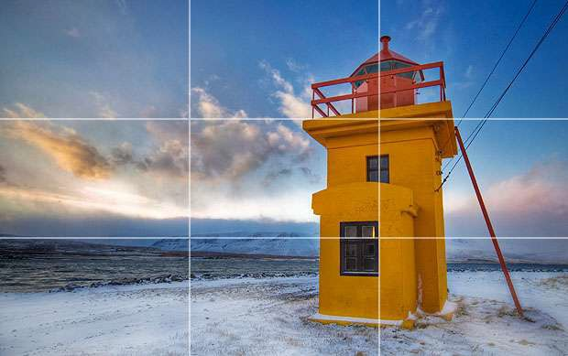
The Rule of Thirds
The rule of thirds involves mentally dividing up your image evenly using 2 horizontal lines and 2 vertical lines, as shown below.
You then position the important elements of your scene along those lines (or at the intersections of those lines).

Slide 4
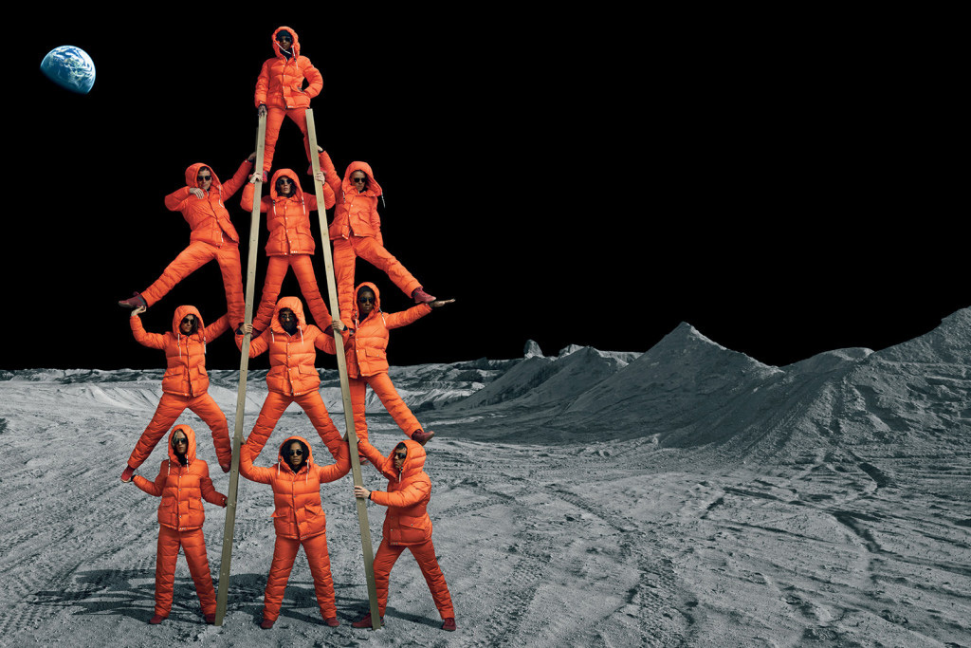
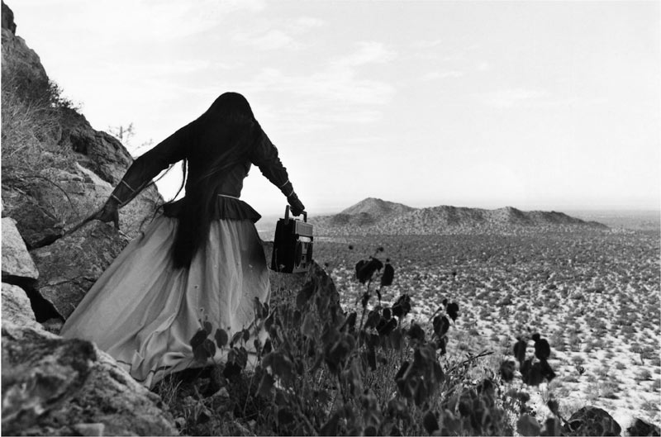
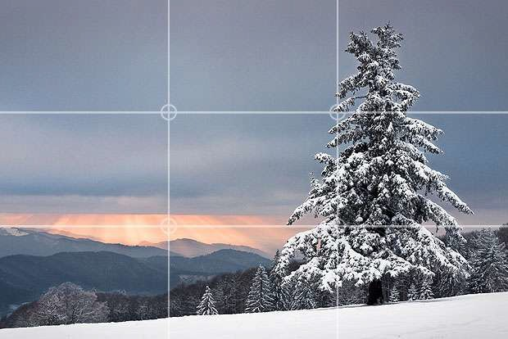
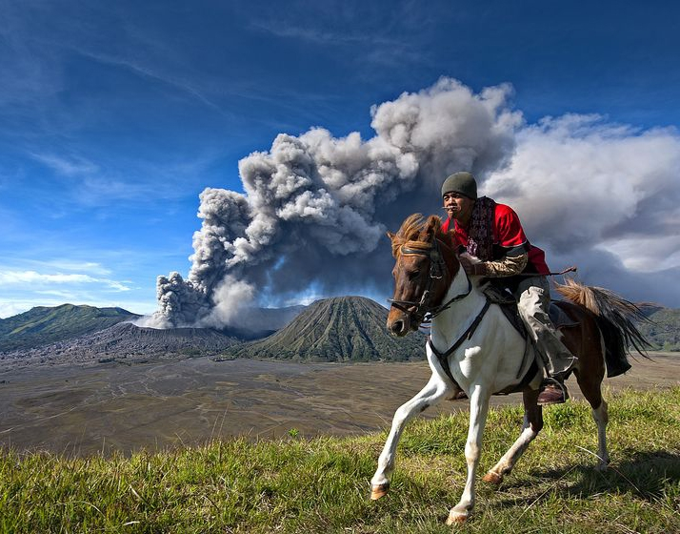



Slide 5
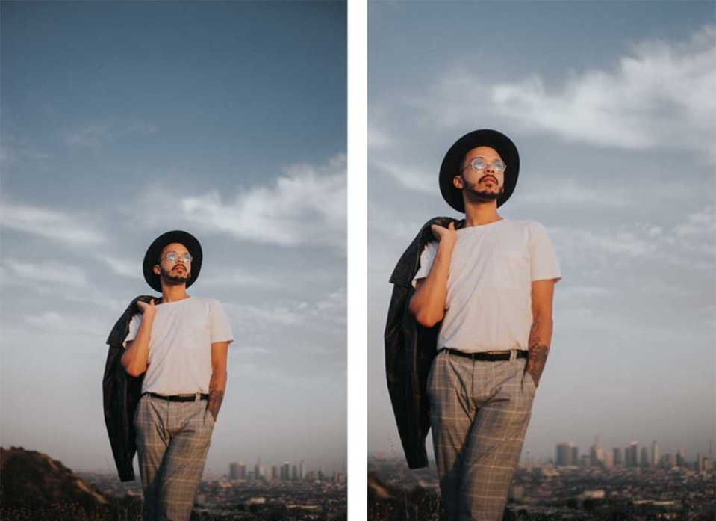

Slide 6
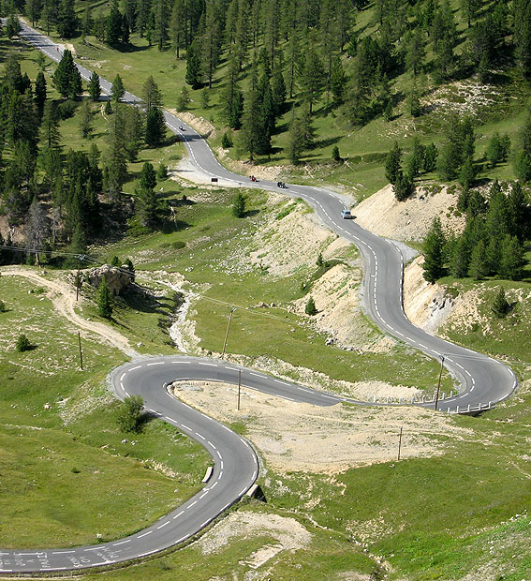

Leading Lines
Lines that guide the viewer’s eyes through an image.
Leading lines can lead to a focal point or simply guide your eyes to move through a composition in a certain direction.

Slide 7
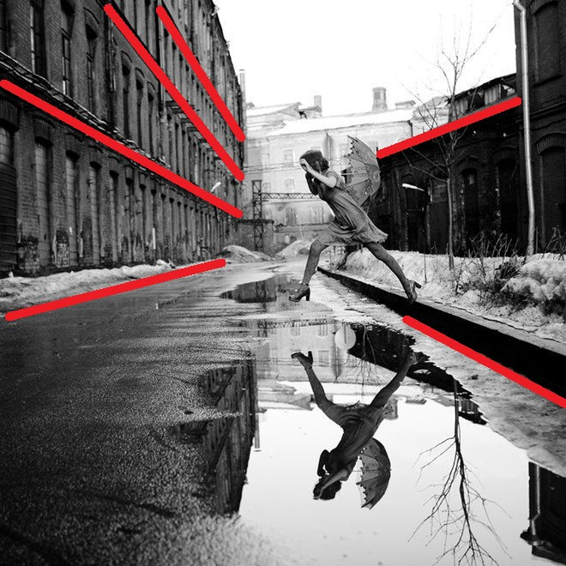
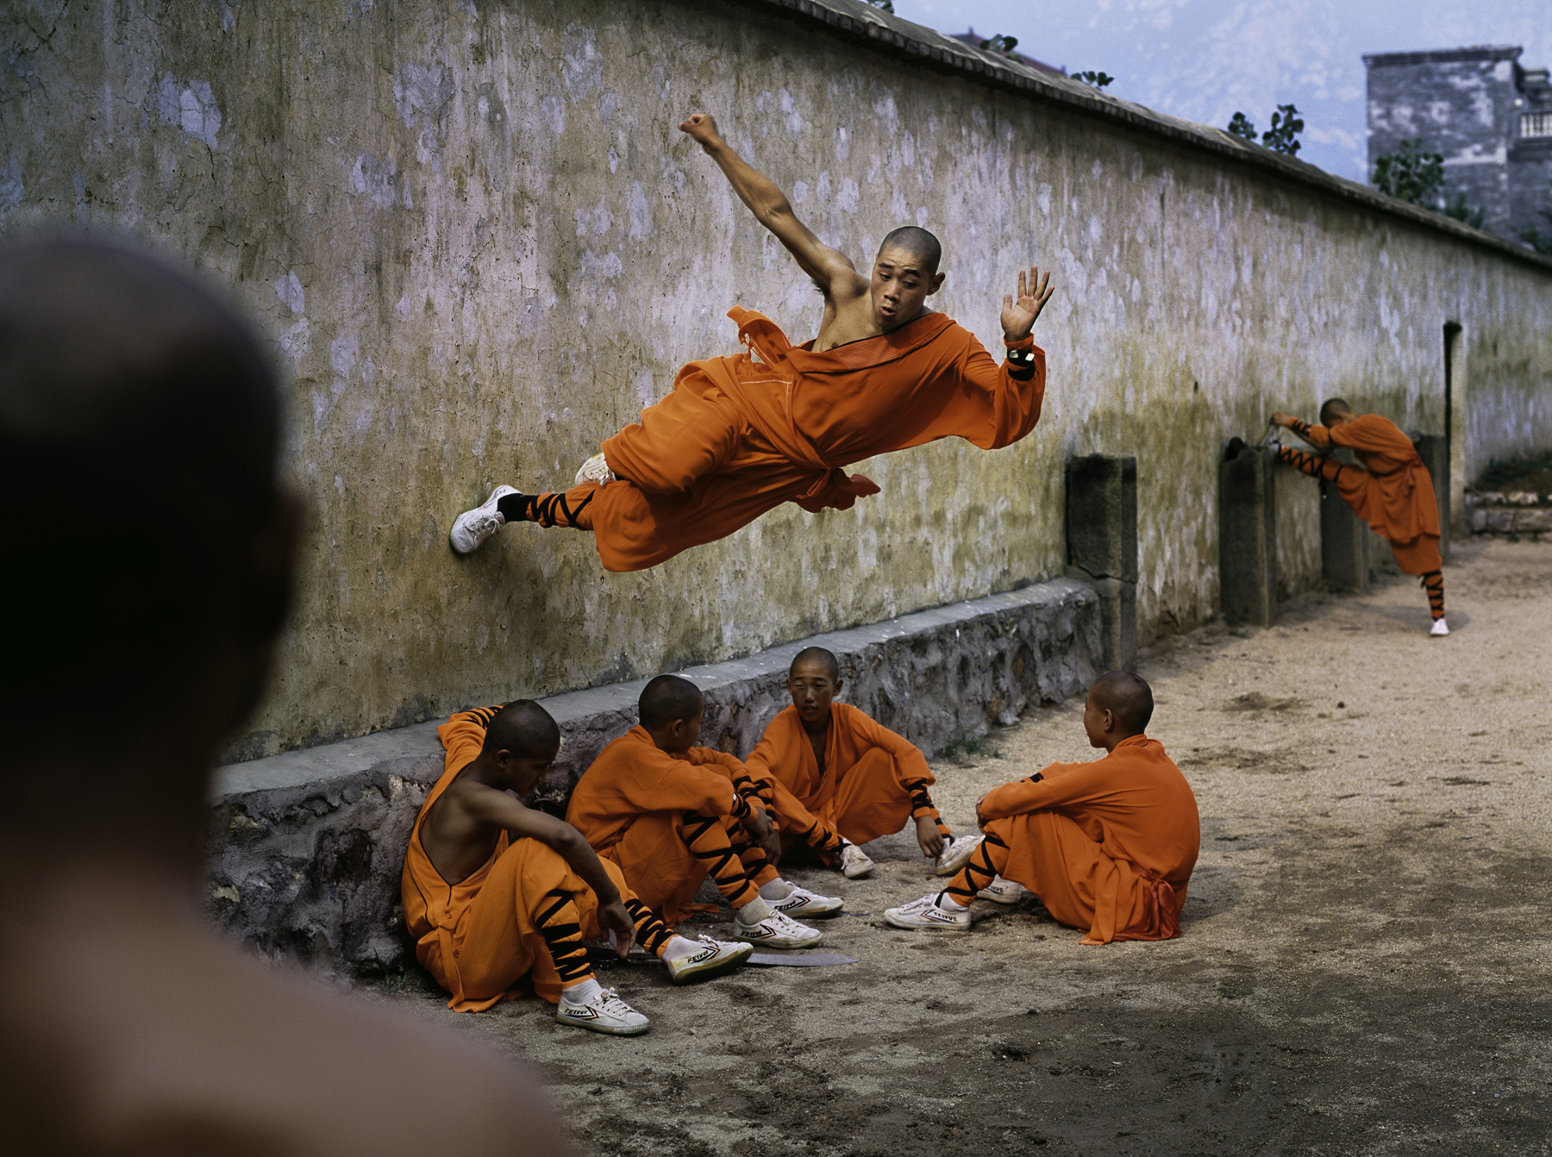



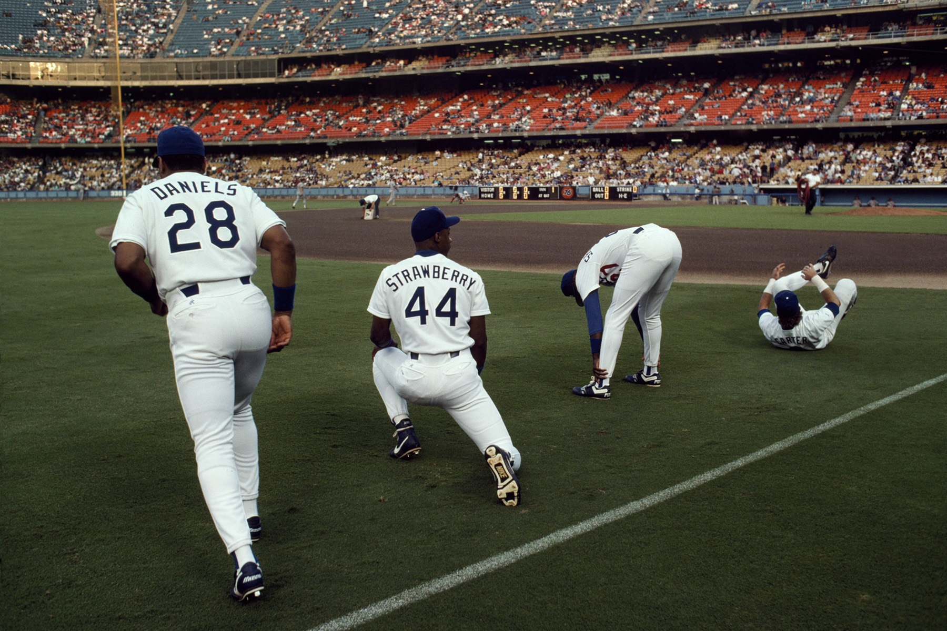

Slide 8





Slide 9
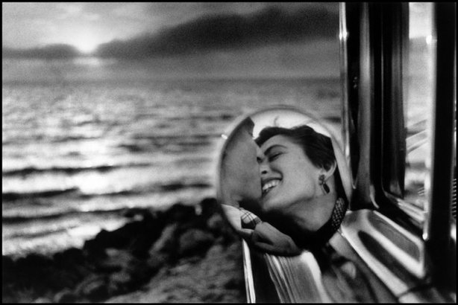
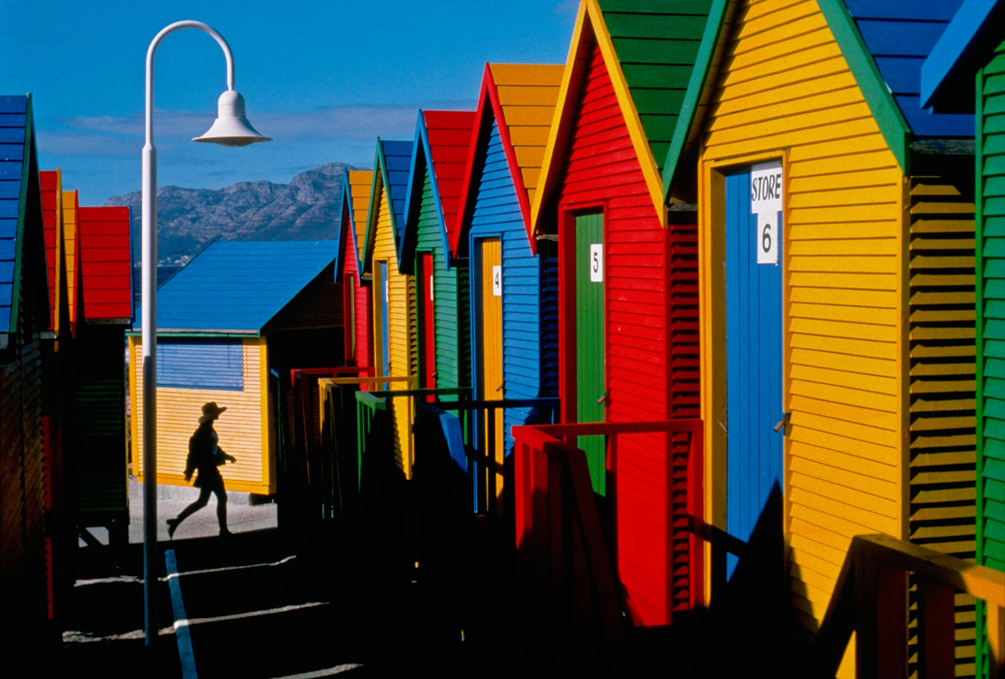
Natural Framing
The world is full of objects, which make perfect natural frames, such as trees, archways and holes. By placing these around the edge of the composition you help to isolate the main subject from the outside world. The result is a more focused image, which draws your eye naturally to the main point of interest.

Slide 10

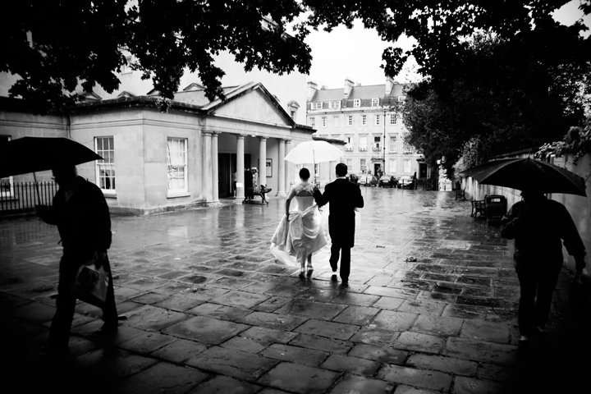
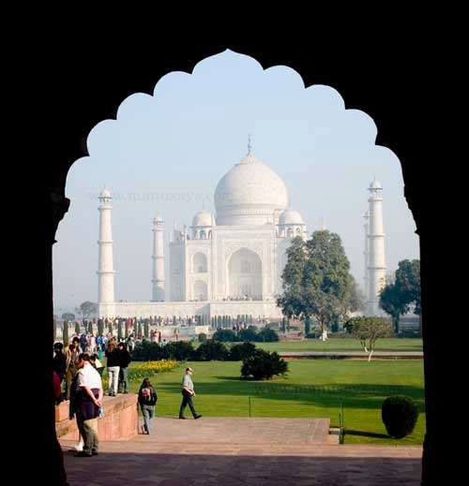
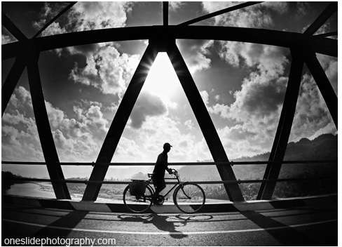
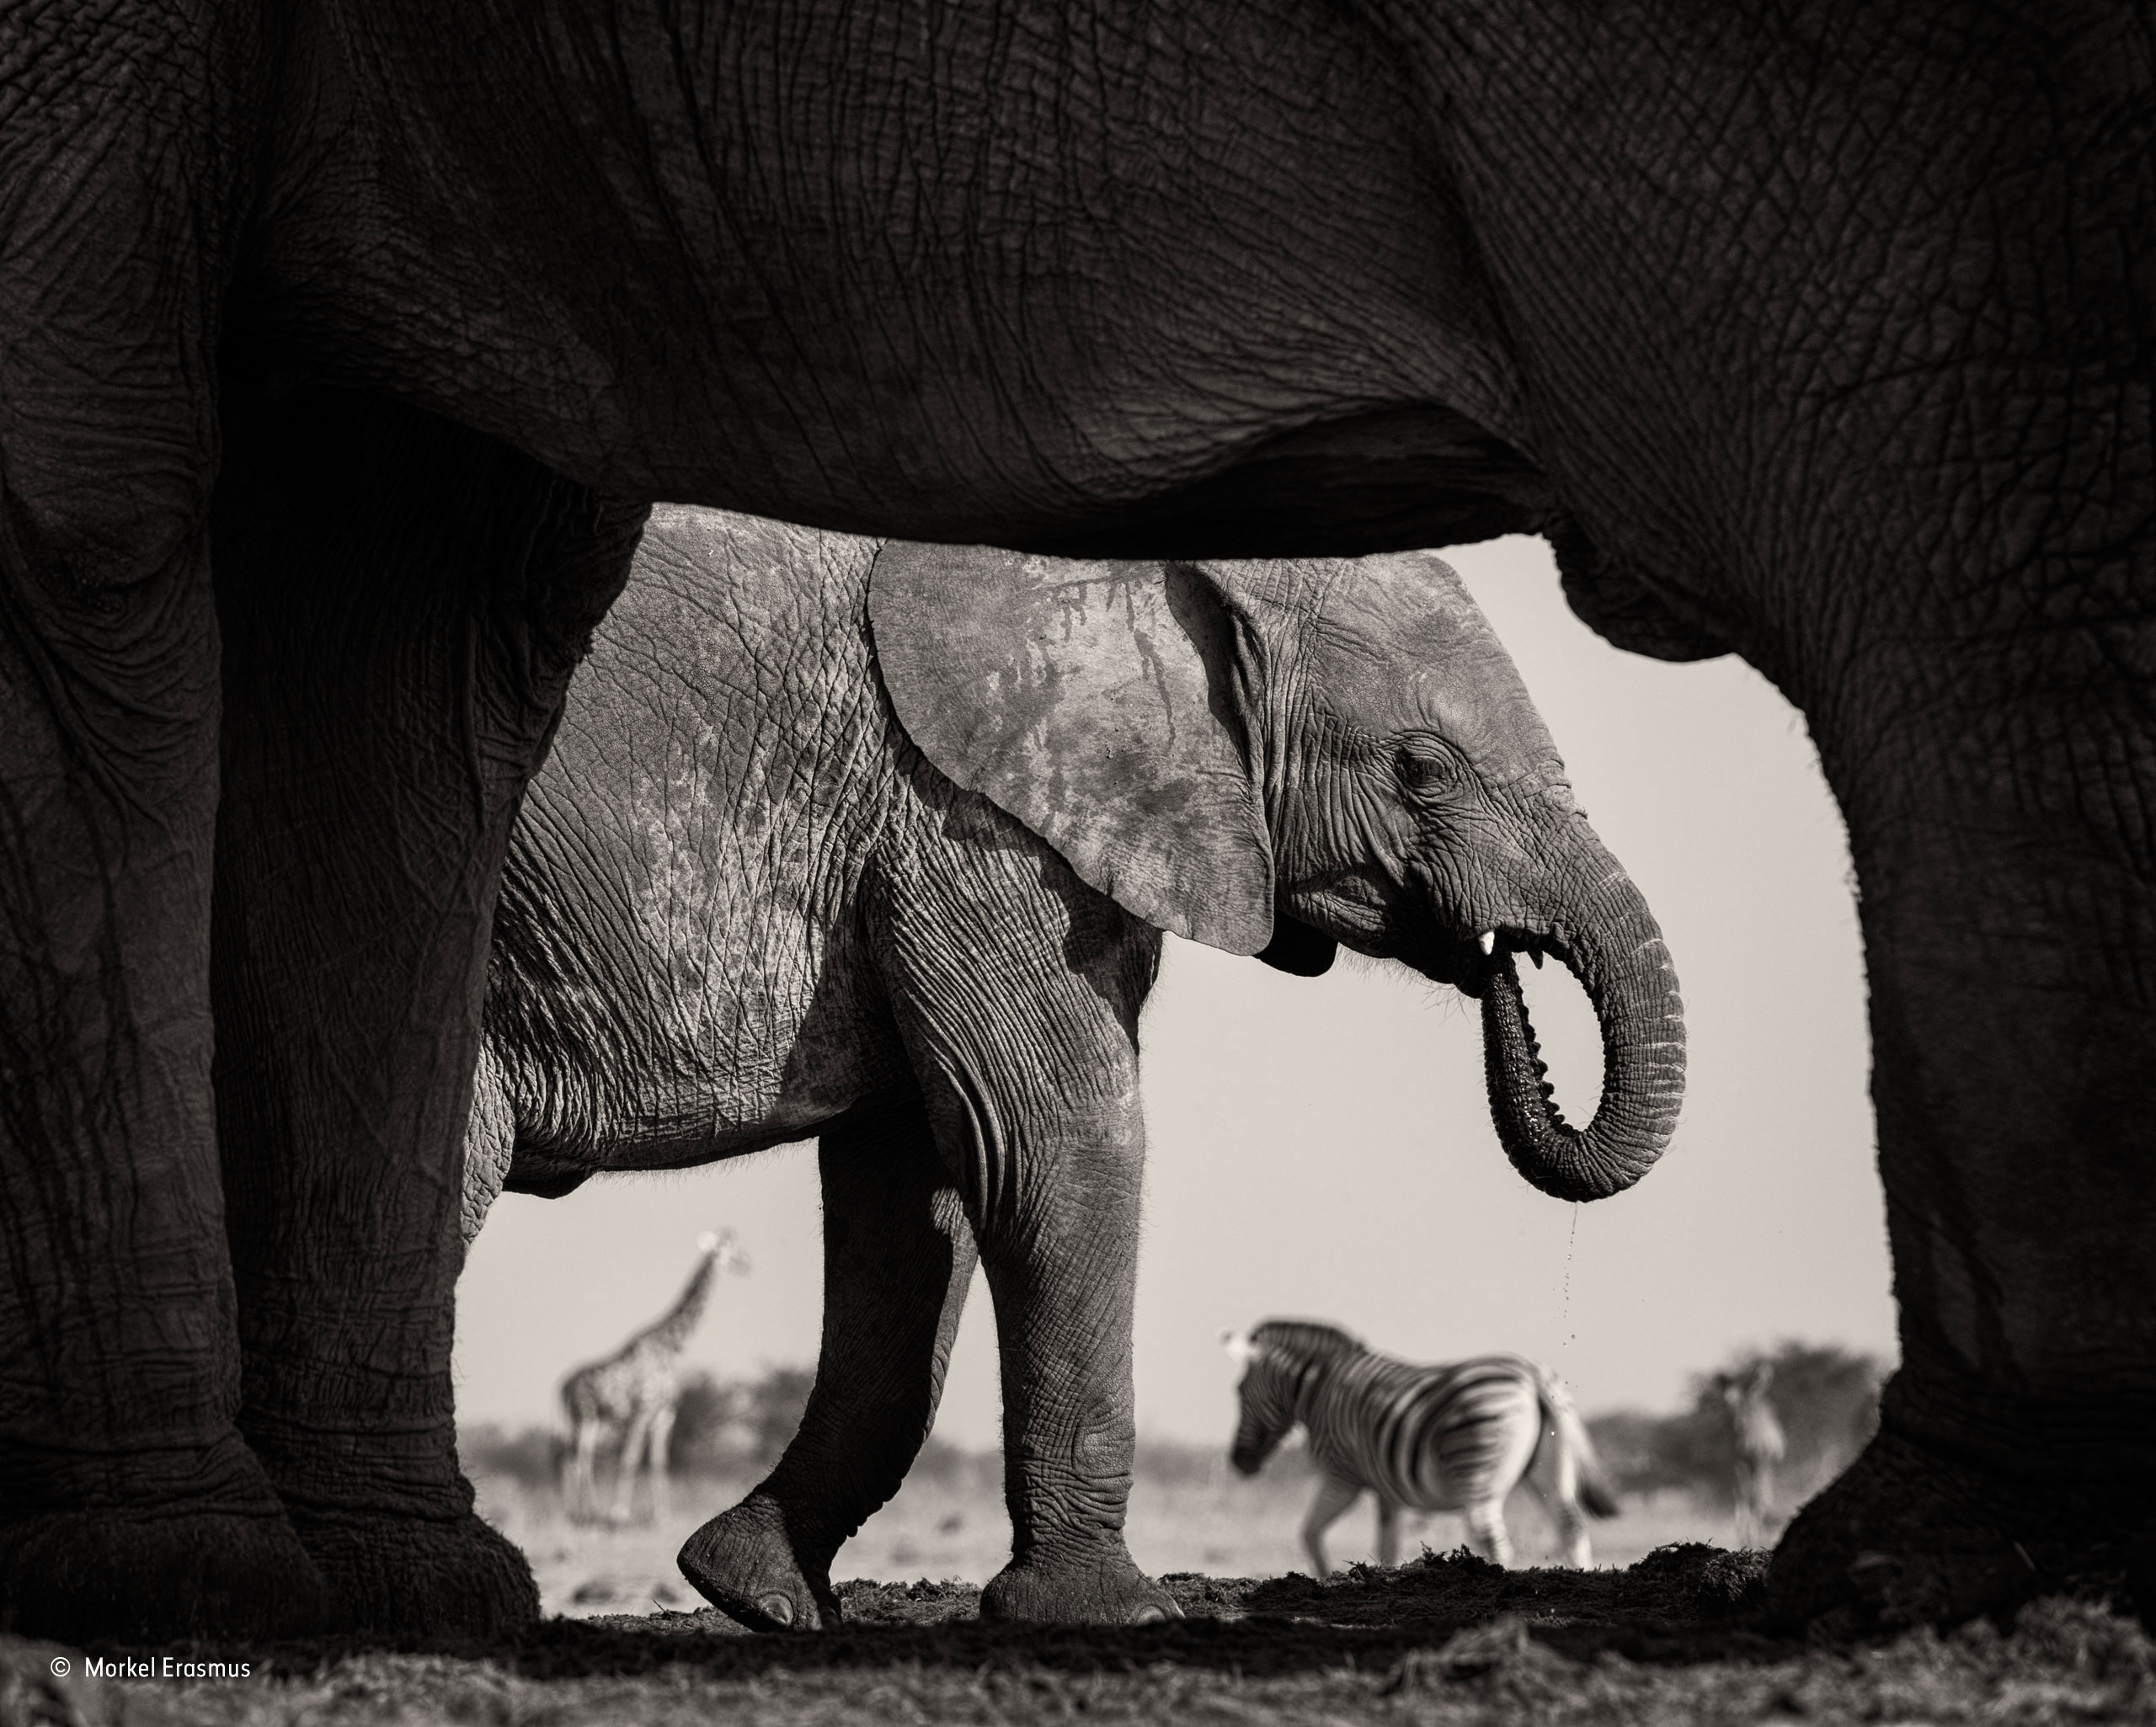
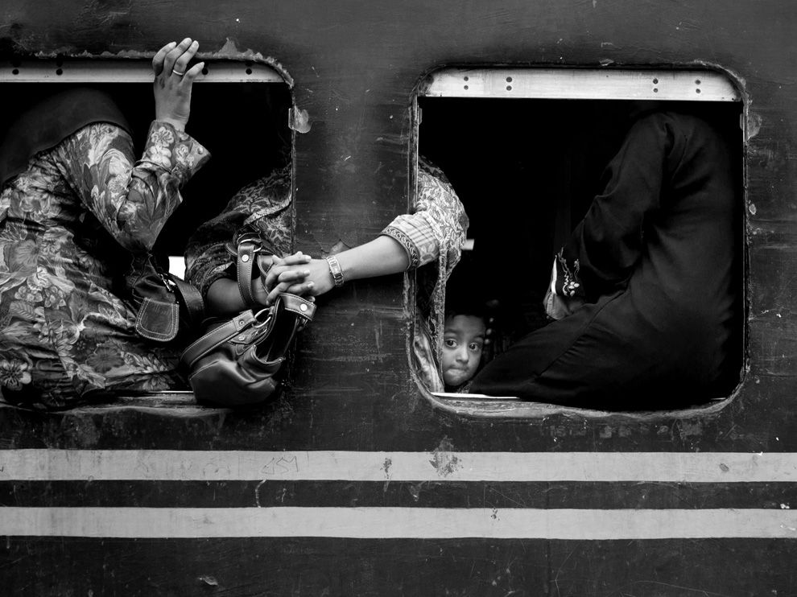

Slide 11
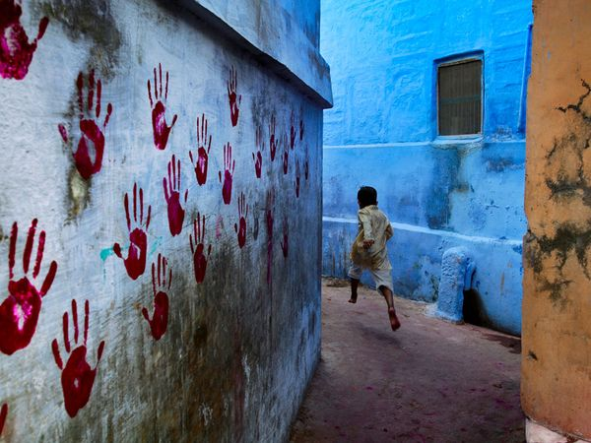
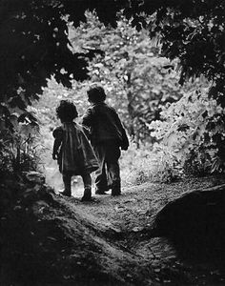

Slide 12

Symmetry and Patterns
Symmetry is when both sides of an image are identical or very similar. Pattern is a repetition of an element. We are surrounded by symmetry and patterns, both natural and man-made. They can make for very eye-catching compositions, particularly in situations where they are not expected. Another great way to use them is to break the symmetry or pattern in some way, introducing tension and a focal point to the scene.

Slide 13
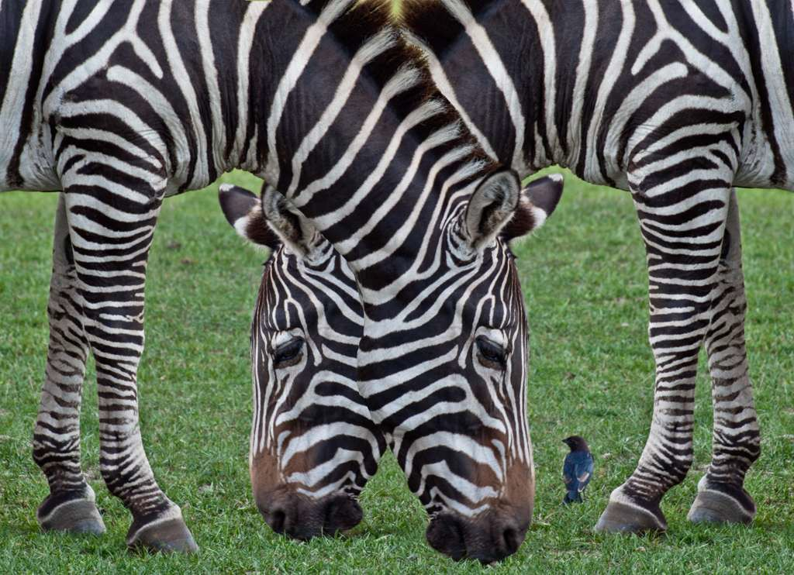


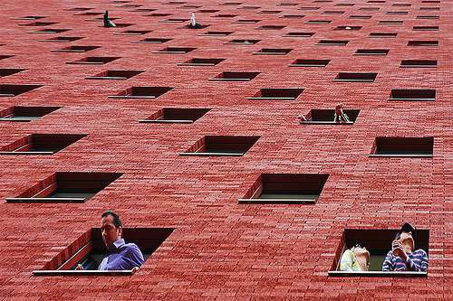

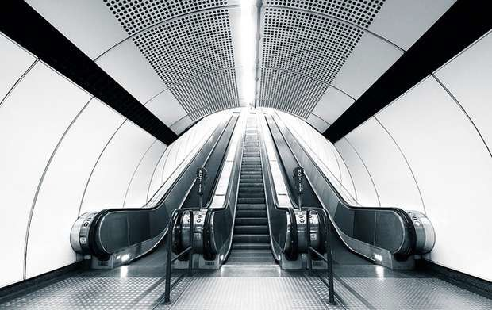

Slide 14

Fill the Frame
The rule of simplicity may seem to contradict this next rule, which is the idea that you should fill the frame with your subject. Filling the frame, of course, is different than crowding the frame. Crowding the frame means that you're breaking that rule of space and putting your subject in a constricting box. The "fill the frame" rule, on the other hand, simply means that you're looking for distracting background elements and cropping them out whenever you can. Or put another way, decide how important your subject is and then give him/her a ratio of the frame that is directly related to his/her importance.

Slide 15

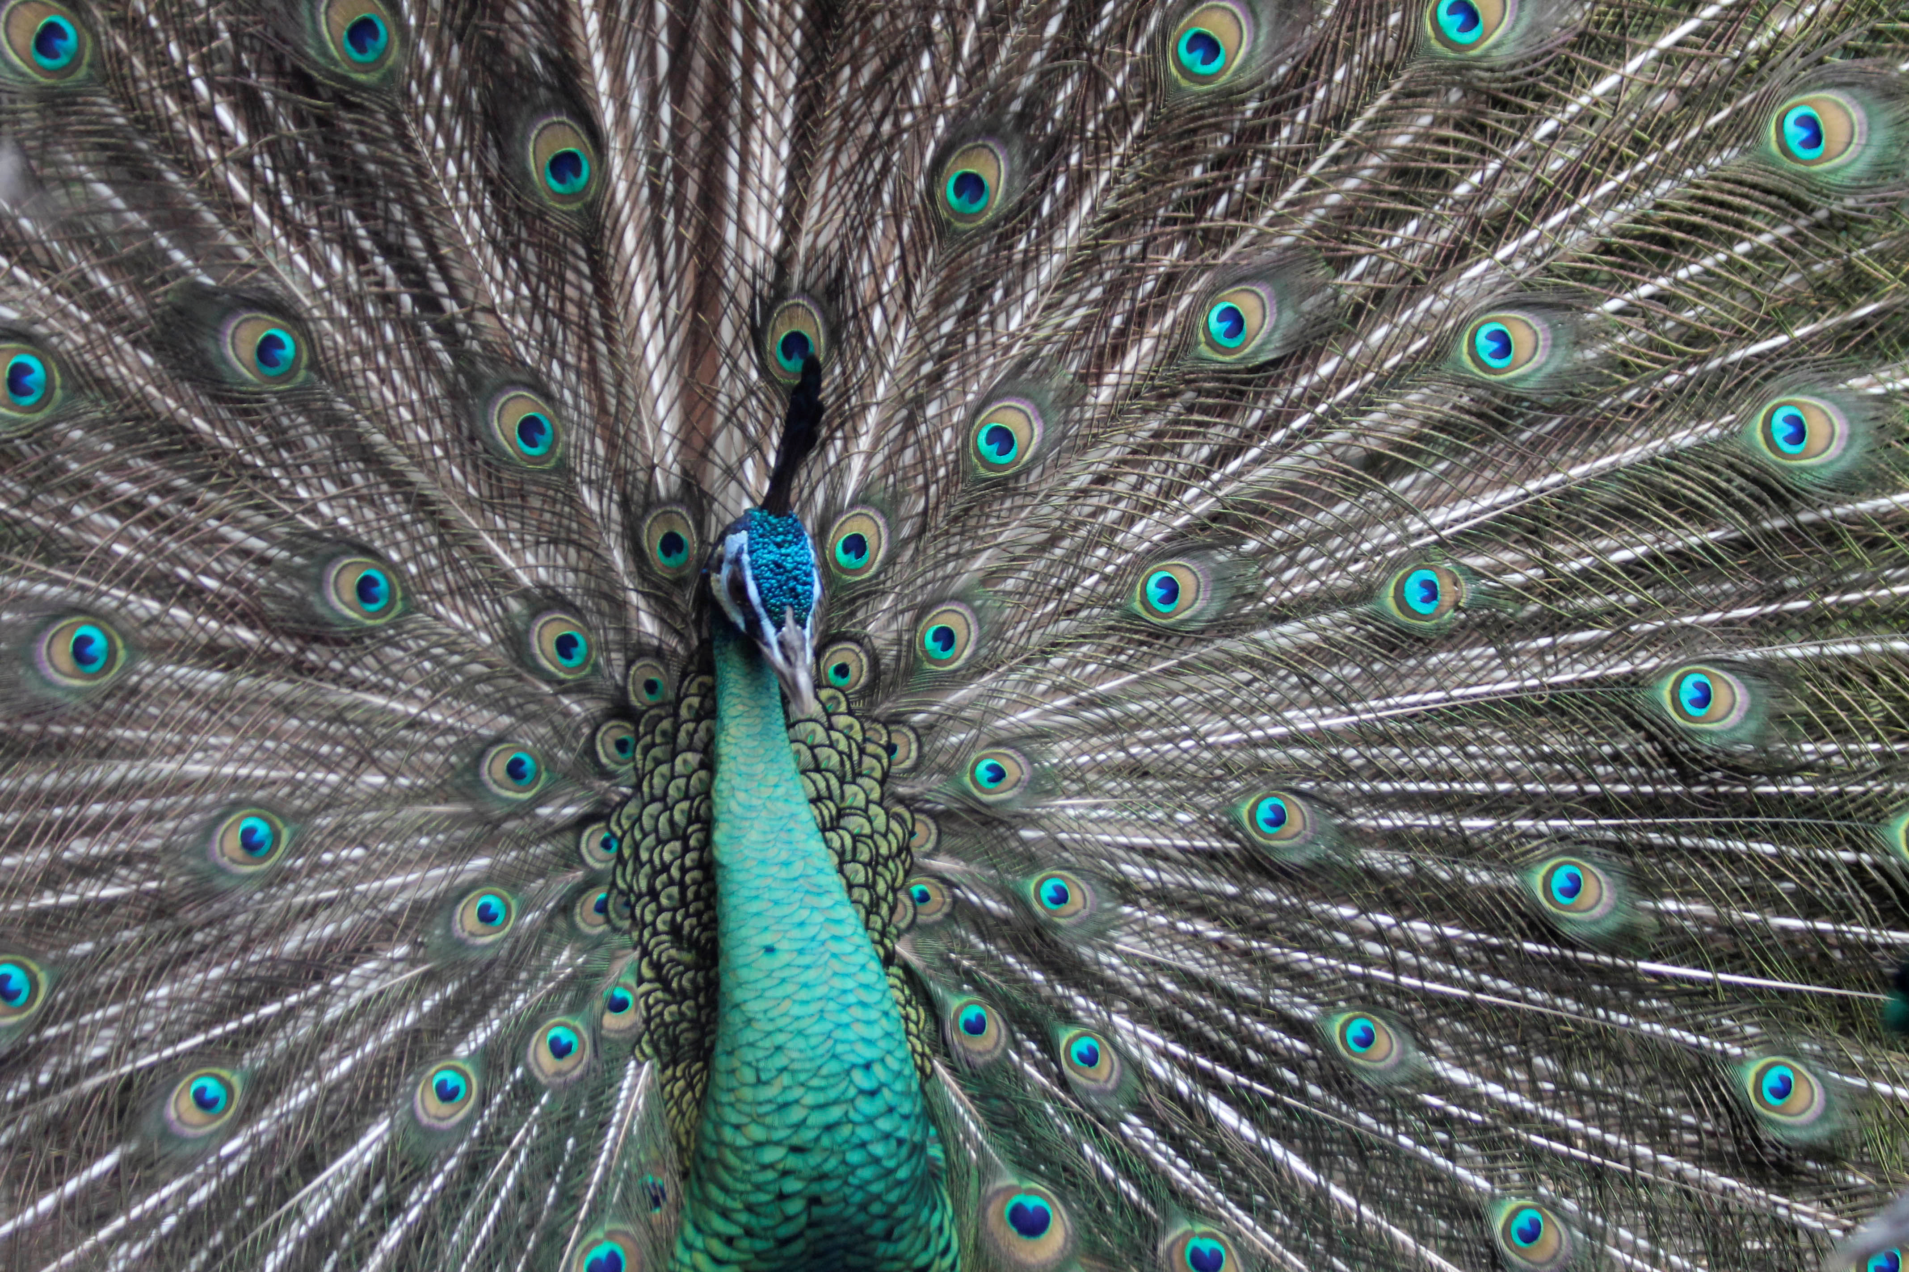



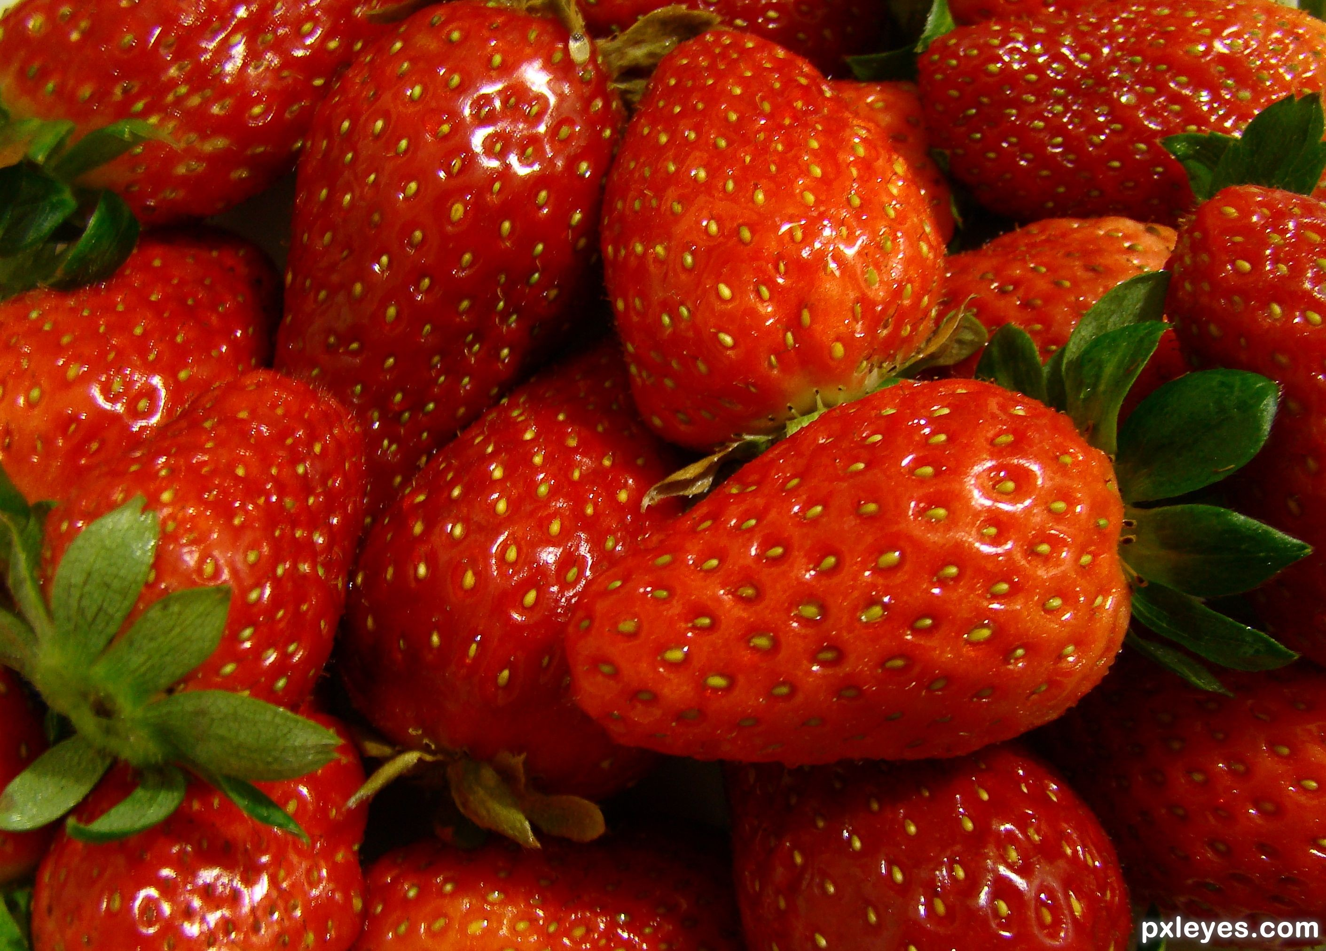

Slide 16
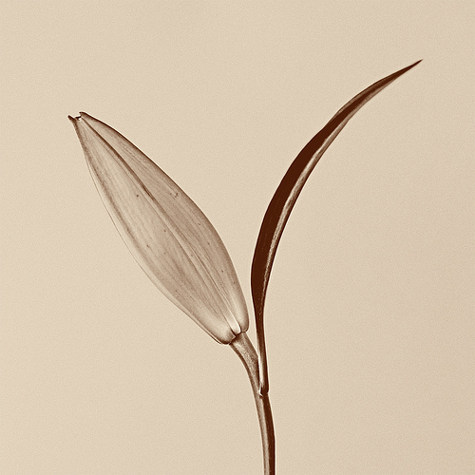

Simplicity
Simple images can be very appealing and pleasing to look at. It requires that you eliminate distractions and clutter so that viewers focus on only the main thing. Simplicity is also used to create certain moods, such as tranquility or loneliness-depending on the subject matter. Empty space in a composition is referred to “negative space” and the actual subject matter (plant, flower, person, building, etc.) is the “positive space”.

Slide 17

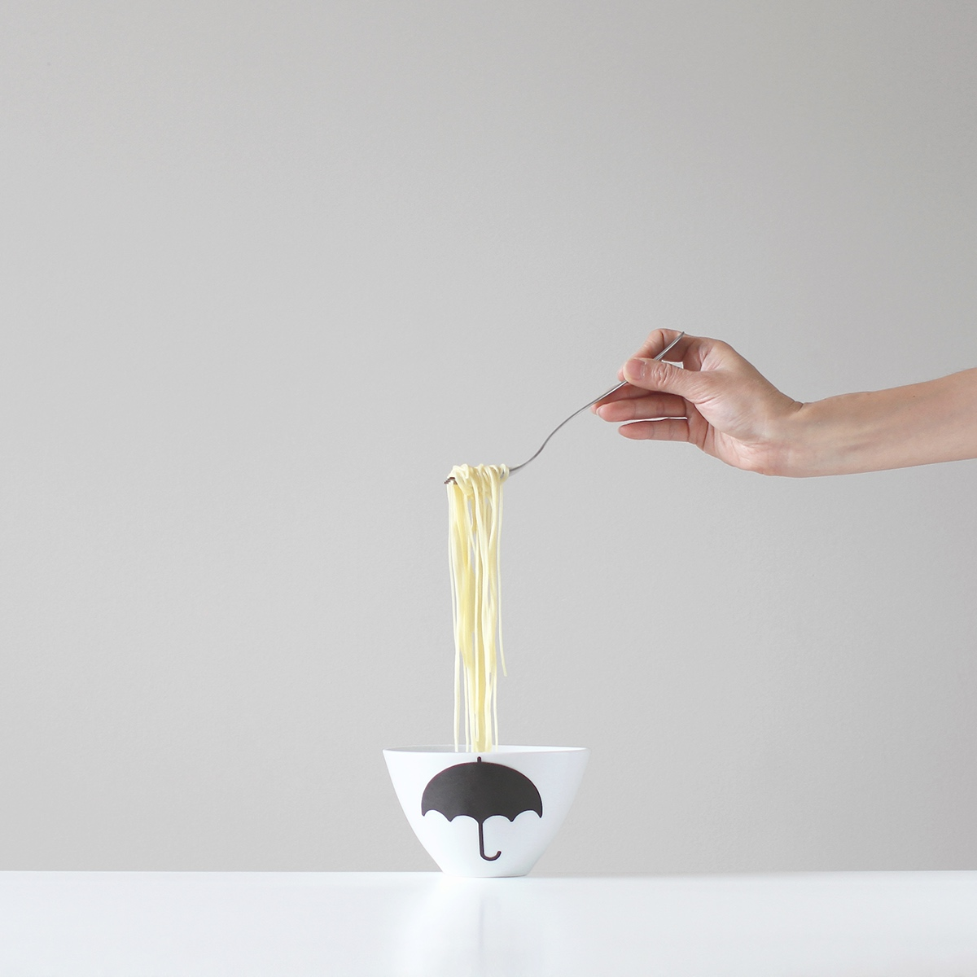
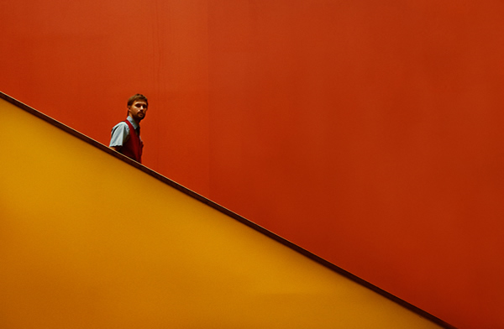

Slide 18
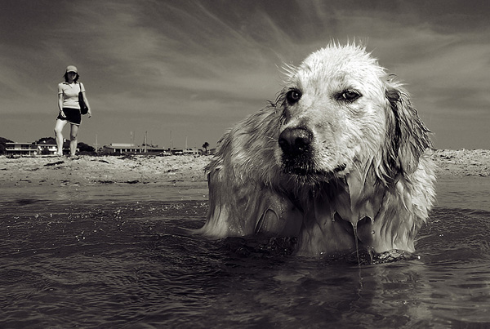


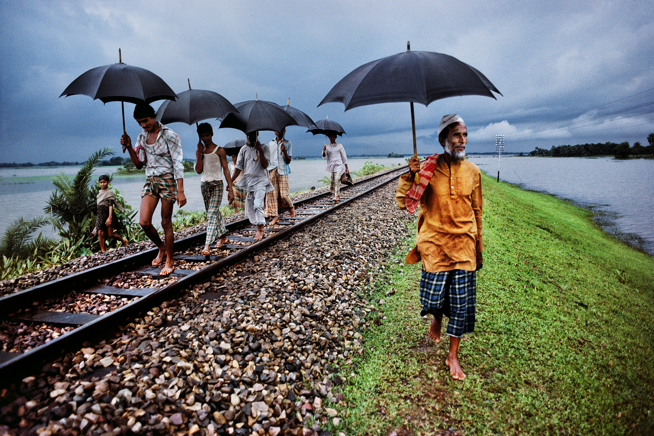
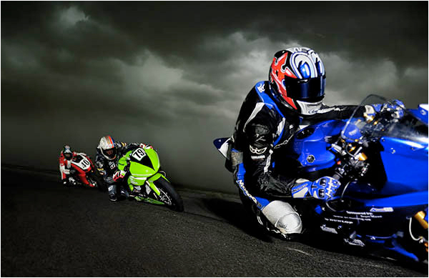
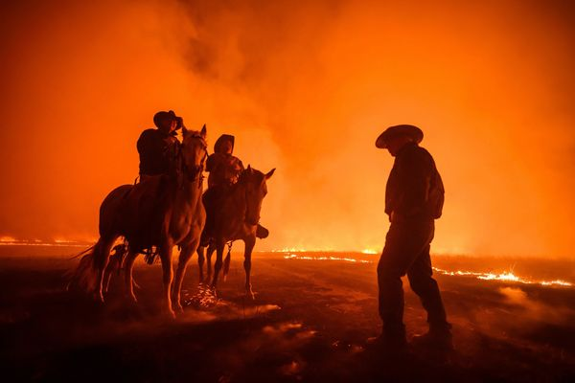
Balance
Especially when you are using the rule of thirds, sometimes an image needs balance. A photo with a large subject positioned in the foreground at one of those sweet spots may end up creating an image that looks tilted, or too heavy on one side. You can create some balance by including a less important, smaller-appearing element in the background.

Slide 19
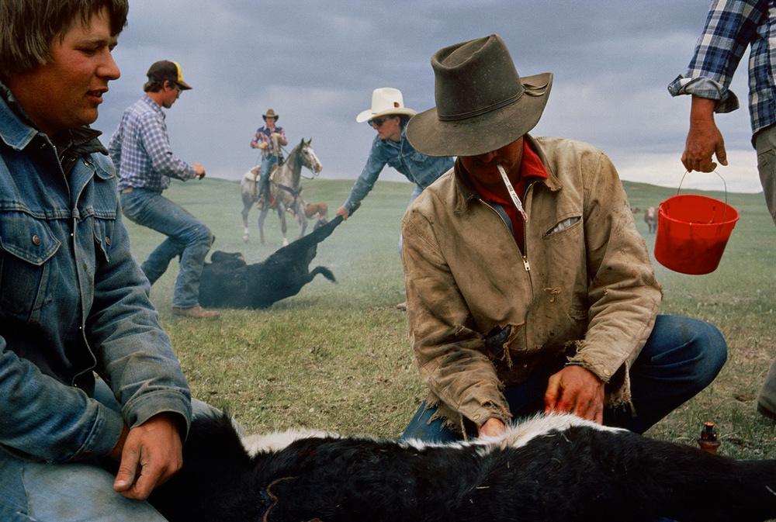


Creating Depth
Because photography is a two-dimensional medium, we have to choose our composition carefully to convey the sense of depth that was present in the actual scene. You can create depth in a photo by 1) including objects in the foreground, middle ground and background. 2) Another useful composition technique is overlapping, where you deliberately partially obscure one object with another. The human eye naturally recognizes these layers and mentally separates them out, creating an image with more depth. 3) A third way is to use shallow depth of field.

Slide 20

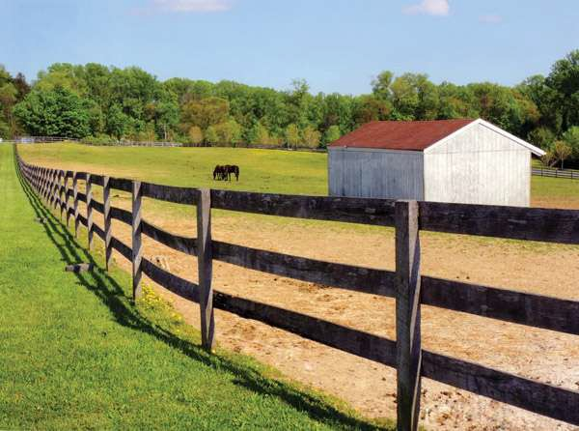
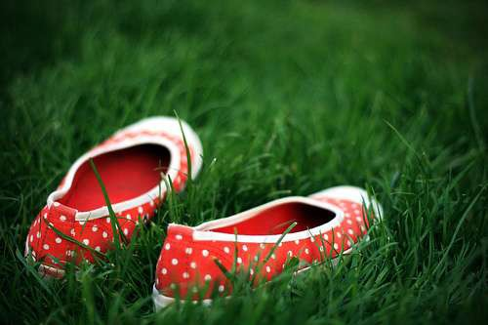

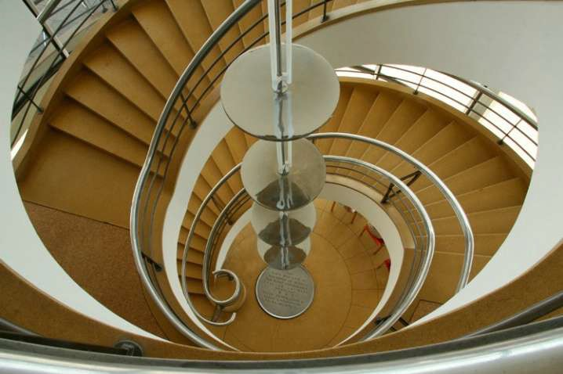

Slide 21
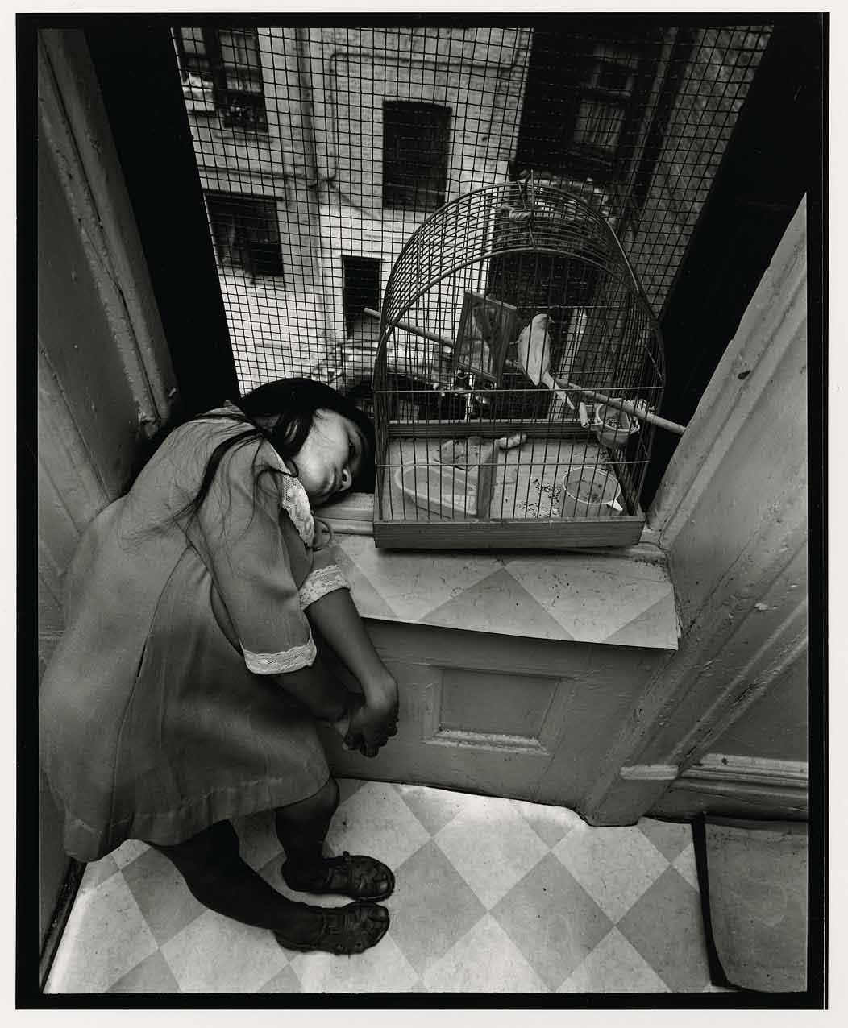
Viewpoint
Before photographing your subject, take time to think about where you will shoot it from. Our viewpoint has a massive impact on the composition of our photo, and as a result it can greatly affect the message that the shot conveys. Rather than just shooting from eye level, consider photographing from high above, down at ground level, from the side, from the back, from a long way away, from very close up, and so on.

Slide 22
