Slide 1
Color Schemes
Summit High School

Slide 2
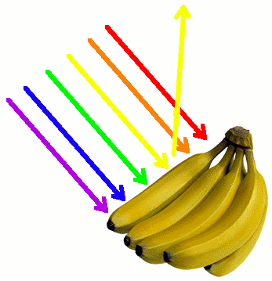
Color
an element of visual art that is derived from reflected light.
We see color because light waves are reflected from objects to our eyes. White light from the sun is a combination of all colors.

Slide 3
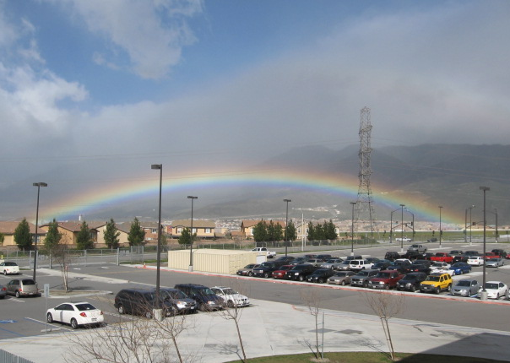
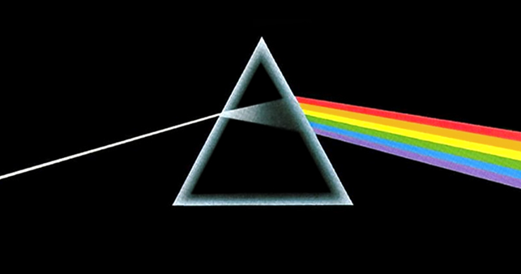
Color Spectrum
When white light bends, it separates into bands of color, called the color spectrum.
The color spectrum always appears in the same order: red, orange, yellow, green, blue, and violet.

Slide 4
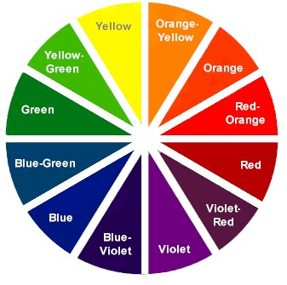
Color Wheel
The spectrum bent into a circle and a tool for organizing colors.

Slide 5
Monochromatic Colors
Monochrome = one color.
A color scheme that uses only one color plus its light and dark values.
A monochromatic color scheme has unifying effect.

Slide 6
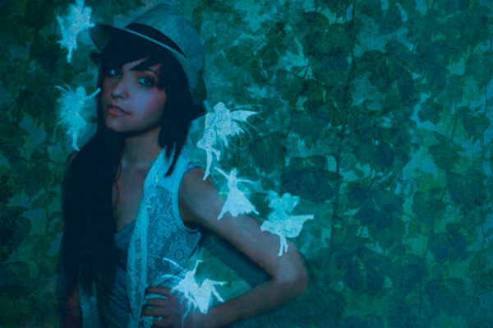
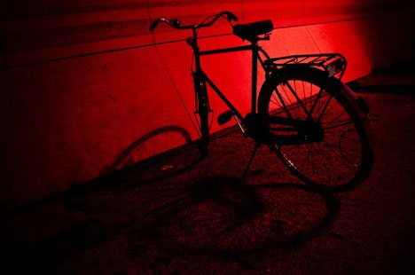
Monochrome photography and the expressive qualities of color

Slide 7
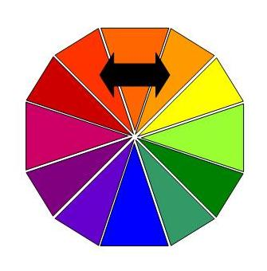
Analogous Colors
Colors that sit side by side on the color wheel AND have a hue in common.
An analogous color scheme helps tie in one shape
to the next through a common color.
It unifies with more variety.

Slide 8
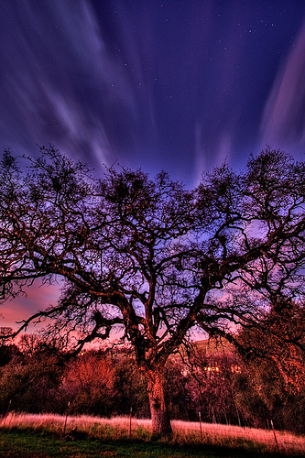
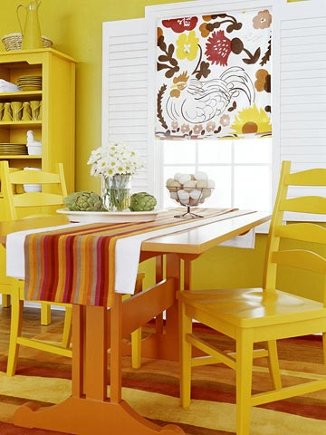

Slide 9
Complementary Colors
Colors that are opposite of each other on the color wheel.
A complementary color scheme has a loud, exciting effect that demands to be noticed.

Slide 10
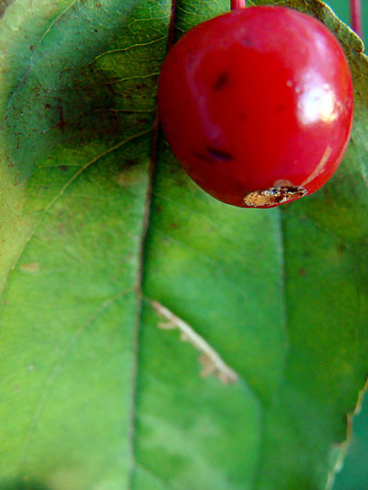
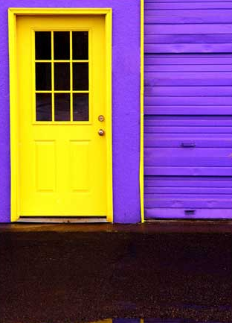
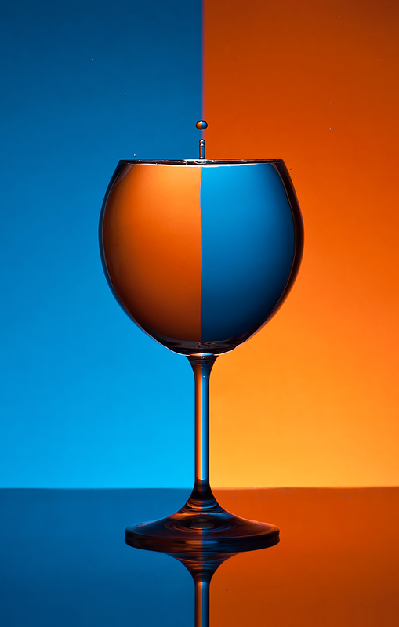
R & G Y & V B & O

Slide 11
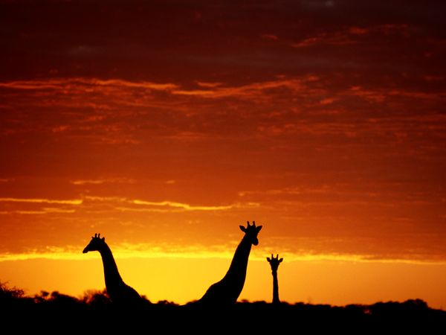
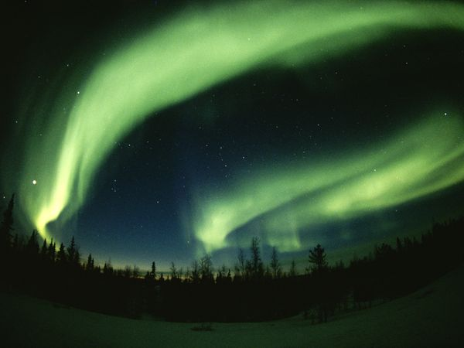
Warm Colors and Cool Colors
Reds, Oranges, and Yellows
Usually associated with sunshine or fire.
Warm colors move towards viewer.
Blues, Greens, and Violets
Usually associated with water, ice/snow, or grass.
Cool colors seem to recede or move away.

