Slide 1
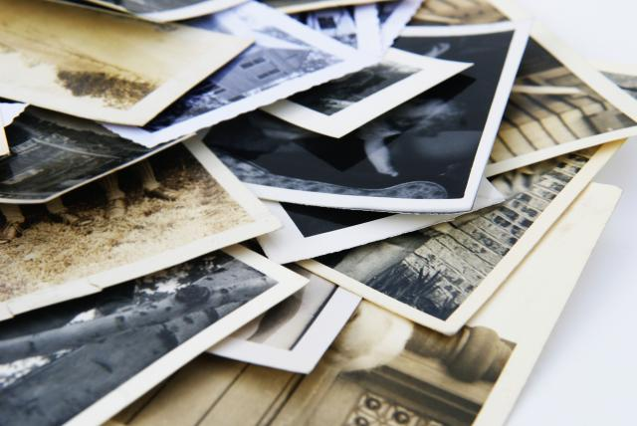
The 4-Step Critique Process
Digital Photography
Ms. De La Rosa

Slide 2
Step 1: Describe what you see.
This step of the critique process is very literal and requires that you observe the photograph closely to describe what you see in the image. (Pretend that you have to describe the photograph to someone who can’t actually see it.)
Here are some possible response frames you can use:
→In this photograph one can see…
→The photograph includes…
→ ______’s photograph shows…

Slide 3
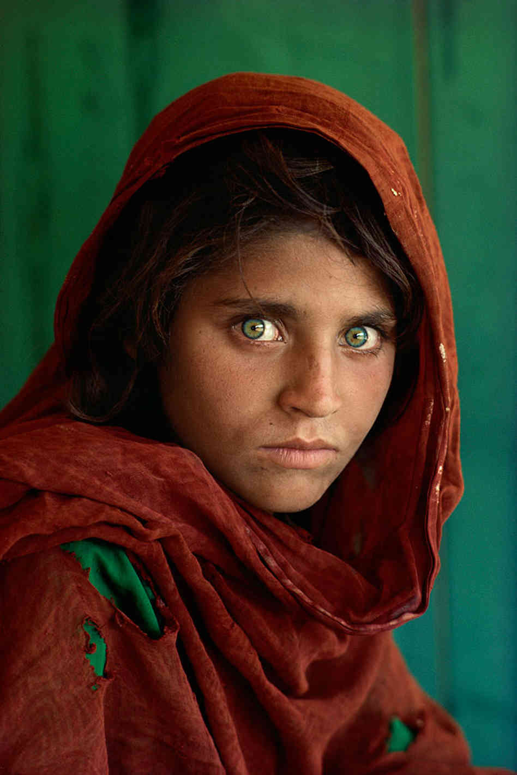
Describe
Photo by Steve McCurry

Slide 4
Step 2: Analyze the composition.
This step of the critique process asks that you examine the techniques the photographer used and decisions they probably made. This includes camera angles, perspective, framing, elements of art (such as the use of lines, colors, space, etc.), principles of design (patterns, rhythm, movement, balance, etc.), camera settings, etc.
Here are some possible response frames you can use:
→The __________ in the photograph demonstrates the use of ______________.
→The photograph uses ___________ in order to…
→I can see the photographer decided to…

Slide 5
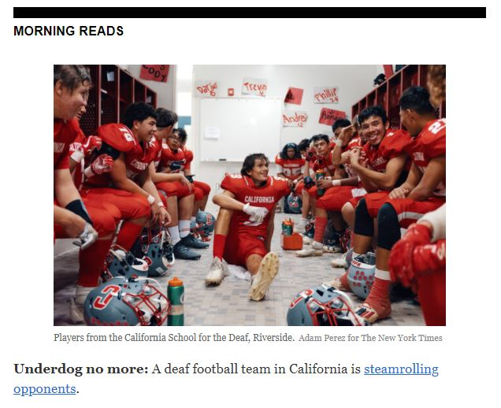
Analyze

Slide 6
Step 3: Interpret what it communicates
Ever heard the saying: “One picture is worth a thousand words”? This means that images can be packed with expressive qualities. Photos can tell a story, document a historical event, and evoke memories.
Images can express feelings, emotions, moods, ideas, and themes through symbols and representations. Photos can confront us to question our culture or identity, or at least to view it from another perspective. A photo can document a unique moment in time or even things we can’t see with the naked eye!
Some useful questions to ask yourself at this step are: What is the photographer trying to say? Why did the photographer create this image in this way? What did they want to show us? Does there seem to be a story behind it?

Slide 7
Here are some possible response frames you can use:
→The ________ in the photograph can symbolize or represent ______________.
→ The use of _________________ can evoke a feeling/the idea of ___________.
→This photograph might remind us that ____________________________.
→ The photographer was probably trying to tell us/show us that __________.

Slide 8
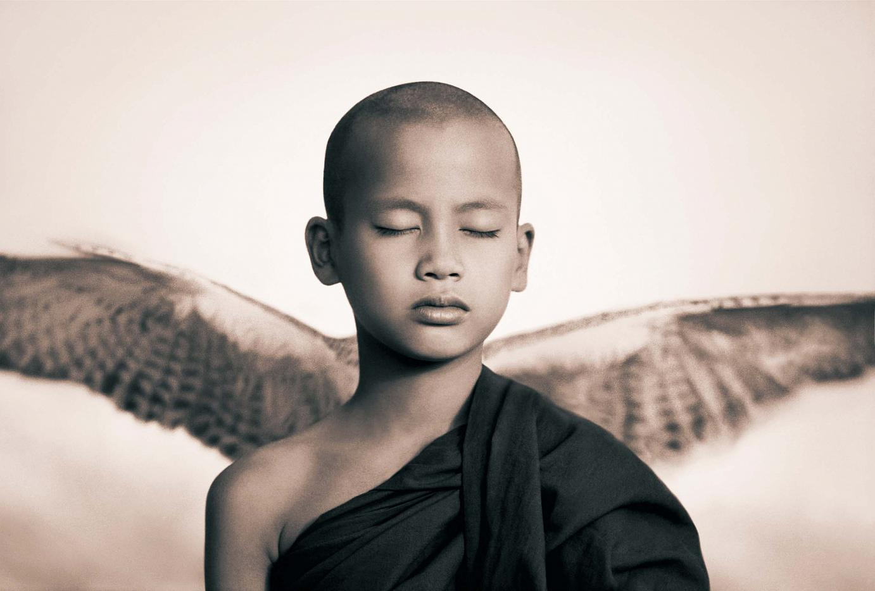
Interpret
Photo by Gregory Colbert

Slide 9
Step 4: Evaluate/Judge
The final step requires that, after careful observation, you provide your opinion of the photograph or image. Was the photographer successful in delivering the photographer’s message or intention? Explain what you like or dislike about the photograph- but be prepared to back up your opinion with evidence!
Here are some possible response frames you can use:
→This photograph succeeds in showing…/is successful because…
→The photographer did a great job of…
→I like this photograph because…
→Something that could improve this photo is…

Slide 10

Evaluate

