Slide 1
Creating Your Photo Blog
Ms. De La Rosa
Digital Photography

Slide 2
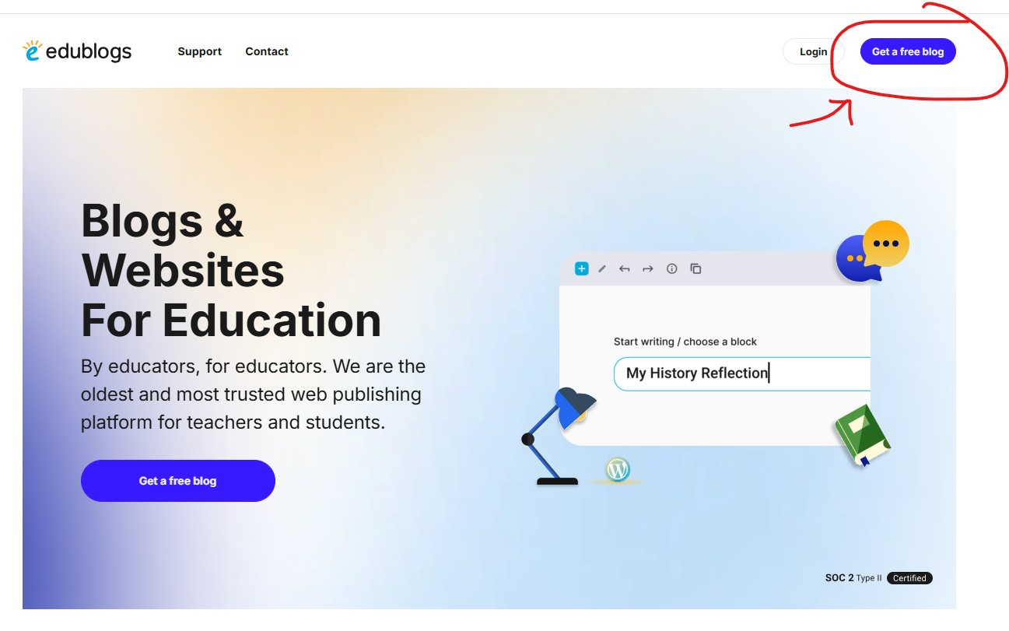
Sign Up with: https://www.edublogs.org
Hold down Ctrl on your keyboard and click on the link above to open it.

Slide 3
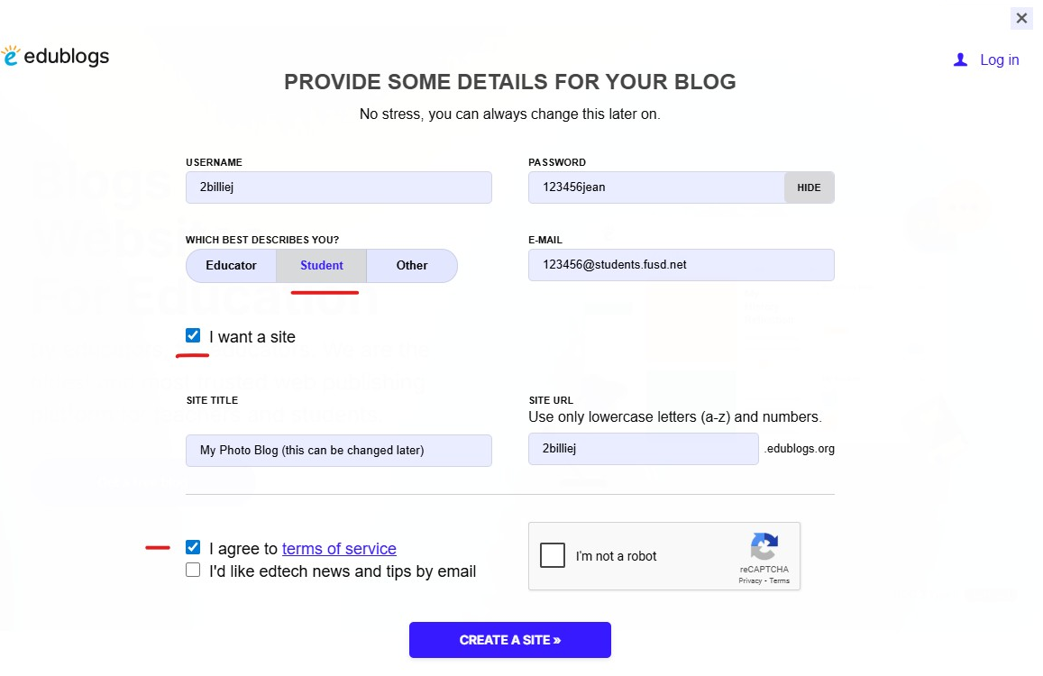
-Username:
class period + first name + last name initial. Ex: 2billiej
-Password:
ID number + last name
Ex: 123456jean
(it’s up to you if you capitalize letters)
-Select “Student”
-E-mail:
your student email
Ex: 123456@students.fusd.net
-Site Title:
Whatever you want, it must be appropriate and relevant to photo class. Ex: Through My Lens.
-Site URL:
Same as username!
Please read the details on the right! →

Slide 4
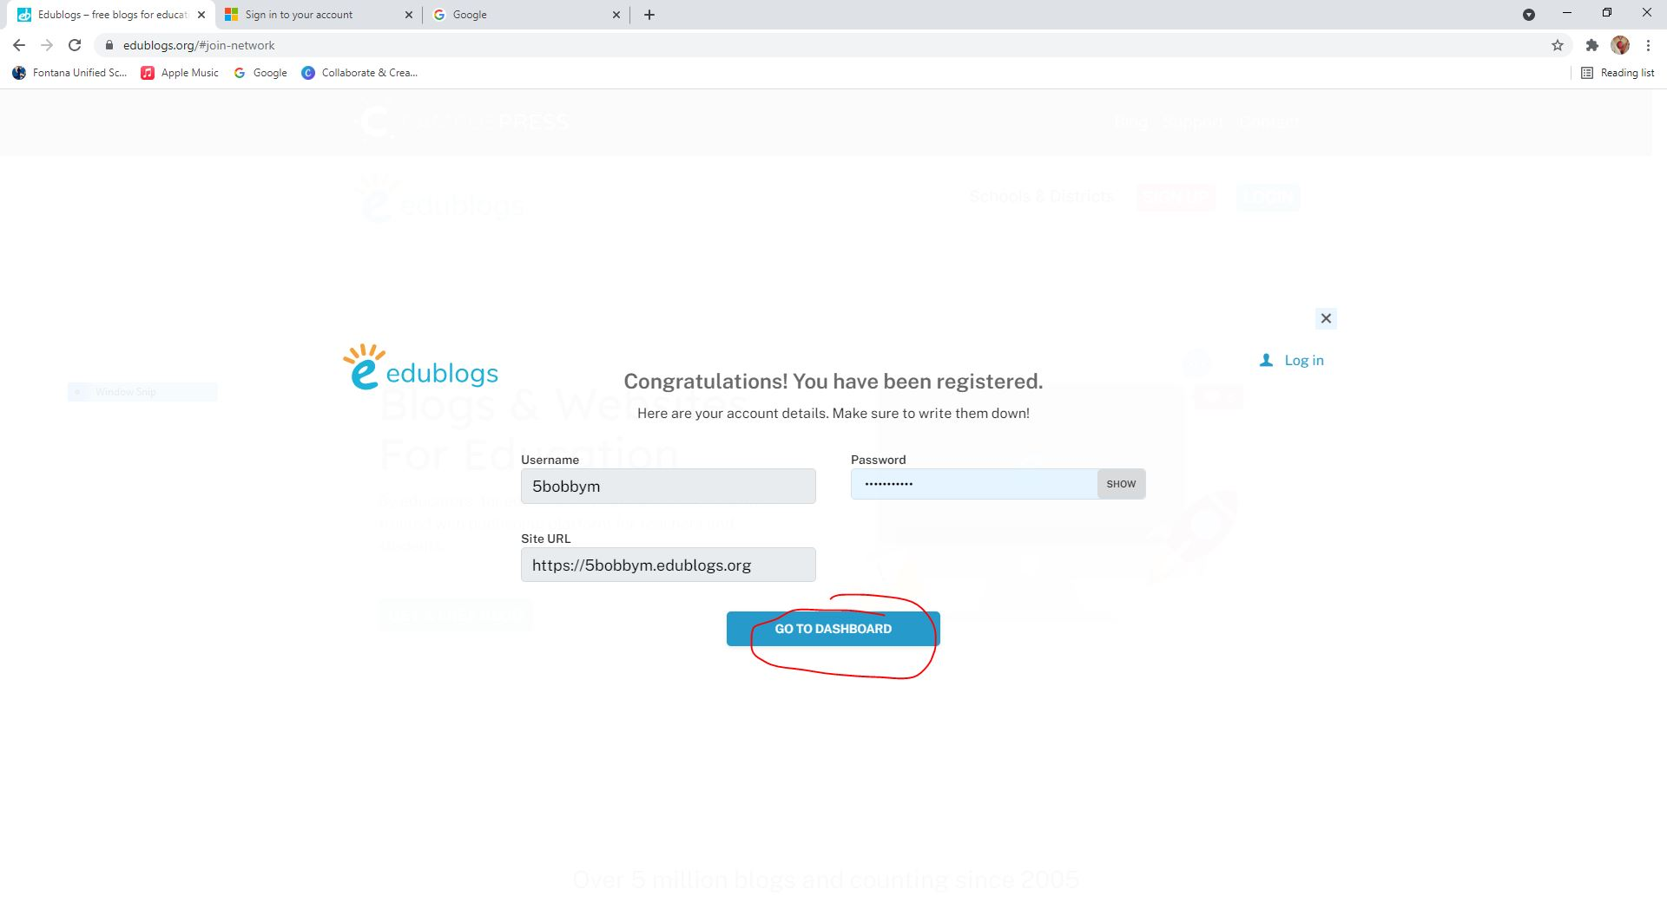

Slide 5
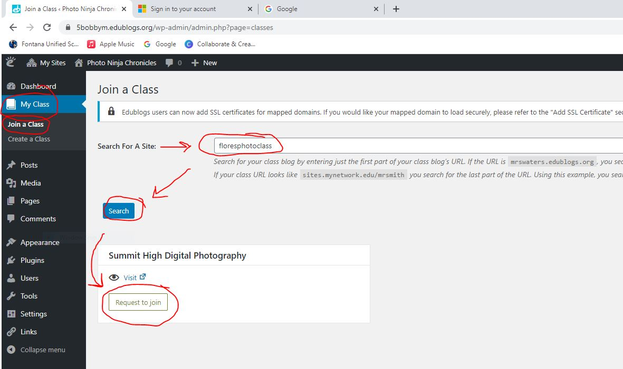

On your dashboard, go to “My Class” then click on “Join a Class”.
Type: floresphotoclass ad click Search button.
My class blog should pop up and you will click on “Request to Join”.
IMPORTANT:
Go back to Dashboard select Settings→Writing→Default editor for all users. Click the “Classic editor” then click save changes.

Slide 6
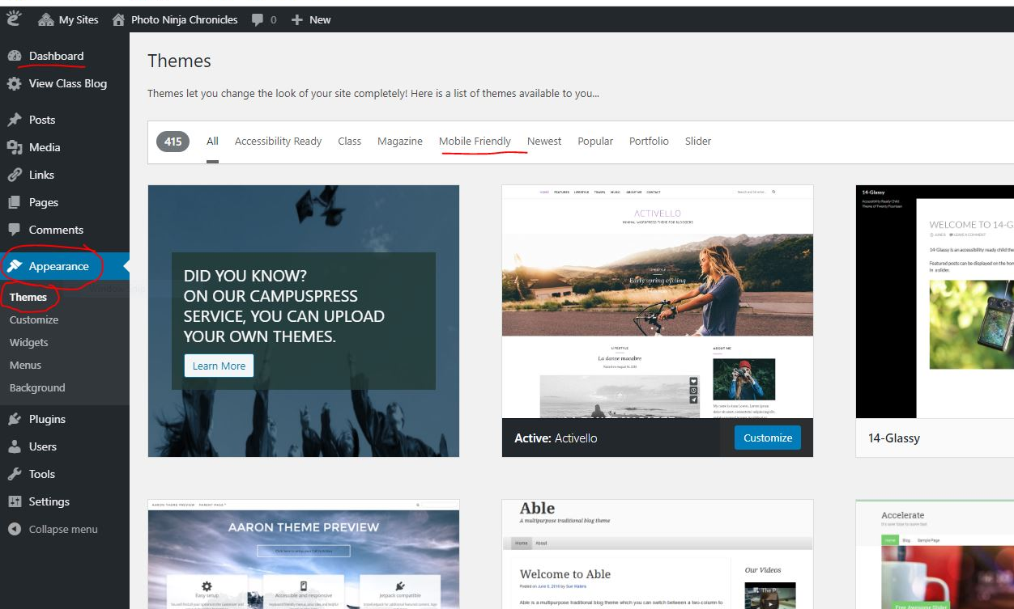
Choose a themed layout
While waiting to be approved to join my class, you can start to customize your website.
Start by choosing a theme! (Dashboard→
Appearance→
Themes)
You change up the theme anytime.

Slide 7
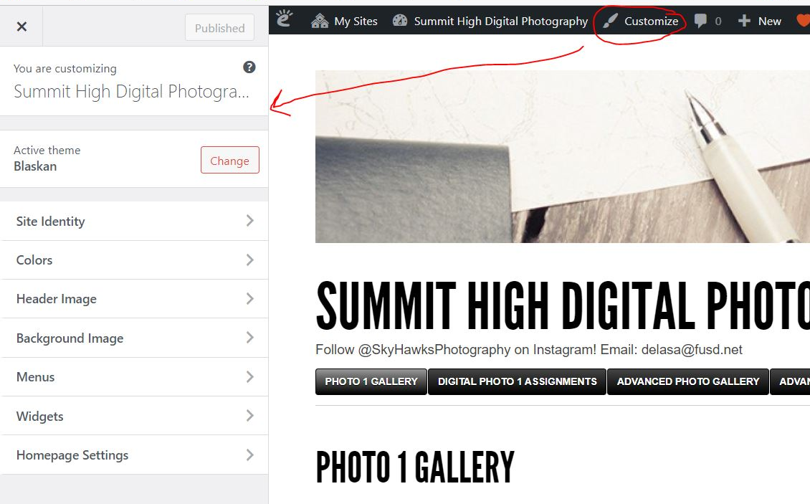
Customize your blog!
Go to Dashboard/Appearance/ Customize/ Site Identity and put your first and last name and period.
Reference the Edublogs User Guide to learn more about customizing your blog and how to navigate it:
Getting started with your blog – Edublogs Help and Support
(Hold down Ctrl on your keyboard and click the link to open it.)

